Slide 2
Wednesday, February 9th, 2022
Unit 13
WHAT DO YOU DO
IN YOUR FREE TIME?
Lesson 2 – p20,21

Slide 3

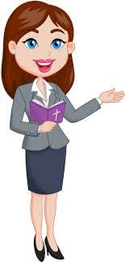
OBJECTIVES
(Mục tiêu của bài học hôm nay)
01
- Learn about some free time activities( Học về một số từ chỉ hoạt động trong thời gian rảnh)
- Ask and answer about what someone does in his/her free time activities (Hỏi và trả lời về ai đó làm gì trong thời gian rảnh rỗi)
02
03
- Practice speaking, listening and reading skills.
(Luyện tập các kĩ năng nói, nghe và đọc hiểu.)
Notes:
Thanh Yến Trần 0967 255 149 zalo/ FB https://www.facebook.com/thanhyentrananhngutaymy/

Slide 4
Vocabulary

Slide 5
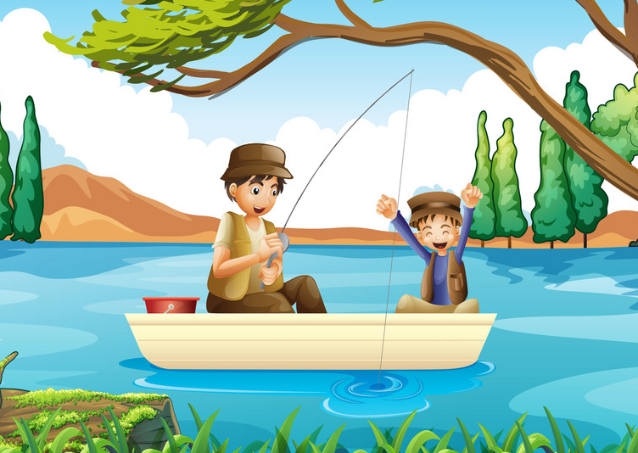

Vocabulary
go fishing
/goʊ ˈfɪʃɪŋ/

Slide 6
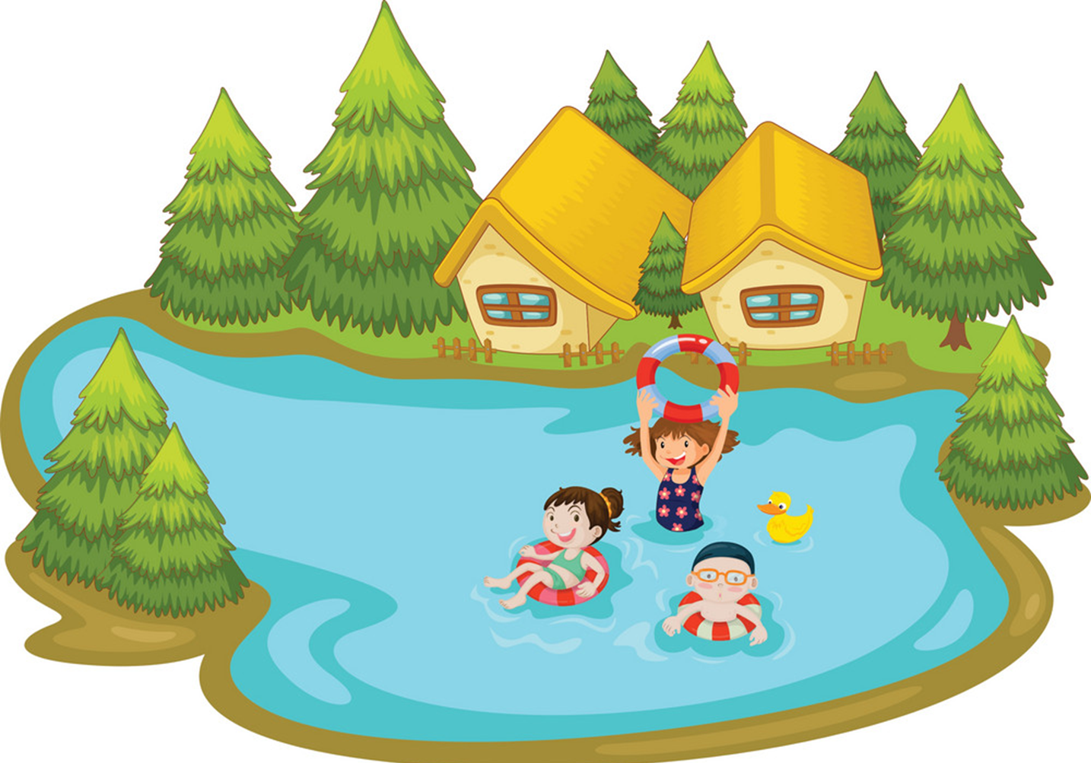
Vocabulary
go swimming
/goʊ ˈswɪmɪŋ/

Slide 7
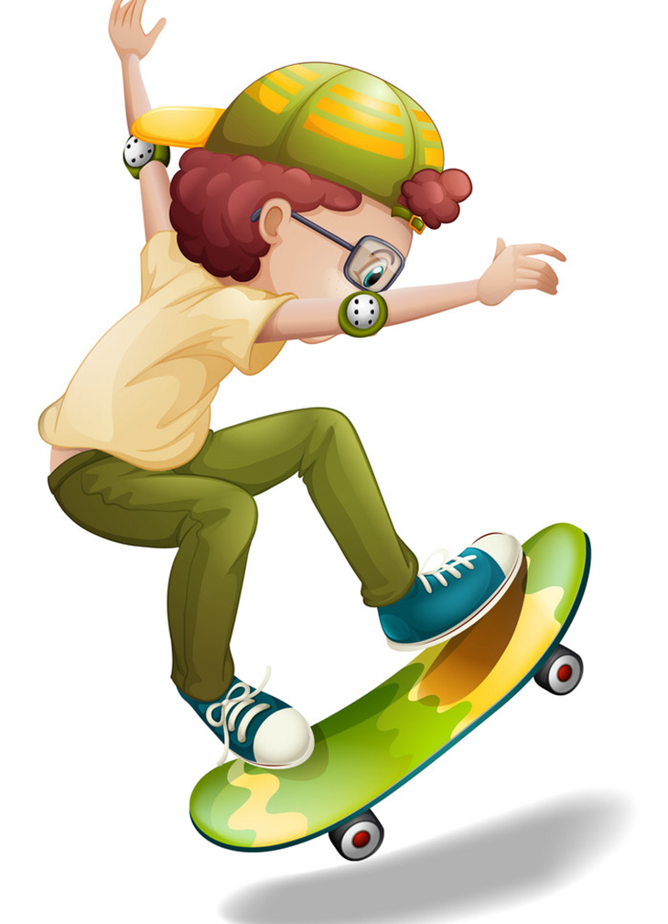
Vocabulary
go skating
/goʊ ˈskeɪtɪŋ /

Slide 8
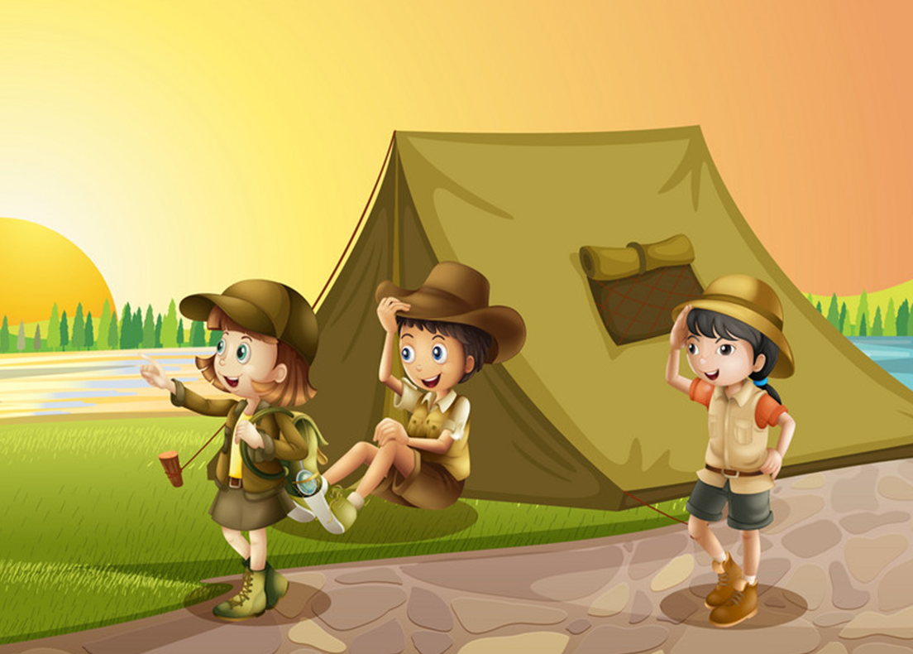
Vocabulary
go camping
/goʊ ˈkæmpɪŋ/

Slide 9

Vocabulary
go fishing
go swimming
go skating
go camping

Slide 10
Grammar

Slide 11
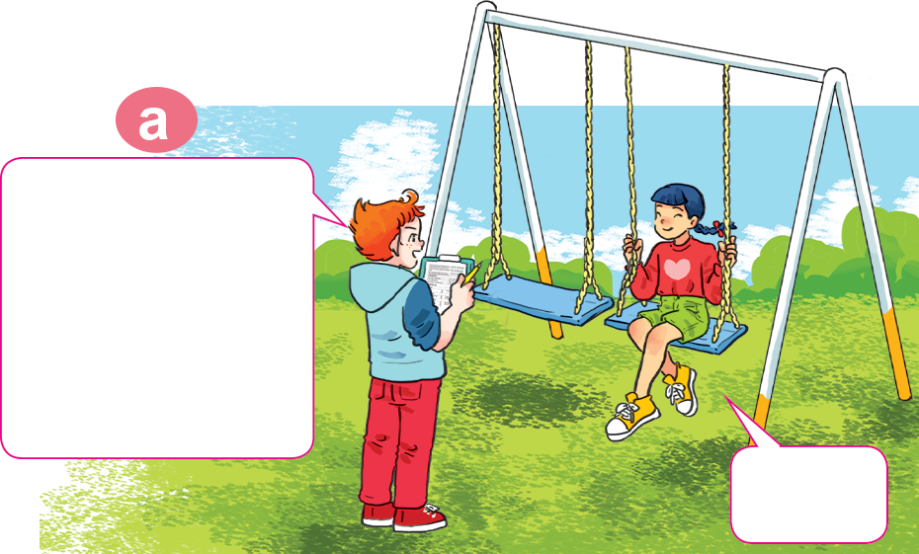
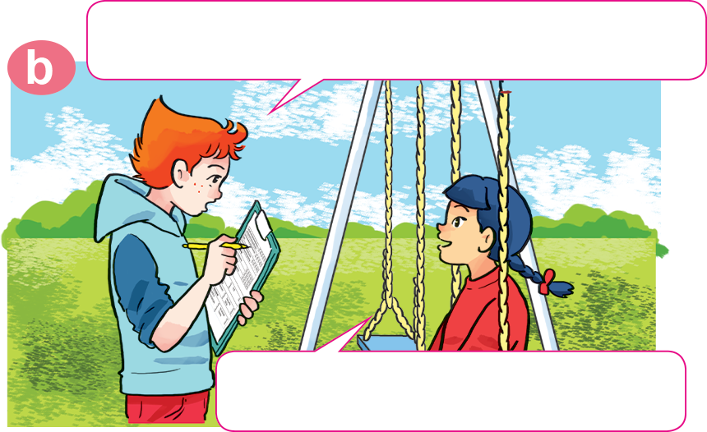
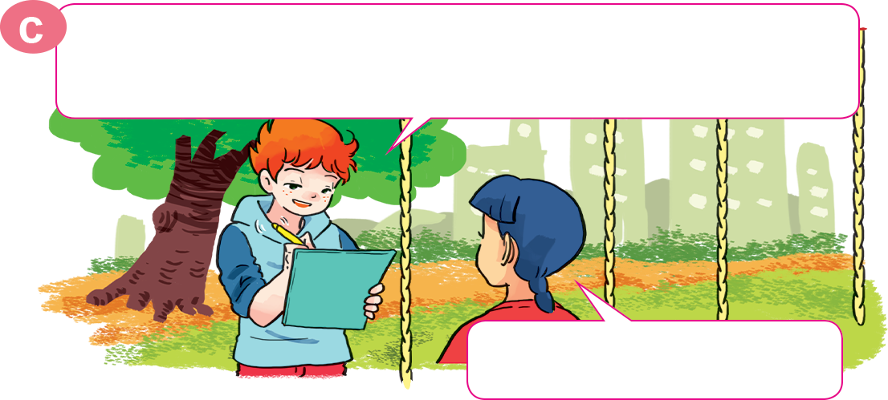
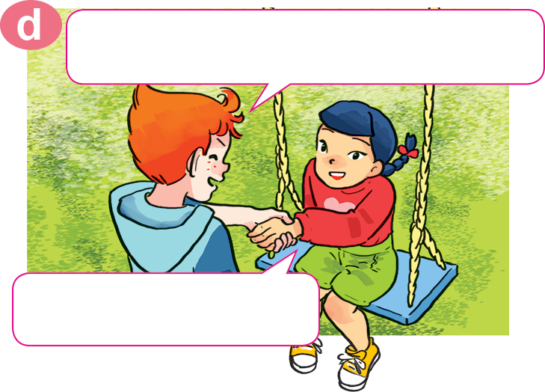
1. Look, listen and repeat
What do you do in your free time?
Hello, Akiko.
May I ask you some questions for my survey?
Sure.
I watch cartoons on TV.
OK, watching cartoons. How about your mother? What does she do in her free time?
OK. Thank you very much.
She goes shopping.
You're welcome.

Slide 12
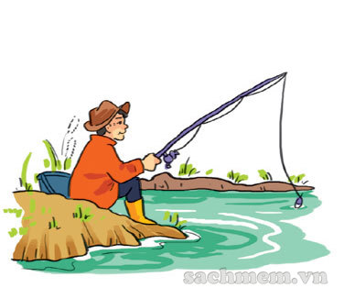
2. Point and say.
father
his
What does your ________ do in ____ free time?
goes fishing
He ______________________.

Slide 13
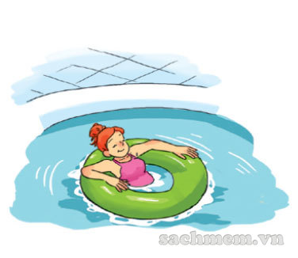
2. Point and say.
her
What does your ________ do in ____ free time?
mother
goes swimming
She ______________________.

Slide 14
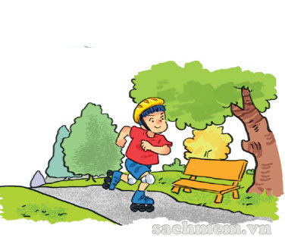
2. Point and say.
brother
his
What does your ________ do in ____ free time?
goes skating
He ______________________.

Slide 15
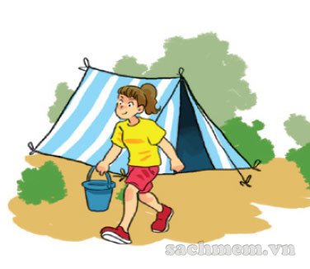
2. Point and say.
sister
her
What does your ________ do in ____ free time?
goes camping
She ______________________.

Slide 16


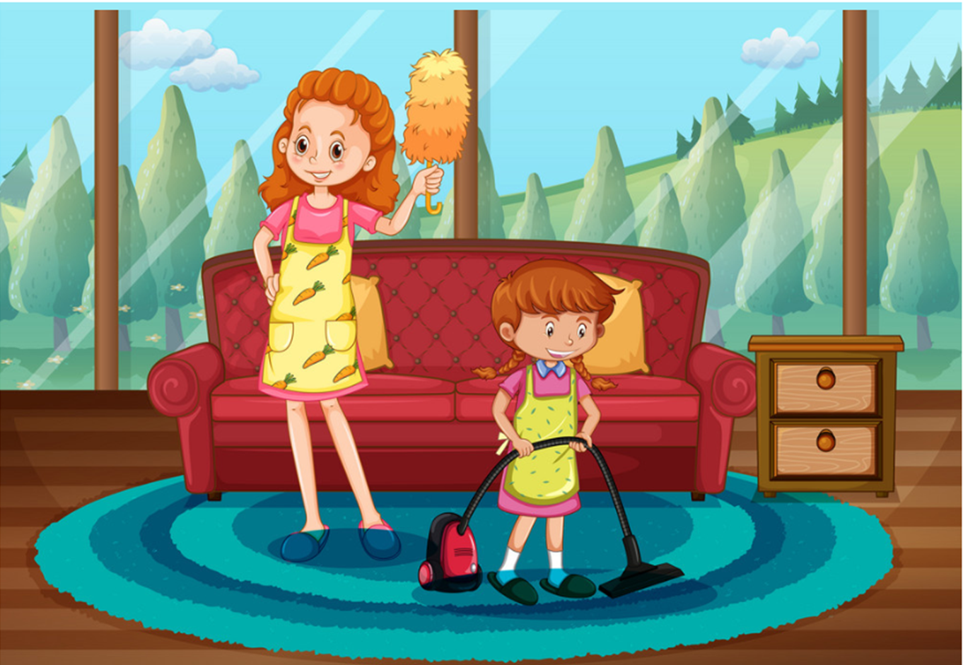

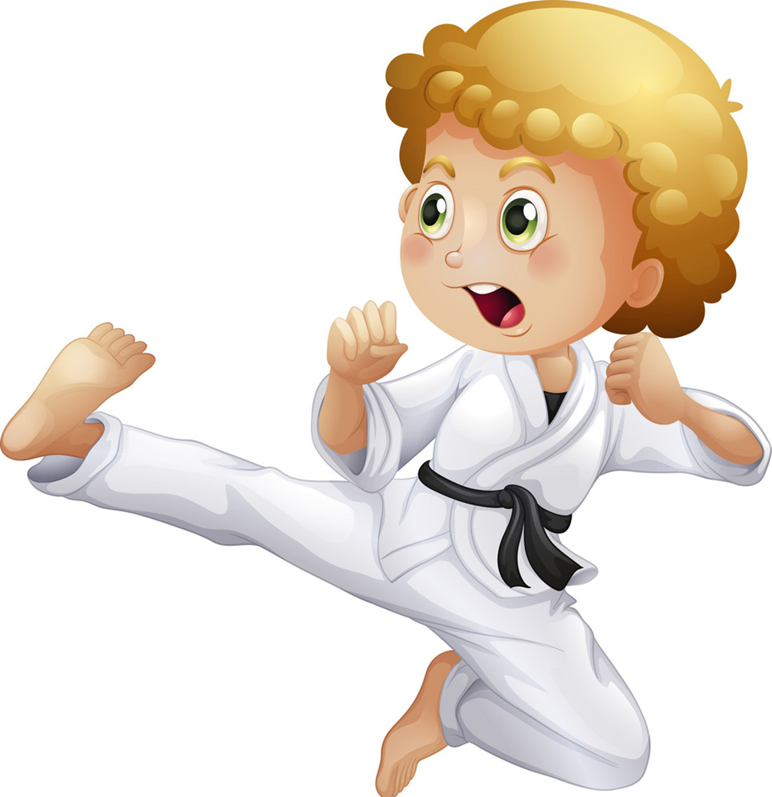
Model sentence
What does your _mother/father_______ do in her/his free time?
She/he ______________________.
surfs the Internet
goes fishing
goes swimming
cleans the house
goes to the cinema
goes camping
goes skating
does karate

Slide 17
4. Listen and circle a, b or c.
1. Phong often goes ___________ in his free time.
a. fishing b. camping c. skating
2. His father ___________ twice a week.
a. does karate b. plays football c. works in the garden
3. His mother goes ___________ at weekends.
a. swimming b. Shopping c. camping
4. His sister ___________ in her free time.
a. surfs the Internet b. does homework
c. cleans the house

Slide 18
5. Write about what your family members do in their free time.
1. What do you do in your free time?
2. How often do you do it?
3. What does your father do in his free time?
4. What does your mother do in her free time?

Slide 19
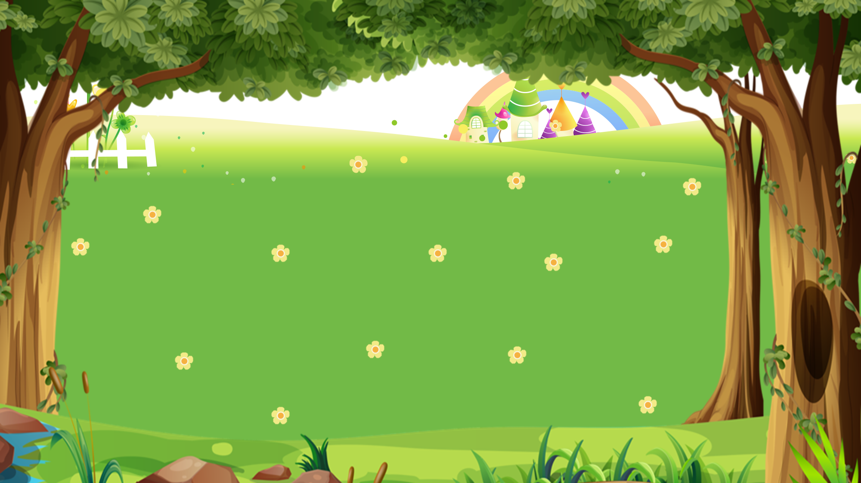

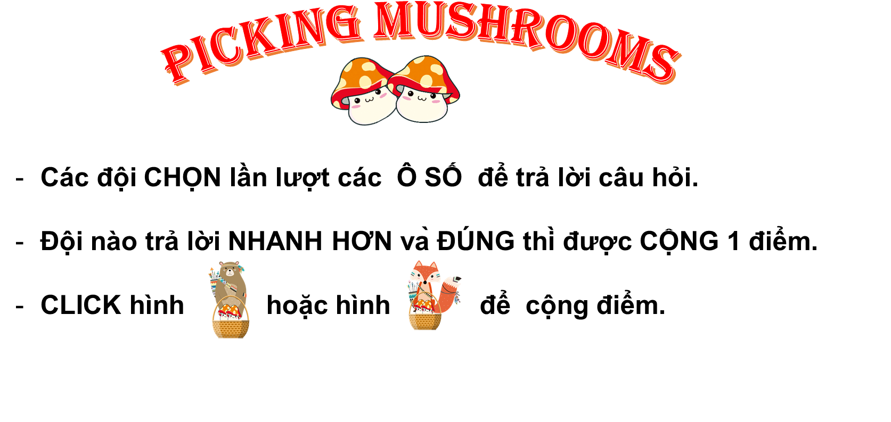






PICKING MUSHROOMS
1
2
3
Các đội CHỌN lần lượt các Ô SỐ để trả lời câu hỏi.
Đội nào trả lời NHANH HƠN và ĐÚNG thì được CỘNG 1 điểm.
CLICK hình hoặc hình để cộng điểm.
4
5
6
7
8
9
10

Slide 20







Time’s up
1
2
3
4
5
6
7
8
9
10
What does _____ do in her free time?
Back
A. she
B. he
C. you
A.

Slide 21
Time’s up
1
2
3
4
5
6
7
8
9
10
What does _____ do
in his free time?
Back
A. you
B. he
C. she
A.

Slide 22
Time’s up
1
2
3
4
5
6
7
8
9
10
What does she do
in _____ free time?
Back
A. your
B. his
C. her
A.

Slide 23
Time’s up
1
2
3
4
5
6
7
8
9
10
What _____ you do
in your free time?
A. Do
Back
B. Does
A.
C. Sai

Slide 24
Time’s up
1
2
3
4
5
6
7
8
9
10
What _____ your father do
in his free time?
B. does
Back
A. do
B. Sai
D. Sai

Slide 25
Time’s up
1
2
3
4
5
6
7
8
9
10
What does your uncle do in his free time?
He ______ camping.
Back
A. goes
B. go
B. Sai
D. Sai

Slide 26
Time’s up
1
2
3
4
5
6
7
8
9
10
What does your mother
do in her free time?
She _______ swimming.
B. goes
Back
A. go
B. Sai
D. Sai

Slide 27


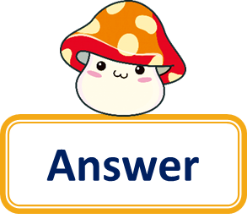

Time’s up
1
2
3
4
5
6
7
8
9
10
Question
What does your teacher do in her free time?
She goes skating.
Back
Answer

Slide 28
Time’s up
1
2
3
4
5
6
7
8
9
10
What does your friend do in his free time?
Question
He does karate.
Back
Answer

Slide 29
Time’s up
1
2
3
4
5
6
7
8
9
10
What do you do
in your free time?
Question
I go fishing.
Back
Answer

Slide 30








Let’s remember!
(Cùng ghi nhớ nhé!)
SB (SGK)
Ex5 – p21
WB (SBT) p53
Review the words, model sentences and dialogues in Unit 13 – Lesson 2
(Ôn lại từ vựng và mẫu câu trong Bài 13 – Tiết 1)
PREVIEW
(Xem trước)
SB: Unit 13 – Lesson 3

Slide 31
Wednesday, February 9th , 2022
Unit 13: Lesson 2 – p20,21
Words
Go fishing
- Go camping
Go swimming
Go skating
2. Model sentence
A: What does your father do in his free time?
B: He goes fishing.

Slide 32
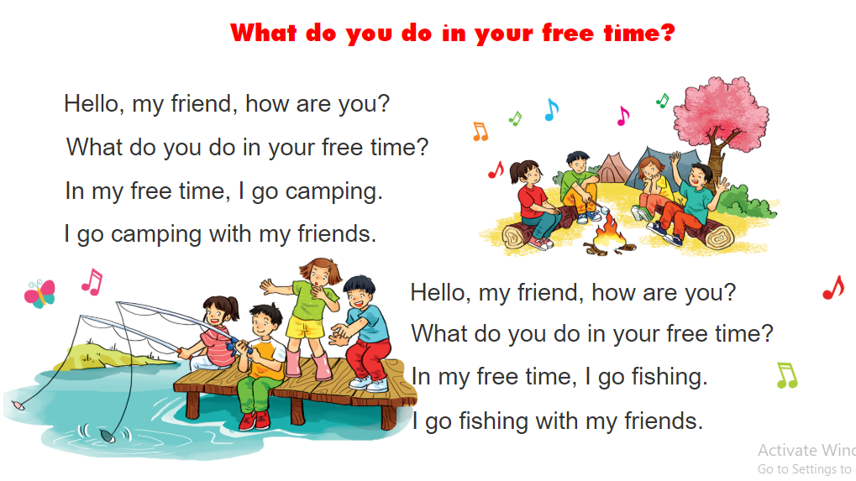
6. Let’s sing.

