Slide 2
Unit 13
WHAT DO YOU DO
IN YOUR FREE TIME?
Lesson 1

Slide 3


OBJECTIVES
(Mục tiêu của bài học hôm nay)
01
- Learn about some free time activities( Học về một số từ chỉ hoạt động trong thời gian rảnh)
- Ask and answer about what someone does in his/her free time activities (Hỏi và trả lời về ai đó làm gì trong thời gian rảnh rỗi)
02
03
- Practice speaking, listening and reading skills.
(Luyện tập các kĩ năng nói, nghe và đọc hiểu.)
Notes:
Thanh Yến Trần 0967 255 149 zalo/ FB https://www.facebook.com/thanhyentrananhngutaymy/

Slide 4
Vocabulary

Slide 5


Vocabulary
surf the Internet
/sɜːf ði: ˈɪntəˌnɛt/

Slide 6


Vocabulary
go to the cinema
/gəʊ tə ðə ˈsɪnəmə/

Slide 7
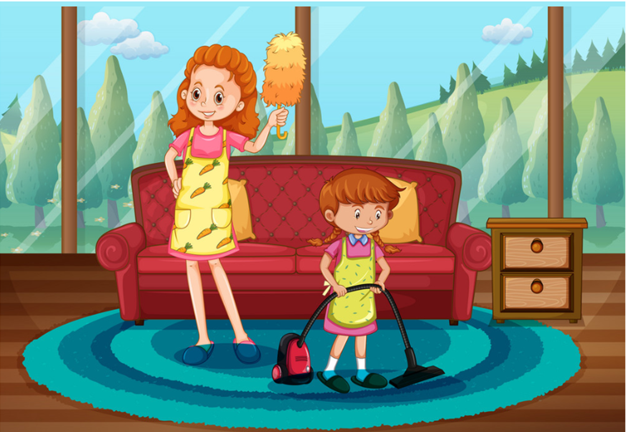
Vocabulary
clean the house
/kliːn ðə haʊs/

Slide 8
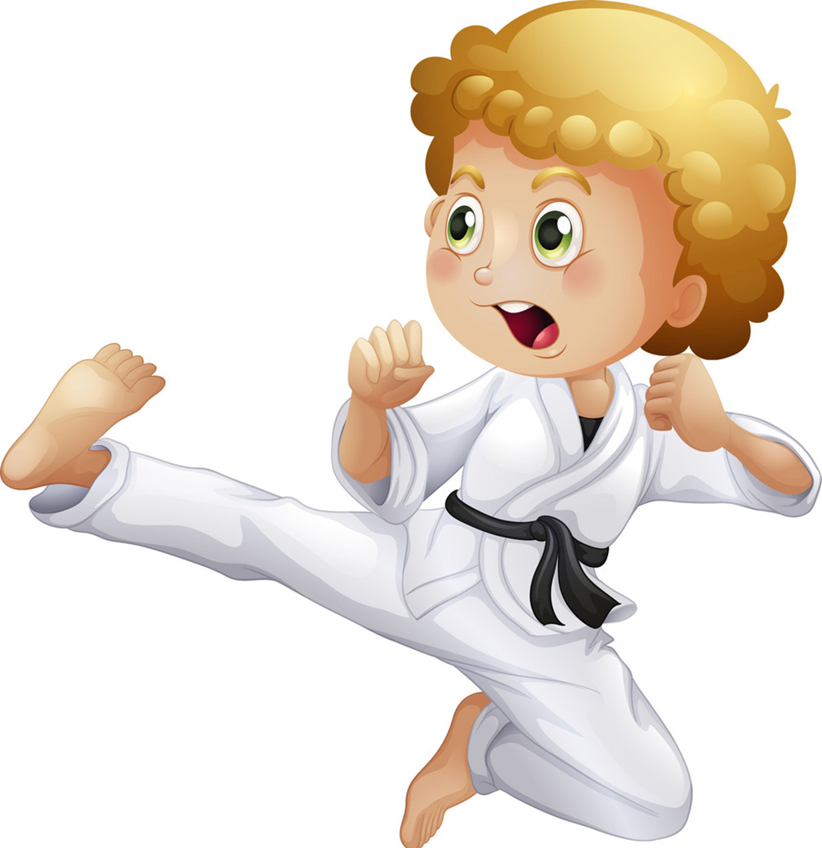
Vocabulary
do karate
/dʊ kəˈrɑːti/

Slide 9
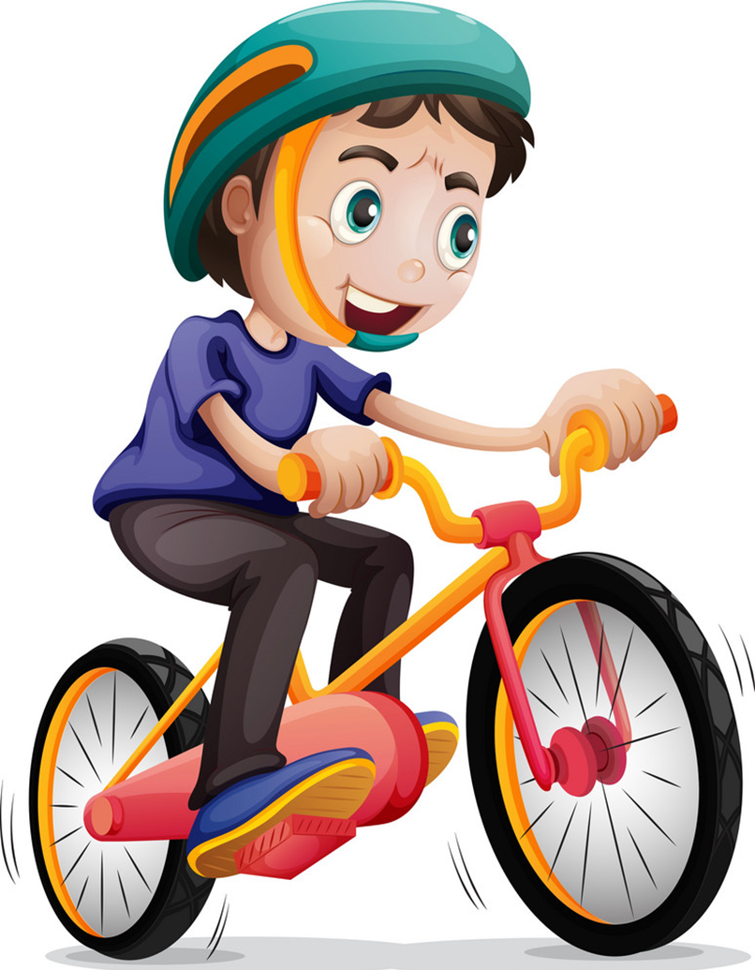
Vocabulary
ride my bike
/raɪd maɪ baɪk/

Slide 10
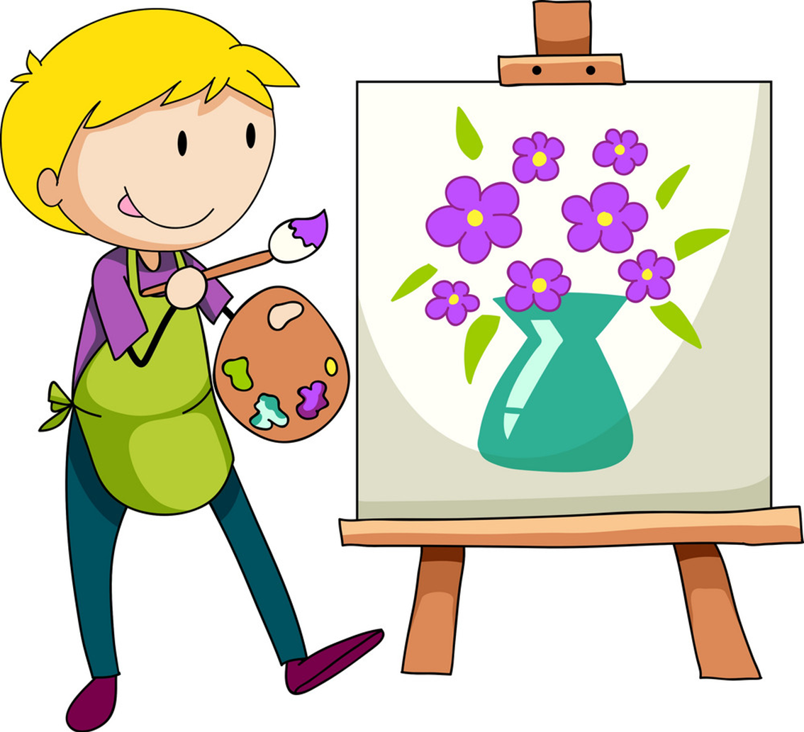
Vocabulary
draw pictures
/drɔ ˈpɪkʧərz/

Slide 11

Vocabulary
surf the Internet
clean the house
ride my bike
do karate
go to the cinema
draw pictures

Slide 13
Grammar

Slide 14
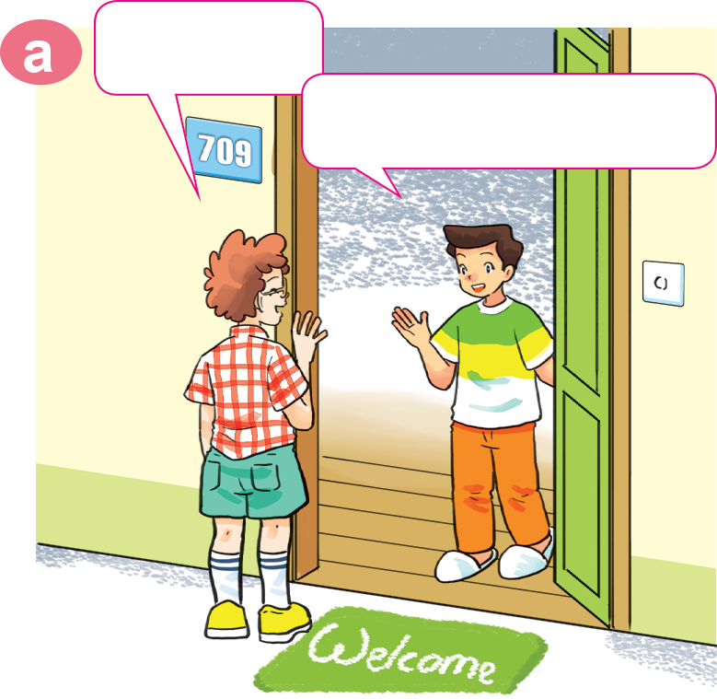
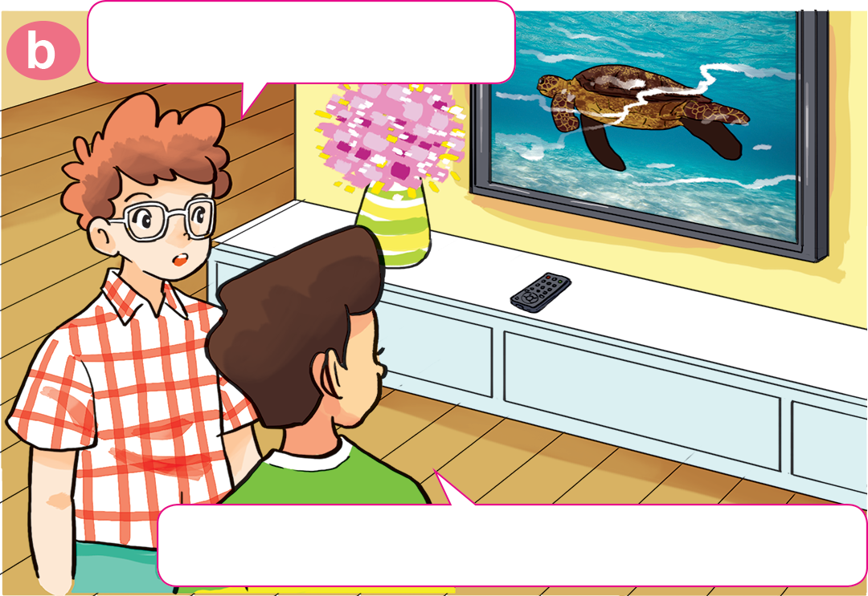
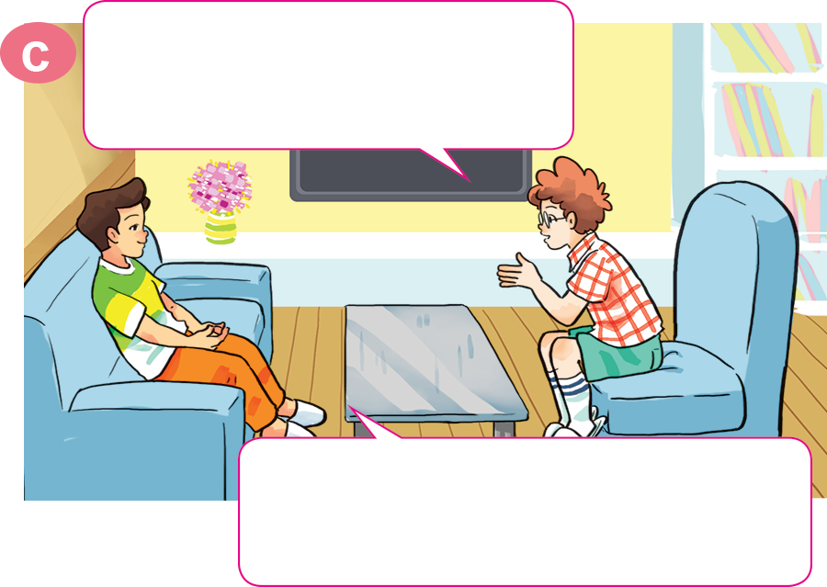
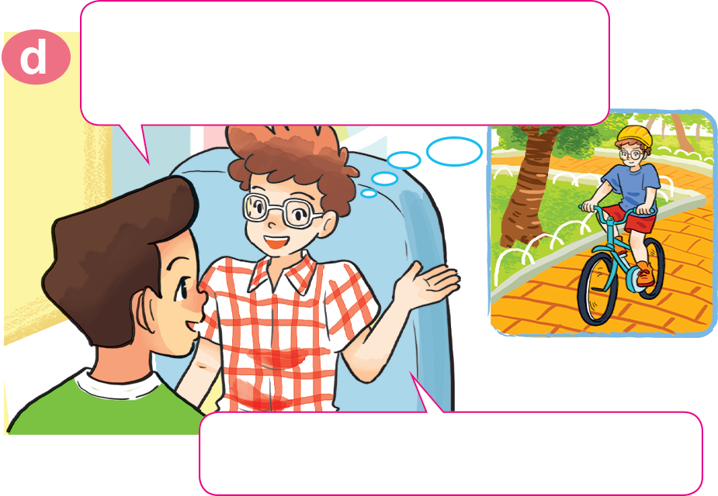
1. Look, listen and repeat
Hi, Nam.
What are you doing?
Hi, Tom. Come in.
I'm watching The World of Animals.
Do you like watching animal programmes?
What about you? What do you do in your free time?
Yes. I often watch them in my free time.
I ride my bike in the park.

Slide 15
2. Point and say.
What do you do in your free time?
surf the Internet
I ______________________.

Slide 16
2. Point and say.
What do you do in your free time?
go to the cinema
I ______________________.

Slide 17
2. Point and say.
What do you do in your free time?
clean the house
I ______________________.

Slide 18
2. Point and say.
What do you do in your free time?
do karate
I ______________________.

Slide 19
Model sentence
What do you do in your free time?
I ______________________.
ride my bike
surf the Internet
do karate
draw pictures
clean the house
go to the cinema

Slide 20

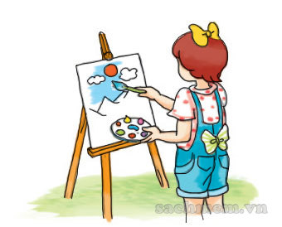
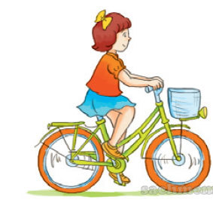



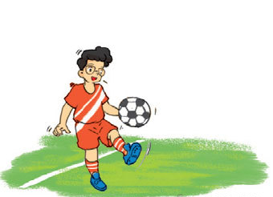
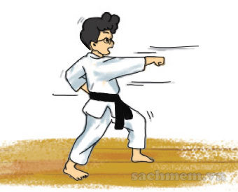
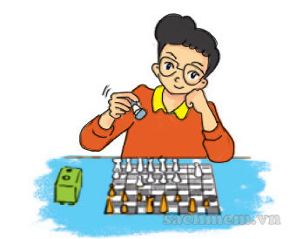
4. Listen and tick.
a
b
c
✓
a
b
c
✓
a
b
c
✓

Slide 21
5. Read and complete
Twice
songs
free
go
watch
Hoa: What do you do in your (1) ______ time, Quan?
Quan: I often (2) ______ sports programmes on TV.
What about you, Hoa?
Hoa: I (3) ______ to the music club with my friends.
Quan: How often do you go to the music club?
Hoa: (4) ______ a week.
Quan: What do you do there?
Hoa: I dance and sing (5) ______.
free
watch
go
Twice
songs

Slide 22








Let’s remember!
(Cùng ghi nhớ nhé!)
SB (SGK)
Ex5 – p19
WB (SBT) p52
Review the words, model sentences and dialogues in Unit 13 – Lesson 1
(Ôn lại từ vựng và mẫu câu trong Bài 13 – Tiết 1)
PREVIEW
(Xem trước)
SB: Unit 13 – Lesson 2

Slide 23
Monday, February 8th , 2022
Unit 13: What do you do in your free time? Lesson 1
Words
Surf the Internet - draw pictures
- Clean the house
Do karate
Go to the cinema
Ride my bike
2. Model sentence
A: What do you do in your free time?
B: I surf the Internet.

Slide 24
6. Let’s play.

Slide 25

Hành Tinh Xanh
PLAY

Slide 26







What do you do in your free time?
surf the Internet
Go to the cinema
Go to the zoo

Slide 27
What do you do in your free time?
Go to the cinema
Go to the library
Go to the zoo

Slide 28
What do you do in your free time?
Surf the Internet
Ride my bike
Do karate

Slide 29
What do you do in your free time?
do karate
draw pictures
clean the house

Slide 30
What do you do in your free time?
surf the Internet
draw pictures
do karate

Slide 31
What do you do in your free time?
go to the cinema
do karate
clean the house

Slide 32

What do you do in ____ free time?
I watch TV.
his
your
her

Slide 33
What ____ you do in your free time?
I surf the Internet.
are
does
do

Slide 34




