Slide 1

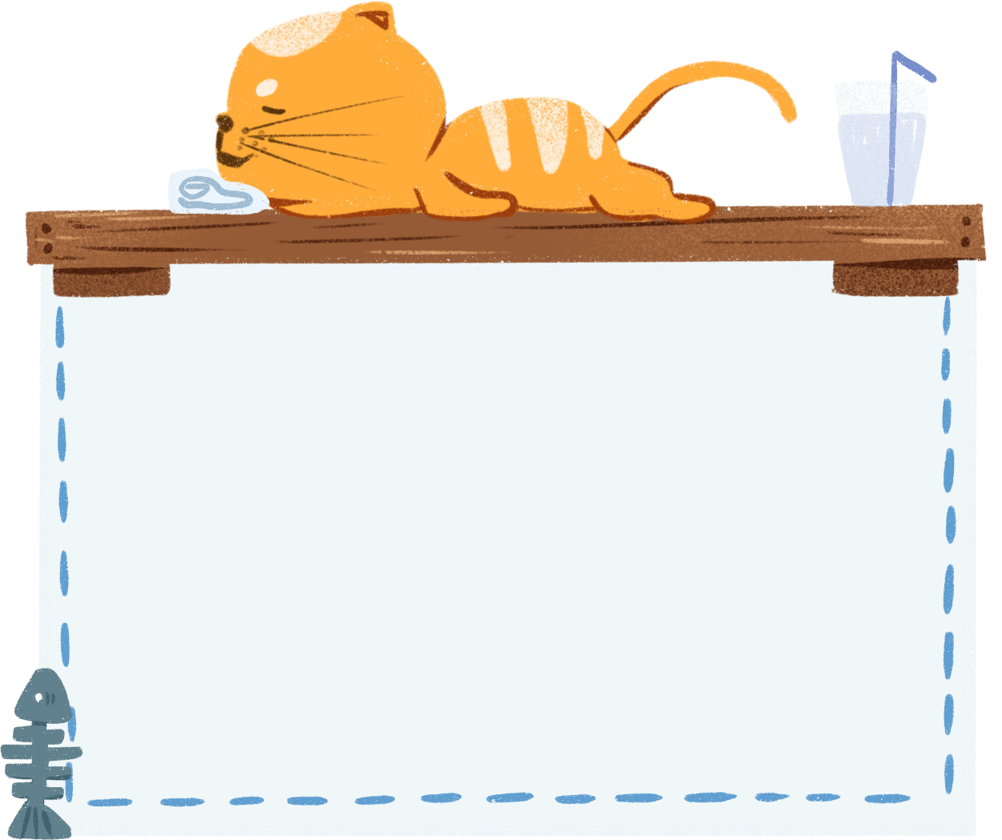
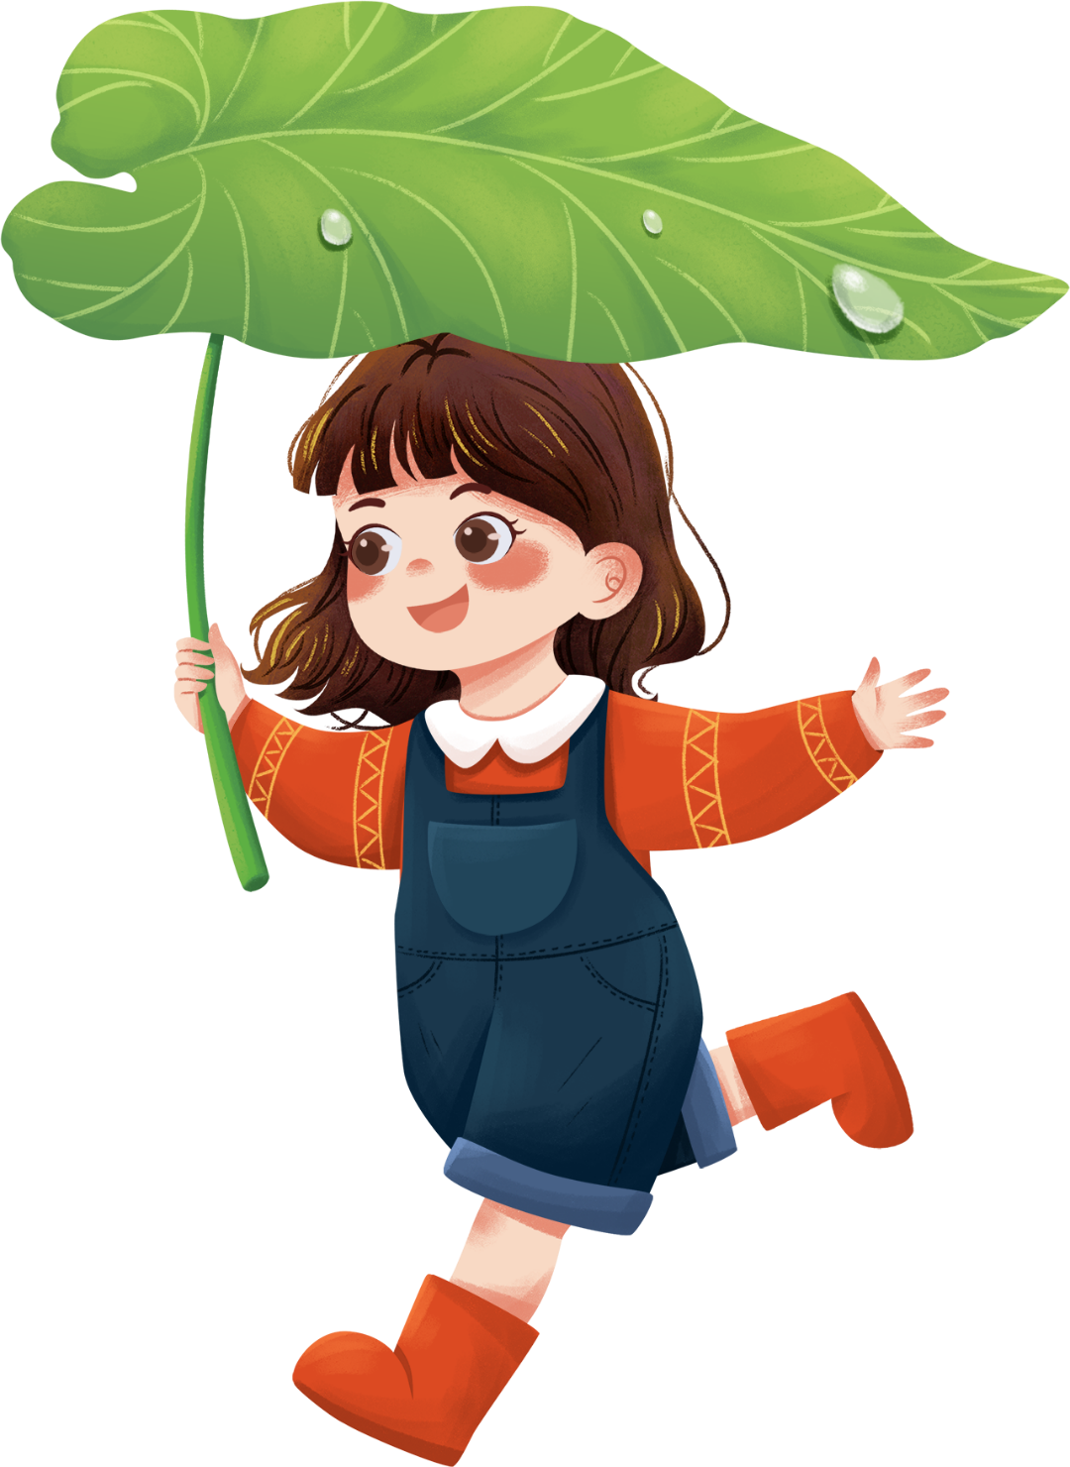

Welcome to
our class
Book : English 3
Teacher : Miss Linh

Slide 2
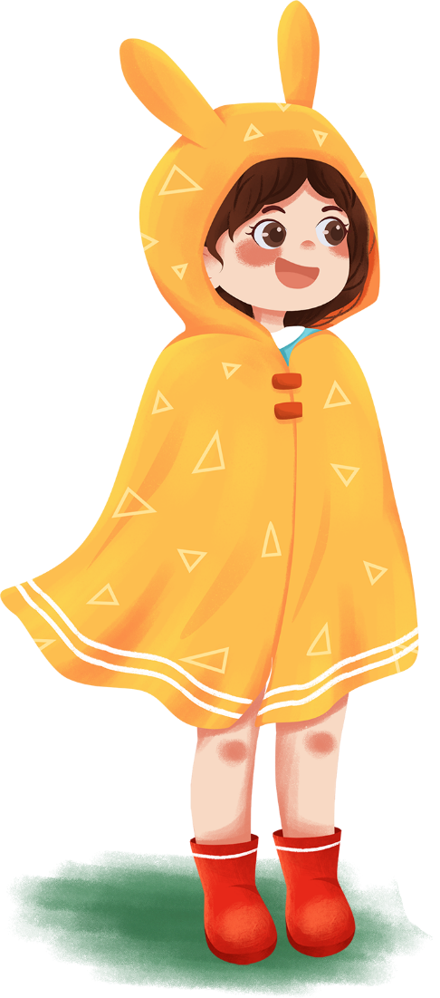
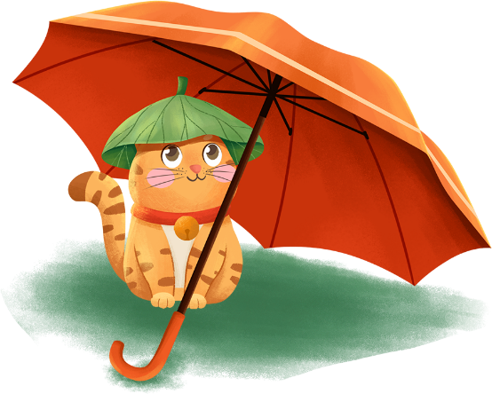
Unit 14 – Lesson 3
Are there any posters
in the room?

Slide 3
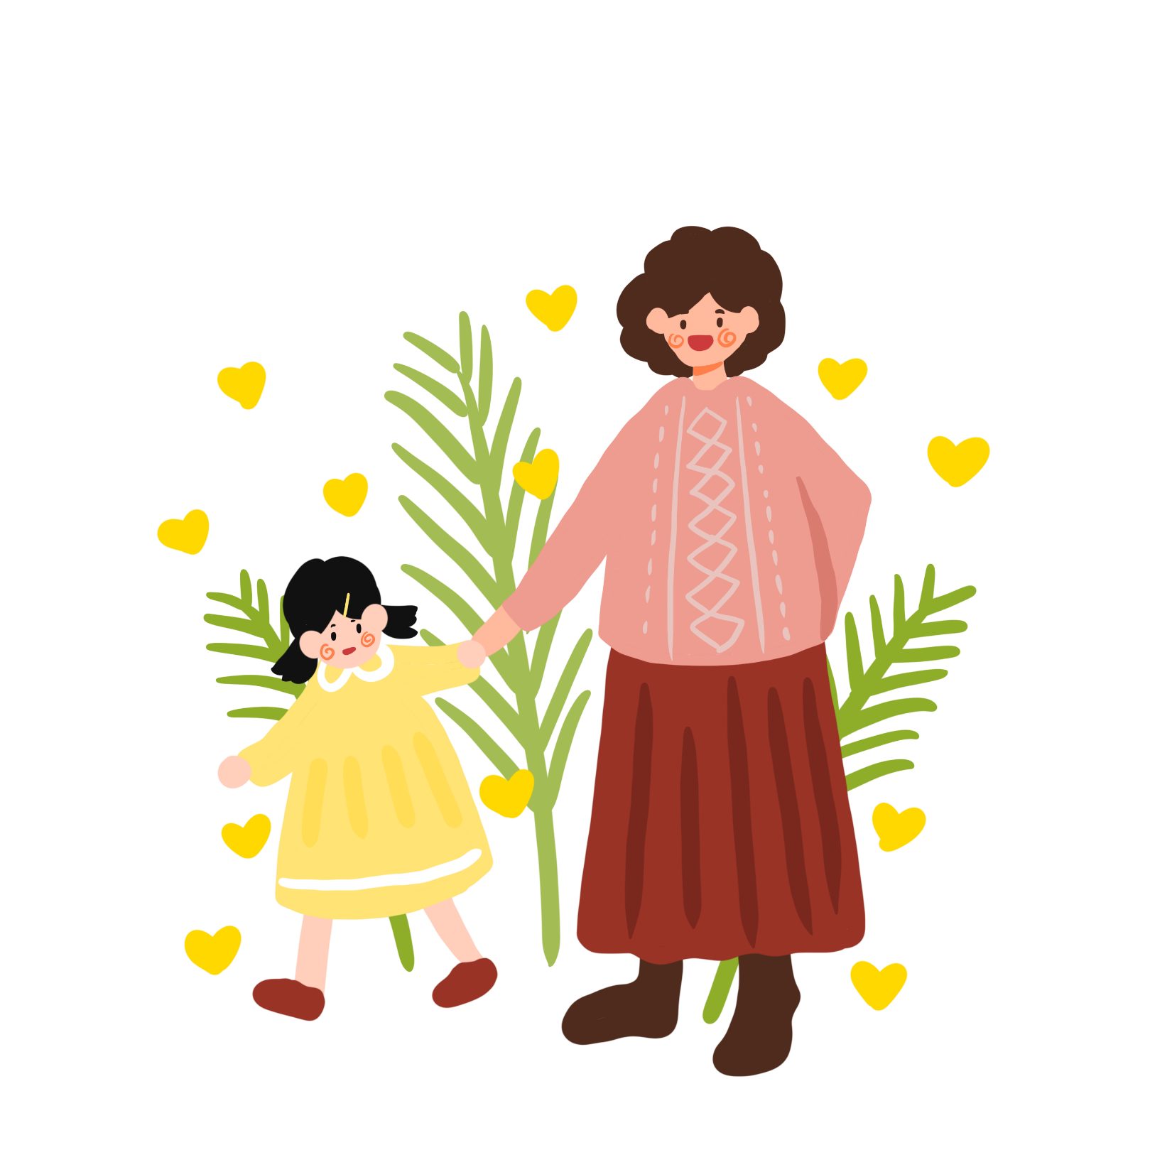
Objectives
2.
Learn the phonics “a” and “u” .
1.
Review the words and sentences.

Slide 4
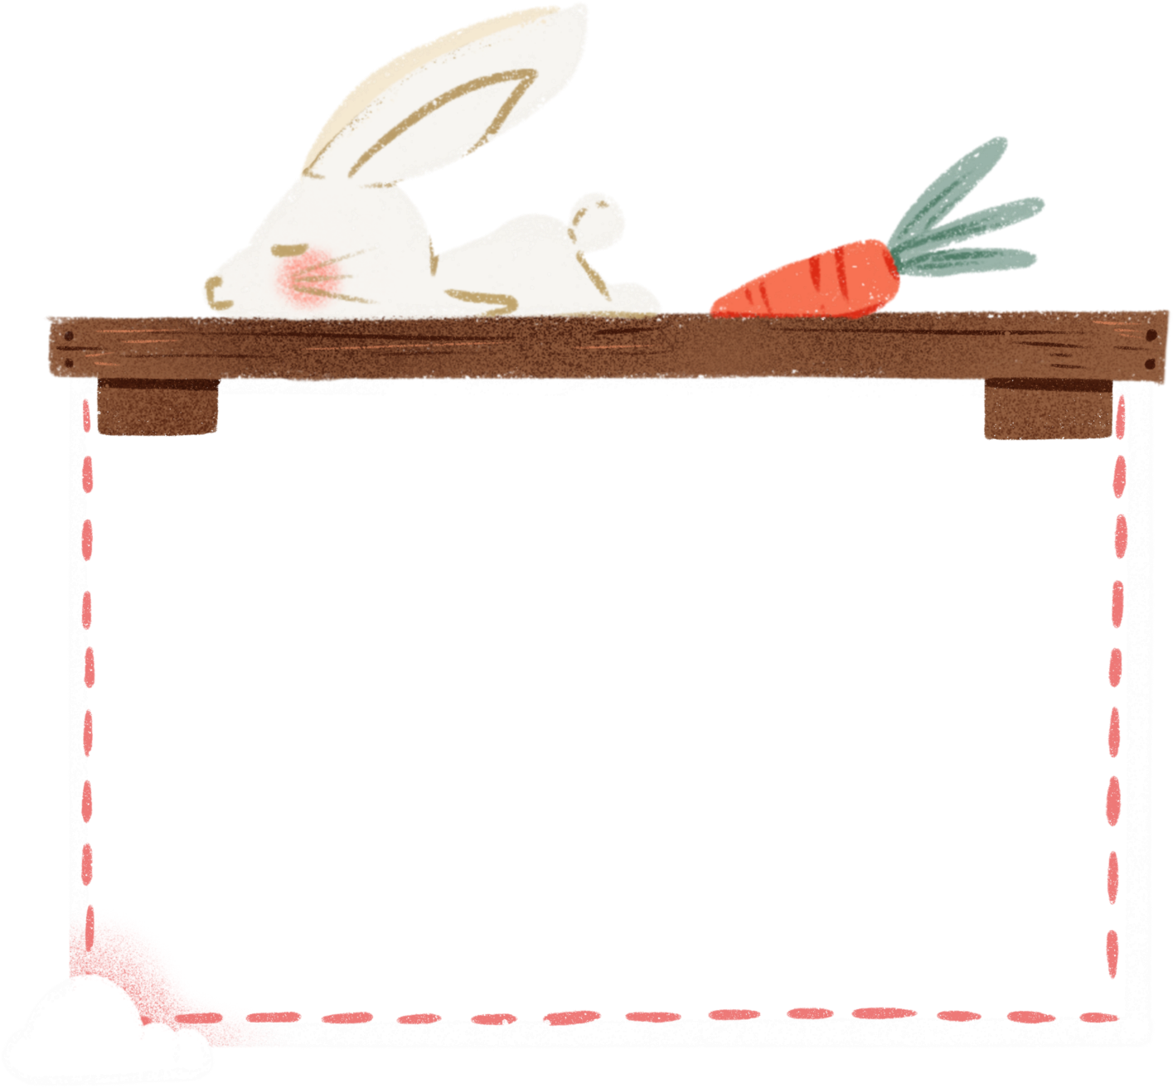
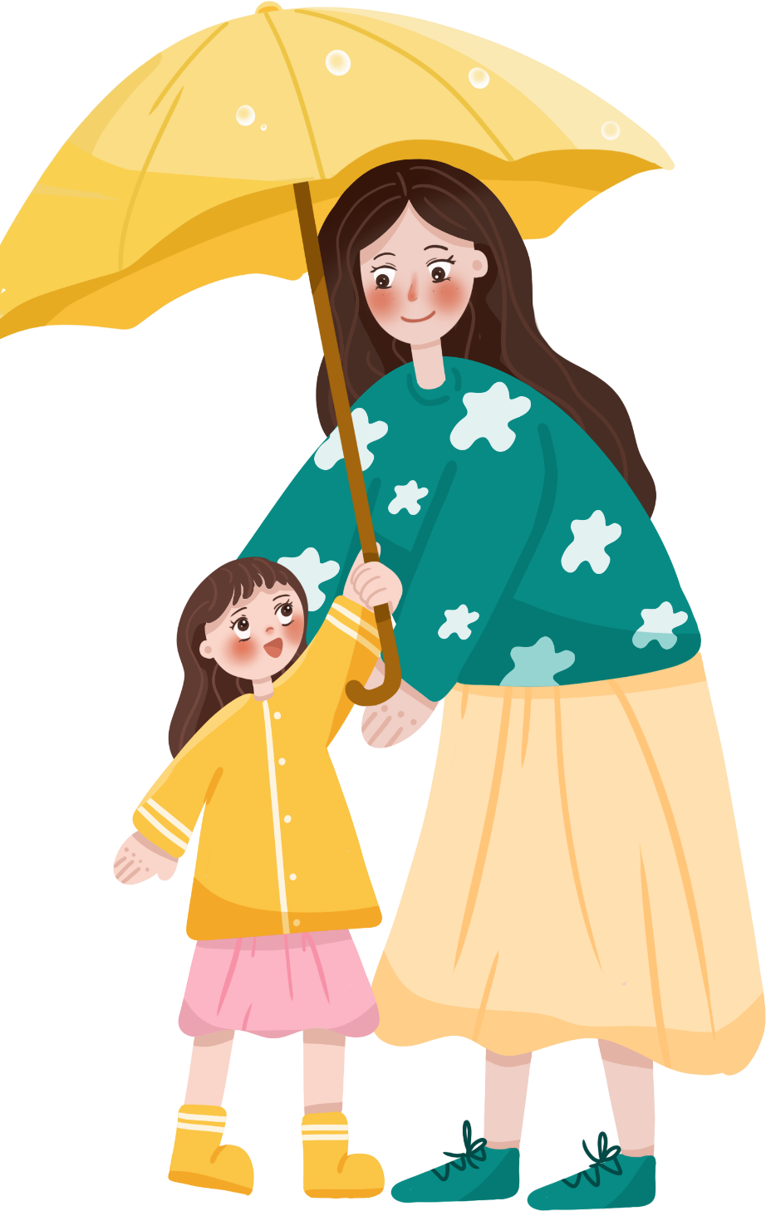
Review

Slide 5
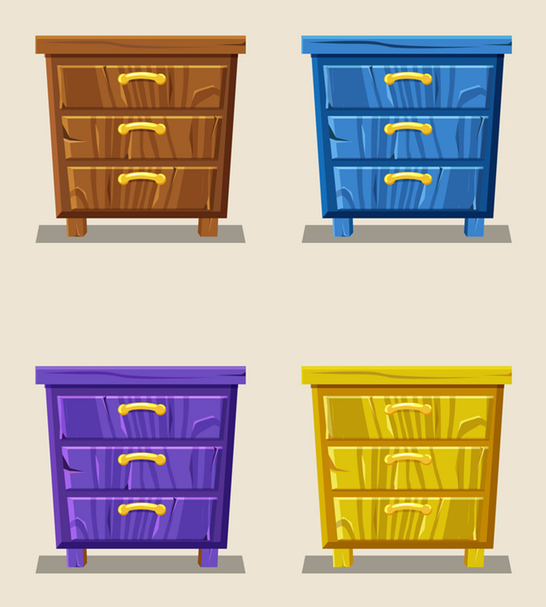
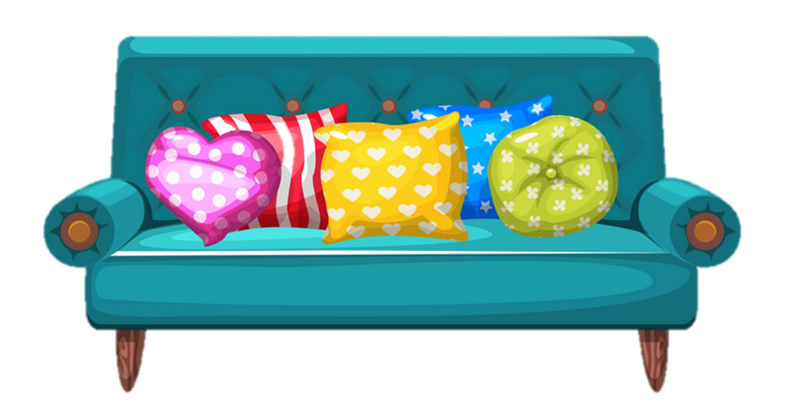
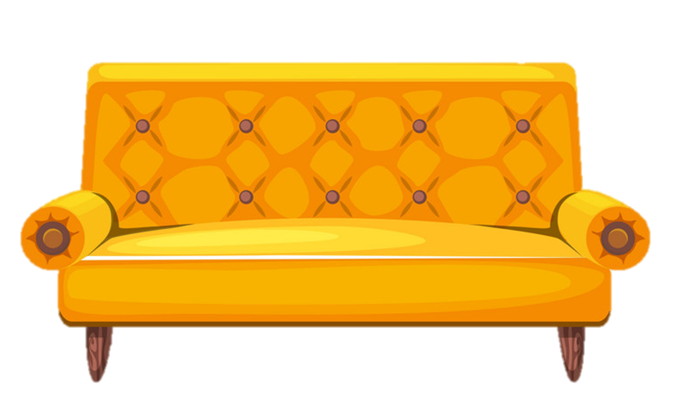
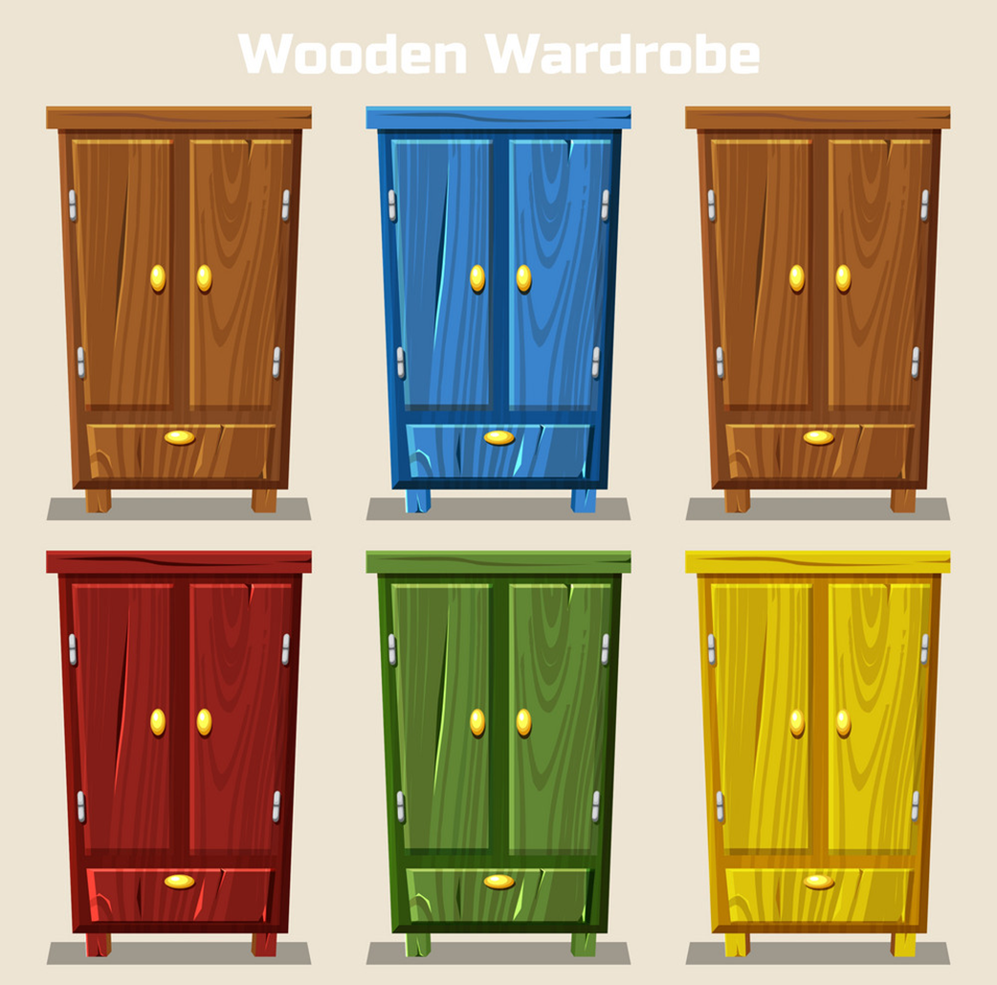
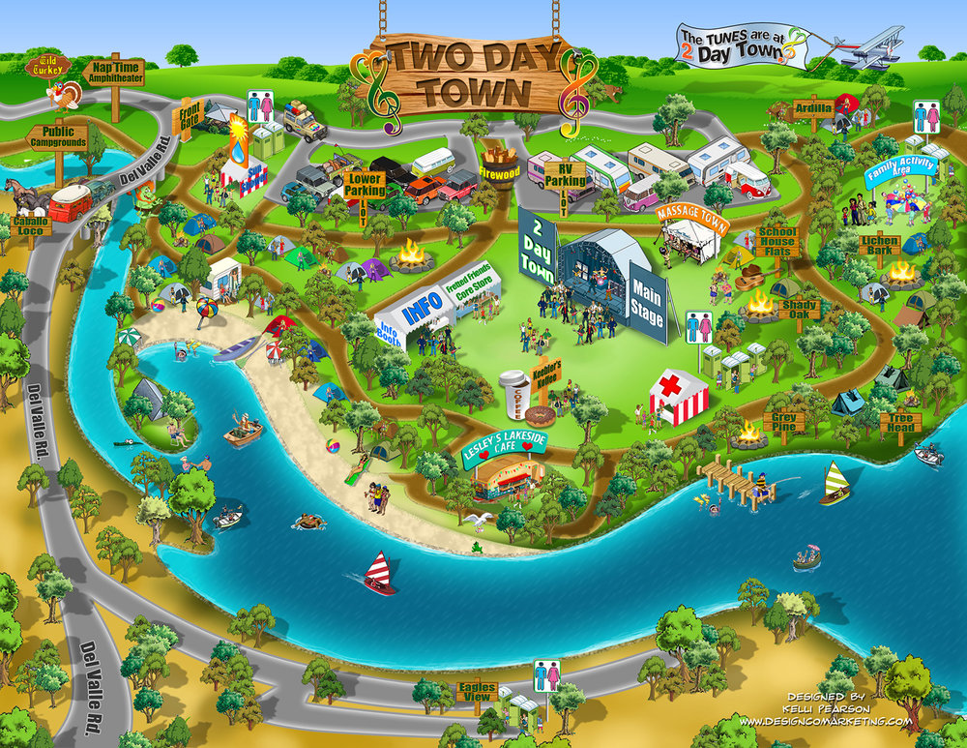
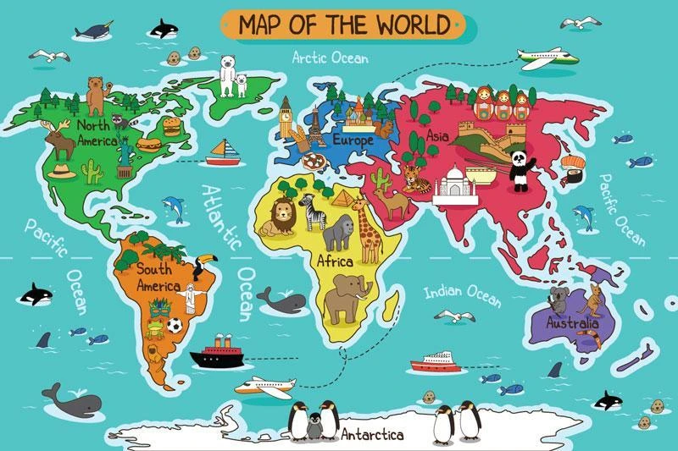
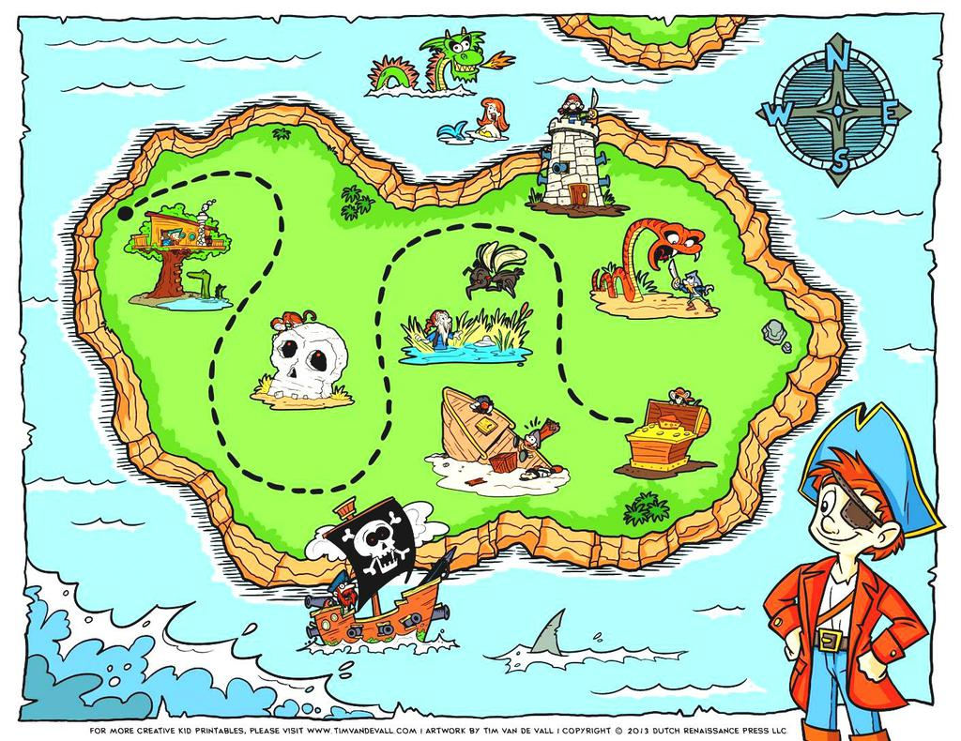
Model sentence
Yes, there are.
Are there any ______?
No, there aren’t.
cupboards
sofas
wardrobes
maps

Slide 6
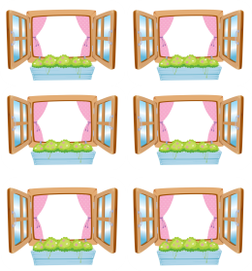

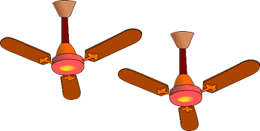

Model sentence
How many _______ are there?
There are __________.
windows
mirrors
fans
cups

Slide 7
Warm up

Slide 8
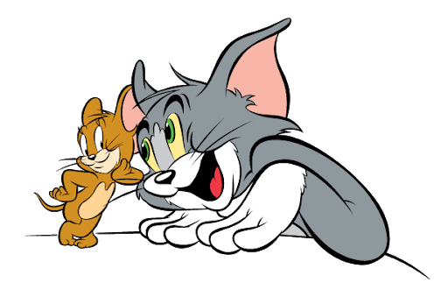
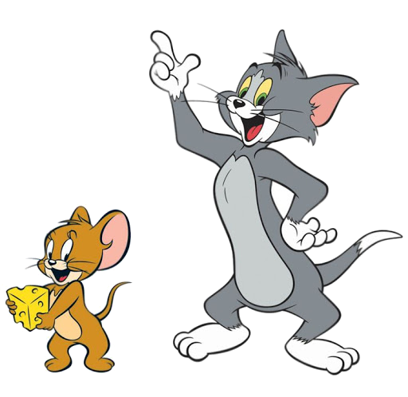

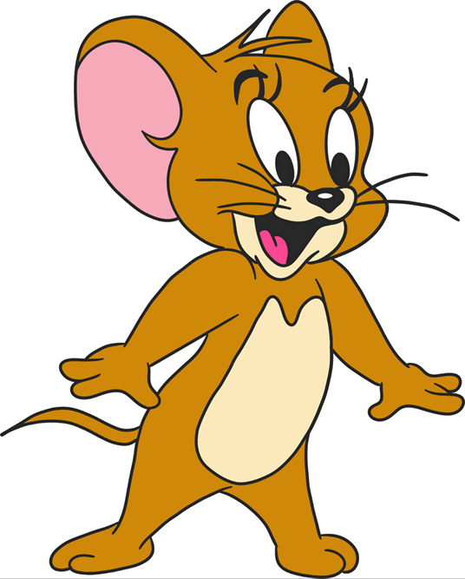
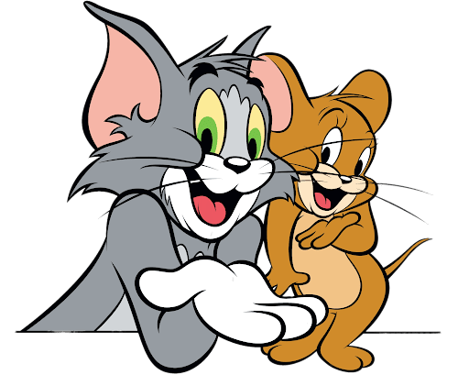

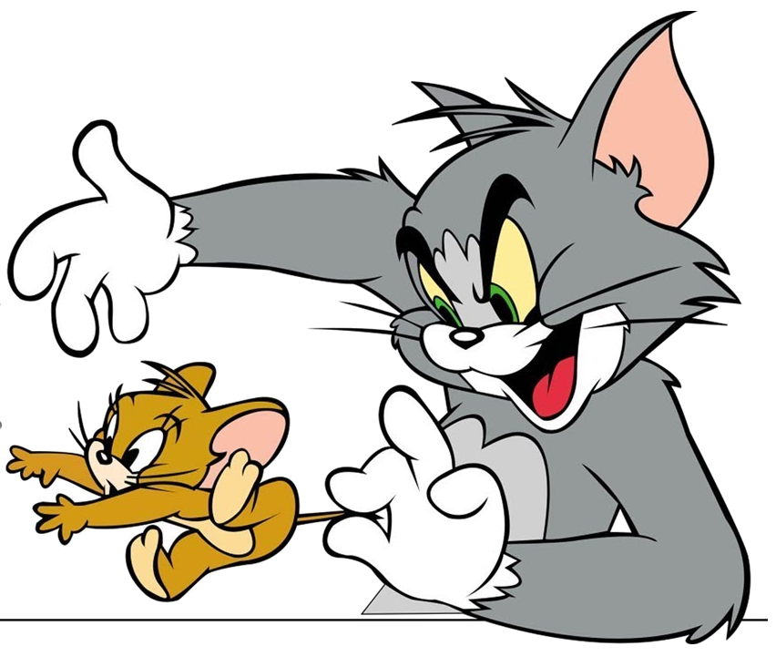
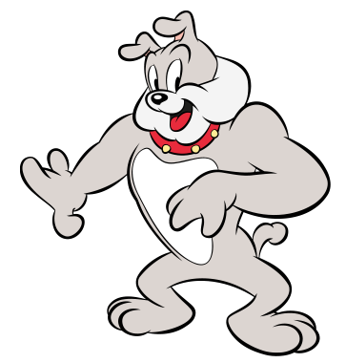
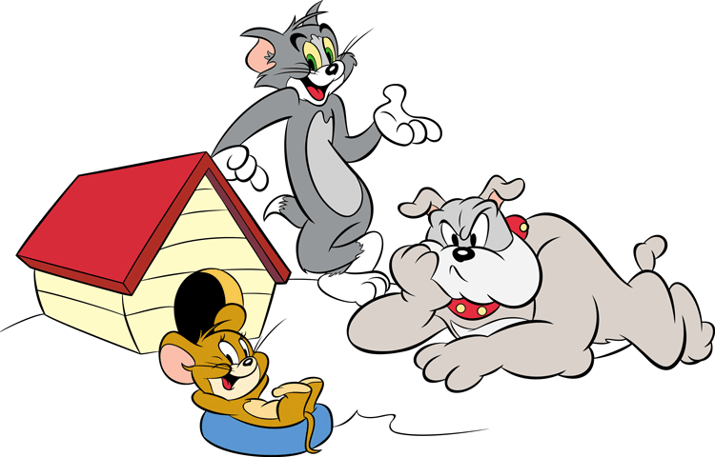
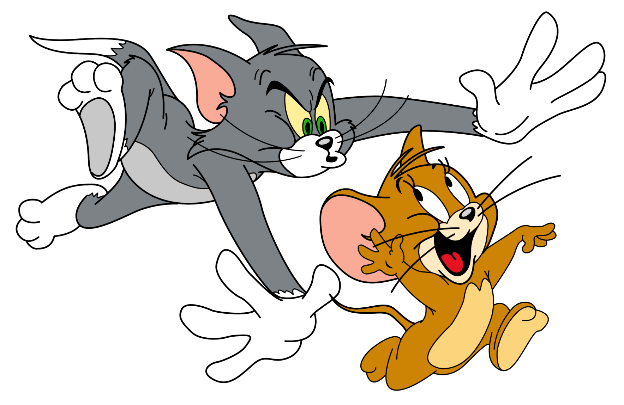

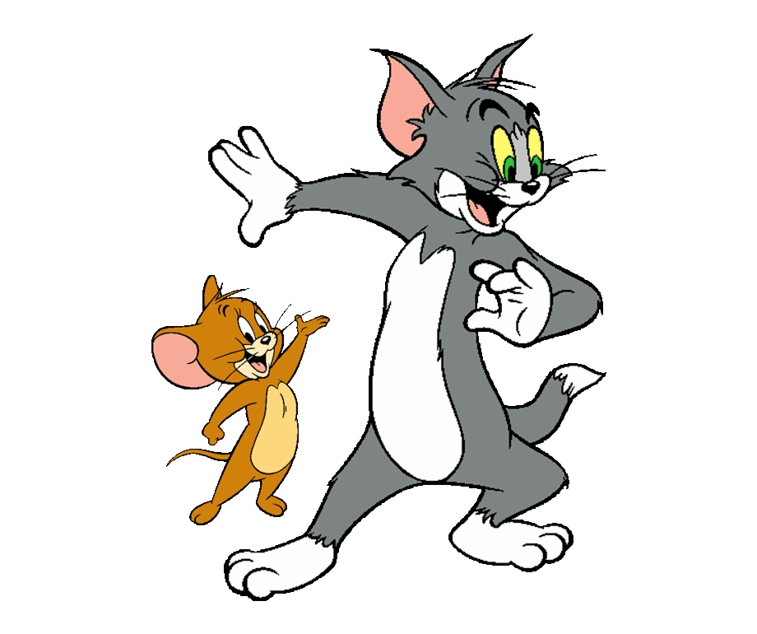
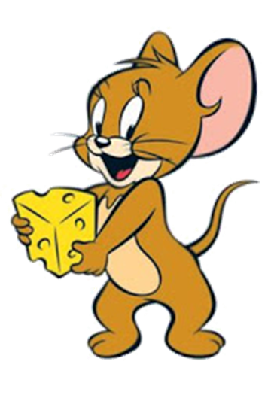
GAME
Notes:
Ms Huyền Phạm - 0936.082.789 – YOUTUBE: MsPham. Facebook: Dạy và học cùng công nghệ.

Slide 9

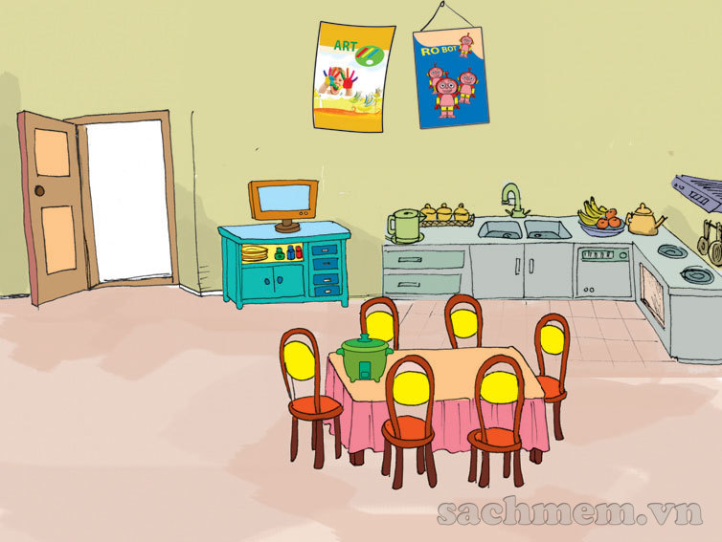

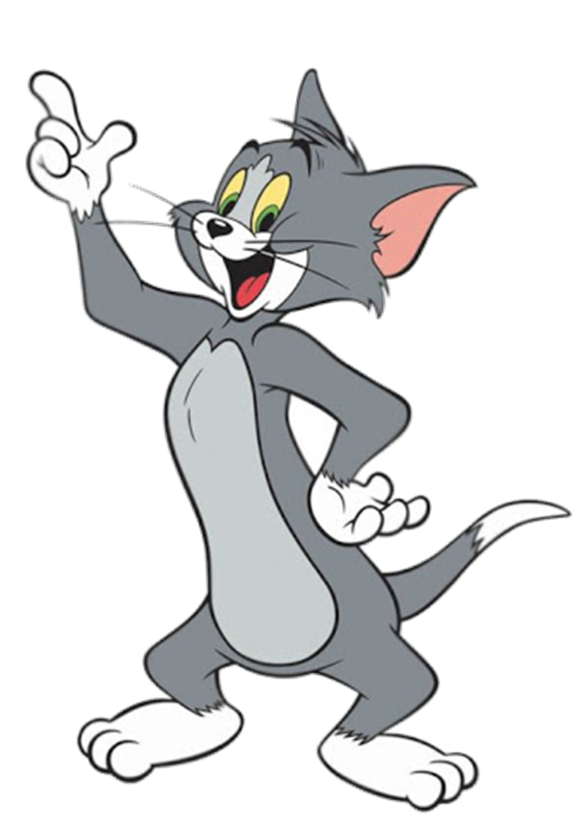

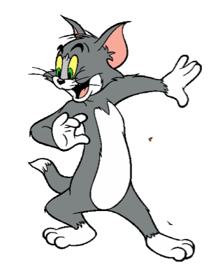






There's a cupboard
near the door.
Notes:
Ms Huyền Phạm - 0936.082.789 – YOUTUBE: MsPham. Facebook: Dạy và học cùng công nghệ.

Slide 10
There's a TV on the wardrobe.
Notes:
Ms Huyền Phạm - 0936.082.789 – YOUTUBE: MsPham. Facebook: Dạy và học cùng công nghệ.

Slide 11
There's a TV on the cupboard.
Notes:
Ms Huyền Phạm - 0936.082.789 – YOUTUBE: MsPham. Facebook: Dạy và học cùng công nghệ.

Slide 12
There are two posters on the TV.
Notes:
Ms Huyền Phạm - 0936.082.789 – YOUTUBE: MsPham. Facebook: Dạy và học cùng công nghệ.

Slide 13
There are two maps on the wall.
Notes:
Ms Huyền Phạm - 0936.082.789 – YOUTUBE: MsPham. Facebook: Dạy và học cùng công nghệ.

Slide 14
There are six chairs near the table.
Notes:
Ms Huyền Phạm - 0936.082.789 – YOUTUBE: MsPham. Facebook: Dạy và học cùng công nghệ.

Slide 15
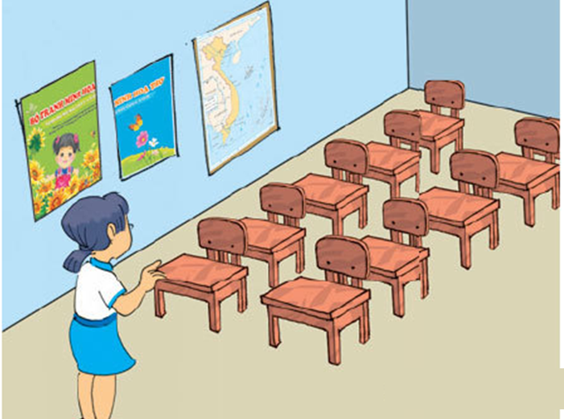
Are there any maps in the classroom? – No, there aren’t.
Notes:
Ms Huyền Phạm - 0936.082.789 – YOUTUBE: MsPham. Facebook: Dạy và học cùng công nghệ.

Slide 16
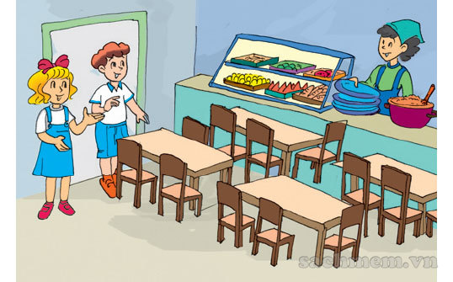
How many tables are there?
There are four tables.
Notes:
Ms Huyền Phạm - 0936.082.789 – YOUTUBE: MsPham. Facebook: Dạy và học cùng công nghệ.

Slide 17


Goob job!
Notes:
Ms Huyền Phạm - 0936.082.789 – YOUTUBE: MsPham. Facebook: Dạy và học cùng công nghệ.

Slide 18
PHONICS

Slide 19


1. Listen and repeat.
a | fan | There's a fan on the wall.
u | cup | There's a cup on the table.

Slide 20
2. Listen and write.
1. Where's the cup ?
2. Where's the fan ?
_________
_________
2

Slide 21
PRACTISE

Slide 22
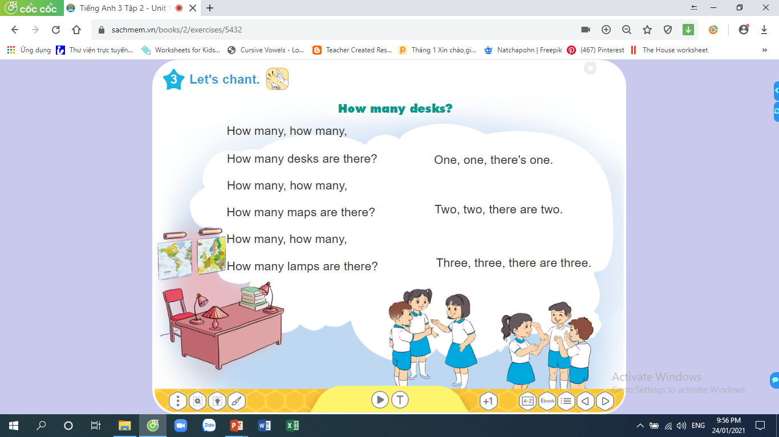
3. Let's chant.

Slide 23
4. Read and circle.
1. Is /Are there any cupboards in the living room?
2. There is / are one wardrobe in the bedroom.
3. How many lamp / lamps are there on the cupboard?
4. There are four chair / chairs next to the desk.
5. There are two posters on / in the wall.

Slide 24
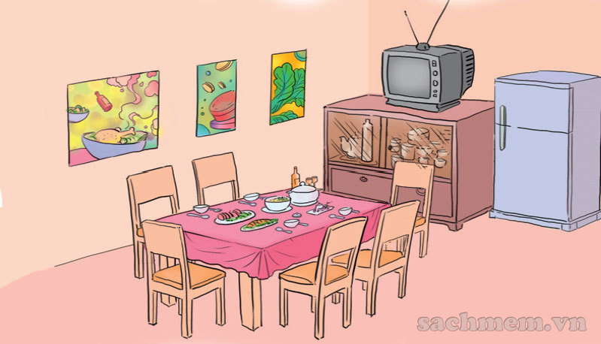
5. Read and write.
This (1) is a dining room. It is large. There is a table and there are six (2) chairs in the room. There is a (3) TV on the cupboard. There are three (4) pictures on the wall.
_____
_______
____
______

Slide 25
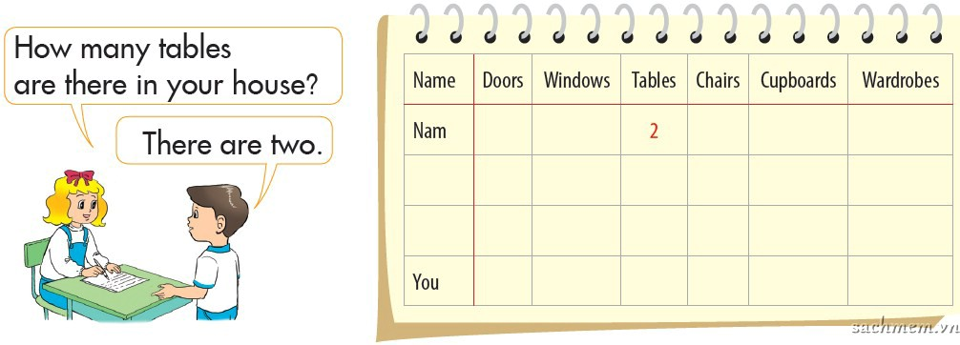
6. Project
Interview your friends and complete the table.

Slide 26

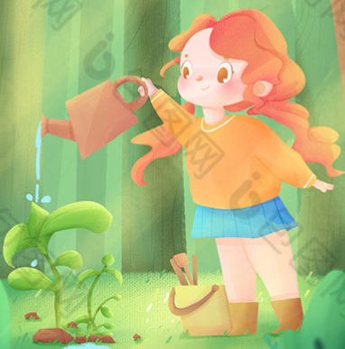
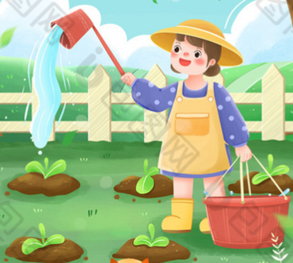
1.
Review the new phonics “a” and “u” .
2.
Do the homework in WB (SBT)
3.
Prepare the new lesson : Unit 14 Lesson 1

Slide 27

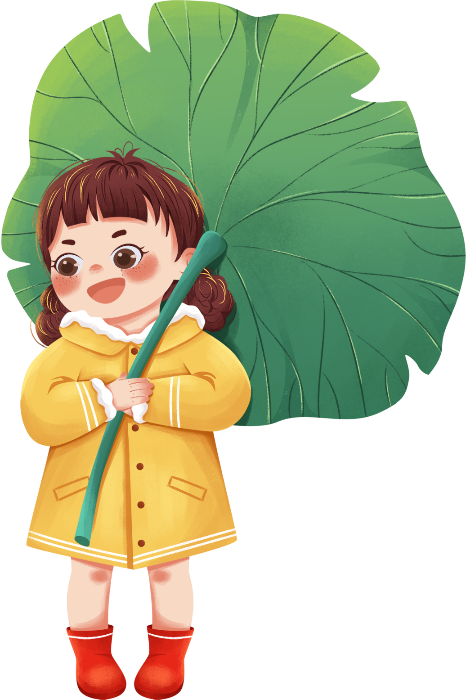
Thursday, February 24 2022
Unit 14: Are there any posters in the room?
Lesson 2
1. Phonics
- Phonic “a” : fan -> There’s a fan on the wall.
- Phonic “u” : cup -> There’s a cup on the table.
2. Homework
- WB (SBT) : Unit 14
- Prepare : Unit 15 - Lesson 1
th

Slide 28

