Slide 1






Welcome
to our Class!
Book: English 3
Teacher: Miss Linh

Slide 2







Unit 14:
Are there any posters in the room?
Lesson 2

Slide 3
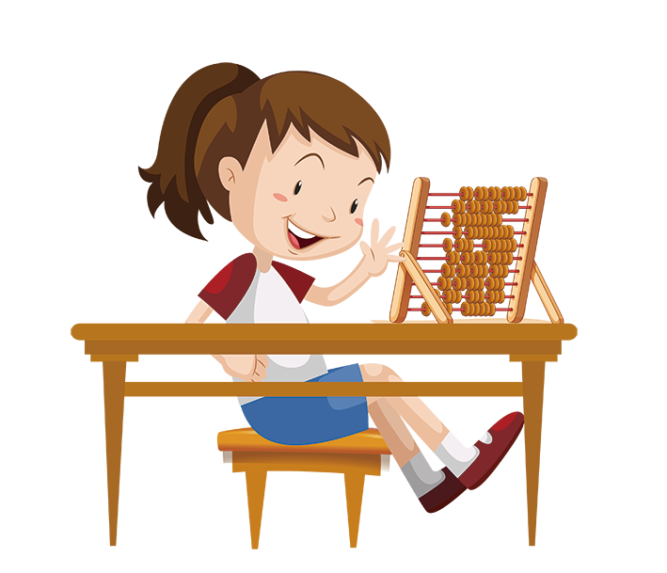
Objectives
Learn the singular and plural noun .
Review the words and sentences.

Slide 4
VOCABULARY

Slide 5


cup
/kʌp/

Slide 6

mirror
/ˈmɪrər/

Slide 7
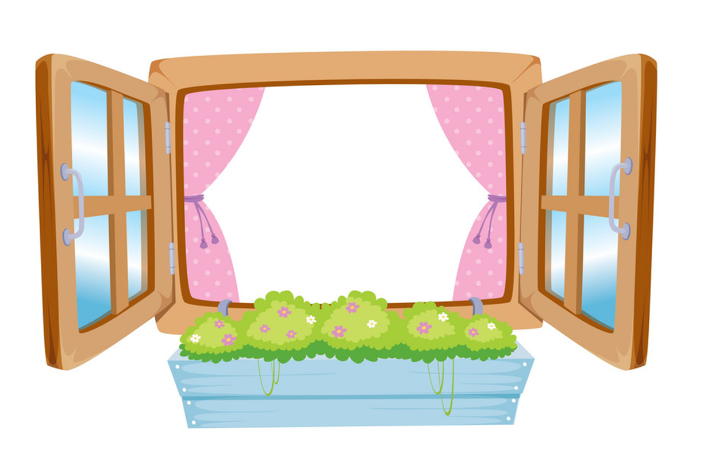
window
/ˈwɪndəʊ/

Slide 8
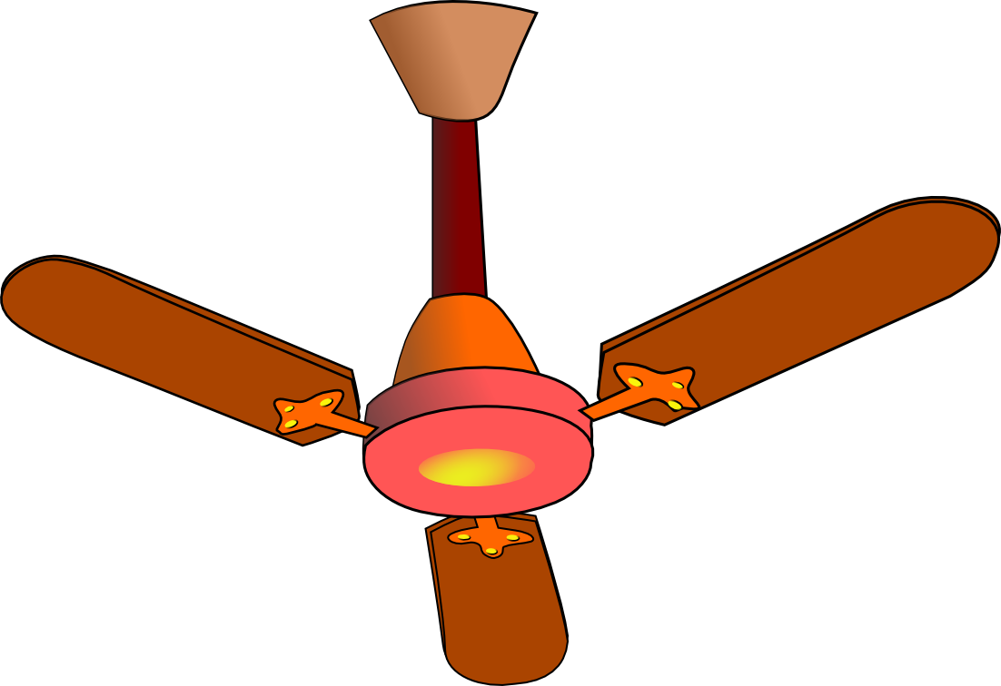
fan
/fæn/

Slide 9


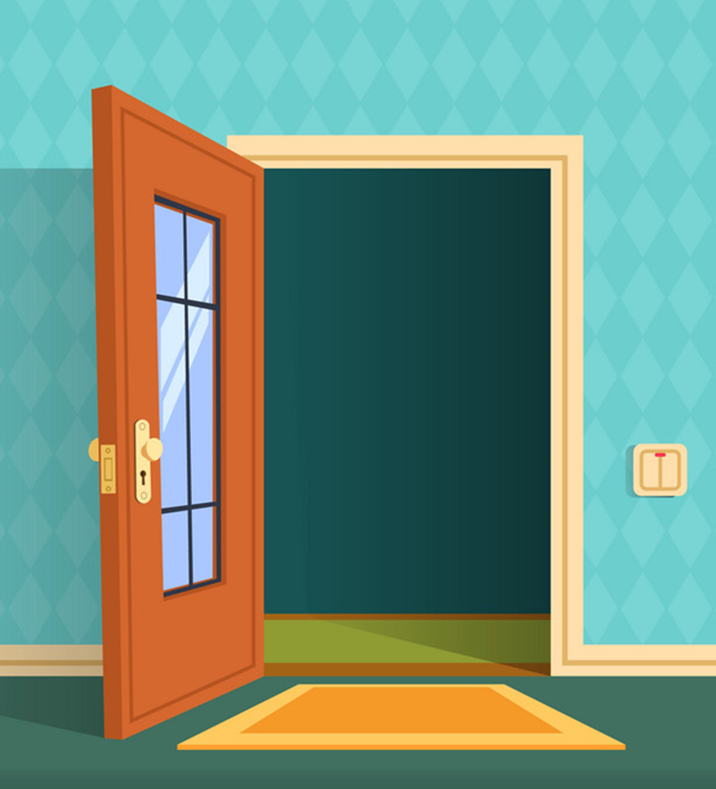
door
/dɔːr/

Slide 10

lamp
/læmp/

Slide 11
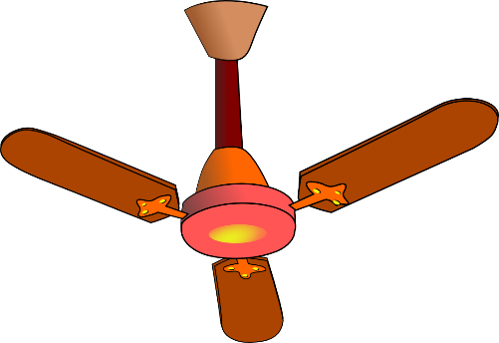
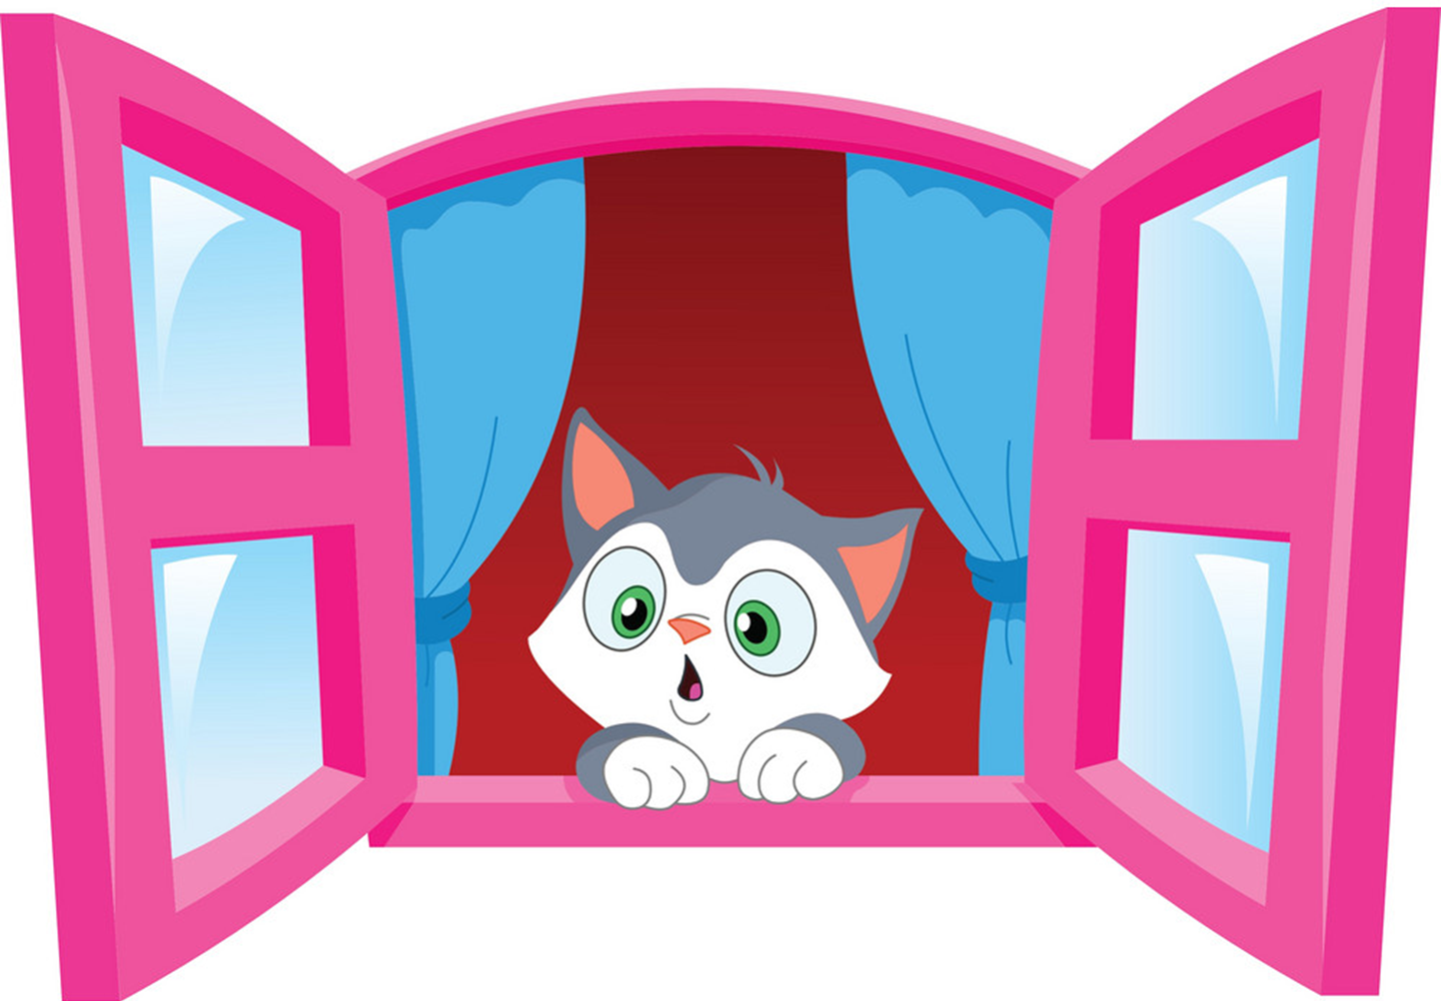
a mirror
a fan
a cup
a window
a door
a lamp

Slide 12


mirrors
fans
cups
windows
doors
lamps

Slide 13
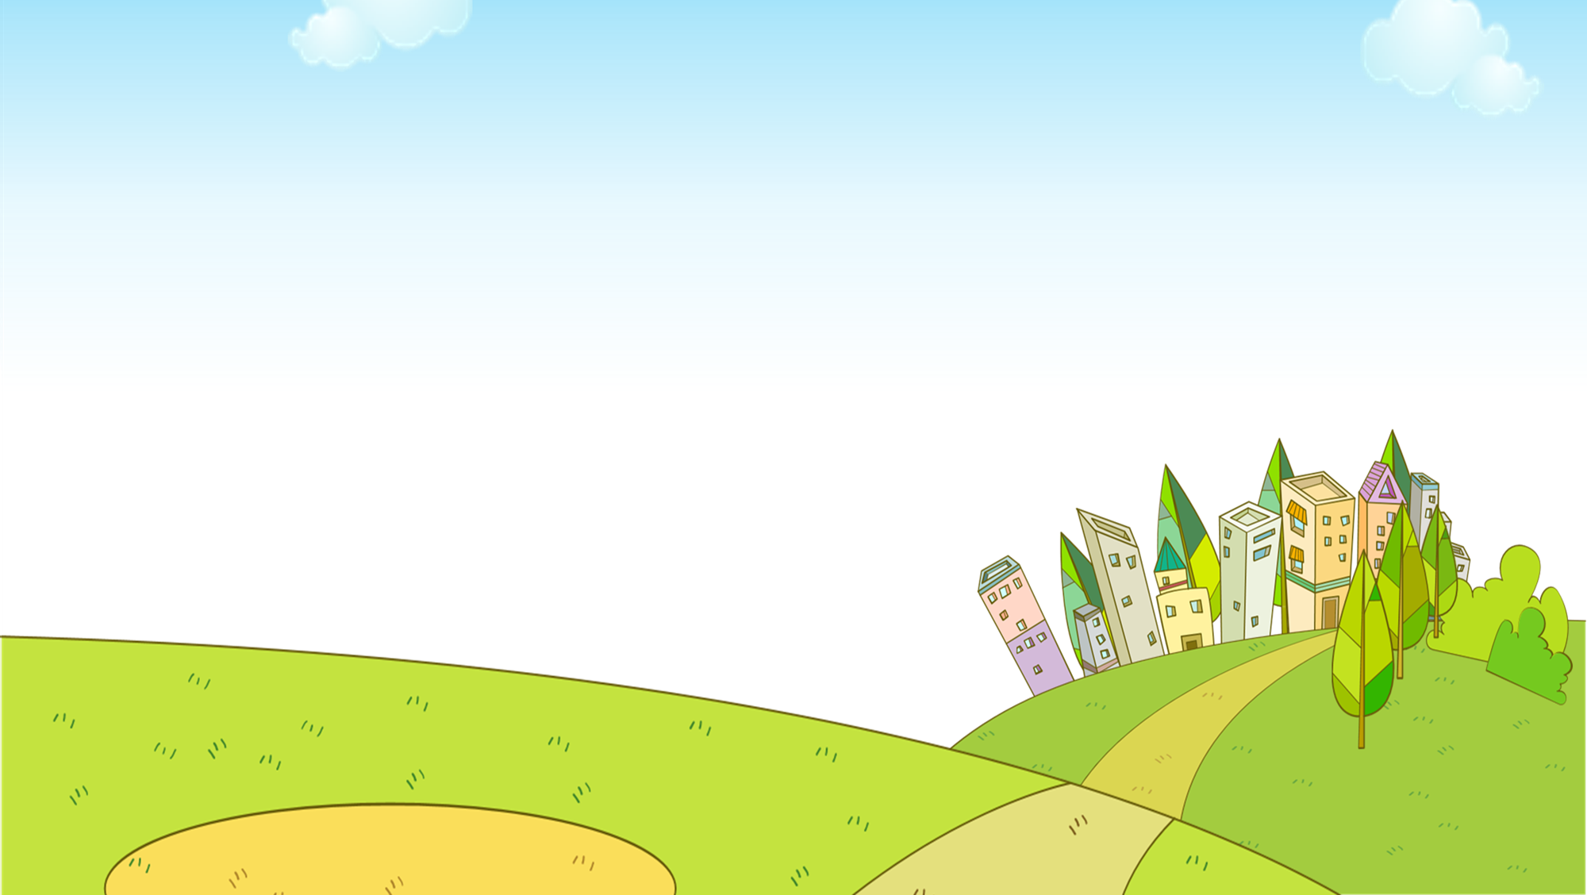


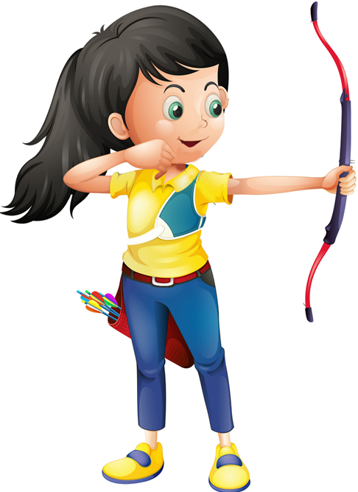




Ms Huyền Phạm
0936.082.789
Notes:
Ms Huyền Phạm - 0936.082.789 – YOUTUBE: MsPham. Facebook: Dạy và học cùng công nghệ.

Slide 14

lamp
mirror
Ms Huyền Phạm
0936.082.789
Notes:
Ms Huyền Phạm - 0936.082.789 – YOUTUBE: MsPham. Facebook: Dạy và học cùng công nghệ.

Slide 15
window
door
Ms Huyền Phạm
0936.082.789
Notes:
Ms Huyền Phạm - 0936.082.789 – YOUTUBE: MsPham. Facebook: Dạy và học cùng công nghệ.

Slide 16
lamp
door
Ms Huyền Phạm
0936.082.789
Notes:
Ms Huyền Phạm - 0936.082.789 – YOUTUBE: MsPham. Facebook: Dạy và học cùng công nghệ.

Slide 17
window
cup
Ms Huyền Phạm
0936.082.789
Notes:
Ms Huyền Phạm - 0936.082.789 – YOUTUBE: MsPham. Facebook: Dạy và học cùng công nghệ.

Slide 18

fan
cup
Ms Huyền Phạm
0936.082.789
Notes:
Ms Huyền Phạm - 0936.082.789 – YOUTUBE: MsPham. Facebook: Dạy và học cùng công nghệ.

Slide 19
lamps
mirrors
Ms Huyền Phạm
0936.082.789
Notes:
Ms Huyền Phạm - 0936.082.789 – YOUTUBE: MsPham. Facebook: Dạy và học cùng công nghệ.

Slide 20
a cup
cups
Ms Huyền Phạm
0936.082.789
Notes:
Ms Huyền Phạm - 0936.082.789 – YOUTUBE: MsPham. Facebook: Dạy và học cùng công nghệ.

Slide 21
door
doors
Ms Huyền Phạm
0936.082.789
Notes:
Ms Huyền Phạm - 0936.082.789 – YOUTUBE: MsPham. Facebook: Dạy và học cùng công nghệ.

Slide 22
mirror
mirrors
Ms Huyền Phạm
0936.082.789
Notes:
Ms Huyền Phạm - 0936.082.789 – YOUTUBE: MsPham. Facebook: Dạy và học cùng công nghệ.

Slide 23
doors
windows
Ms Huyền Phạm
0936.082.789
Notes:
Ms Huyền Phạm - 0936.082.789 – YOUTUBE: MsPham. Facebook: Dạy và học cùng công nghệ.

Slide 24
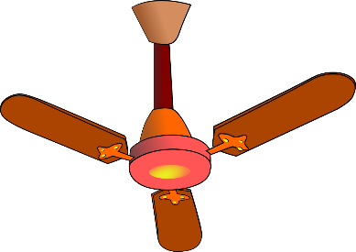
fans
cups
Ms Huyền Phạm
0936.082.789
Notes:
Ms Huyền Phạm - 0936.082.789 – YOUTUBE: MsPham. Facebook: Dạy và học cùng công nghệ.

Slide 25
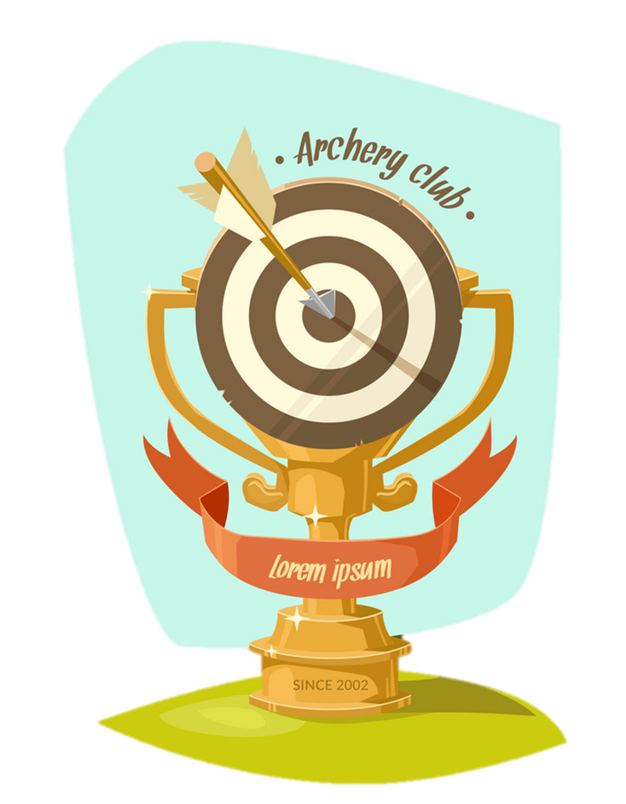
Good job!
Ms Huyền Phạm
0936.082.789
Notes:
Ms Huyền Phạm - 0936.082.789 – YOUTUBE: MsPham. Facebook: Dạy và học cùng công nghệ.

Slide 26
GRAMMAR

Slide 27

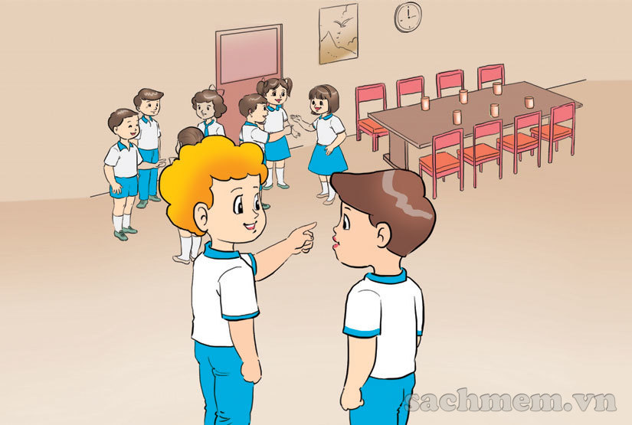
1. Look, listen and repeat.
How many chairs are there?
Let's count them. One, two, three,....
There are eight.

Slide 28
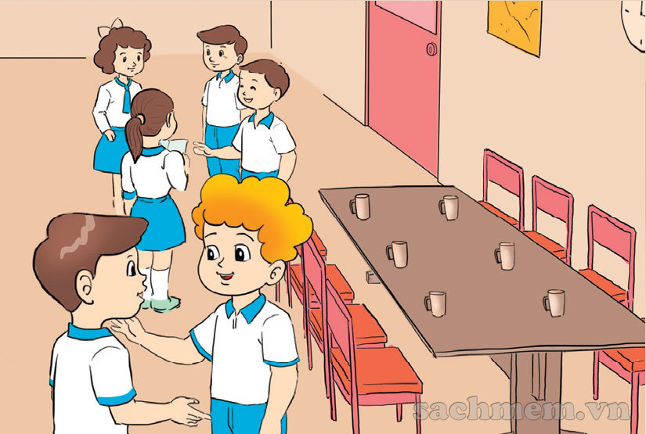
1. Look, listen and repeat.
And how many cups
are there?
There are six.

Slide 29
2. Point and say.
How many mirrors are there?
_____________
There are three.
/There are three mirrors.
_________

Slide 30

2. Point and say.
How many fans are there?
__________
There are two .
/There are two fans.
_________

Slide 31
2. Point and say.
How many cups are there?
___________
There are four .
/There are four cups.
_________

Slide 32
2. Point and say.
How many windows are there?
_____________
There are six .
/There are six windows.
_______

Slide 33
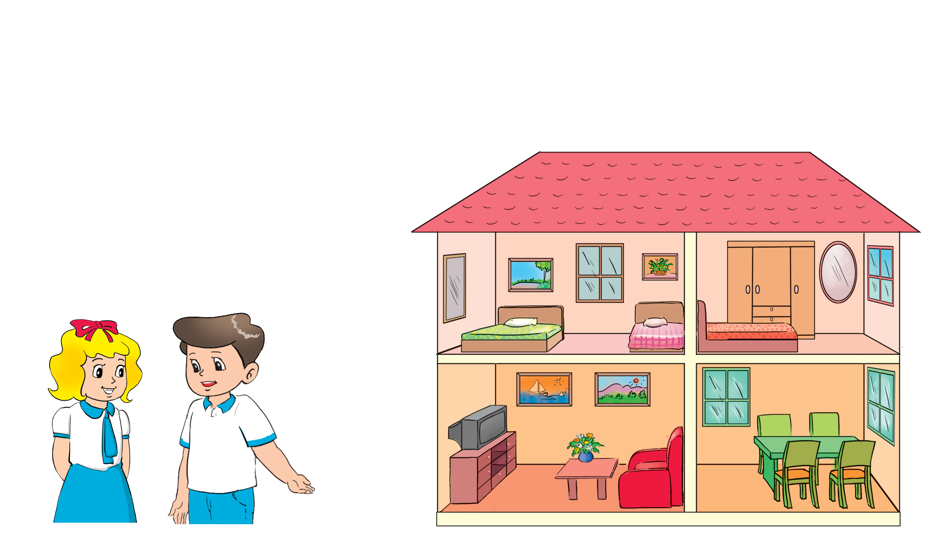
3. Let's talk.
How many ___________are there?
There are ___________

Slide 34




Slide 35
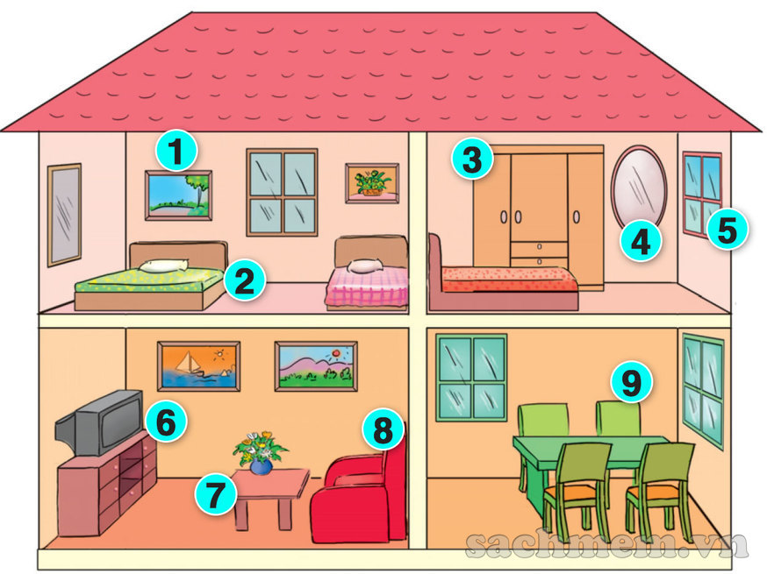
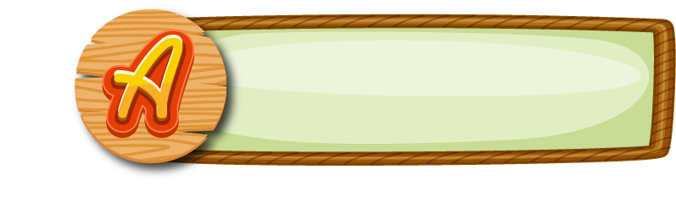




How many pictures are there?
There are four.
There are five.
There are six.

Slide 36
How many beds are there?
There are two.
There are three.
There are four.

Slide 37
How many wardrobes are there?
There are ten.
There are five.
There is one.

Slide 38
How many mirrors are there?
There is one.
There are two.
There are three.

Slide 39
How many windows are there?
There are three.
There are five.
There are four.

Slide 40
How many cupboards are there?
There is one.
There is a.
There are two.

Slide 41
How many tables are there?
There are one.
There are two.
There are three.

Slide 42
How many sofas are there?
There is a sofas.
There is an sofa.
There is a sofa.

Slide 43
How many chairs are there?
There are five.
There are four.
There are three.

Slide 44
End!

Slide 45

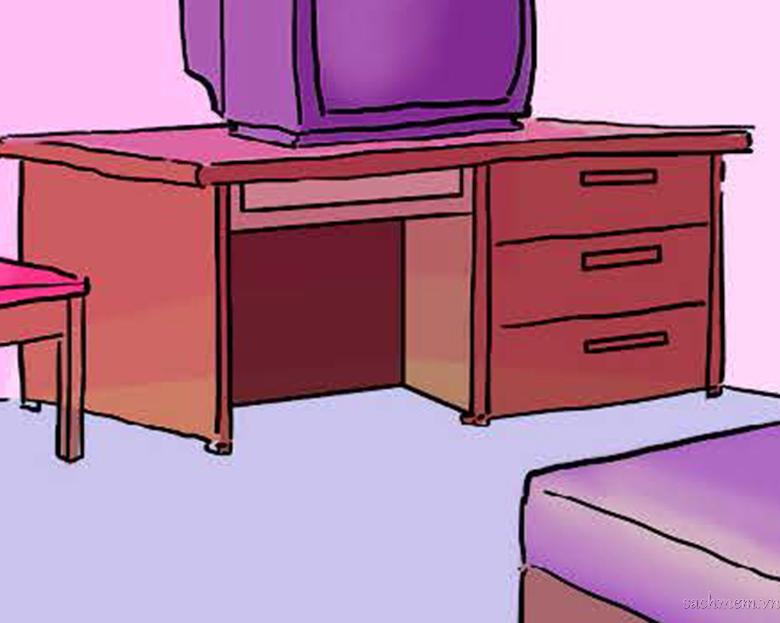
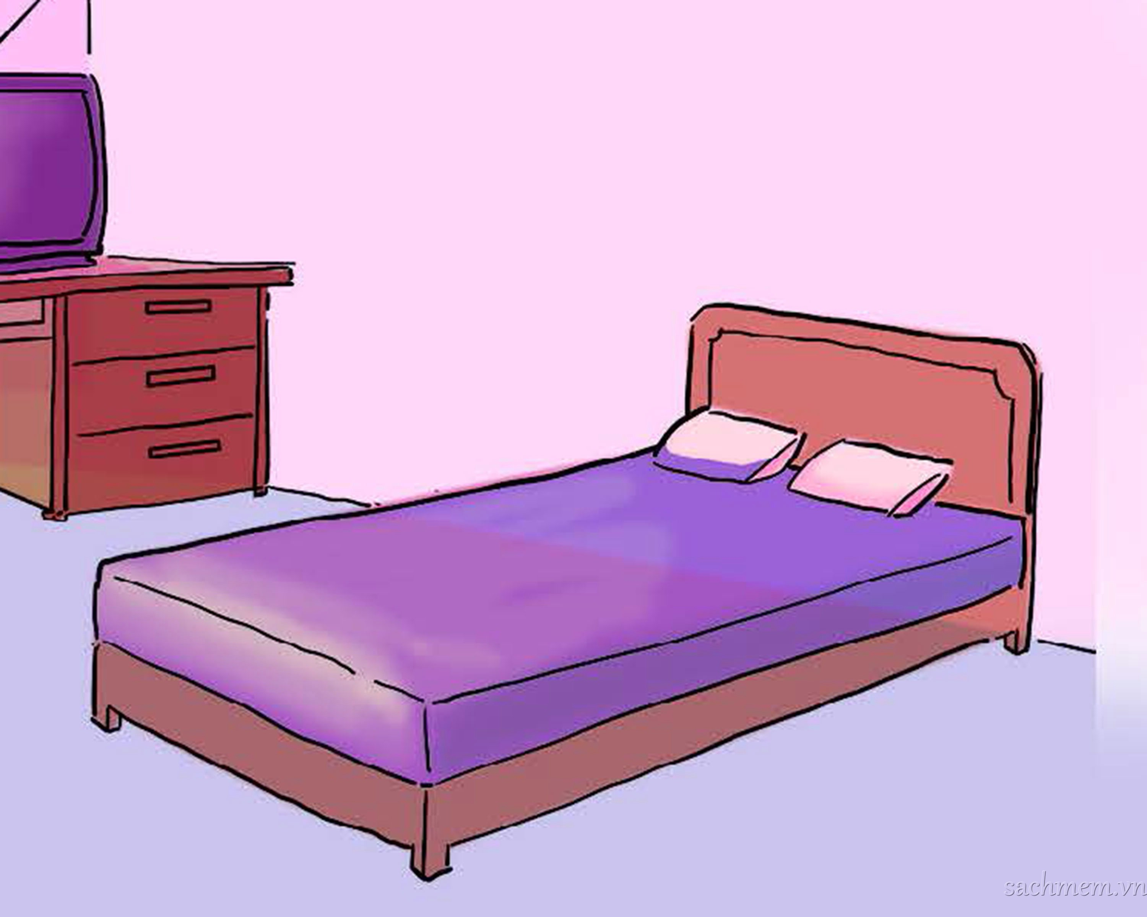
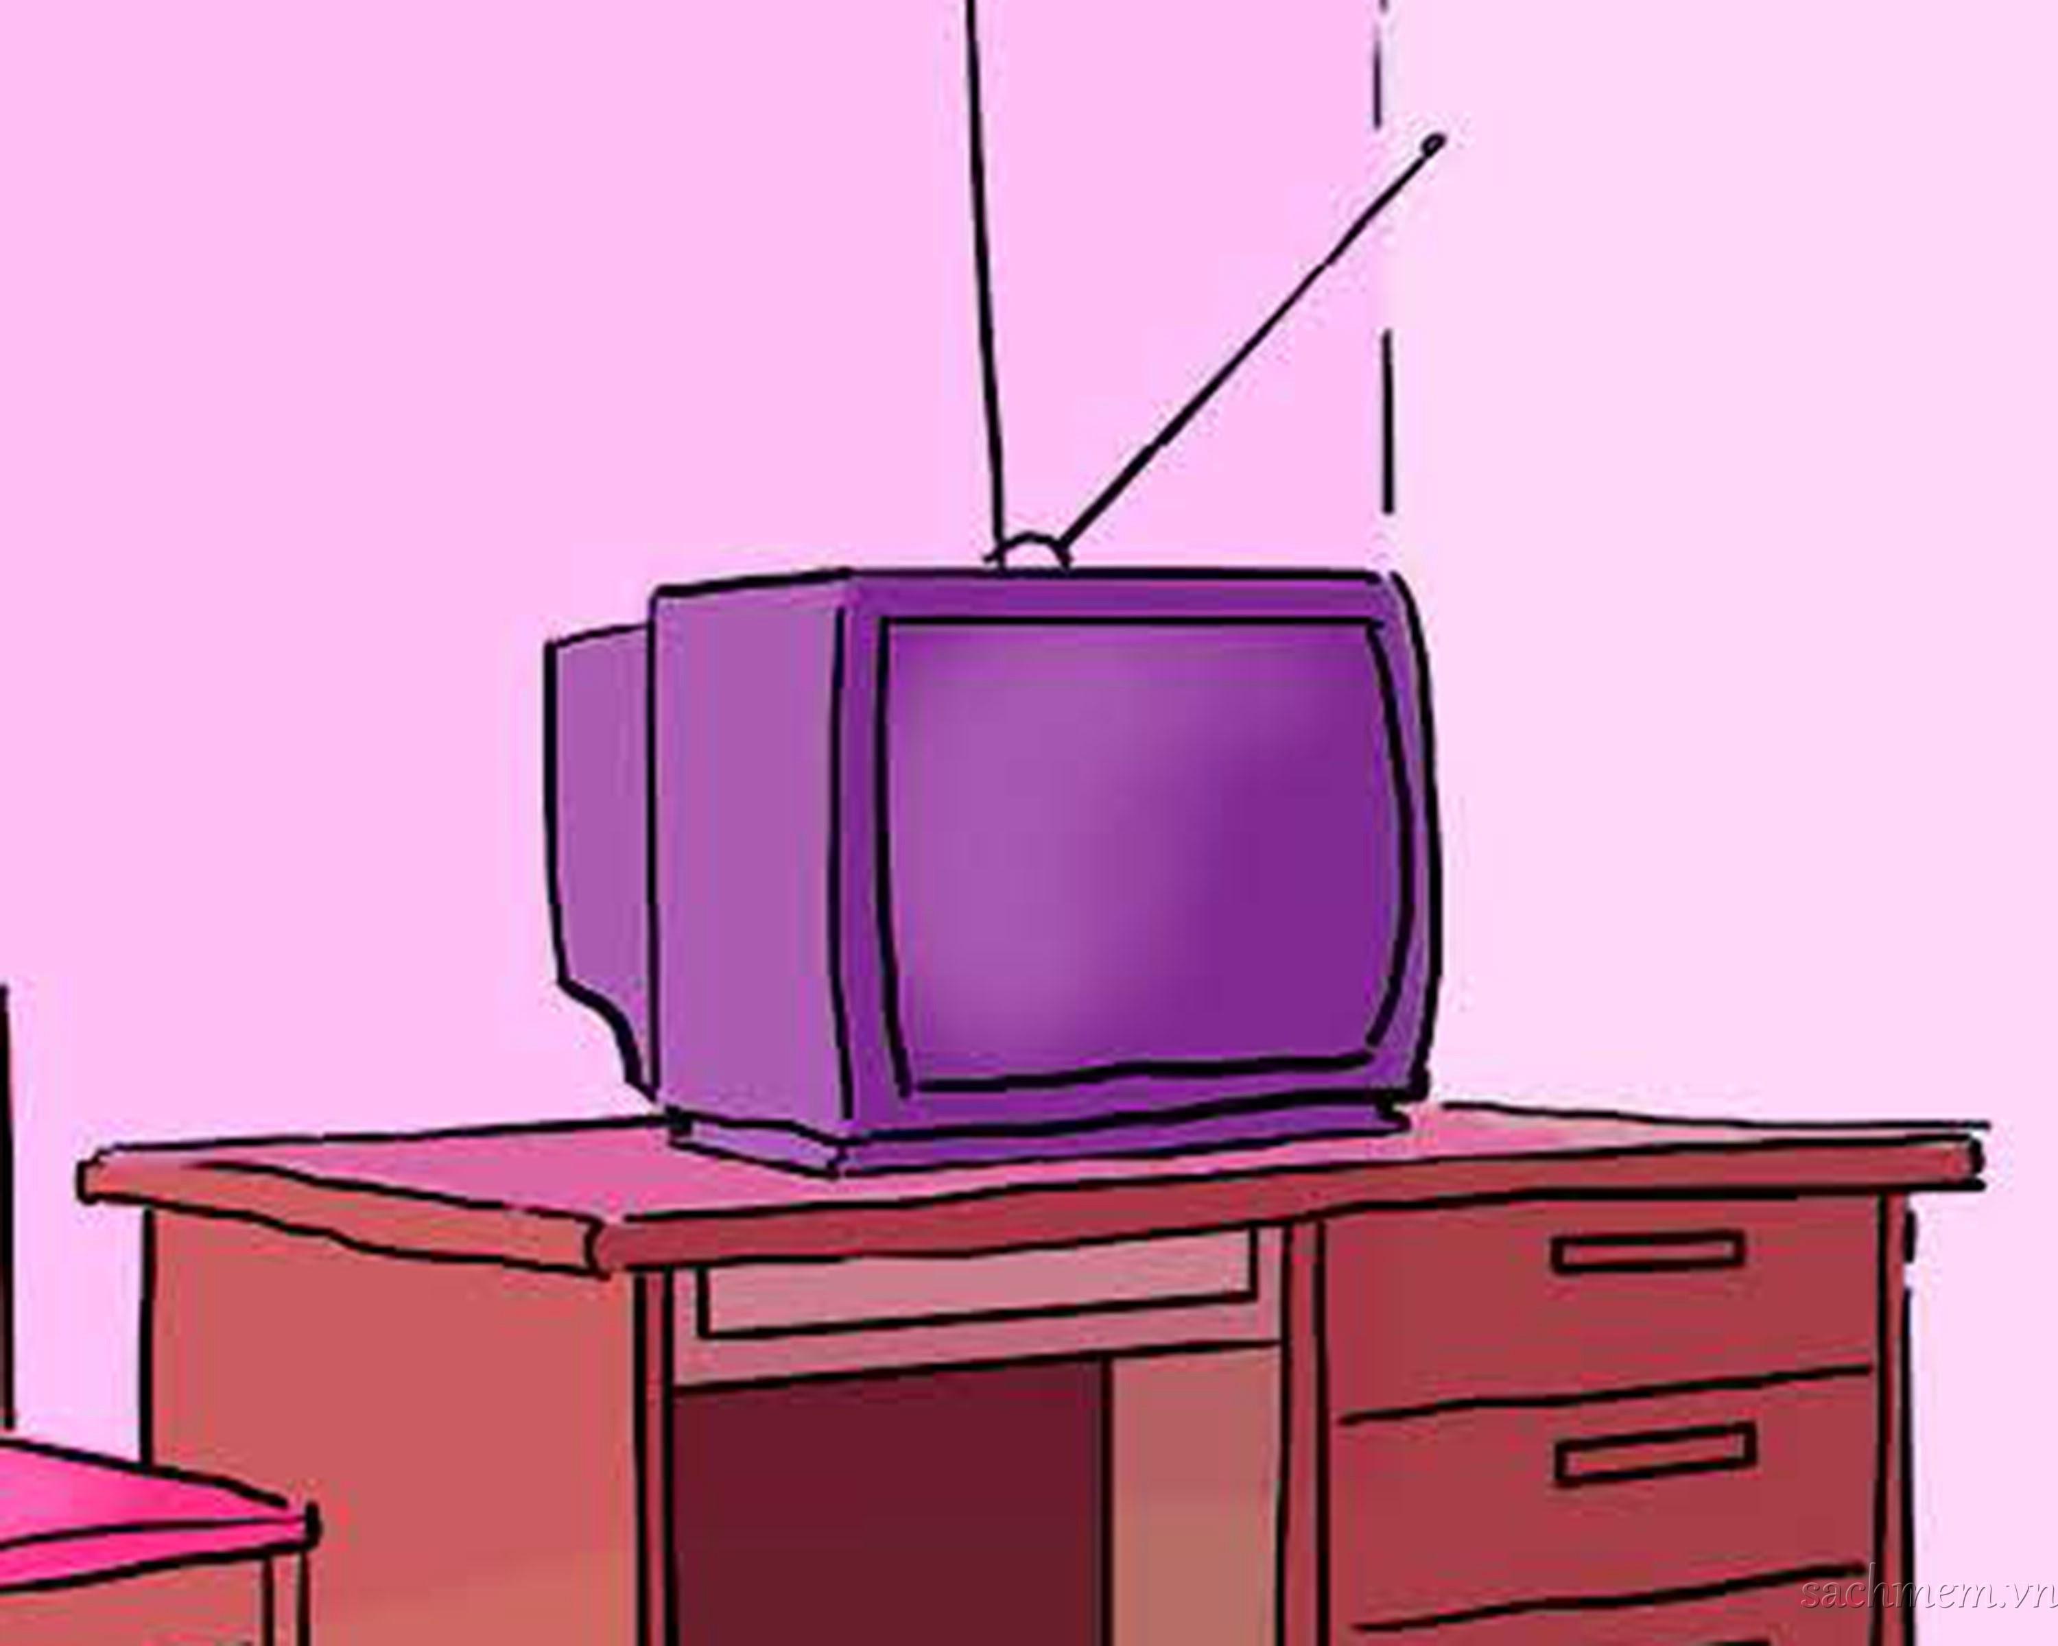
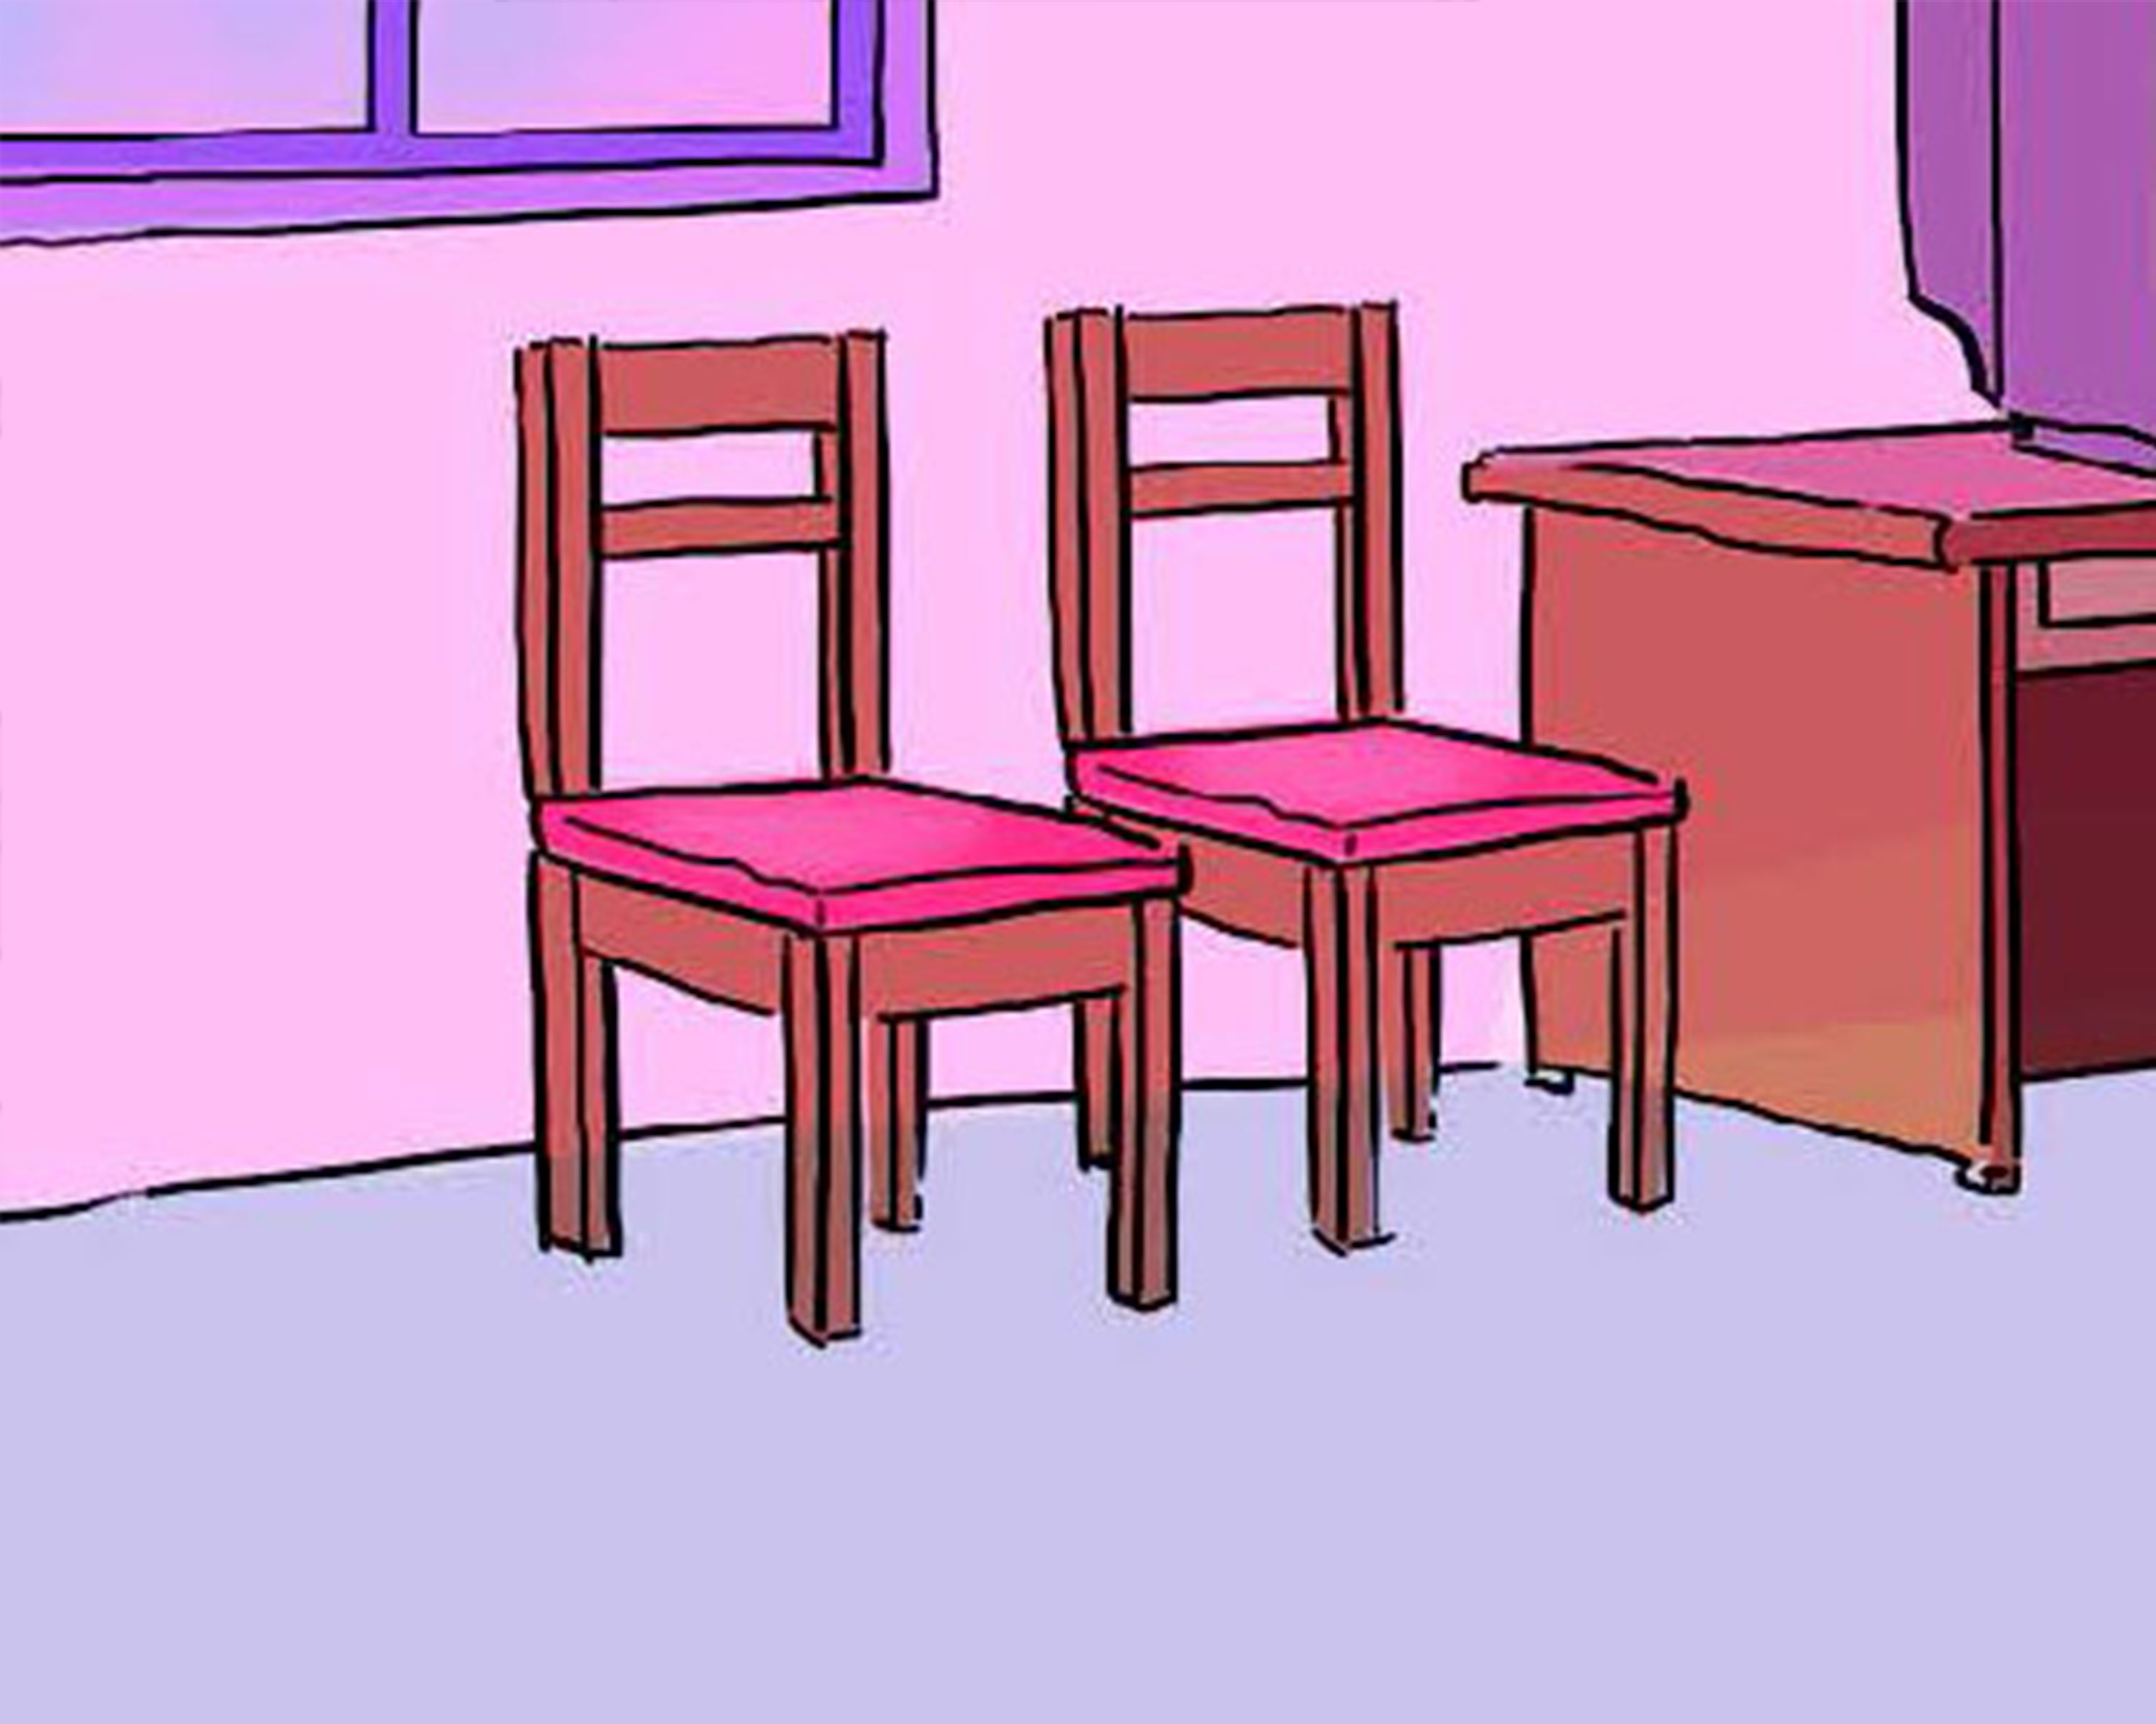
4. Listen and number.
a
b
c
d
2
1
4
3

Slide 46
5. Read and write.
This is my living room. There are many things in the room. There are two windows and one door. There are eight chairs, a desk and a sofa. There is a lamp on the desk and a TV on the cupboard. There are four pictures and two fans on the wall.
1. How many doors are there in the living room?
There is one door.
2. How many windows are there?
There are two windows.
3. How many chairs are there?
There are eight chairs.
4. How many pictures are there?
There are four pictures.
5. How many fans are there?
There are two fans.

Slide 47
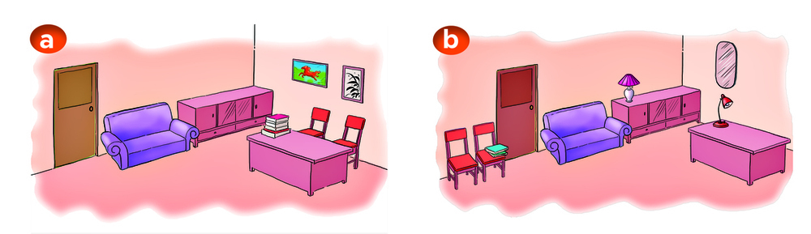
6. Let's play.
Spot the differences.

Slide 48
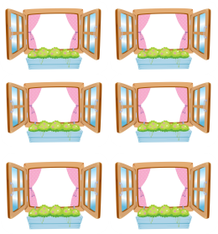
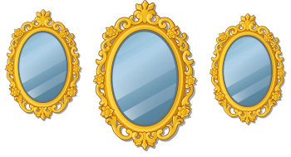
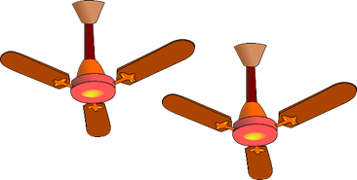
Model sentence
How many _______ are there?
There are __________.
windows
mirrors
fans
cups

Slide 49
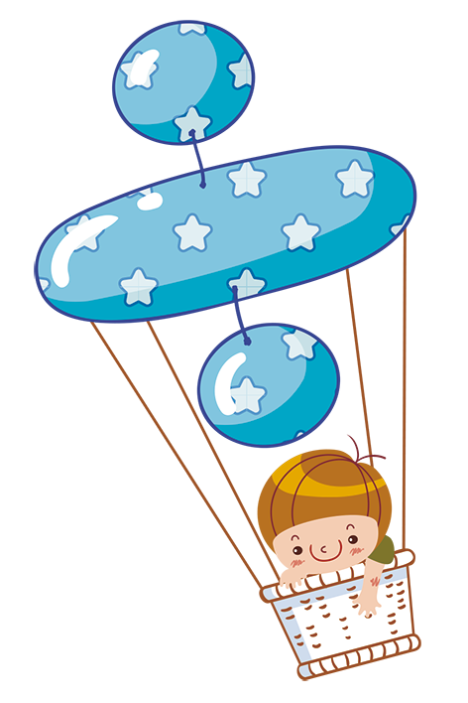

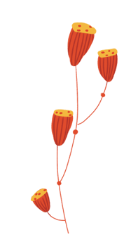


Home link
Review the sentences (singular and plural noun) .
Do the homework in WB (SBT): B (1,2,3)
Prepare the new lesson : Unit 14: Lesson 3

Slide 50

Tuesday, February 22 2022
Unit 14: Are there any posters in the room?
Lesson 2
1. New words
- cup: cái cốc
- mirror : cái gương
- window : cửa sổ
- door : cửa ra vào
- fan : cái quạt
- lamp : đèn ngủ
2. Sentences
How many ......... (things) are there in the room?
There is ........ (number) / There are ........ (number)
nd

Slide 51



THANK YOU

