Slide 1



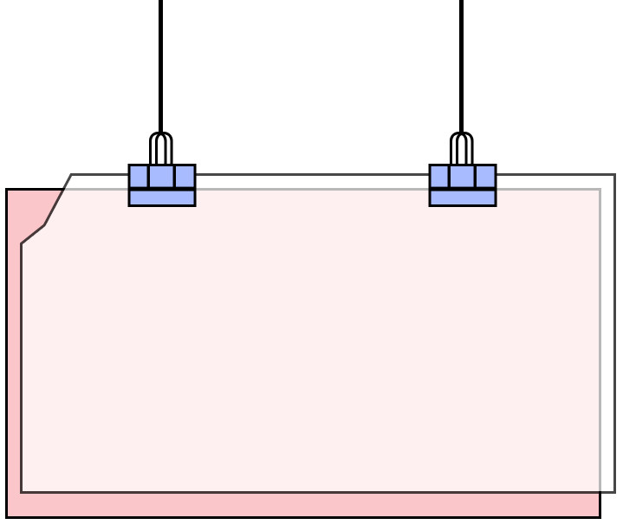


Welcome
to our Class!
Book: English 3
Prepare: Miss Linh

Slide 2



Lesson 3
Unit 13:
Where’s my book?

Slide 3
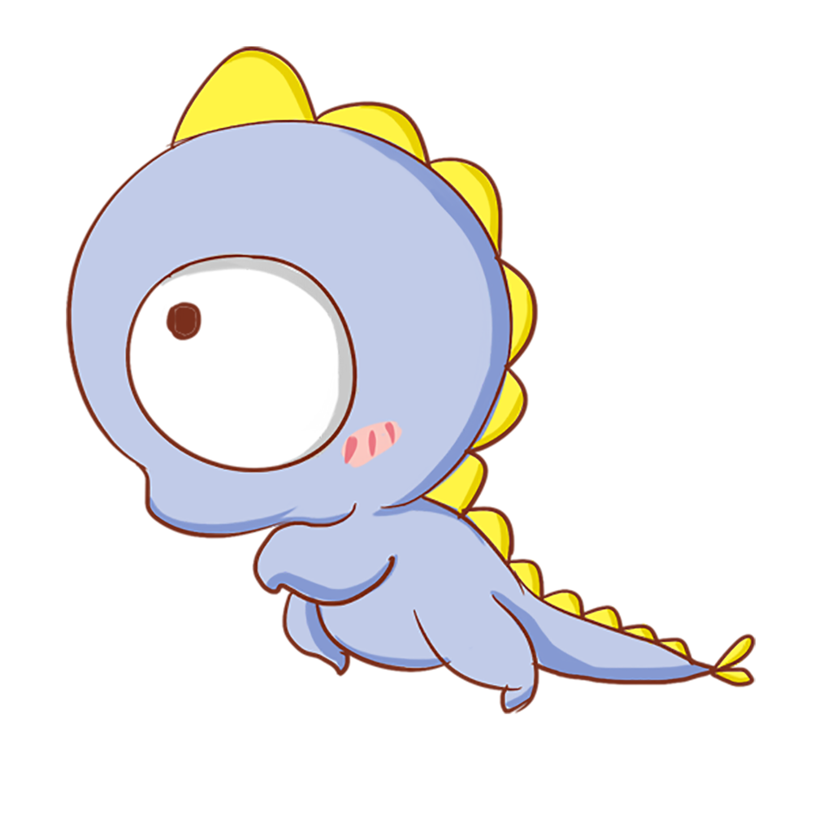
Objectives
01
02
Learn the phonics “ch” and “wh ” .
Review the words and sentences.

Slide 4

Warm up

Slide 5





PRERENT WHEEL
10
50
30
30
20
Good job!
SPIN/STOP
SPIN/STOP
SPIN/STOP
SPIN/STOP
SPIN/STOP
SPIN/STOP
SPIN/STOP
SPIN/STOP
SPIN/STOP
SPIN/STOP
SPIN/STOP
SPIN/STOP
SPIN/STOP
SPIN/STOP
SPIN/STOP
40
SPIN/STOP
60
60
40
20
30
10
50
Notes:
Ms Huyền Phạm - 0936.082.789 – YOUTUBE: MsPham. Facebook: Dạy và học cùng công nghệ.

Slide 6

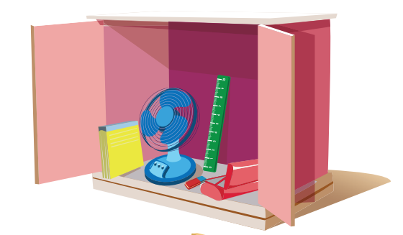

Where is the ruler?
It’s in the cupboard.
It’s on the cupboard.
Notes:
Ms Huyền Phạm - 0936.082.789 – YOUTUBE: MsPham. Facebook: Dạy và học cùng công nghệ.

Slide 7
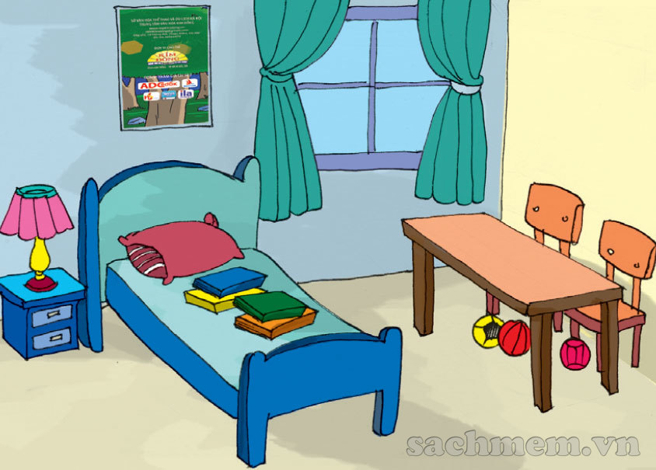
Where is the lamp?
It’s in the cupboard.
It’s on the cupboard.
Notes:
Ms Huyền Phạm - 0936.082.789 – YOUTUBE: MsPham. Facebook: Dạy và học cùng công nghệ.

Slide 8
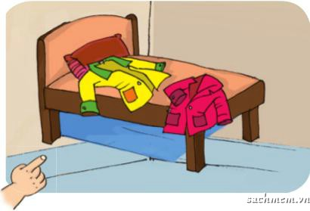
True
Where is the coats?
False
Notes:
Ms Huyền Phạm - 0936.082.789 – YOUTUBE: MsPham. Facebook: Dạy và học cùng công nghệ.

Slide 9

Where is the pencil?
It’s ___________.
on the pencil case.
in the pencil case.
Notes:
Ms Huyền Phạm - 0936.082.789 – YOUTUBE: MsPham. Facebook: Dạy và học cùng công nghệ.

Slide 10
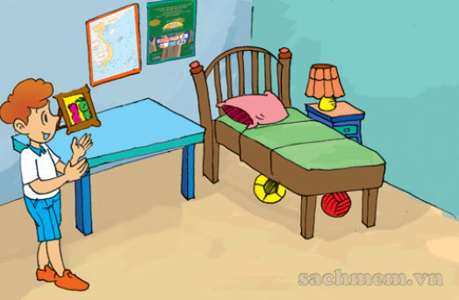
Where is the map?
______________
It’s on the wall.
Where are the map?
Where are the maps?
Notes:
Ms Huyền Phạm - 0936.082.789 – YOUTUBE: MsPham. Facebook: Dạy và học cùng công nghệ.

Slide 11
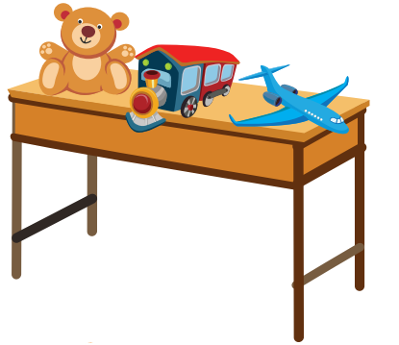
They’re in the desk.
Where is the toys?
They’re on the desk.
It’s in the desk.
Notes:
Ms Huyền Phạm - 0936.082.789 – YOUTUBE: MsPham. Facebook: Dạy và học cùng công nghệ.

Slide 12
What can you see?
______________
It’s in the cupboard.
What is this?
Where is the rubber?
Notes:
Ms Huyền Phạm - 0936.082.789 – YOUTUBE: MsPham. Facebook: Dạy và học cùng công nghệ.

Slide 13
What are the books?
They’re on the bed.
Who are the books?
Where are the books?
Notes:
Ms Huyền Phạm - 0936.082.789 – YOUTUBE: MsPham. Facebook: Dạy và học cùng công nghệ.

Slide 14

Where are the pictures?
______________
It’s on the wall.
What is the picture?
Where is the picture?
Notes:
Ms Huyền Phạm - 0936.082.789 – YOUTUBE: MsPham. Facebook: Dạy và học cùng công nghệ.

Slide 15
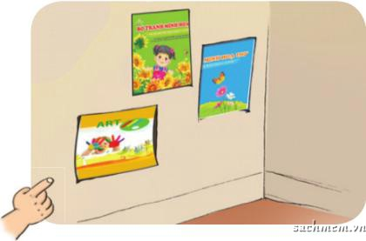
In the wall.
Where are the poster?
They’re __________.
On the wall.
under the wall.
Notes:
Ms Huyền Phạm - 0936.082.789 – YOUTUBE: MsPham. Facebook: Dạy và học cùng công nghệ.

Slide 16
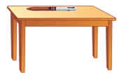
Answer
Where is the pen ?
It’s on the table.
Notes:
Ms Huyền Phạm - 0936.082.789 – YOUTUBE: MsPham. Facebook: Dạy và học cùng công nghệ.

Slide 17
They’re under the bed.
Where are the chair?
They’re near the lamp.
They’re near the table.
They’re near the books.
Notes:
Ms Huyền Phạm - 0936.082.789 – YOUTUBE: MsPham. Facebook: Dạy và học cùng công nghệ.

Slide 18

a book
Where are the _____?
books
a books
book
Notes:
Ms Huyền Phạm - 0936.082.789 – YOUTUBE: MsPham. Facebook: Dạy và học cùng công nghệ.

Slide 19
They’re under the cupboard.
Where are the balls?
They’re under the bed.
They’re under the window.
They’re under the table.
Notes:
Ms Huyền Phạm - 0936.082.789 – YOUTUBE: MsPham. Facebook: Dạy và học cùng công nghệ.

Slide 20

It’s on the wall.
Where is the clock?
It’s in the wall.
It’s behind the wall.
It’s near the wall.
Notes:
Ms Huyền Phạm - 0936.082.789 – YOUTUBE: MsPham. Facebook: Dạy và học cùng công nghệ.

Slide 21
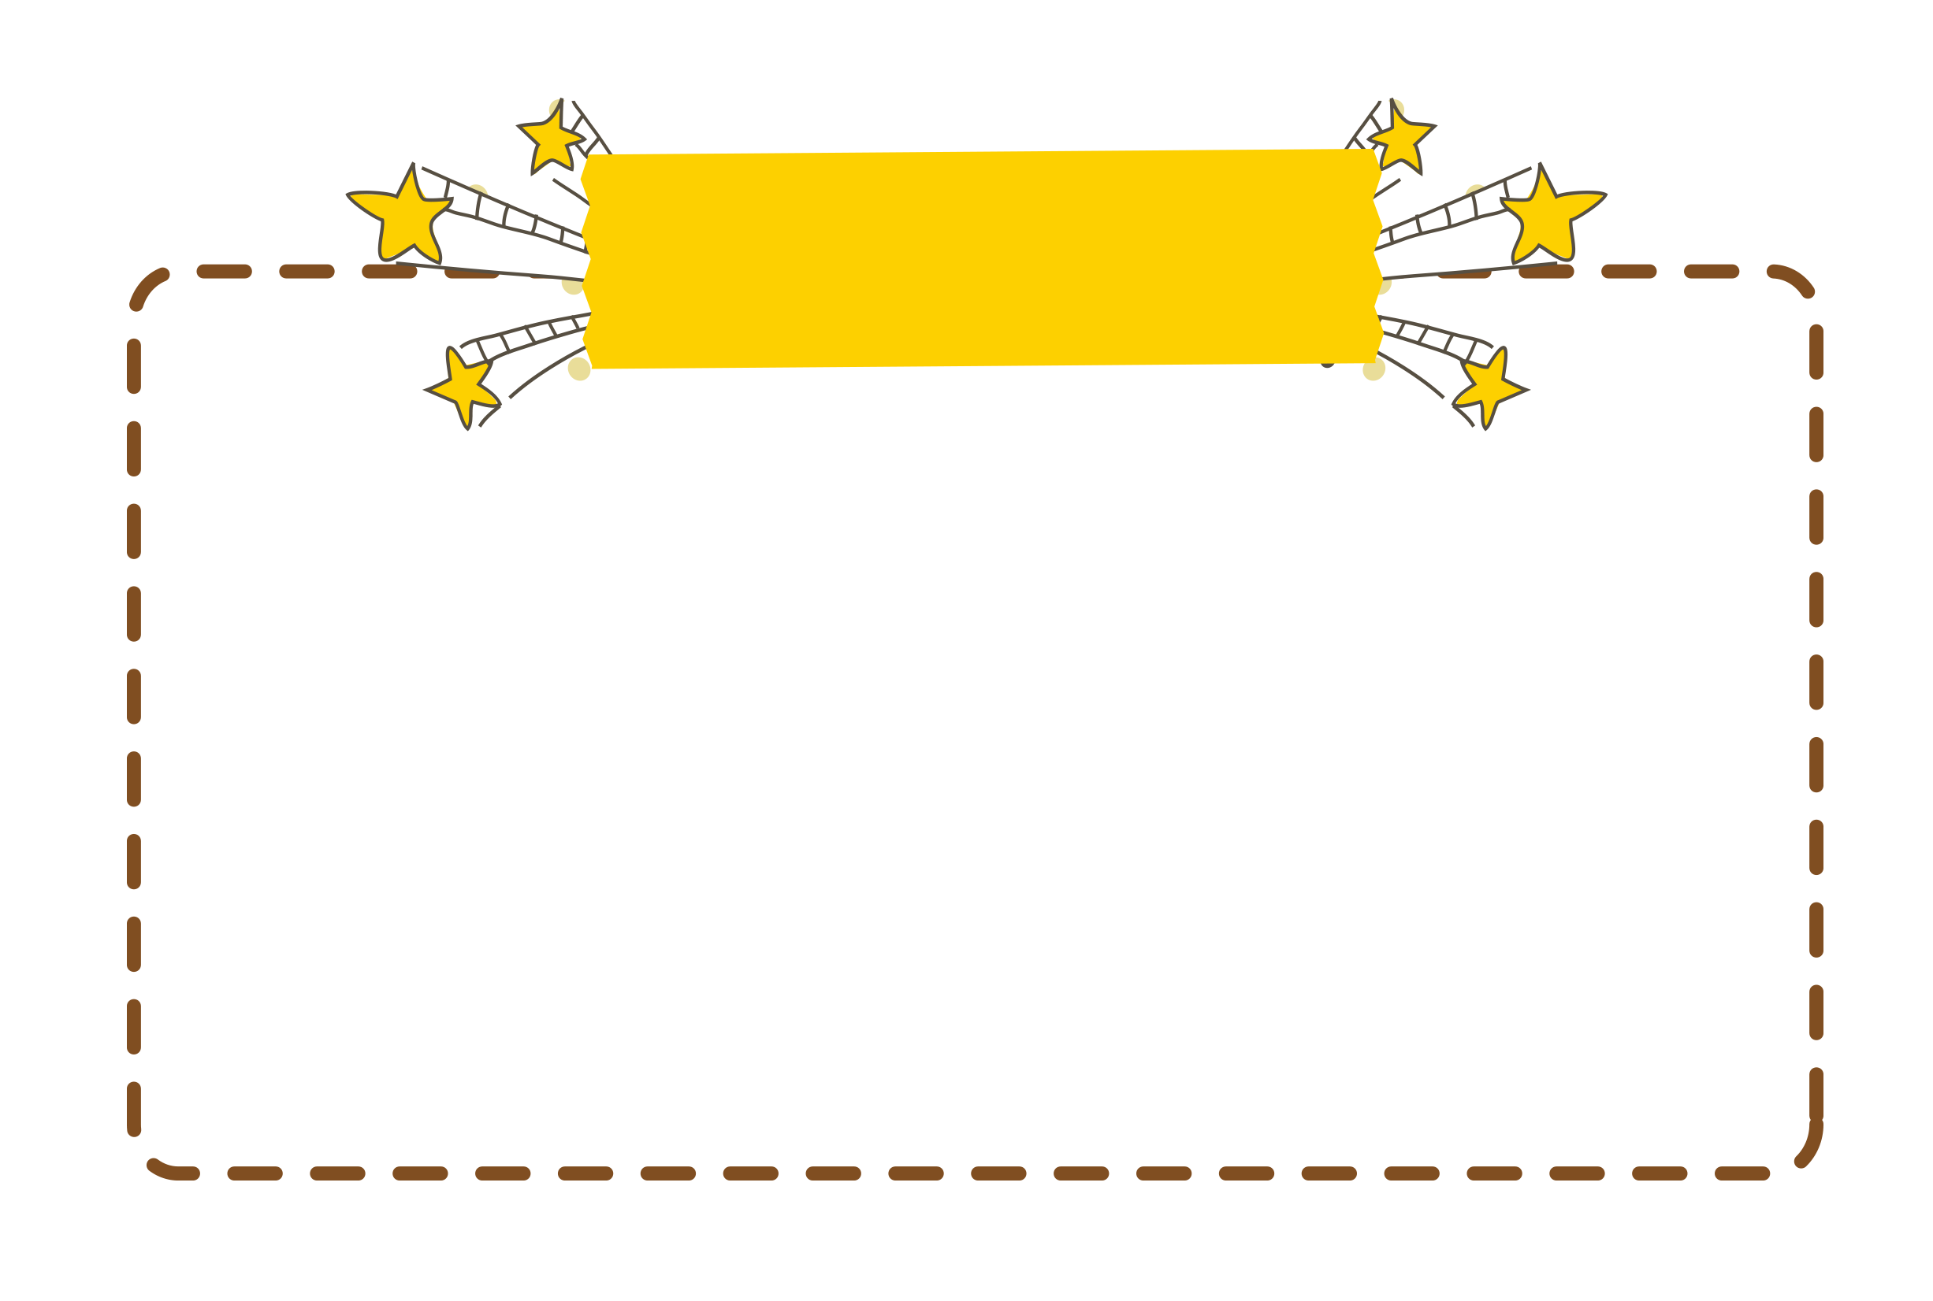

“ch” and “ wh”
Phonics

Slide 22

1. Listen and repeat.
ch | chair | It's under the chair.
wh | where | Where's the ball?

Slide 23

2. Listen and write.
1. _______ the book?
2. The book is on the ______.
Where's
chair

Slide 24

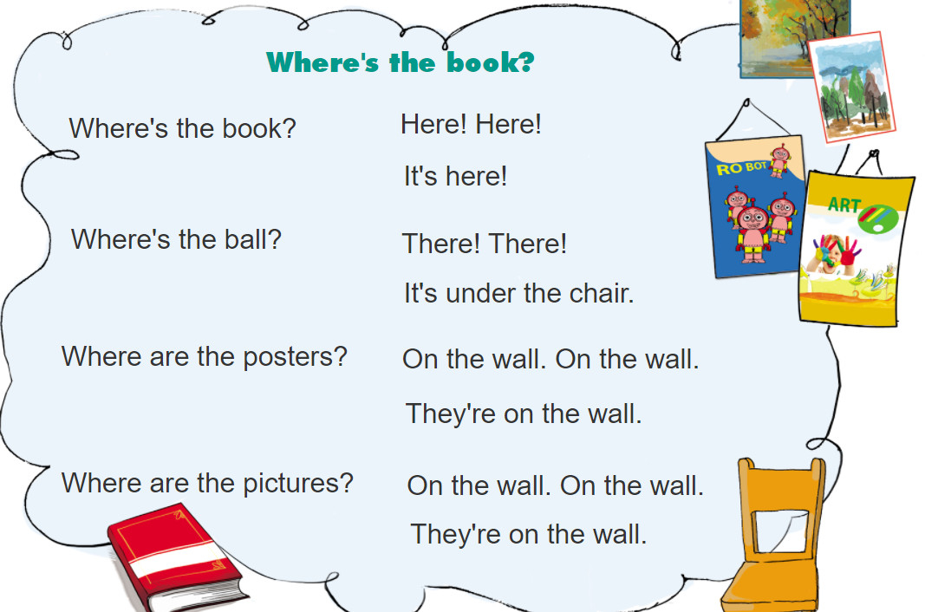
3. Let’s chant.

Slide 25
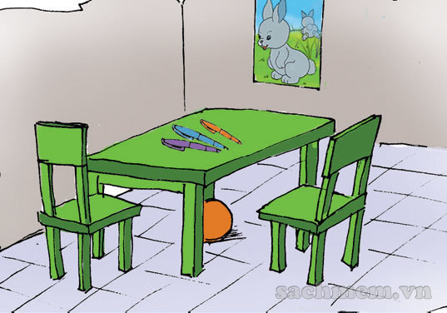
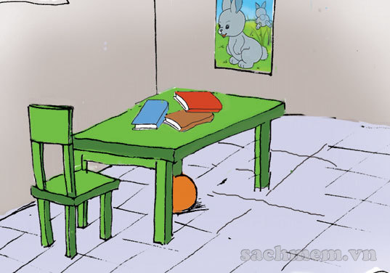
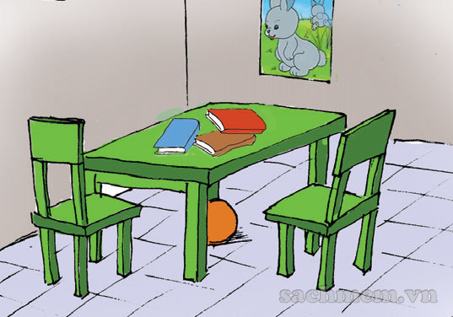

4. Read and tick.
This is my room. There is a table and there are two chairs. There is a poster on the wall. There is a ball under the table. There are three books on the table.
a
b
c

Slide 26
5. Read and write.
You: Look! This is a picture of my bedroom.
Your friend: It's nice. Tell me about the things in your room.
You: OK. Well, there's a _________ and two _________.
Your friend: What about books and posters?
You: __________.

Slide 27
Practice

Slide 28
Match
1. Where is
2. It
3. Where are
4. They
a. the coats?
b. are behind the door.
c. is on the table.
d. the book?

Slide 29
Match
1. Is this your poster?
2. Where's my coat?
3. Are these your books?
4. Where are my photos?
a. They're on the table.
b. Yes, it is.
c. It's on the bed.
d. No, they aren't.

Slide 30
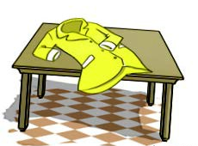
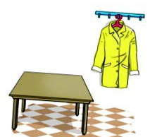
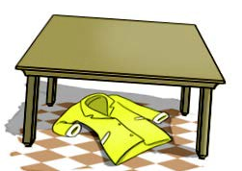
Match
1. It's under the table.
2. It's on the table.
3. It's next to the table.

Slide 31
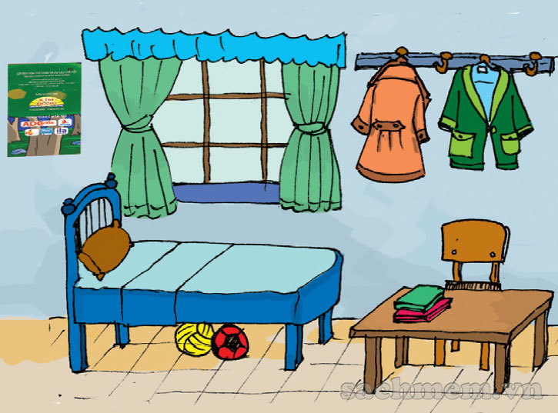
Look and answer.
1. Where are the coats?
They are on the wall.
2. Where's the chair?
It is behind the table.
3. Where's the poster?
It's on the wall.
4. Where are the books?
They're on the table.
5. Where are the balls?
They're under the bed.

Slide 32


Home link
1.
Using the new sentences in the real life .
2.
Do the homework in WB (SBT)
3.
Prepare the new lesson : Unit 14 Lesson 1

Slide 33
Tuesday, February 15 2022
Unit 13: Where’s my book? - Lesson 3
1. Phonics
- Phonic “ch” : chair -> It’s under the chair.
- Phonic “wh” : where -> Where’s the ball ?
2. Homework
- WB (SBT) : Unit 13
- Prepare : Unit 14 - Lesson 1
th

Slide 34





Thanh Am Primary School

