Slide 1



THANH AM PRIMARY SCHOOL
Welcome
to our Class!
Book: English 3
Teacher: Miss Linh

Slide 2






Lesson 2
Unit 13
Where’s my book?

Slide 3
Objectives
Mục tiêu của bài học
03
02
01
Learn the sentences
Is the school new?
Review the words and sentences.
Learn the new words about the location of things in the house.

Slide 4
Vocabulary

Slide 5


on
/ɒn/

Slide 6

under
/ˈʌndər/

Slide 7
near
/nɪr/

Slide 8
behind
/bɪˈhaɪnd/

Slide 9
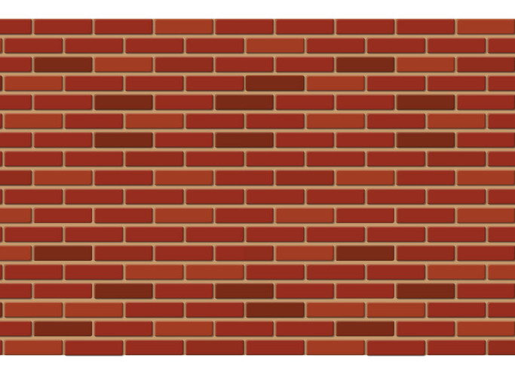

wall
/wɔːl/

Slide 10


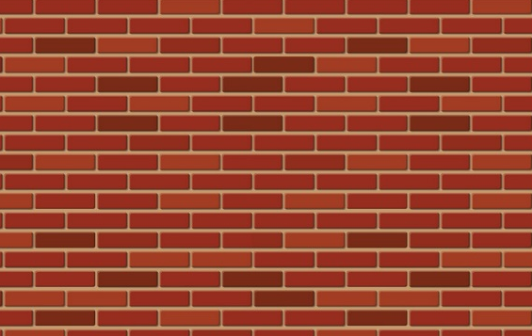
Vocabulary
in
on
under
wall
behind
near

Slide 11
Look read and circle.
in
on
under
in
under
on
behind
in
under

Slide 12
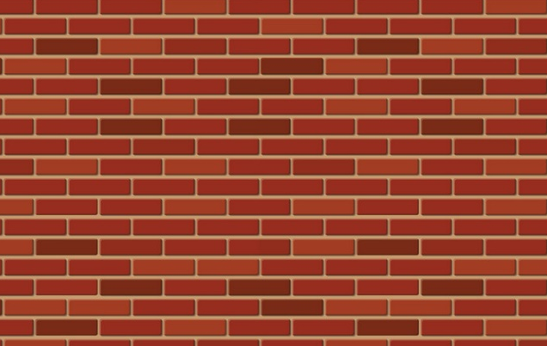
Look read and circle.
under
near
in
wall
bed
poster
behind
on
near

Slide 13
Grammar

Slide 14



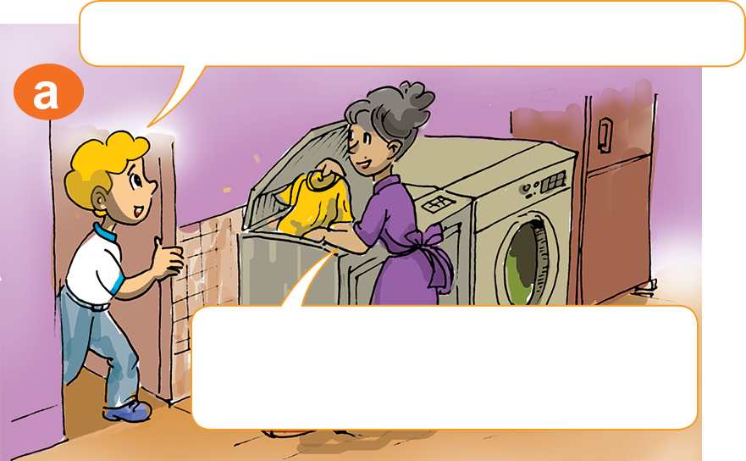
1. Look, listen and repeat.
Where are my posters, Mum?
I don't know, dear.
Look in your bedroom.

Slide 15

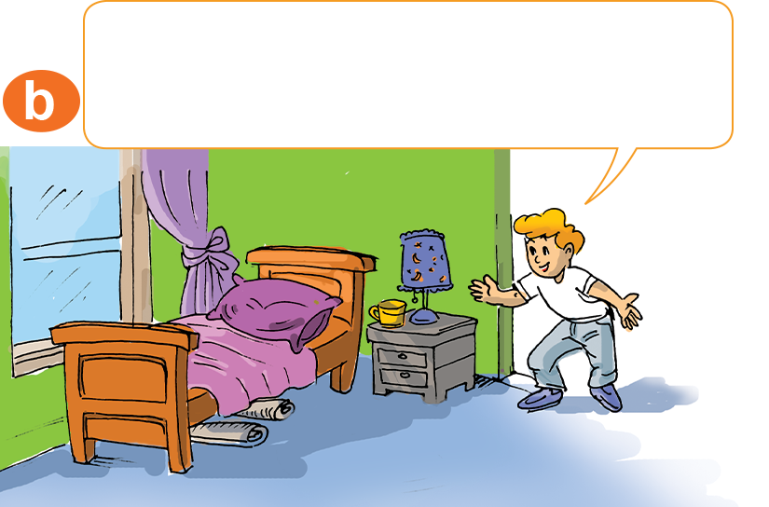
1. Look, listen and repeat.
Oh, they're under my bed.
Thanks, Mum.

Slide 16
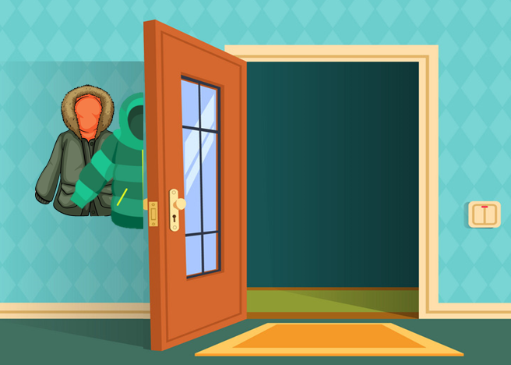








Where are the/my ________?
They’re _________.
Model sentence
behind the door
near the table
on the wall
on the table
under the bed

Slide 17


There is ___________.
a ball
a bed
a chair
a table
a poster
a picture
There are ___________.
balls
beds
chairs
tables
posters
pictures

Slide 18
2. Point and say.
Where are the chairs?
Where are the balls?
They’re under the bed.
_____________________.
_____________________.
They’re near the table.

Slide 19



2. Point and say.
Where are the posters?
Where are the coats?
They’re behind the door.
They’re on the wall.
_____________________.
_____________________.

Slide 20
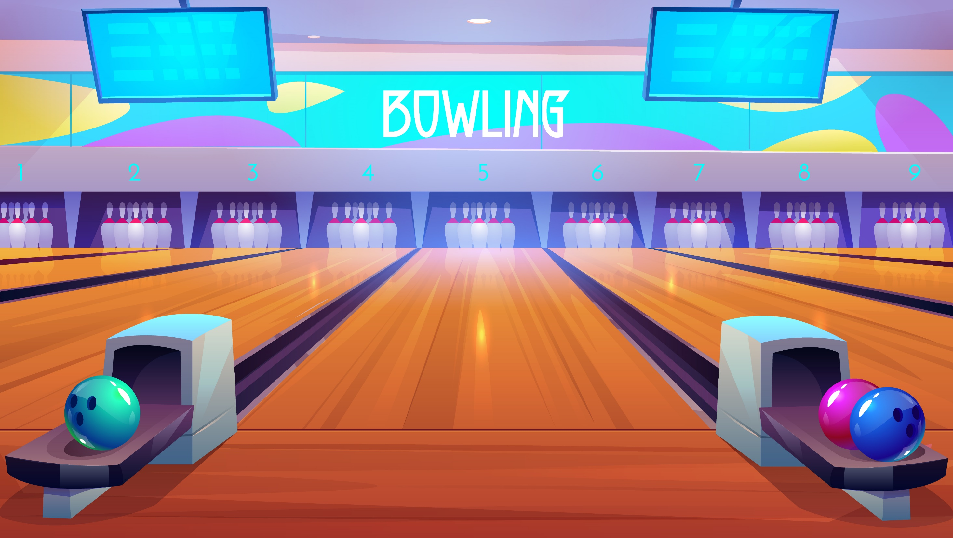
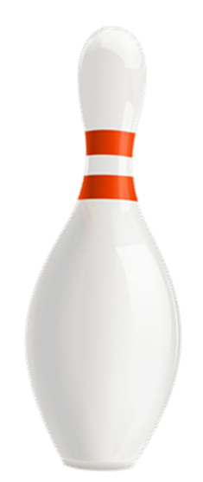


Notes:
Ms Huyền Phạm - 0936.082.789 – YOUTUBE: MsPham. Facebook: Dạy và học cùng công nghệ.

Slide 21
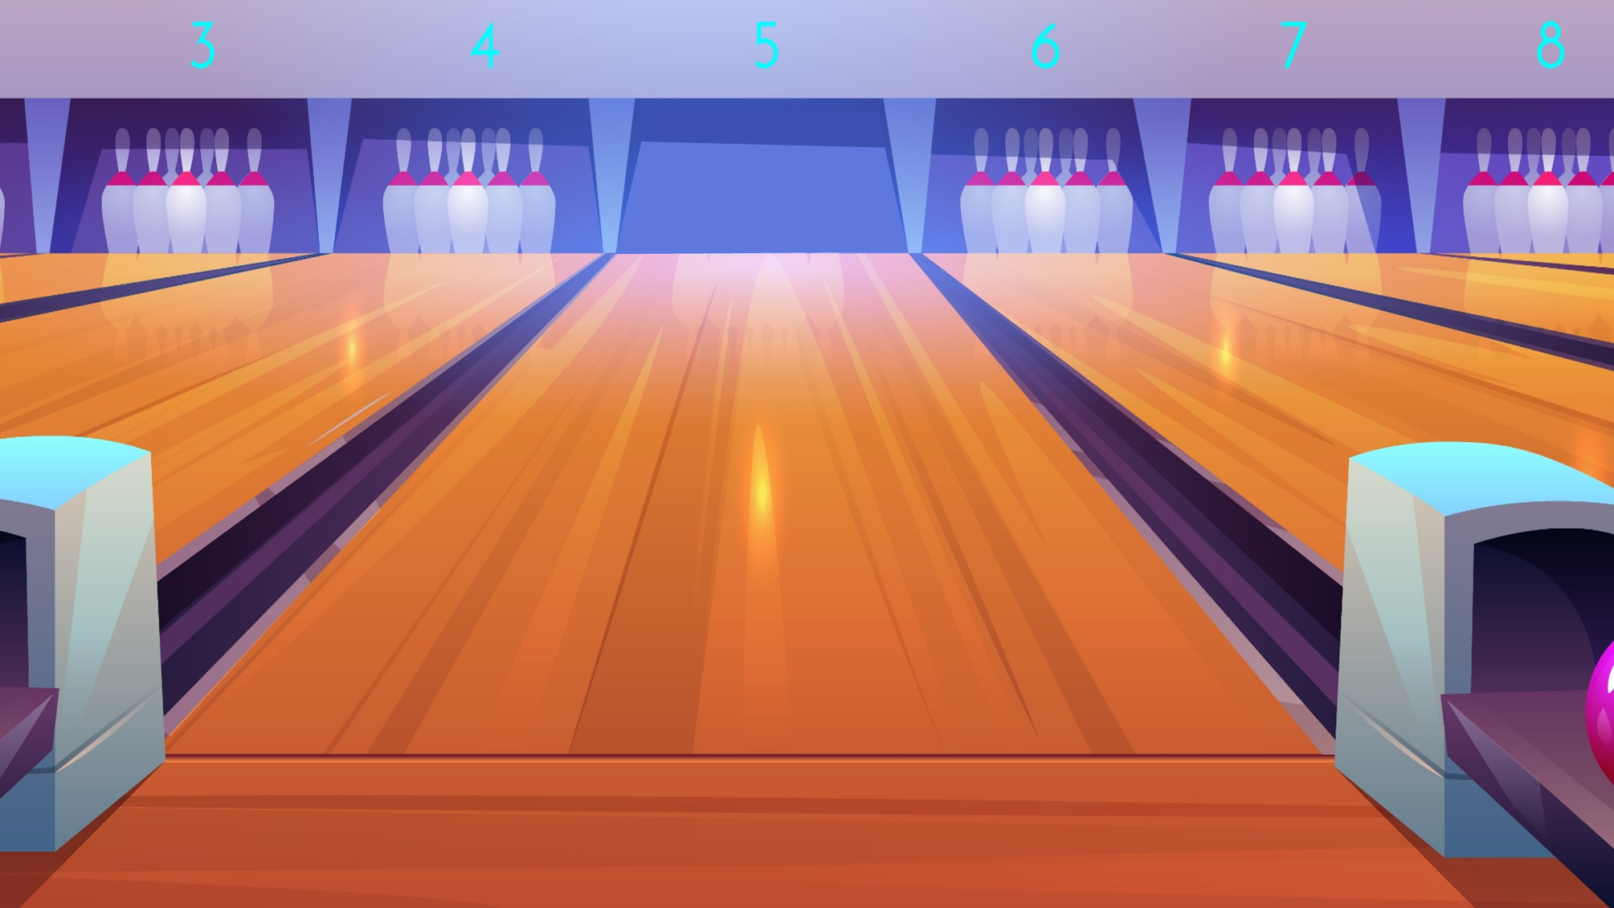



Where are the _______?
a. coats
b. coat
c. a coat
Next
Notes:
Ms Huyền Phạm - 0936.082.789 – YOUTUBE: MsPham. Facebook: Dạy và học cùng công nghệ.

Slide 22
______ are the balls?
They’re under the bed.
a. Who
b. Where
c. What
Next
Notes:
Ms Huyền Phạm - 0936.082.789 – YOUTUBE: MsPham. Facebook: Dạy và học cùng công nghệ.

Slide 23
Where are the books?
a. They’s on the desk.
b. They’re on the desk.
c. It’s on the desk.
Next
Notes:
Ms Huyền Phạm - 0936.082.789 – YOUTUBE: MsPham. Facebook: Dạy và học cùng công nghệ.

Slide 24
Where are the pictures?
a. They’re in the wall.
b. They’re under the wall.
c. They’re on the wall.
Next
Notes:
Ms Huyền Phạm - 0936.082.789 – YOUTUBE: MsPham. Facebook: Dạy và học cùng công nghệ.

Slide 25
Where _____ the posters?
a. are
b. is
c. am
Notes:
Ms Huyền Phạm - 0936.082.789 – YOUTUBE: MsPham. Facebook: Dạy và học cùng công nghệ.

Slide 26
They’re behind the door.
a. Where is the chairs?
b. Where are the chair?
c. Where are the chairs?
Next
Notes:
Ms Huyền Phạm - 0936.082.789 – YOUTUBE: MsPham. Facebook: Dạy và học cùng công nghệ.

Slide 27

Good job!
EXIT
Notes:
Ms Huyền Phạm - 0936.082.789 – YOUTUBE: MsPham. Facebook: Dạy và học cùng công nghệ.

Slide 28
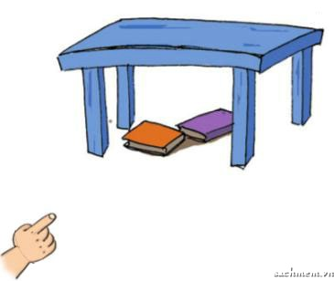
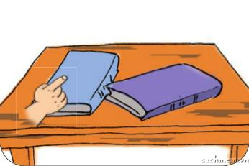
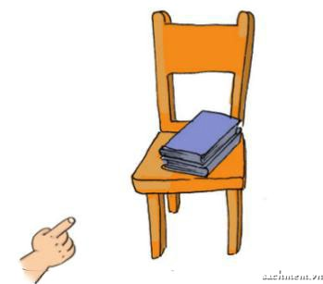
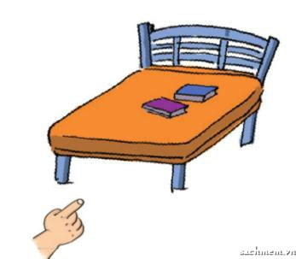
4. Listen and number.
1
2
a
2
b
4
3
4
c
1
d
3

Slide 29
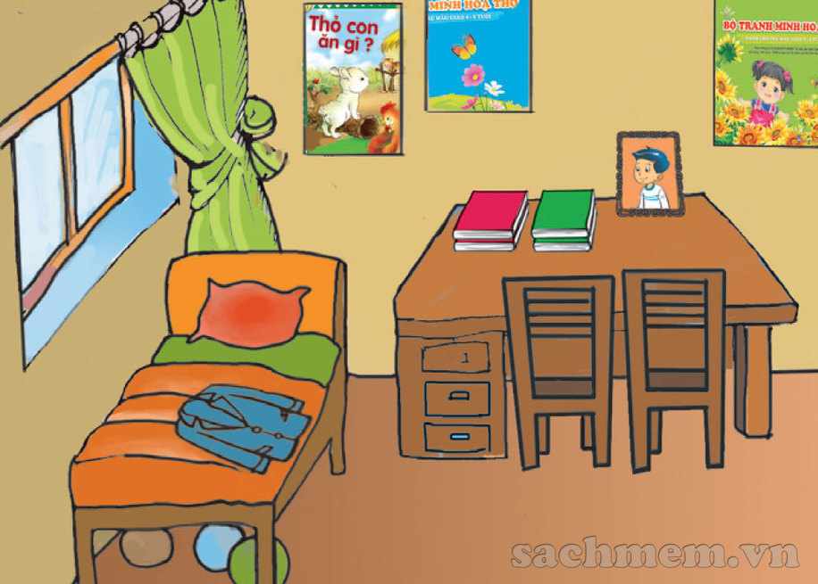
5. Read and complete.
Hello! My name is Phong. Here is a picture of my room. This is my bed. My coat is on the bed. There are three balls under the bed. There are two chairs near the desk. There are four books and a photo on the desk. There are three posters on the wall.
Where is Phong's coat?
It is on the bed.
2. Where are the balls?
They are under the bed.
3. Where are the chairs?
They are near the desk.
4. Where are the books and Phong's photo?
They are on the desk.
5. Where are the posters?
They are on the wall.
_________________________________.
_________________________________.
_________________________________.
_________________________________.
_________________________________.

Slide 30
6. Write about your bedroom.
There is __, __, __, __ and__.
There are __, __, __, __ and__.

Slide 31


Home link
Thanh Am Primary School
Dặn dò
2. Do the homework in WB (SBT): B(1,2,3)
1. Using the new sentences in the real life .
3. Prepare the new lesson : Unit 13 - Lesson 3

Slide 32









Thursday, February 10 2022
Unit 13: Where’s my book? - Lesson 2
1.New words
- in : ở trong
- on : ở trên
- under : ở dưới
- behind : ở phía sau
- near : gần
- wall : bức tường
2. Model Sentences
Where are the picture? -> They are on the wall.
3. Homework
- WB (SBT) : B(1,2,3)
- Prepare : Unit 13 - Lesson 3
th
th

Slide 33




Thanh Am Primary School

