Slide 1


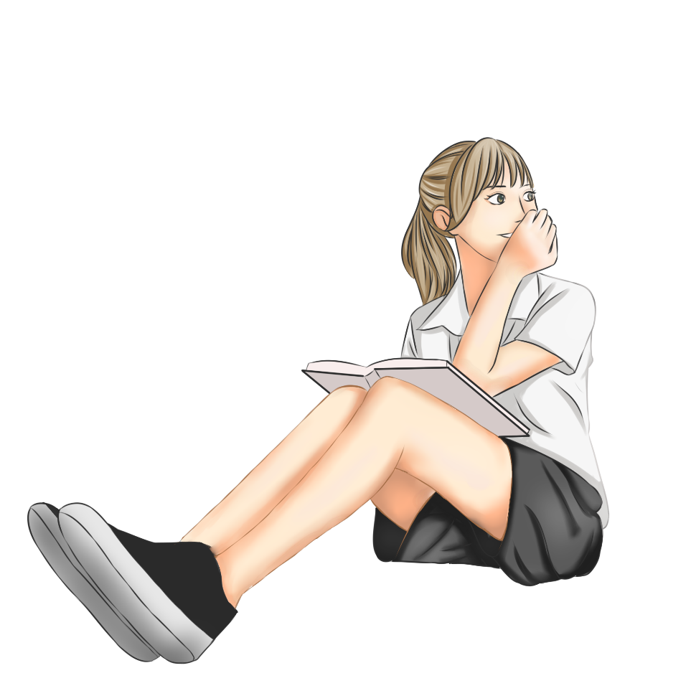
Synergistically utilize technically sound portals with frictionless chainsSynergistically
Welcome
to our Class!
Book: English 3
Teacher: Miss Linh
Notes:
Pexels.com

Slide 2


13
Unit
Where’s my book?
Lesson 1

Slide 3
Review the last Unit
01.
Review the last Unit
01.
Ojbectives
Learn the new words and sentences about the location
of things in the house.
02.
02.
Notes:
Pexels.com

Slide 4
Synergistically utilize technically sound portals with frictionless chainsSynergistically
New words
Notes:
Pexels.com

Slide 5

chair
/tʃer/

Slide 6

table
/ˈteɪbl/

Slide 7

bed
/bed/

Slide 8

poster
/ˈpəʊstər/

Slide 9

picture
/ˈpɪktʃər/

Slide 10


coat
/kəʊt/

Slide 11

ball
/bɔːl/

Slide 12
Vocabulary
chair
bed
table
coat
ball
poster
picture

Slide 13
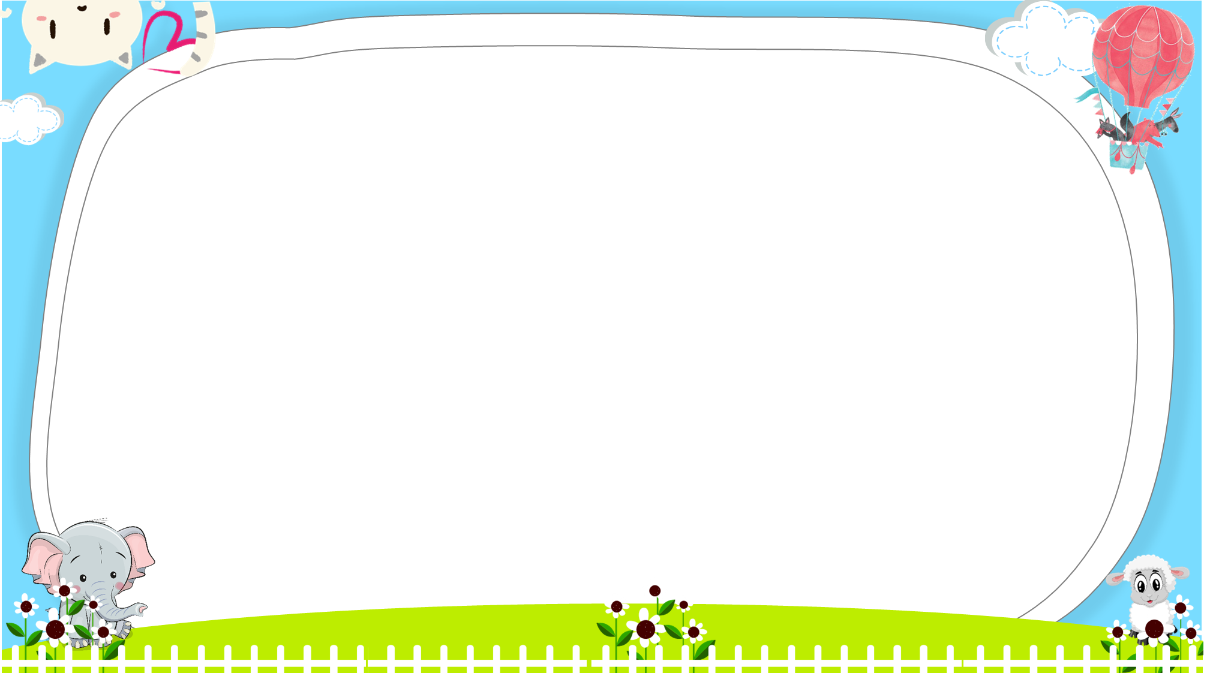





AND
GAME
PLAY
Notes:
Ms Huyền Phạm - 0936.082.789 – YOUTUBE: MsPham. Facebook: Dạy và học cùng công nghệ.

Slide 14



Look and tick
There is a ball.
Next
Notes:
Ms Huyền Phạm - 0936.082.789 – YOUTUBE: MsPham. Facebook: Dạy và học cùng công nghệ.

Slide 15
Look and tick
There is a poster.
Next
Notes:
Ms Huyền Phạm - 0936.082.789 – YOUTUBE: MsPham. Facebook: Dạy và học cùng công nghệ.

Slide 16
Look and tick
There is a coat.
Next
Notes:
Ms Huyền Phạm - 0936.082.789 – YOUTUBE: MsPham. Facebook: Dạy và học cùng công nghệ.

Slide 17
Look and tick
Is there a bed?
Yes, there is.
Next
Notes:
Ms Huyền Phạm - 0936.082.789 – YOUTUBE: MsPham. Facebook: Dạy và học cùng công nghệ.

Slide 18
Look and tick
Is there a picture?
Yes, there is.
Next
Notes:
Ms Huyền Phạm - 0936.082.789 – YOUTUBE: MsPham. Facebook: Dạy và học cùng công nghệ.

Slide 19
Look and tick
Is there a table?
Yes, there is.
Next
Notes:
Ms Huyền Phạm - 0936.082.789 – YOUTUBE: MsPham. Facebook: Dạy và học cùng công nghệ.

Slide 20
Look and tick
Is there a chair?
Yes, there is.
Next
Notes:
Ms Huyền Phạm - 0936.082.789 – YOUTUBE: MsPham. Facebook: Dạy và học cùng công nghệ.

Slide 21


Notes:
Ms Huyền Phạm - 0936.082.789 – YOUTUBE: MsPham. Facebook: Dạy và học cùng công nghệ.

Slide 22
GRAMMAR

Slide 23

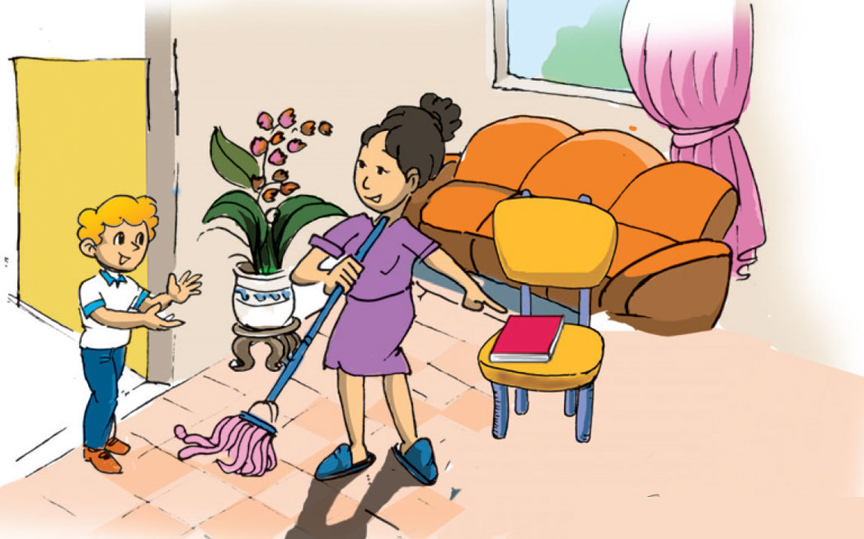
1. Look, listen and repeat.
a
Where's my book, Mum?
I can't see it in my room!
It's here, dear. On the chair.

Slide 24
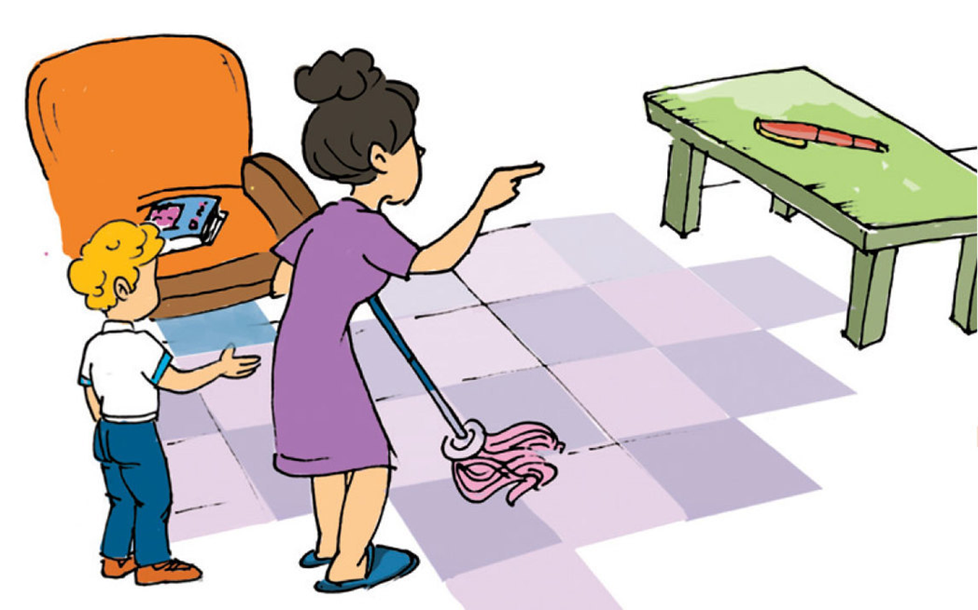

1. Look, listen and repeat.
b
No, it's not on the chair.
It's there, on the table.
Is the pen there too, Mum?

Slide 25

Model sentence
Where’s my ________?
It’s here.
It’s there.
coat
ball
bed
table
poster
chair
picture

Slide 26

2. Point and say.
Where's my chair?
Where's my ball?
It’s here.
It’s there.

Slide 27
2. Point and say.
Where's my bed?
Where's my poster?
It’s here.
It’s there.

Slide 28
2. Point and say.
Where's my picture?
Where's my coat?
It’s there.
It’s here.

Slide 29
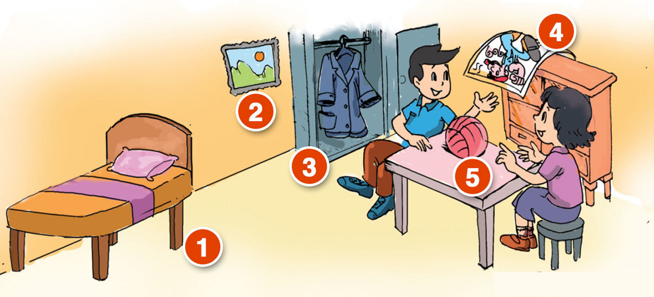
3. Let’s talk
Where's my picture?
Where's my bed?
It’s there.
It’s there.
4
Where's my ball?
2
It’s here.
3
5
1
Where's my coat?
Where's my poster?
It’s there.
It’s here.

Slide 30
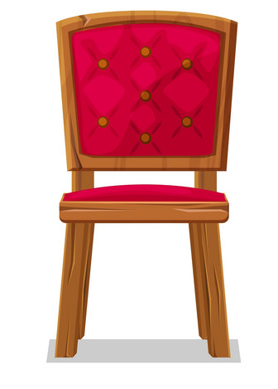

4. Listen and tick.
1
2
3
a
a
a
b
b
b

Slide 31

5. Look, read and complete : here / there
This is my bed.
It is here.
This is my desk.
It is here, next to the bed.
_______
_______

Slide 32


5. Look, read and complete : here / there
These are my school bags and books.
They are here, on the desk.
_____
Those are posters, pictures and maps.
They are there, on the wall.
______

Slide 33

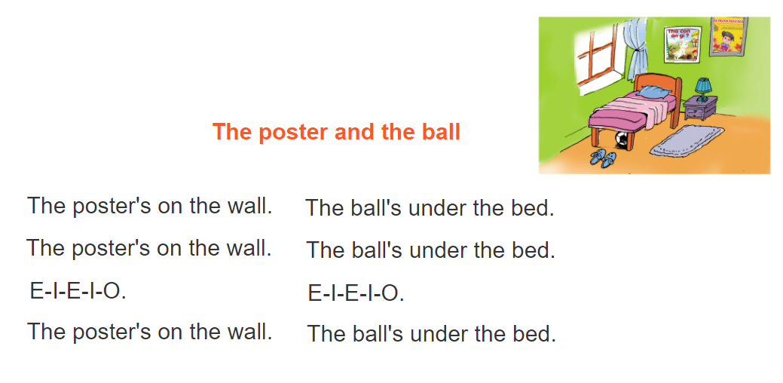
6. Let’s sing.

Slide 34
2. Do the homework in WB (SBT): A(2,3)
3. Prepare the new lesson : Unit 13
Lesson 2
1. Review the new words and sentences .
Home link
Notes:
Pexels.com

Slide 35









th
Tuesday, February 08 2022
Unit 13: Where’s my book? - Lesson 1
1. New words
- chair: cái ghế
- bed : cái giường
- table : cái bàn ( không có ngăn)
- desk : cái bàn ( có ngăn)
- coat : áo khoác
- ball : quả bóng
- poster : áp phích
- picture : bức tranh
2. Model Sentences
Where’s my book ?
-> It’s here. ( ở đây)
-> It’s there. ( ở kia)

Slide 36




