Slide 1
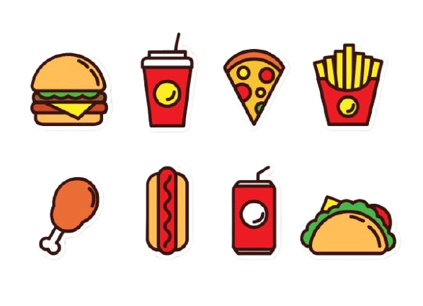
Food and drink
Thanh Yến Trần 0967 255 149 zalo/ FB https://www.facebook.com/thanhyentrananhngutaymy/
Theme 6
Lesson 1
Notes:
Thanh Yến Trần 0967 255 149 zalo/ FB https://www.facebook.com/thanhyentrananhngutaymy/

Slide 2
Warm-up
Notes:
Thanh Yến Trần 0967 255 149 zalo/ FB https://www.facebook.com/thanhyentrananhngutaymy/

Slide 3


Slide 4
Vocabulary

Slide 5


rice
Notes:
Thanh Yến Trần 0967 255 149 zalo/ FB https://www.facebook.com/thanhyentrananhngutaymy/

Slide 6

eggs

Slide 7
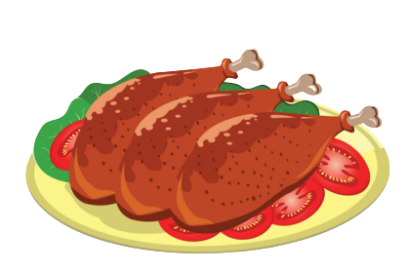
chicken

Slide 8

cereal

Slide 9
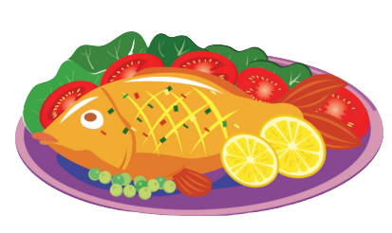
fish

Slide 10

bread

Slide 11

rice
eggs
chicken
cereal
fish
bread

Slide 12
Structure

Slide 13
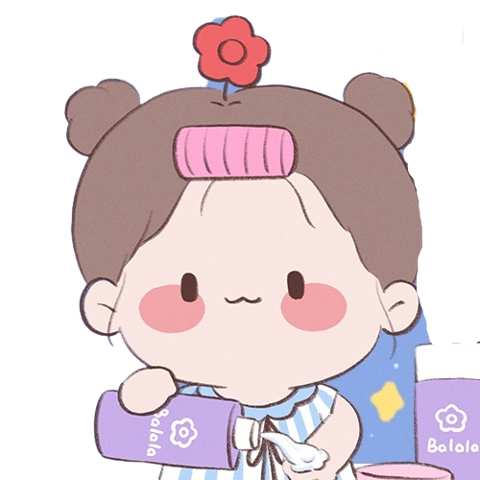

What do you want to eat?
May I have eggs?

Slide 14
What do you want to eat?
May I have chicken?

Slide 15
What do you want to eat?
May I have cereal?

Slide 16


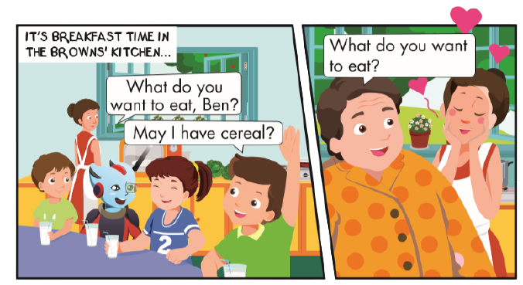
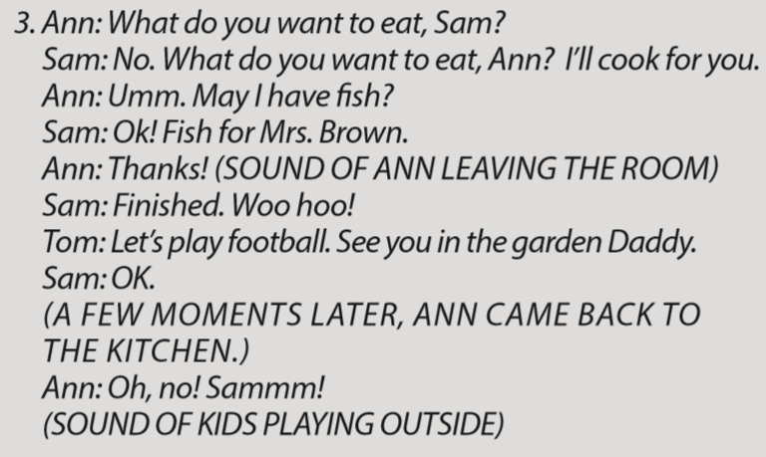
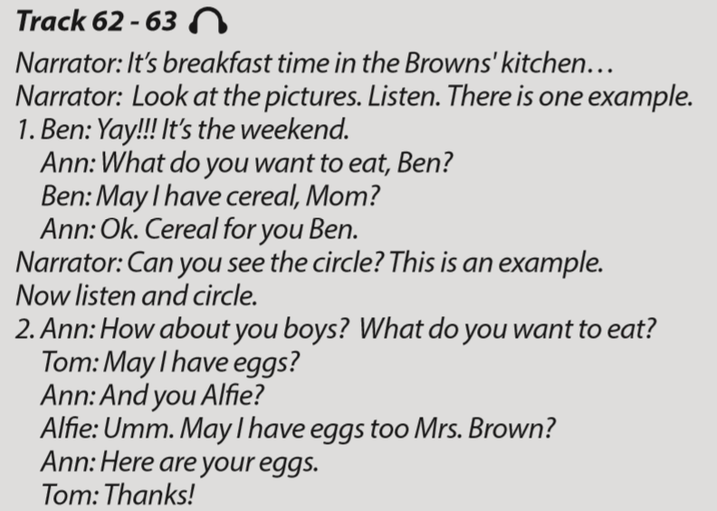
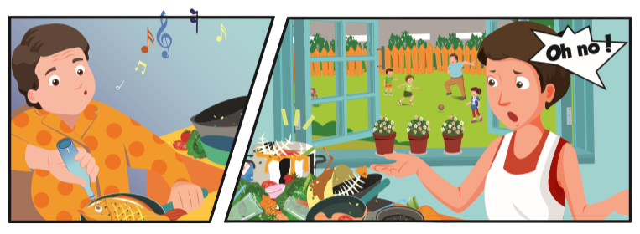

Slide 17

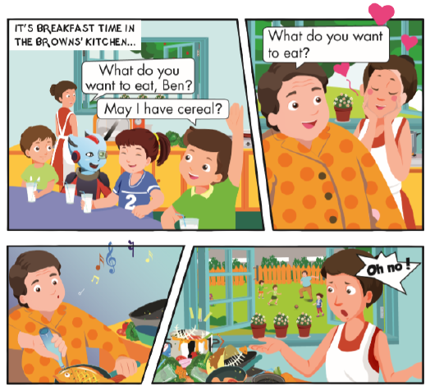
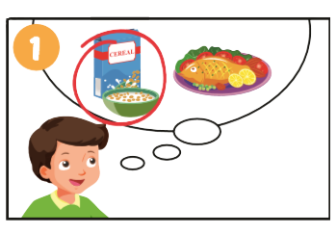
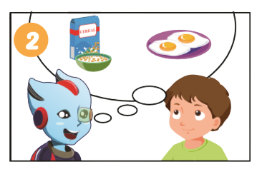
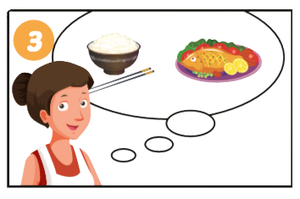

Slide 18

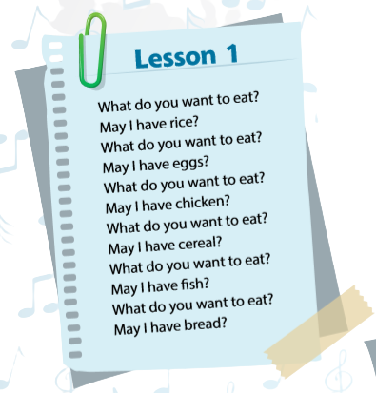



Slide 19
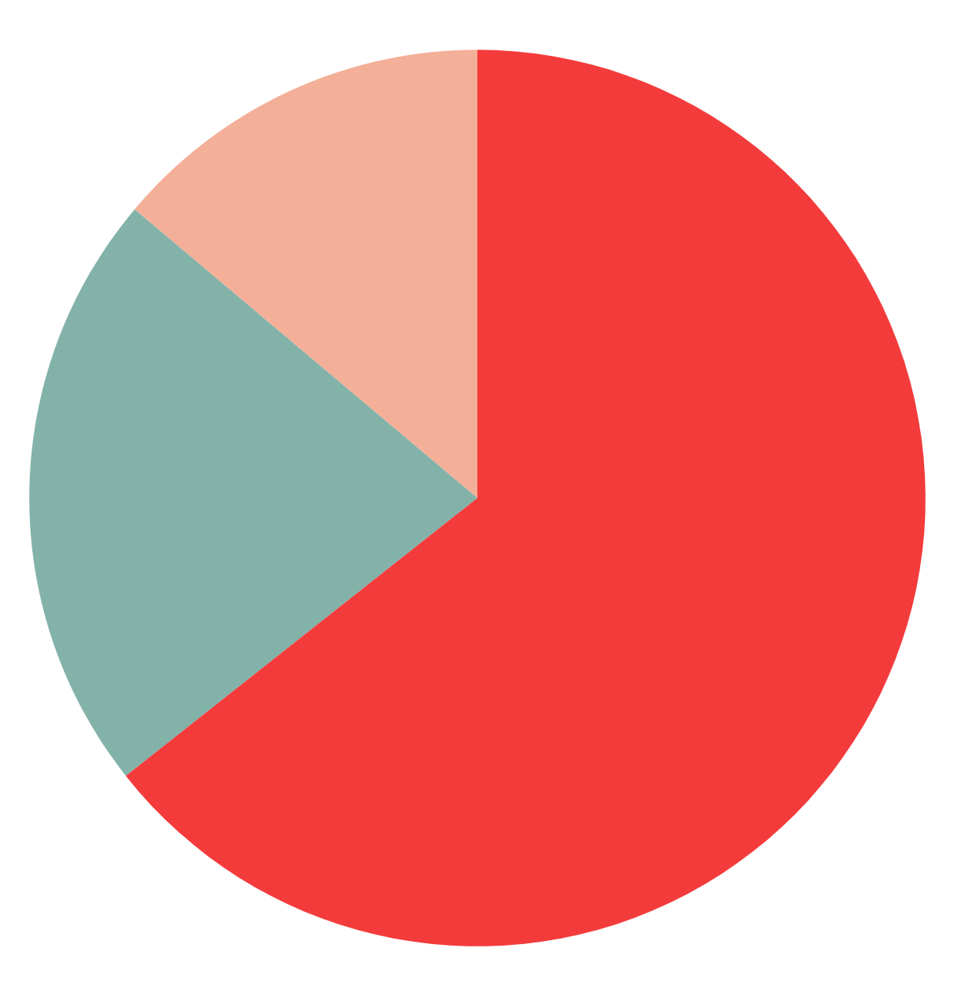
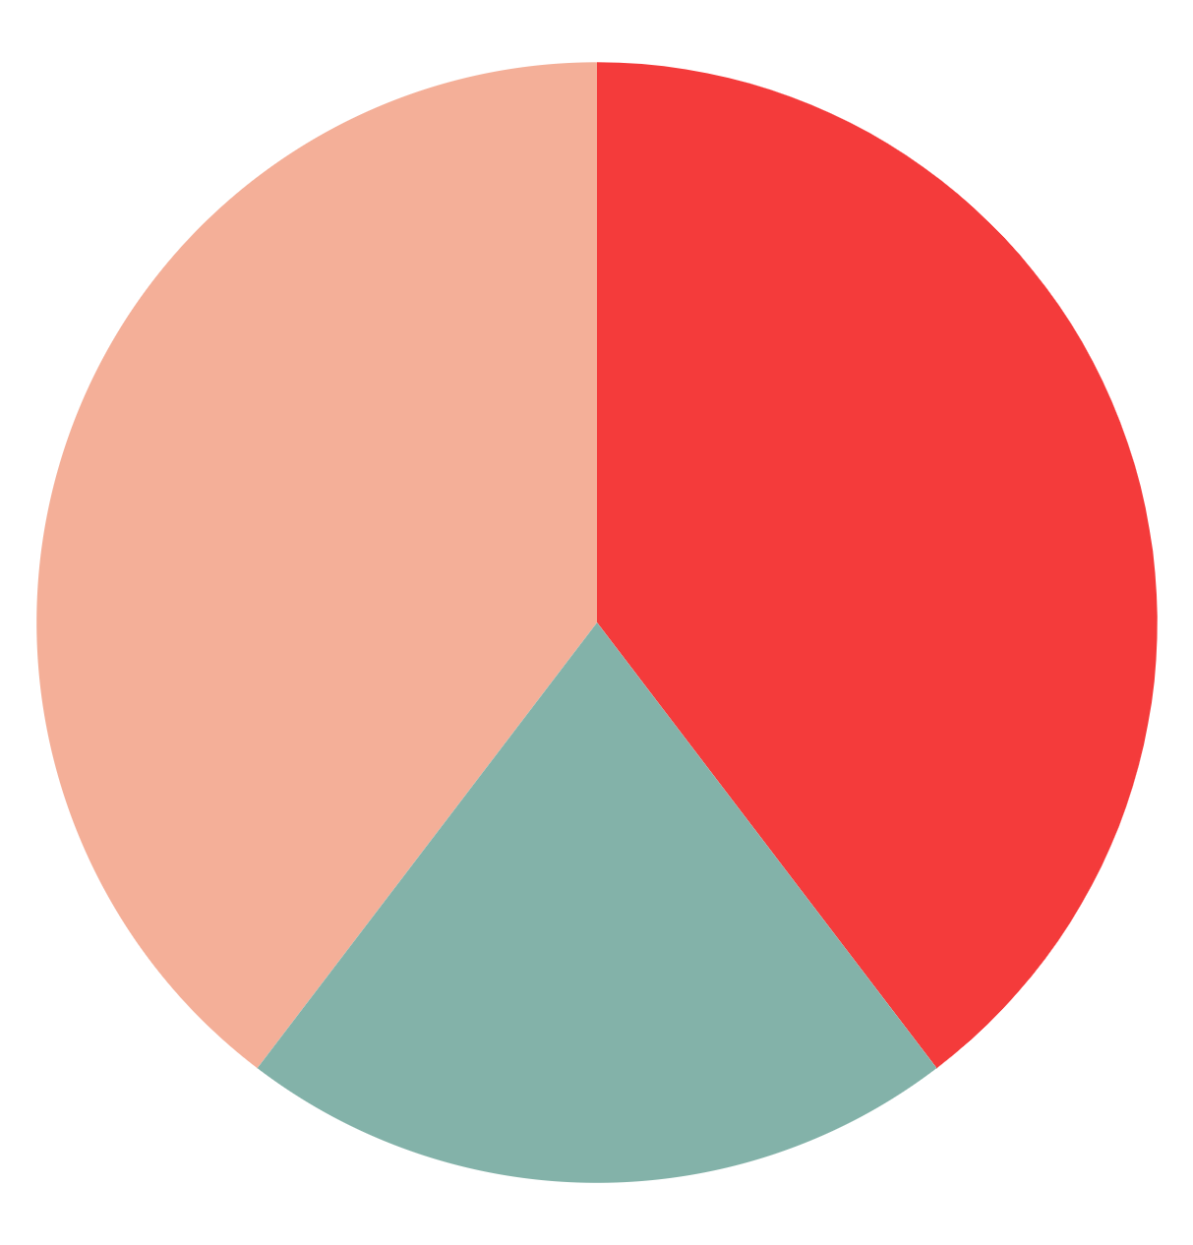
Let’s play game

Slide 20



Notes:
Thanh Yến Trần 0967 255 149 zalo/ FB https://www.facebook.com/thanhyentrananhngutaymy/

Slide 21











are
a.
b.
c.
a
b
c
Notes:
Thanh Yến Trần 0967 255 149 zalo/ FB https://www.facebook.com/thanhyentrananhngutaymy/

Slide 22
old
a. kitchen b. chicken
c. chickin
a
b
c

Slide 23
you
a. b. C.
a
b
c
Notes:
Thanh Yến Trần 0967 255 149 zalo/ FB https://www.facebook.com/thanhyentrananhngutaymy/

Slide 24
old
a. rice b. bread
c. bred
a
b
c

Slide 25
are
b.
a.
c.
a
b
c

Slide 26
you
a. cereal b. creal
c. crereal
a
b
c

Slide 27
are
b.
c.
a.
a
b
c

Slide 28
old
a. egg b. eggs
c. egsg
a
b
c

Slide 29
you
May I have eggs?
May I have cereal?
May I have fish?
a
b
c

Slide 30
are
a. rice and fish b. chicken and eggs
c. rice and chicken
a
b
c

Slide 31


GOOD JOB!
STOP

Slide 32

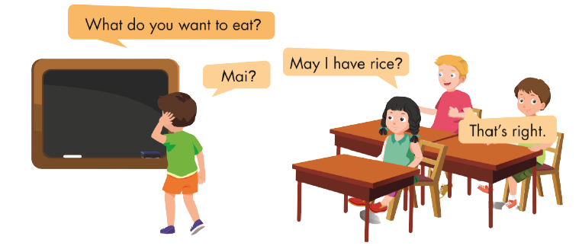

Slide 33
ALTERNATIVE RESOURCES

