Slide 1
Wednesday, January 5th, 2022.
Unit 11
What’s the matter with you?
Lesson 1 – p6,7

Slide 2


OBJECTIVES
(Mục tiêu của bài học hôm nay)
01
- Learn about some diseases ( Học về một số các căn bệnh thường gặp)
- Ask and answer about health(Hỏi thăm sức khoẻ của một ai đó)
02
03
- Practice speaking, listening and reading skills.
(Luyện tập các kĩ năng nói, nghe và đọc hiểu.)
Notes:
Thanh Yến Trần 0967 255 149 zalo/ FB https://www.facebook.com/thanhyentrananhngutaymy/

Slide 3
Vocabulary

Slide 4
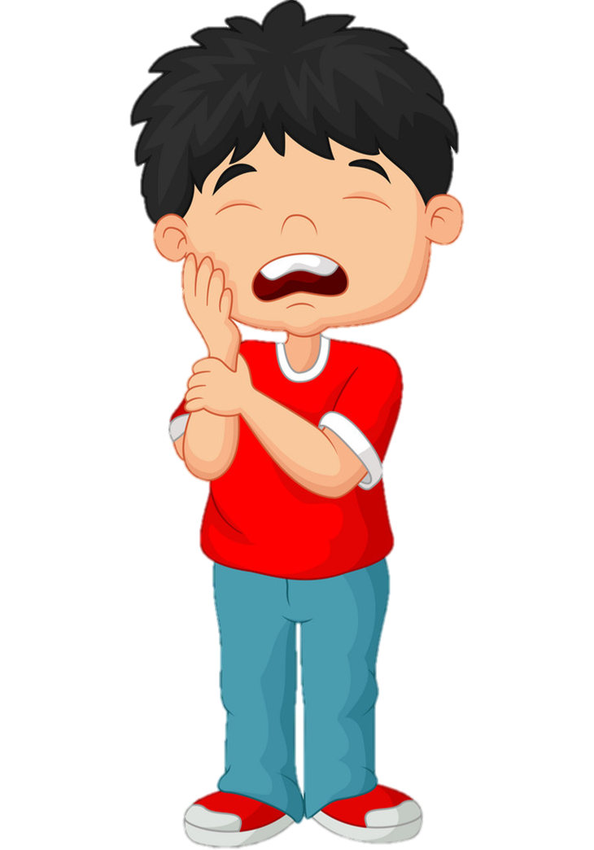
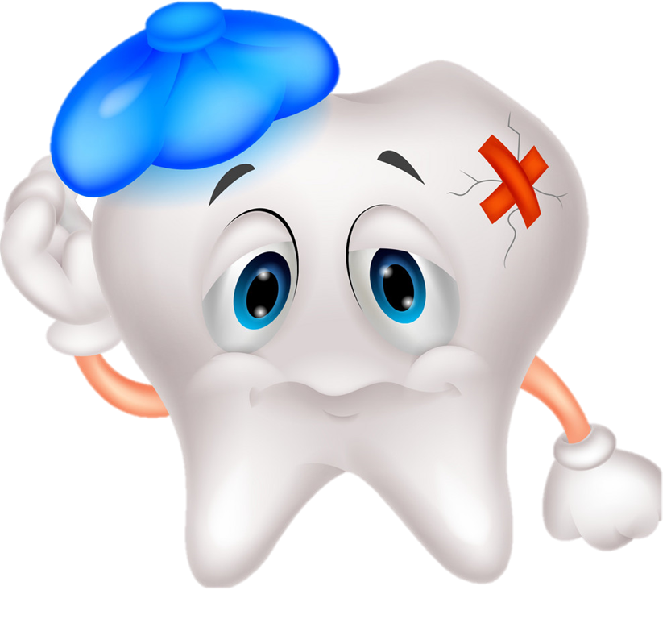
Toothache
/ˈtuːθeɪk/

Slide 5
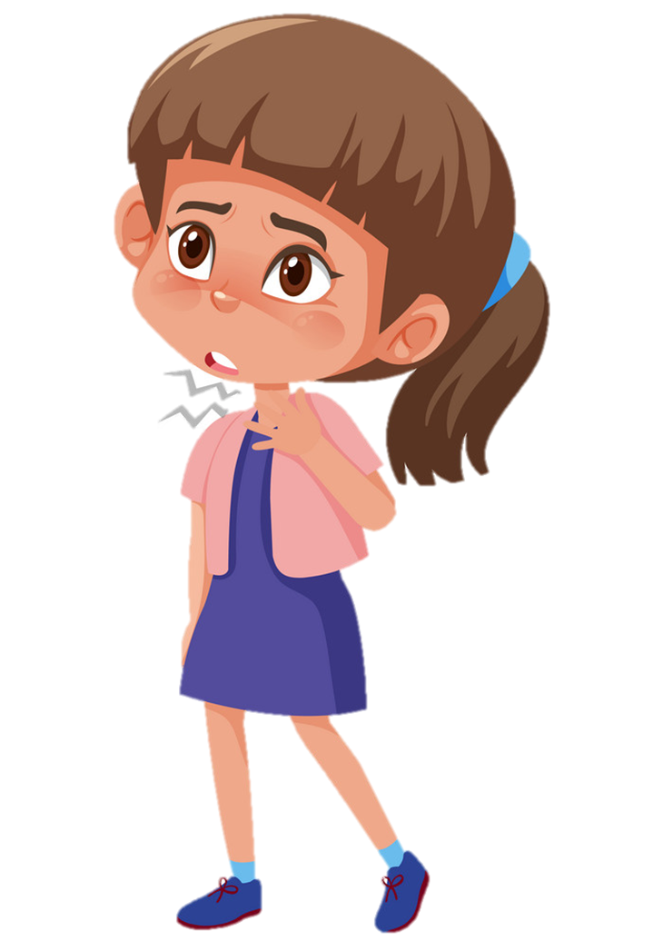
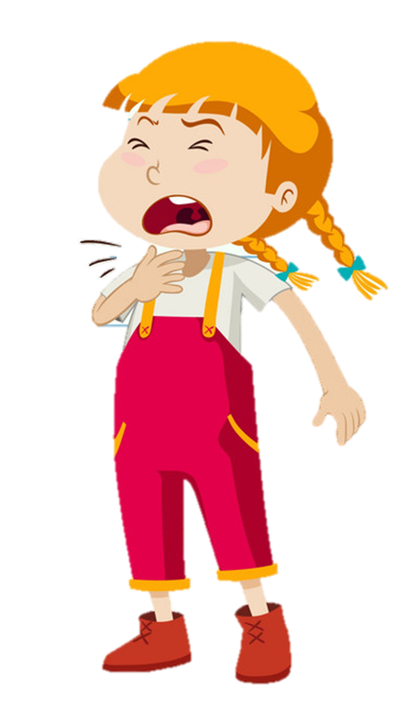
Sore throat
/sɔː θrəʊt/

Slide 6
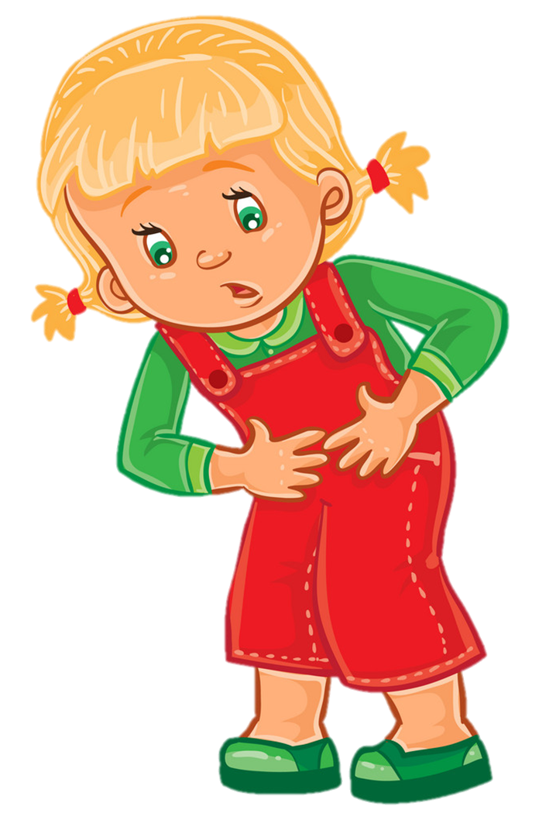
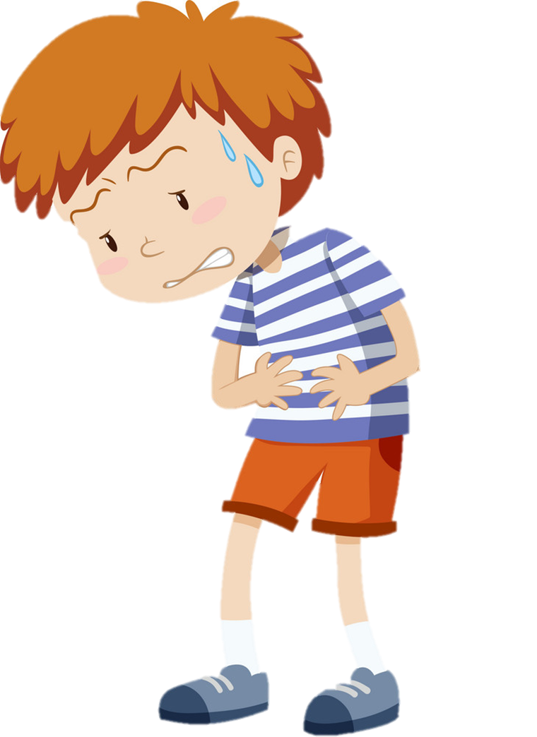
Stomach ache
/ˈstʌmək eɪk/

Slide 7
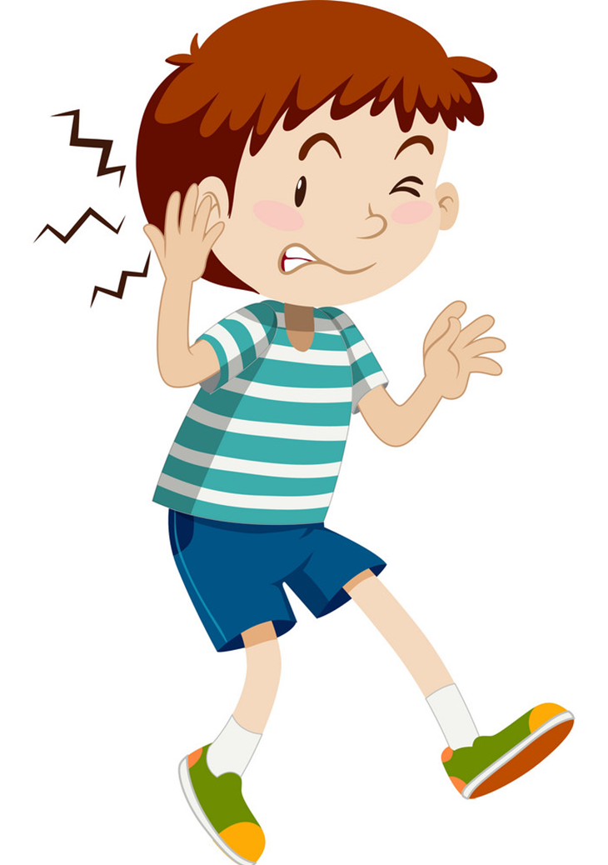
Earache
/ˈɪəreɪk/

Slide 8
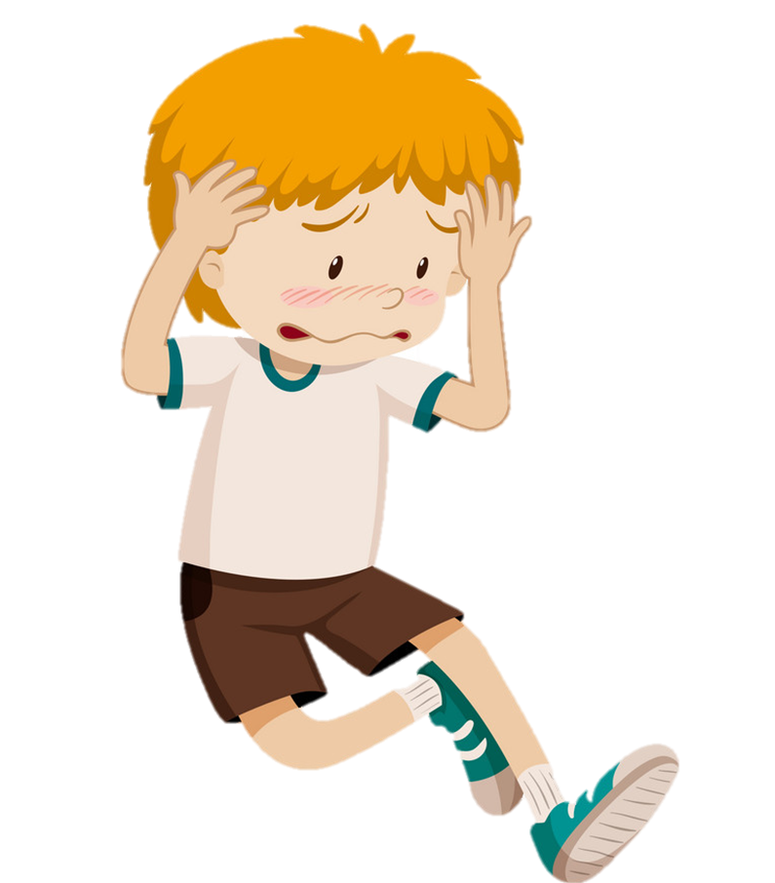
Headache
/ˈhedeɪk/

Slide 9
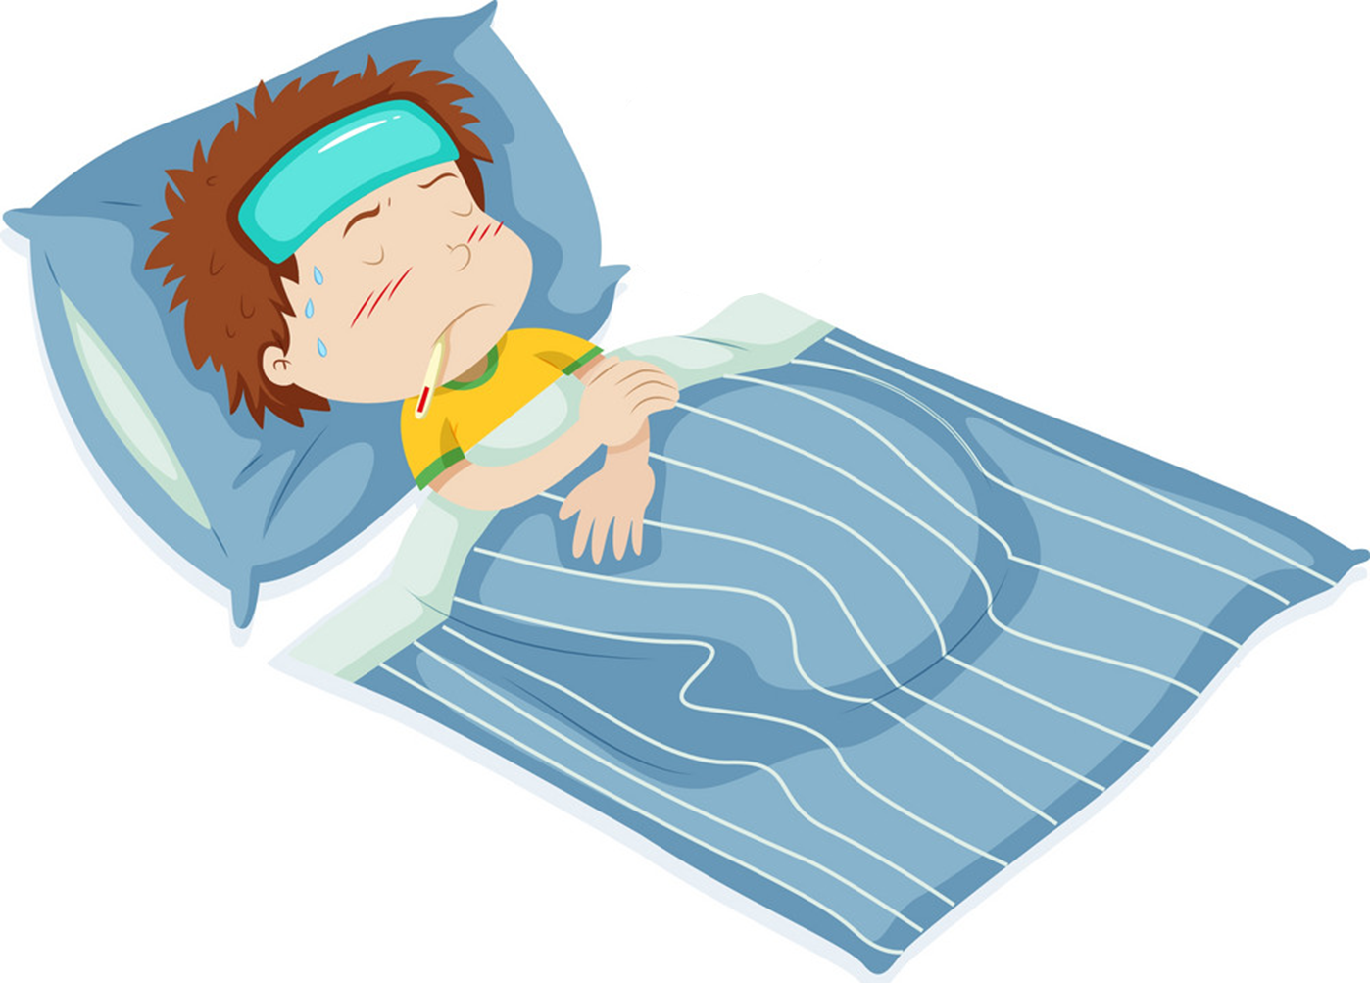
Fever
/ˈfiːvər/

Slide 10
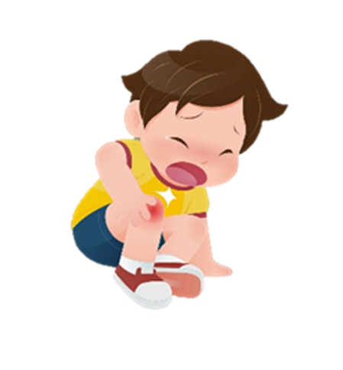
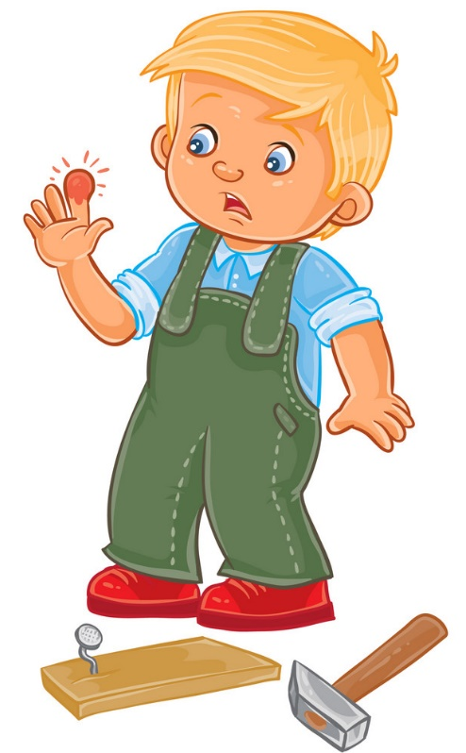

Pain
/peɪn/

Slide 11
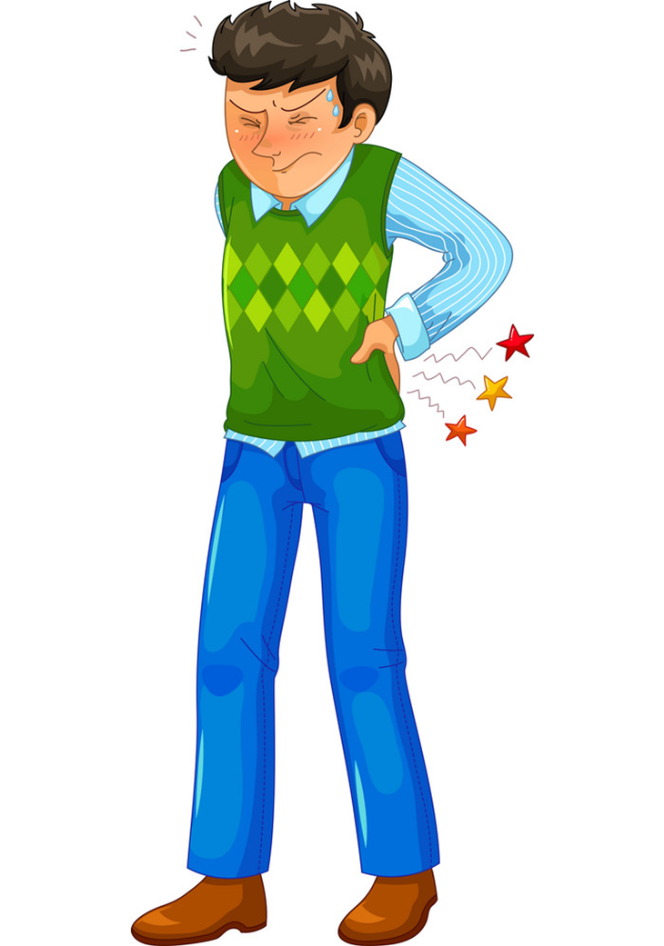
Backache
/ˈbækeɪk/

Slide 12
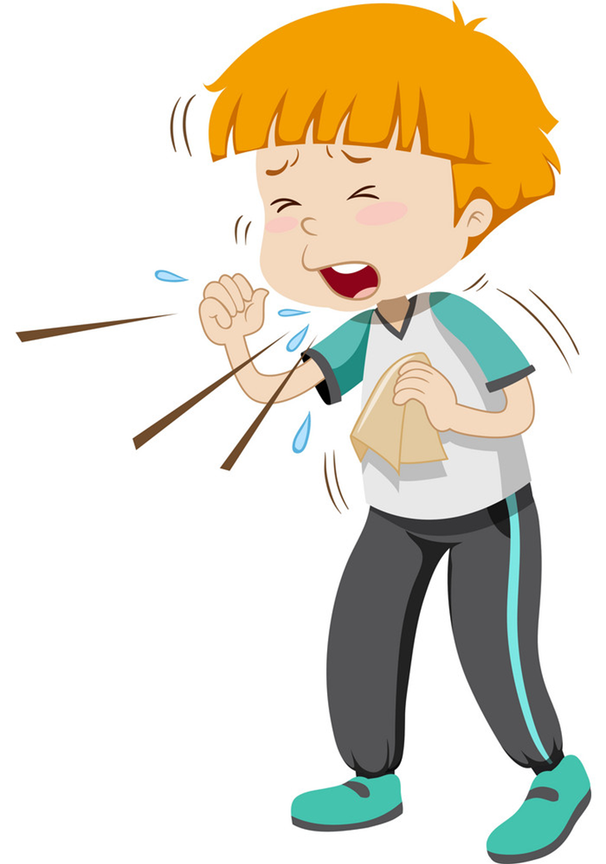
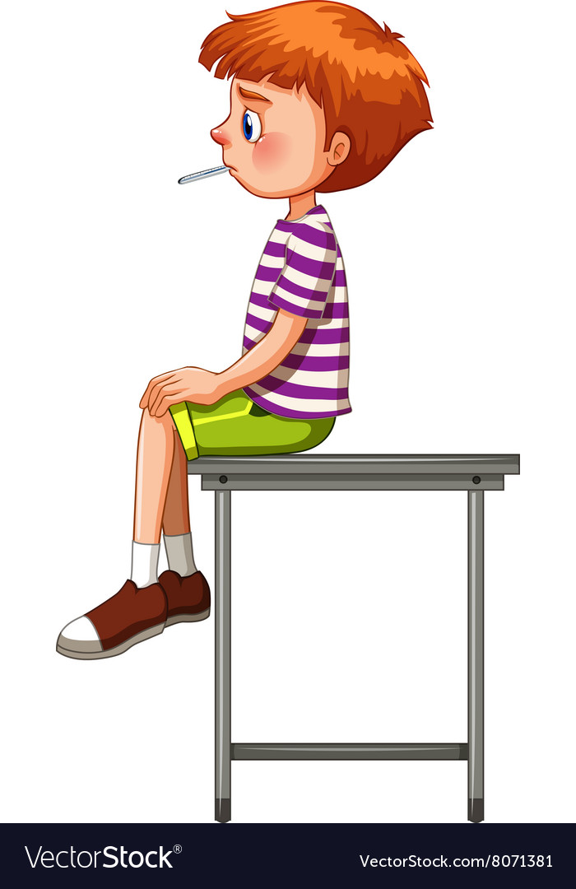
Cough
/kɒf/

Slide 13
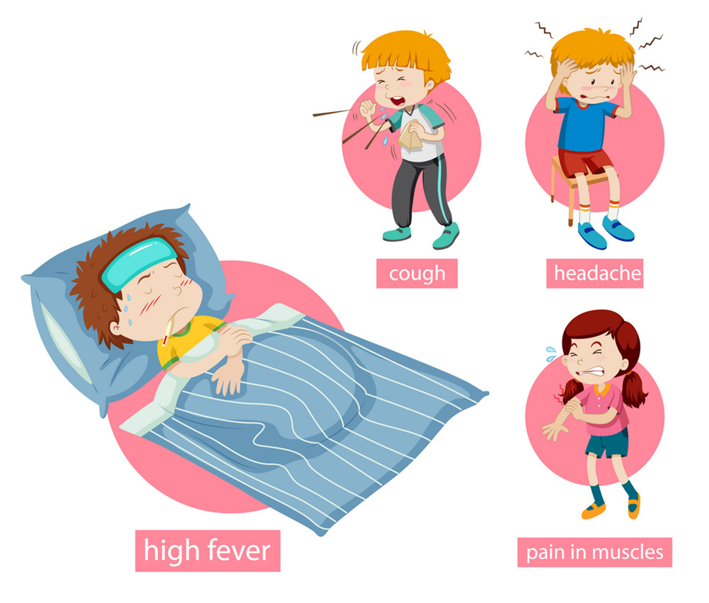
Flu
/fluː/

Slide 14
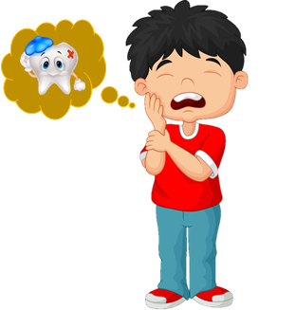
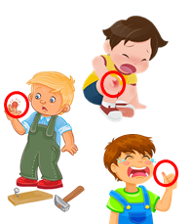
Review
1
2
3
4
5
Flu
/fluː/
Sore throat
/sɔː θrəʊt/
Cough
/kɒf/
Toothache
/ˈtuːθeɪk/
headache
/ˈhedeɪk/
10
6
7
8
9
Earache
/ˈɪəreɪk/
Pain
/peɪn/
Fever
/ˈfiːvər/
Stomach ache
/ˈstʌmək eɪk/
Backache
/ˈbækeɪk/

Slide 15


Toothache
/ˈtuːθeɪk/
Pain
/peɪn/
Backache
/ˈbækeɪk/

Slide 16
Flu
/fluː/
Pain
/peɪn/
headache
/ˈhedeɪk/

Slide 17
Cough
/kɒf/
Backache
/ˈbækeɪk/
Stomach ache
/ˈstʌmək eɪk/

Slide 18
Earache
/ˈɪəreɪk/
Backache
/ˈbækeɪk/
Stomach ache
/ˈstʌmək eɪk/

Slide 19
Stomach ache
/ˈstʌmək eɪk/
Fever
/ˈfiːvər/
Cough
/kɒf/

Slide 20
Flu
/fluː/
Sore throat
/sɔː θrəʊt/
Cough
/kɒf/

Slide 21
Toothache
/ˈtuːθeɪk/
headache
/ˈhedeɪk/
Earache
/ˈɪəreɪk/

Slide 22
Sore throat
/sɔː θrəʊt/
Toothache
/ˈtuːθeɪk/
Stomach ache
/ˈstʌmək eɪk/

Slide 23
Toothache
/ˈtuːθeɪk/
Earache
/ˈɪəreɪk/
Sore throat
/sɔː θrəʊt/

Slide 24
Cough
/kɒf/
Toothache
/ˈtuːθeɪk/
headache
/ˈhedeɪk/

Slide 25
A
B
C
Stomach ache

Slide 26
A
B
C
Fever

Slide 27
A
B
C
Earache

Slide 28
A
B
C
Flu

Slide 29
A
B
C
Headache

Slide 30
A
B
C
Toothache

Slide 31
A
B
C
Sore throat

Slide 32
A
B
C
Cough

Slide 33
A
B
C
Backache

Slide 34
A
B
C
Pain

Slide 35
Grammar

Slide 36
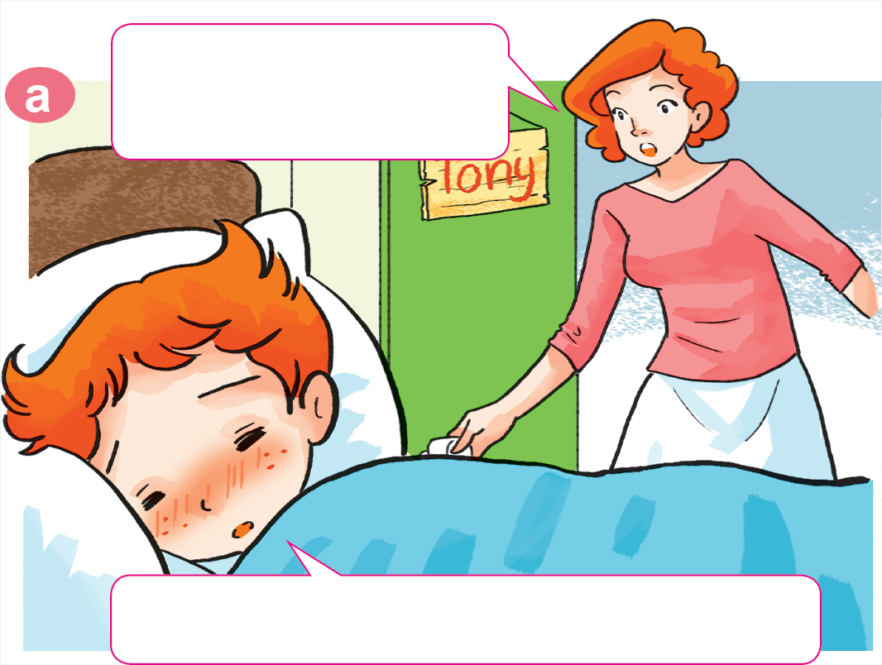
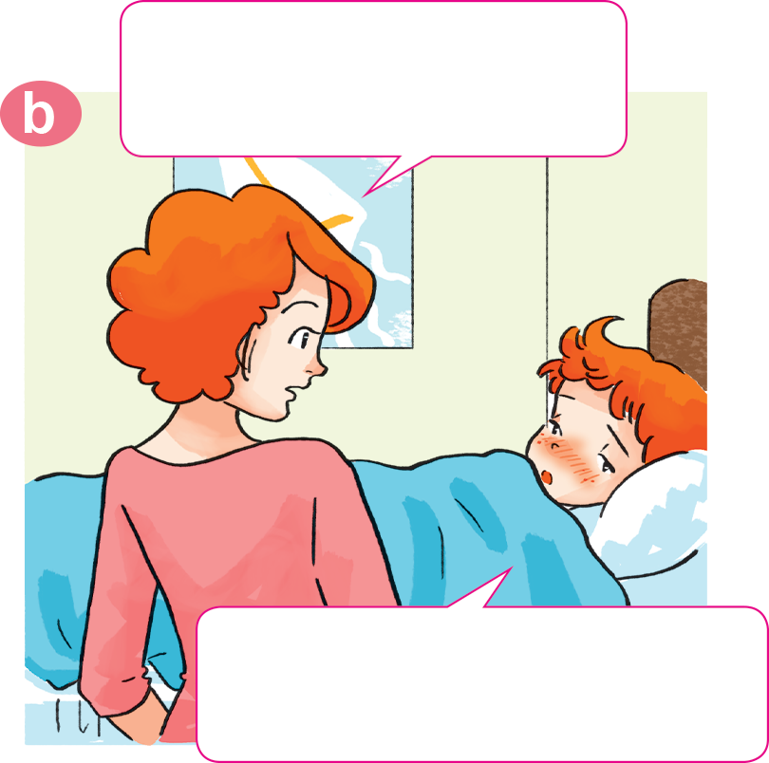
1. Look, listen and repeat.
Why not? What's the
matter with you?
Tony, get up!
Breakfast's ready.
I don't feel well.
I have a headache.
Sorry, I can't have breakfast, Mum.

Slide 37
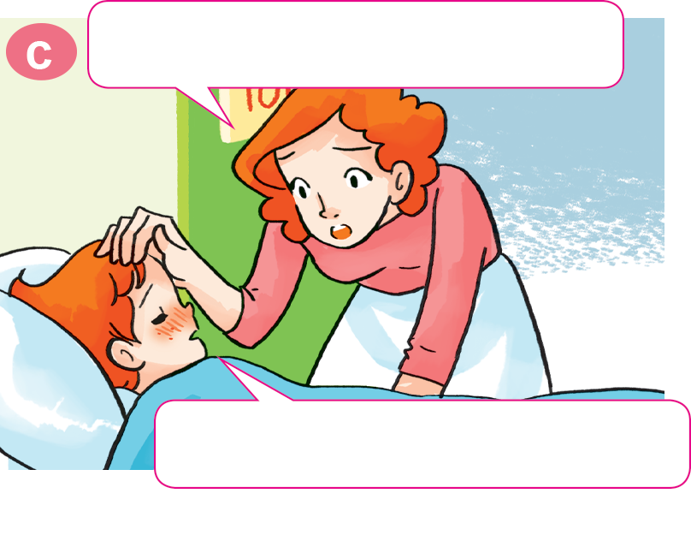
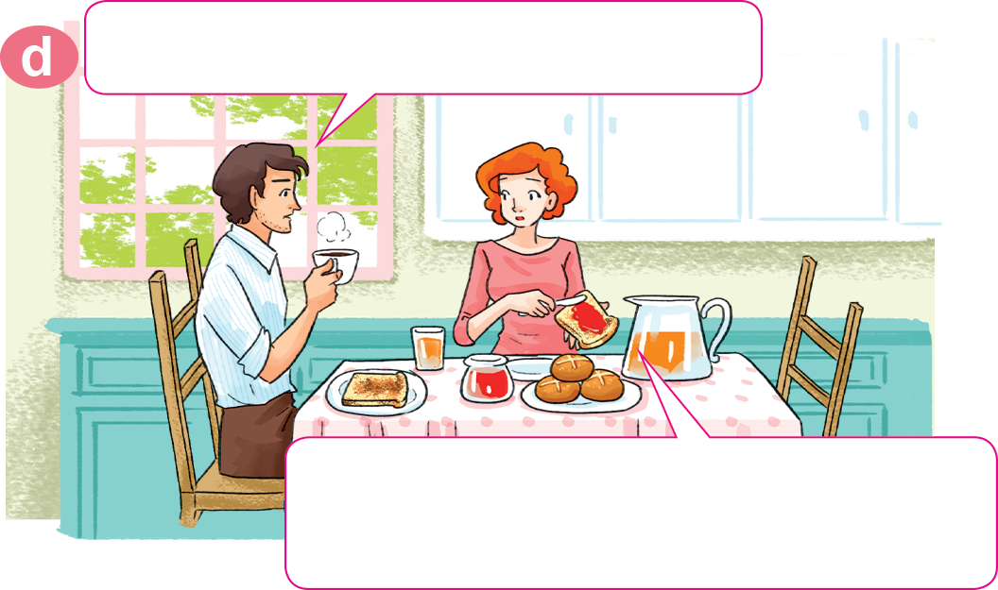
1. Look, listen and repeat.
Oh, you have a fever, too.
What's the matter with Tony?
He has a fever. I'll take him to
the doctor after breakfast.
Yes, Mum. I feel very hot.

Slide 38
2. Point and say.
What's the matter with you?
I have a toothache.
___________________

Slide 39
2. Point and say.
What's the matter with you?
I have an earache.
___________________.

Slide 40
2. Point and say.
What's the matter with you?
I have a sore throat.
___________________.

Slide 41
2. Point and say.
What's the matter with you?
I have a stomach ache.
___________________.

Slide 42
Model sentence
What's the matter with you?
What's the matter with you?
I have a _______________.
I have an _______________.
sore throat
earache

Slide 43
Temperature
/ˈtemprətʃər/
Model sentence
cough
toothache
sore throat
flu
headache
What's the matter with you?
I have a/an ______________.
earache
backache
pain
stomach ache
fever
Earache
/ˈɪəreɪk/

Slide 44
Extra sentence
What's the matter with her?
What's the matter with him?
She has
a stomach ache.
He has
a stomach ache.

Slide 45
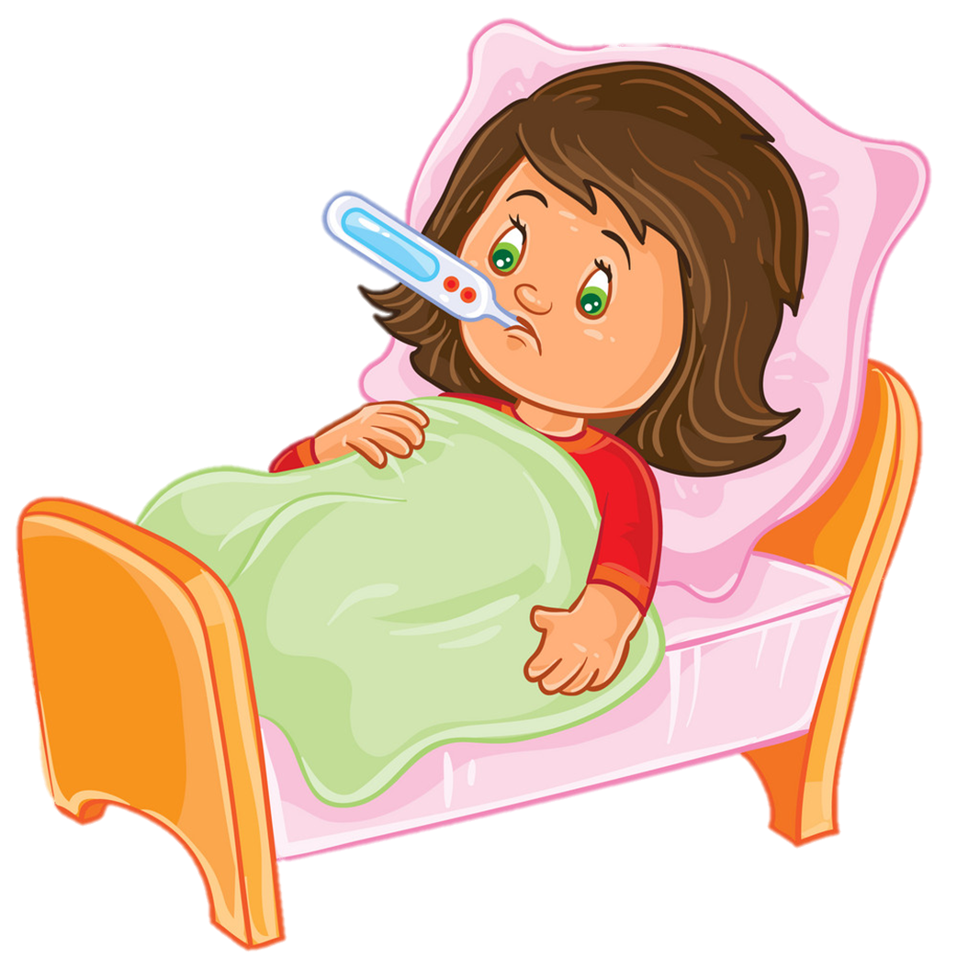
Temperature
/ˈtemprətʃər/
Extra sentence
cough
toothache
headache
sore throat
What's the matter with her/him?
She/He has a/an ______________.
backache
earache
stomach ache
fever
Earache
/ˈɪəreɪk/

Slide 46

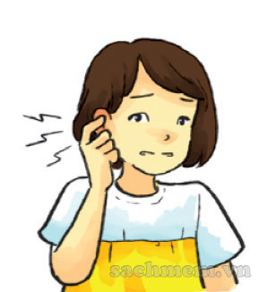
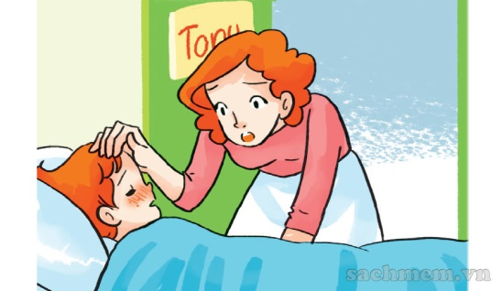
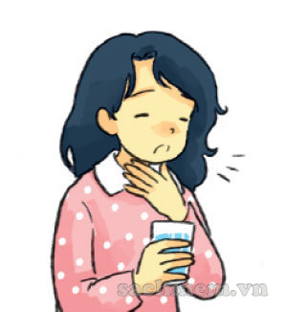
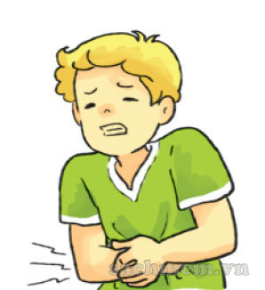
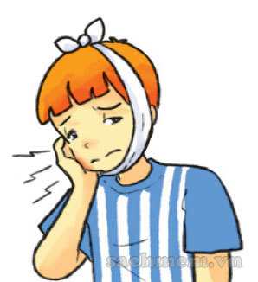
1. Vocabulary
- a fever
- a toothache
- an earache
- a sore throat
- a stomach ache
- a headache

Slide 47
Wednesday, January 5th , 2022
Unit 11: What’s the matter with you. Lesson 1 – p6,7
Words
Fever: bị sốt
a headache: đau đầu - a stomache: đau bụng
a toothache: đau răng - a sorethroat: đau họng
an earache: đau tai
2. Model sentence
What’s the matter with you?/ I have a headache.
3. HomeLink
- Luyện đọc và viết từ mới mỗi từ 2 dòng
SB (SGK – T2): 5 – p7
WB(SBT): p44,45 - Xem trước Unit 11: Lesson 2

