Slide 1



Thanh Am Primary School
WELCOME TO
OUR CLASS!
Book: English 3
Teacher : Miss Linh

Slide 2
Unit 12
This is my house
Lesson 3

Slide 3
OBJECTIVES
Review the last lesson
Practise
Learn the new phonics

Slide 4
WARM-UP

Slide 5







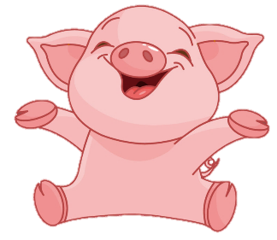


Thanh Am Primary School
2
100
200
4
1
100
-200
3
100
7
5
6
+200
200
8
100
100
9
10
200
Notes:
Ms Huyền Phạm - 0936.082.789 – YOUTUBE: MsPham. Facebook: Dạy và học cùng công nghệ.

Slide 6

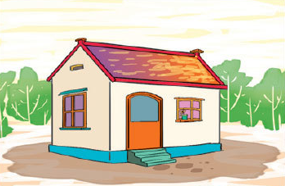


Thanh Am Primary School
Back
This is a ______. It is small.
yard
house
pond
Notes:
Ms Huyền Phạm - 0936.082.789 – YOUTUBE: MsPham. Facebook: Dạy và học cùng công nghệ.

Slide 7
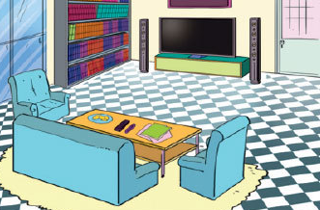
Thanh Am Primary School
Back
______ a living room. It is large.
There is
Is there
Is that
Notes:
Ms Huyền Phạm - 0936.082.789 – YOUTUBE: MsPham. Facebook: Dạy và học cùng công nghệ.

Slide 8
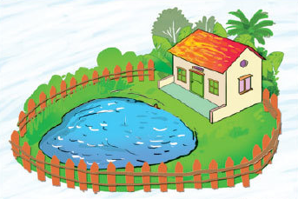
Thanh Am Primary School
Back
There is _______ in the garden.
a yard
pond
a pond
Notes:
Ms Huyền Phạm - 0936.082.789 – YOUTUBE: MsPham. Facebook: Dạy và học cùng công nghệ.

Slide 9
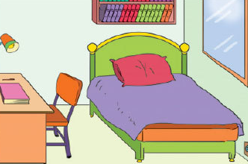
Thanh Am Primary School
Back
______ a bedroom in the house?
This is
There is
Is there
Notes:
Ms Huyền Phạm - 0936.082.789 – YOUTUBE: MsPham. Facebook: Dạy và học cùng công nghệ.

Slide 10
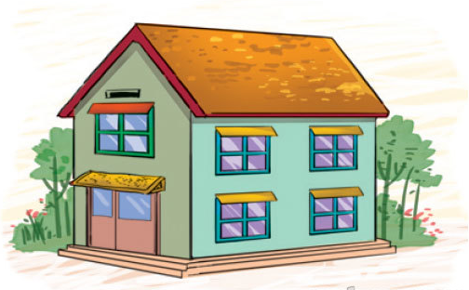

Thanh Am Primary School
Back
Is that a pond?
Answer
No, it isn't. It's a house.
Notes:
Ms Huyền Phạm - 0936.082.789 – YOUTUBE: MsPham. Facebook: Dạy và học cùng công nghệ.

Slide 11
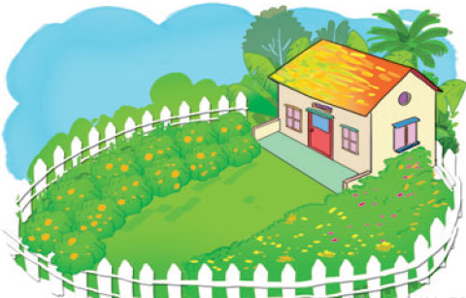
Thanh Am Primary School
Back
Is there a pond in the garden?
Answer
No, there isn't.
Notes:
Ms Huyền Phạm - 0936.082.789 – YOUTUBE: MsPham. Facebook: Dạy và học cùng công nghệ.

Slide 12
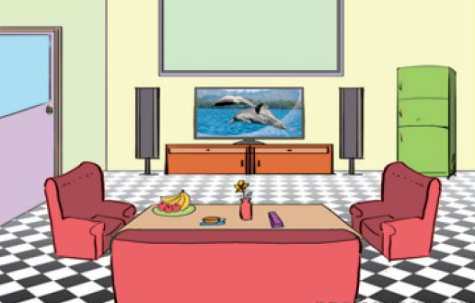
Thanh Am Primary School
Back
Is the living room large?
Answer
Yes, it is.
Notes:
Ms Huyền Phạm - 0936.082.789 – YOUTUBE: MsPham. Facebook: Dạy và học cùng công nghệ.

Slide 13
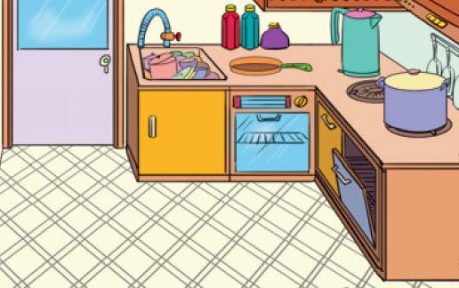
Thanh Am Primary School
Back
Is the kitchen big?
Answer
No, it isn't. It is small.
Notes:
Ms Huyền Phạm - 0936.082.789 – YOUTUBE: MsPham. Facebook: Dạy và học cùng công nghệ.

Slide 14
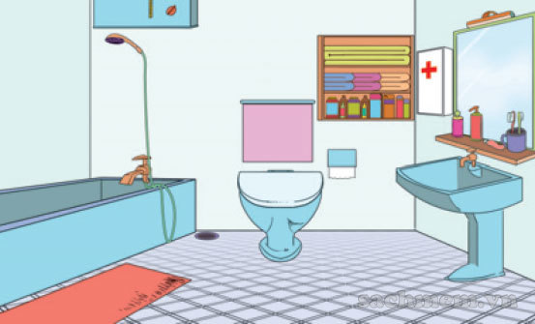
Thanh Am Primary School
Back
Yes, there is.
Is there a living room?
Is there a bathroom?
Is there a bedroom?
Notes:
Ms Huyền Phạm - 0936.082.789 – YOUTUBE: MsPham. Facebook: Dạy và học cùng công nghệ.

Slide 15
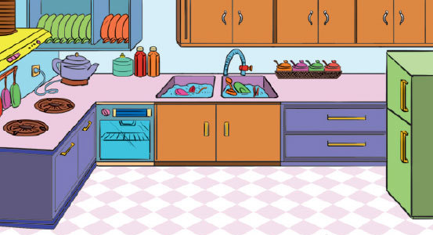
Thanh Am Primary School
Back
No, there isn’t.
Is there a kitchen?
Is there a bathroom?
Is the kitchen small?
Notes:
Ms Huyền Phạm - 0936.082.789 – YOUTUBE: MsPham. Facebook: Dạy và học cùng công nghệ.

Slide 16
PHONICS

Slide 17

1. Listen and repeat.
ch | kitchen | This is the kitchen.
th | bathroom | Is there a bathroom?

Slide 18
2. Listen and write.
1. The bathroom is large.
2. Is there a kitchen?
_____________
_____________

Slide 19
PRACTISE

Slide 20
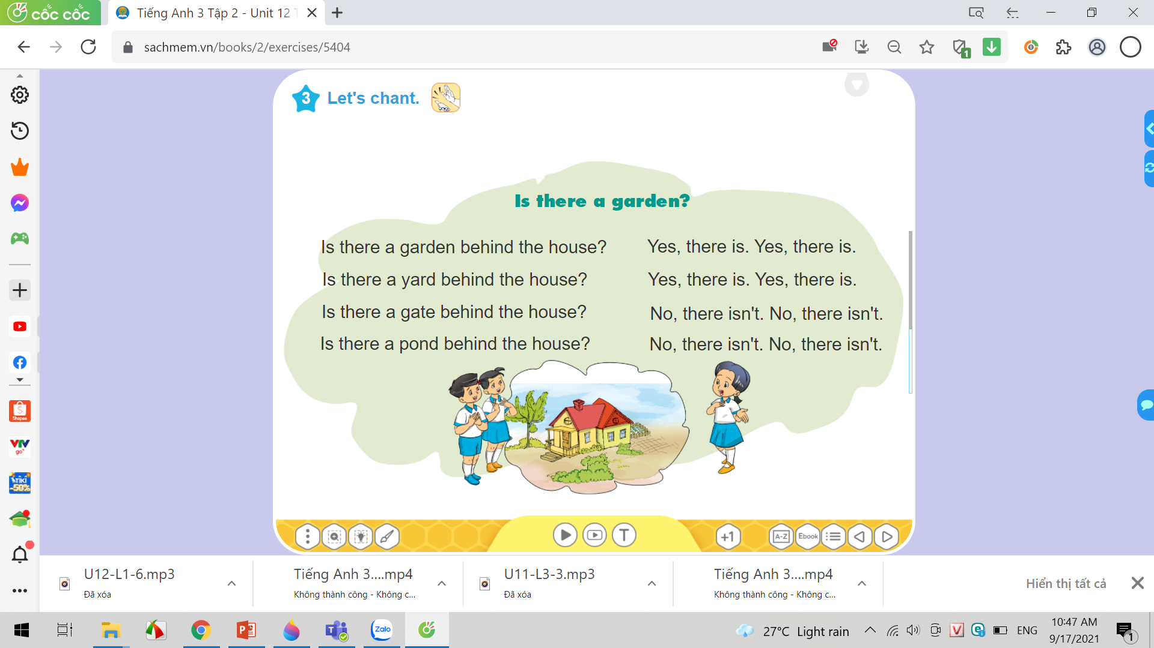

3. Let’s chant.

Slide 21
Read and match.
a. over there.
b. is large.
c. garage?
d. house.
1. This is my
2. There's a garden
3. The living room
4. Is there a

Slide 22
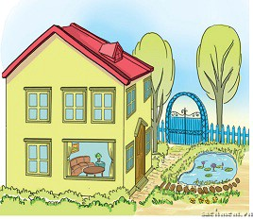
4. Look, read and write.
Hi. My name is Mai. This is my (1) house. It is large. The gate of the house is blue. There is a (2) garden in front of the house. There is a (3) pond in the garden.
________
__________
__________
You can see the (4) living room in the house. It is quite big.
________

Slide 23
5. Read again and write the answers.
1. Is Mai's house small?
No, It isn't.
2. What colour is the gate?
It's blue.
3. Is there a garden?
Yes, there is.
4. Is there a pond in the garden?
Yes, there is.
5. Is there a yard?
No, there isn't.
_________________________________
_________________________________
_________________________________
_________________________________
_________________________________

Slide 24
6. Project
Draw and colour your house. Write the names of the rooms in the house.
My house is _____________.
There is a ___________. It is ________.
There is a ________. It is ________.
There isn't a ________.

Slide 25
HOME LINK
01
02
Using the new words and sengtences in the real life
Do homework
unit 12
03
Prepare
Unit 13: Lesson 1
v

Slide 26

Thursday, January 27 2022
Unit 12: This is my house - Lesson 3
1. New words
- ch : kitchen
- th : bathroom
2. Sentences
A. There is a kitchen.
B . Is there a bathroom ?
-> Yes, there is.
-> No, there isn’t.
th

Slide 27
THANK YOU!

