Slide 1



WELCOME TO
OUR CLASS!
Book : English 3
Teacher : Miss Linh

Slide 2
Unit 12
This is my house
Lesson 2

Slide 3
OBJECTIVES
Review the last lesson
Learn the new sentences
Learn the new words

Slide 4
WARM UP

Slide 5

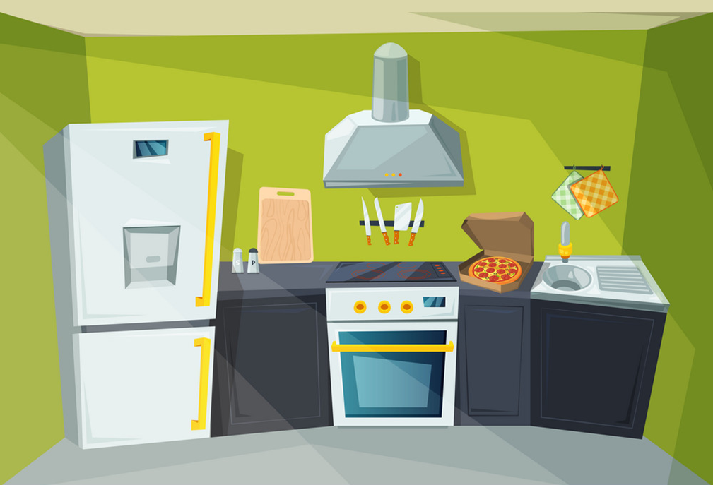


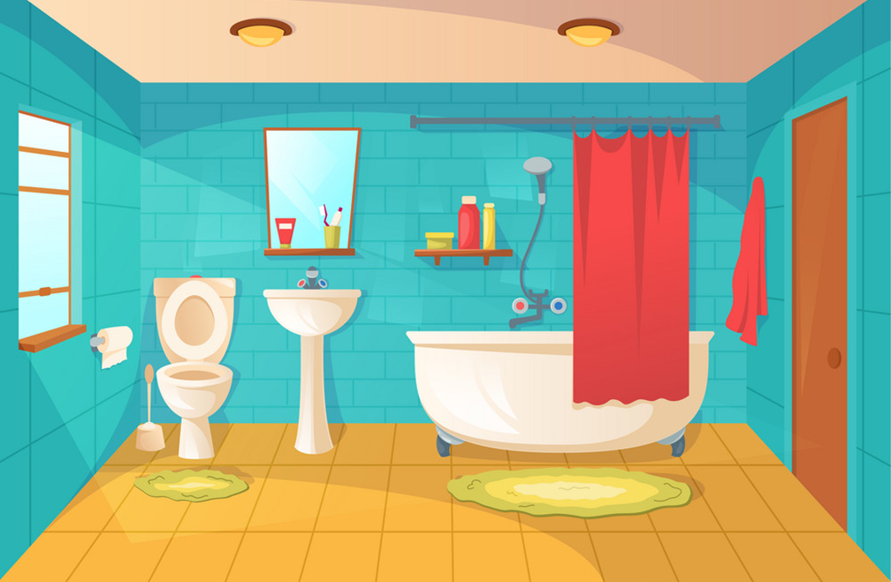


Do the puzzle
Hướng dẫn
Click ô số để mở gợi ý
Click ô số lần 2 để mở đáp án
Click bức tranh để ẩn gợi ý
5
 |  |  |  |  |  |  | K
 |  |  |  |  | G |  | I |  |  | 1 | B | E | D | R | O | O | M
 |  |  |  |  | A |  | T |  |  |  | A
 |  |  |  |  | R |  | C |  |  |  | T
 |  |  |  |  | D |  | H |  |  |  | H | O | U | S | E
 |  |  |  |  | E |  | E |  |  |  | R
 |  |  | D | I | N | I | N | G |  | R | O | O | M
 |  |  |  |  |  |  |  |  |  |  | O
 | L | I | V | I | N | G |  | R | O | O | M
4
6
5
4
2
1
6
3
1
2
3
Notes:
Ms Huyền Phạm - 0936.082.789 – YOUTUBE: MsPham. Facebook: Dạy và học cùng công nghệ.

Slide 6
NEW WORDS

Slide 7







yard
/jɑːrd/

Slide 8

gate
/ɡeɪt/

Slide 9

pond
/pɒnd/

Slide 10

fence
/fens/

Slide 11

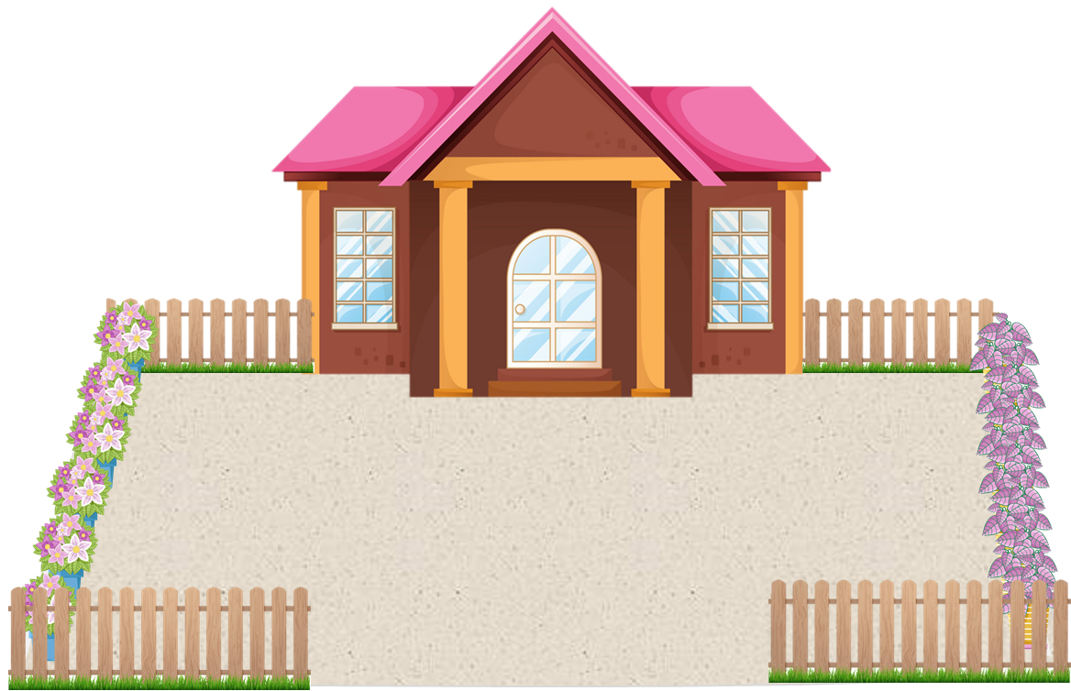

Vocabulary
gate
yard
fence
pond

Slide 12
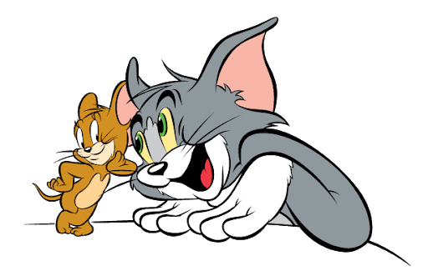
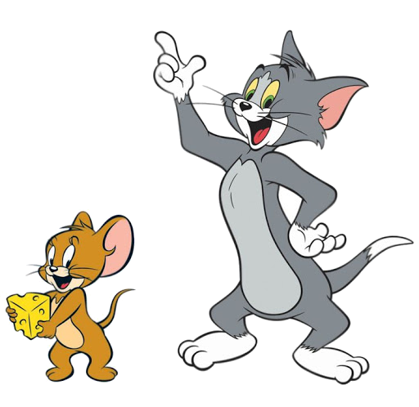

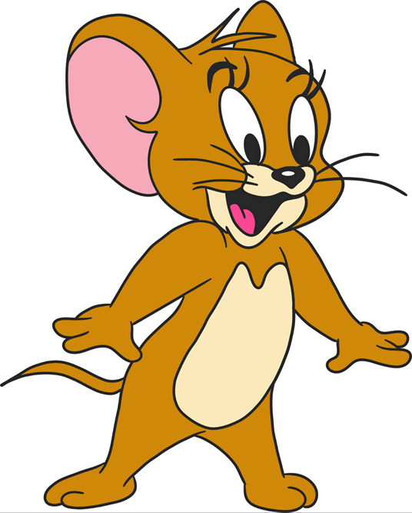


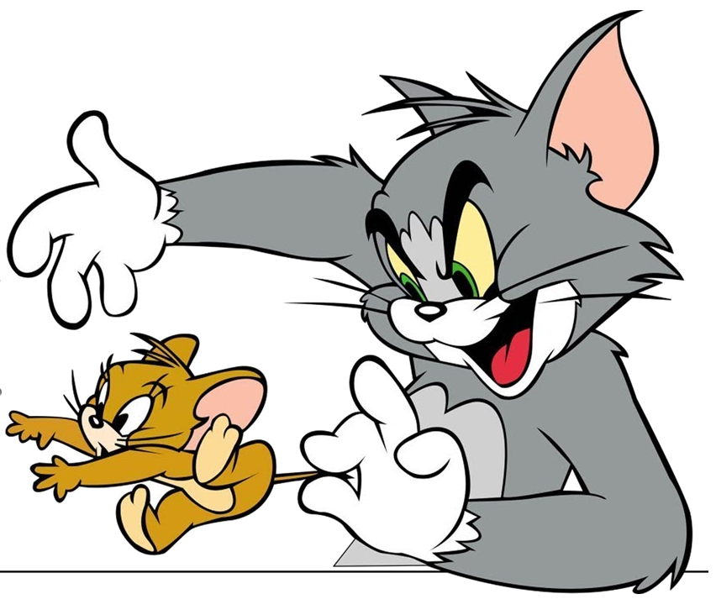

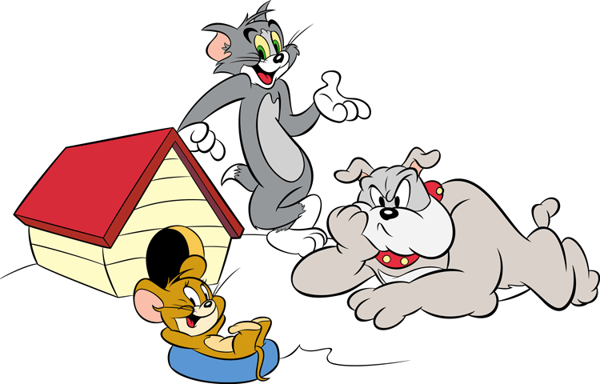
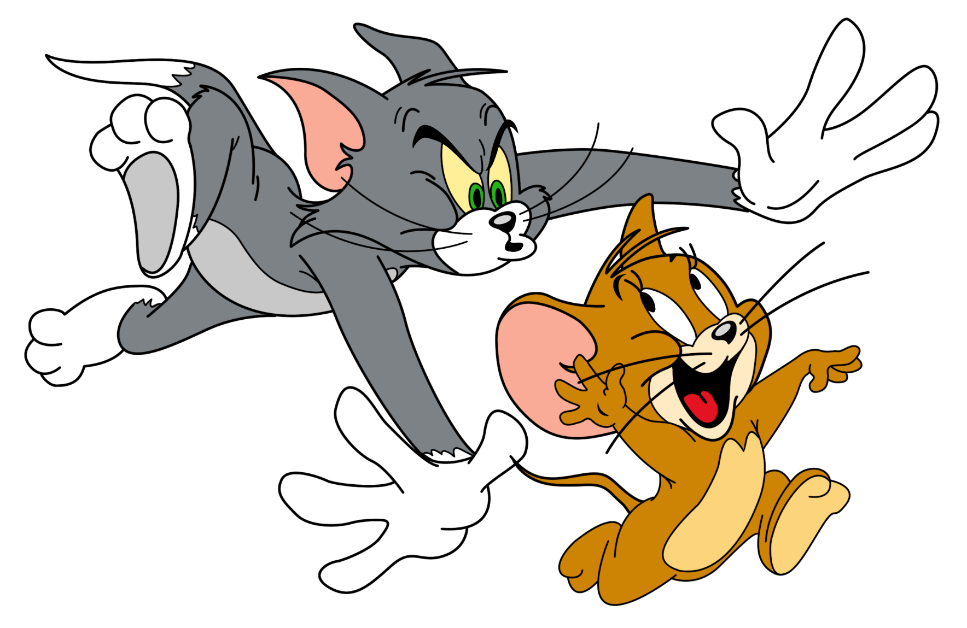



GAME
Notes:
Ms Huyền Phạm - 0936.082.789 – YOUTUBE: MsPham. Facebook: Dạy và học cùng công nghệ.

Slide 13










There is a house.
Notes:
Ms Huyền Phạm - 0936.082.789 – YOUTUBE: MsPham. Facebook: Dạy và học cùng công nghệ.

Slide 14
There is a yard.
Notes:
Ms Huyền Phạm - 0936.082.789 – YOUTUBE: MsPham. Facebook: Dạy và học cùng công nghệ.

Slide 15
There is a pond.
Notes:
Ms Huyền Phạm - 0936.082.789 – YOUTUBE: MsPham. Facebook: Dạy và học cùng công nghệ.

Slide 16

There is a fence.
Notes:
Ms Huyền Phạm - 0936.082.789 – YOUTUBE: MsPham. Facebook: Dạy và học cùng công nghệ.

Slide 17
There is a gate.
Notes:
Ms Huyền Phạm - 0936.082.789 – YOUTUBE: MsPham. Facebook: Dạy và học cùng công nghệ.

Slide 18

There is a kitchen.
Notes:
Ms Huyền Phạm - 0936.082.789 – YOUTUBE: MsPham. Facebook: Dạy và học cùng công nghệ.

Slide 19


Good job!
Notes:
Ms Huyền Phạm - 0936.082.789 – YOUTUBE: MsPham. Facebook: Dạy và học cùng công nghệ.

Slide 20
GRAMMAR

Slide 21

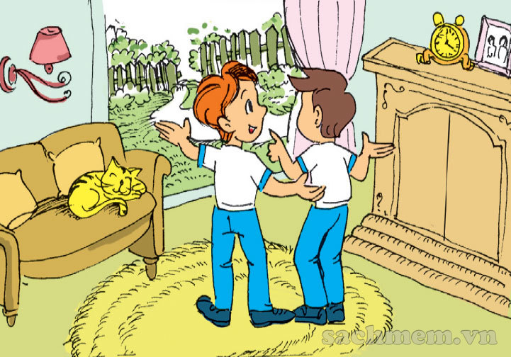
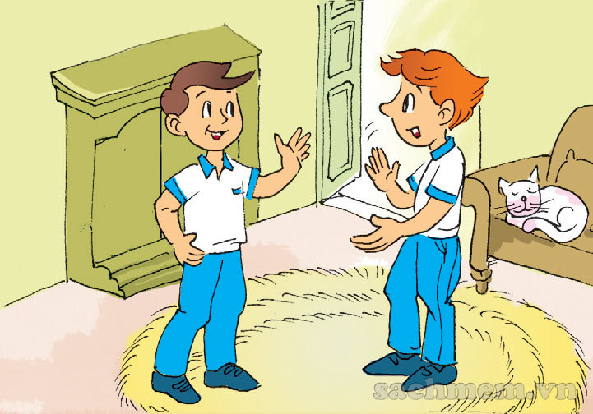
1. Look, listen and repeat.
Is there a fence?
This is the living room.
Yes, there is.
Come and see it.
Wow! It's nice!
Is there a garden?
No, there isn’t.

Slide 22
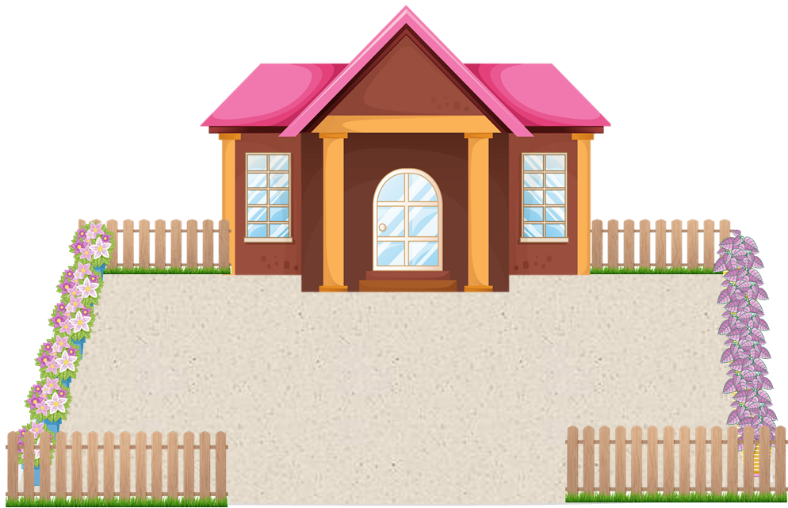



Is there ________?
Yes, there is.
No, there isn’t.
a pond
a yard
a fence
a gate

Slide 23


2. Point and say.
Is there a yard?
_____________ ?
Yes, there is.
________ .

Slide 24
2. Point and say.
Is there a gate?
_____________ ?
No, there isn’t.
__________ .

Slide 25
2. Point and say.
Is there a fence?
_____________ ?
Yes, there is.
________ .

Slide 26
2. Point and say.
Is there a pond?
_____________ ?
No, there isn’t.
____________ .

Slide 27
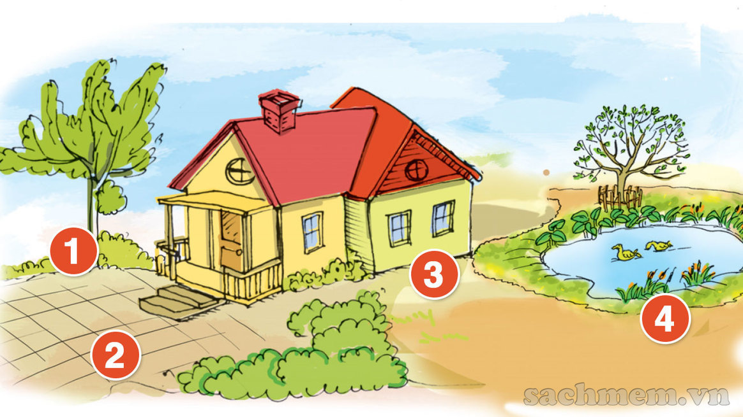

3. Let's talk.
1
Is there a fence?
No, there isn’t.

Slide 28
3. Let's talk.
2
Is there a yard?
Yes, there is.

Slide 29
3. Let's talk.
3
Is there a gate?
No, there isn’t.

Slide 30
3. Let's talk.
4
Is there a pond?
Yes, there is.

Slide 31
Vòng quay kì diệu
50
10
20
30
PLAY
10
20
30
40
Spin
Notes:
Ms Huyền Phạm - 0936.082.789 – YOUTUBE: MsPham. Facebook: Dạy và học cùng công nghệ.

Slide 32
Is there a pond?
Yes, _______.
50
10
20
30
10
20
30
40
there is
Xem đáp án
Spin
Notes:
Ms Huyền Phạm - 0936.082.789 – YOUTUBE: MsPham. Facebook: Dạy và học cùng công nghệ.

Slide 33
___ there a house?
No, there isn’t.
50
10
20
30
10
20
30
40
Is
Xem đáp án
Spin
Notes:
Ms Huyền Phạm - 0936.082.789 – YOUTUBE: MsPham. Facebook: Dạy và học cùng công nghệ.

Slide 34

____________
Yes, there is.
50
10
20
30
10
20
30
40
Is there a fence?
Xem đáp án
Spin
Notes:
Ms Huyền Phạm - 0936.082.789 – YOUTUBE: MsPham. Facebook: Dạy và học cùng công nghệ.

Slide 35
Is there a gate?
No, there ______.
50
10
20
30
10
20
30
40
isn’t
Xem đáp án
Spin
Notes:
Ms Huyền Phạm - 0936.082.789 – YOUTUBE: MsPham. Facebook: Dạy và học cùng công nghệ.

Slide 36
Are there a garden?
Yes, there is.
True - False
50
10
20
30
10
20
30
40
False
Xem đáp án
Spin
Notes:
Ms Huyền Phạm - 0936.082.789 – YOUTUBE: MsPham. Facebook: Dạy và học cùng công nghệ.

Slide 37
Is there a yard?
_____ , there is.
50
10
20
30
10
20
30
40
Yes
Xem đáp án
Spin
Notes:
Ms Huyền Phạm - 0936.082.789 – YOUTUBE: MsPham. Facebook: Dạy và học cùng công nghệ.

Slide 38



50
10
20
30
10
20
30
40
EXIT
Notes:
Ms Huyền Phạm - 0936.082.789 – YOUTUBE: MsPham. Facebook: Dạy và học cùng công nghệ.

Slide 39

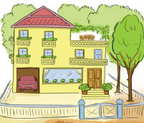
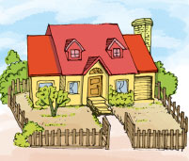
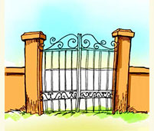
4. Listen and number.
a
b
c
d
2
1
4
3

Slide 40
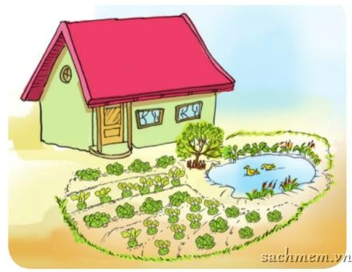
5. Read and complete.
beautiful
pond
house
tree
Hi! My name is Phong. This is my
(1) house. There is not any fence around my house. There is not a yard, but there is a garden in front of the house. It is (2) beautiful. There is a (3) tree / pond and a (4) pond / tree in the garden.
_____.
______.
________
________

Slide 41
Read and match
a. No, it isn't. It's old.
b. Wow! It's beautiful!
c. Yes. There is.
d. Yes, it is my house.
Is there a pond
in front of the house?
2. Is that your house?
3. That is my room.
4. Is the house new?

Slide 42
6. Write about your house.
 | Yes, there is. / No, there isn't.
1. Is there a garden?
2. Is there a fence?
3. Is there a yard?
4. Is there a pond?
5. Is there a tree?

Slide 43
HOME LINK
01
02
Using the new words and sengtences in the real life
Do homework
B(1,2,3) - Page
03
Prepare
Unit 12: Lesson 3
v

Slide 44

Tuesday, January 25 2022
Unit 12: This is my house - Lesson 2
1. New words
- yard : cái sân
- gate : cái cổng
- pond : cái ao
- fence : hàng rào
2. Sentences
Is there a fence ?
-> Yes, there is.
-> No, there isn’t.
th

Slide 45
THANK YOU!

