Slide 1

WELCOME TO
OUR CLASS!
Book: English 3
Teacher : Miss Linh

Slide 2
Unit 12
Lesson 1
This is my house

Slide 3
Review the last Unit
Learn the new words
about topic “house”
Learn the new sentences
about topic “house”
OBJECTIVES

Slide 4
WARM-UP

Slide 5
Read and match.
1. Who's that man?
2. How old is your brother?
3. How old are you?
4. Is your grandfather old?
a. I'm ten.
b. Yes, he is.
c. He's thirteen.
d. He's my father.

Slide 6
VOCABULARY

Slide 7

house
/haʊs/

Slide 8
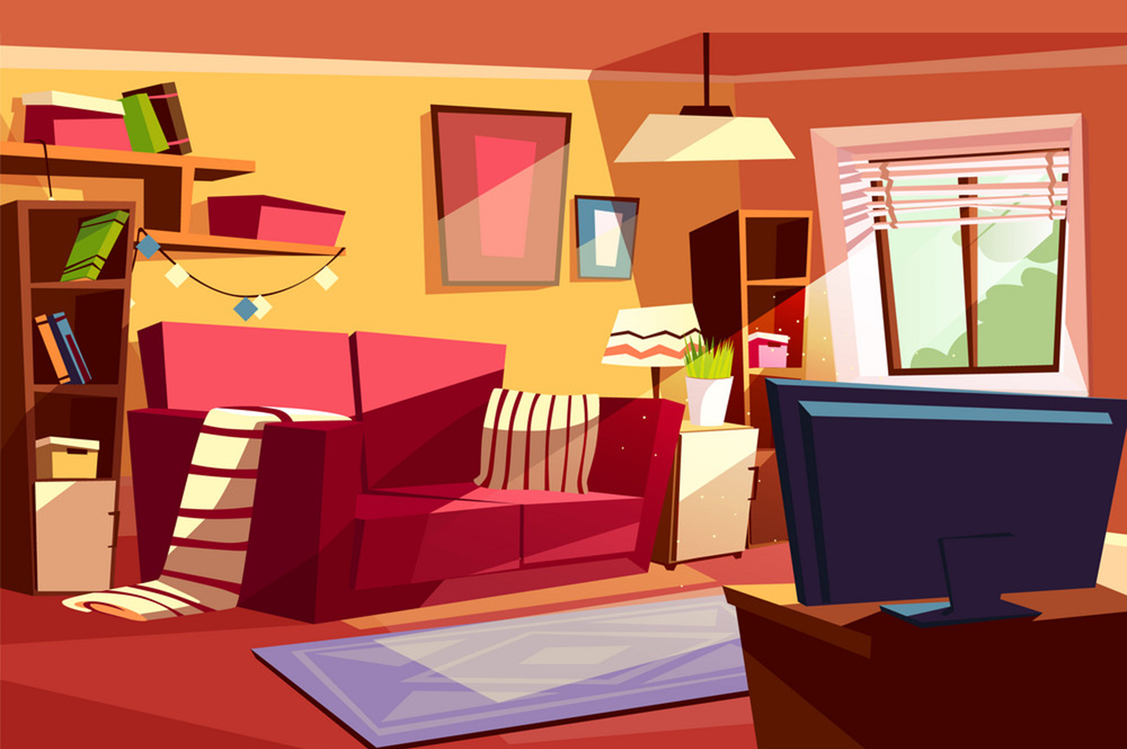
living room
/ˈlɪvɪŋ ruːm/

Slide 9
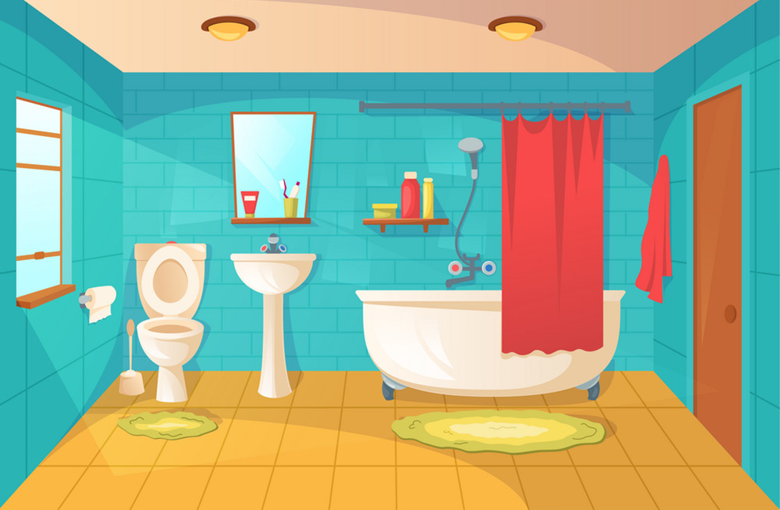
bathroom
/ˈbæθruːm/

Slide 10
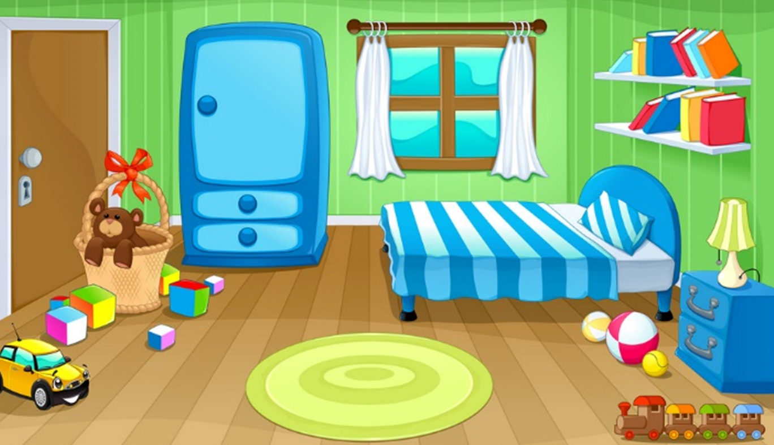
bedroom
/ˈbedruːm/

Slide 11
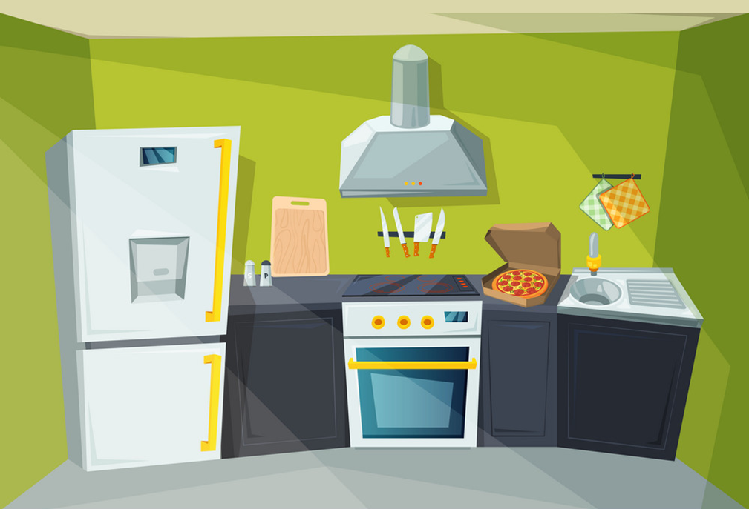
kitchen
/ˈkɪtʃɪn/

Slide 12
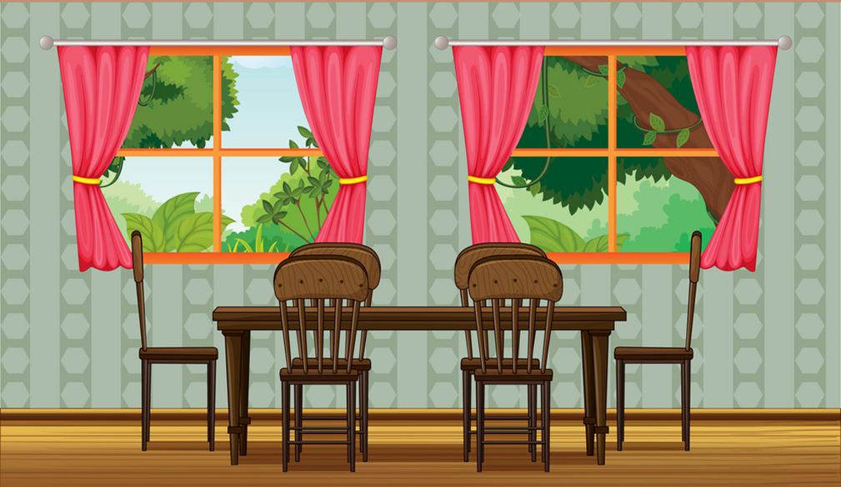
dining room
/ˈdaɪnɪŋ ruːm/

Slide 13

garden
/ˈɡɑːrdn/

Slide 14

Vocabulary
garden
house
dining room
bedroom
living room
kitchen
bathroom

Slide 15
Grammar

Slide 16


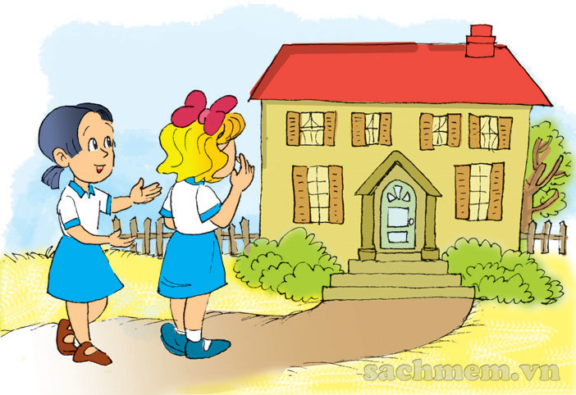
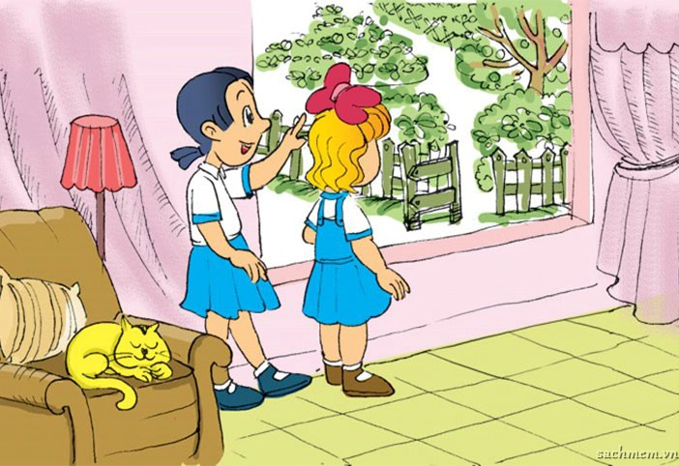
1. Look, listen and repeat.
This is my house.
There's a garden over there.
Come and see it.
Wow! It's big!
It's very nice!

Slide 17
Model sentence
There is a ________.
It’s very nice.
bathroom
livingroom
kitchen
bedroom
garden
dining room

Slide 18


2. Point and say.
There's a living room.
_____________ .
It's very nice!

Slide 19
2. Point and say.
There's a bathroom.
_____________ .
It's very nice!

Slide 20
2. Point and say.
There's a bedroom.
_____________ .
It's very nice!

Slide 21
2. Point and say.
There's a kitchen.
_____________ .
It's very nice!

Slide 22
2. Point and say.
There's a dining room.
_____________ .
It's very nice!

Slide 23
2. Point and say.
There's a garden.
_____________ .
It's very nice!

Slide 24
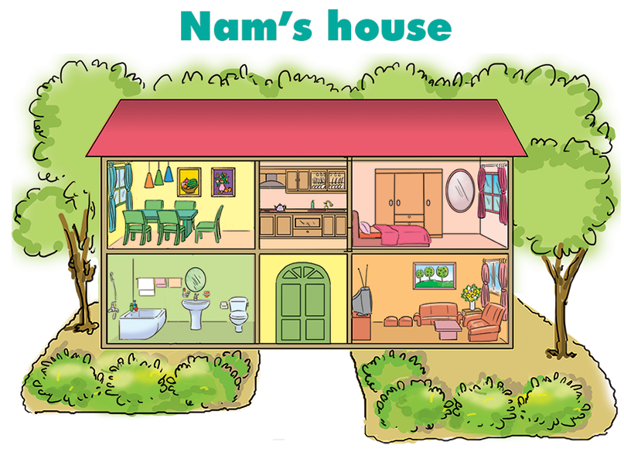
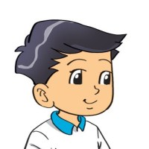
3. Let's talk.
There's a kitchen.
1
2
3
Wow!
It's very nice!
4
5

Slide 25
3. Let's talk.
There's a bedroom.
1
2
3
Wow! It's very nice!
4
5

Slide 26
3. Let's talk.
There's a bathroom.
1
2
3
Wow!
It's very nice!
4
5

Slide 27
3. Let's talk.
There's a
living room.
1
2
3
Wow!
It's very nice!
4
5

Slide 28
3. Let's talk.
There's a
dining room.
1
2
3
Wow!
It's very nice!
4
5

Slide 29









PLAY

Slide 30







This is_________.
a house
Next
Notes:
Ms Huyền Phạm - 0936.082.789 – YOUTUBE: MsPham. Facebook: Dạy và học cùng công nghệ.

Slide 31
There is ________.
a living room
Next
Notes:
Ms Huyền Phạm - 0936.082.789 – YOUTUBE: MsPham. Facebook: Dạy và học cùng công nghệ.

Slide 32
There is _______.
a bedroom
Next
Notes:
Ms Huyền Phạm - 0936.082.789 – YOUTUBE: MsPham. Facebook: Dạy và học cùng công nghệ.

Slide 33
There is _________.
a dining room
Next
Notes:
Ms Huyền Phạm - 0936.082.789 – YOUTUBE: MsPham. Facebook: Dạy và học cùng công nghệ.

Slide 34
There is _______________.
a bathroom
Next
Notes:
Ms Huyền Phạm - 0936.082.789 – YOUTUBE: MsPham. Facebook: Dạy và học cùng công nghệ.

Slide 35
There is _________.
a kitchen
Next
Notes:
Ms Huyền Phạm - 0936.082.789 – YOUTUBE: MsPham. Facebook: Dạy và học cùng công nghệ.

Slide 36
There is __________.
a garden
Next
Notes:
Ms Huyền Phạm - 0936.082.789 – YOUTUBE: MsPham. Facebook: Dạy và học cùng công nghệ.

Slide 37
WELL DONE!
EXIT
Notes:
Ms Huyền Phạm - 0936.082.789 – YOUTUBE: MsPham. Facebook: Dạy và học cùng công nghệ.

Slide 38


4. Listen and tick.
a
a
a
b
b
b
1
2
3

Slide 39
5. Look and write
There is a dining room.
_____________ .
This is a house.
_____________ .
There is a bathroom.
_____________ .
There is
a living room.
_____________ .
There is a garden.
_____________ .
There is a bedroom.
_____________ .
There is a kitchen.
_____________ .

Slide 40

Do homework
A(2,3) - page
Revision the new
words
Revision the new
sentences
Prepare
Unit 12: Lesson 2

Slide 41





Friday, January 21 2022
Unit 12: This is my house - Lesson 1
1. New words
- house : ngôi nhà
- living room : phòng khách
- dining room: phòng ăn
- kitchen : phòng bếp
- bedroom : phòng ngủ
- bathroom : phòng tắm
- garden : sân vườn
2. Sentences
There is a ............ (room)
-> It’s very nice.
th

Slide 42

THANKS

