Slide 1



WELCOME TO OUR
CLASS!
Book: English 3
Teacher : Miss Linh

Slide 2
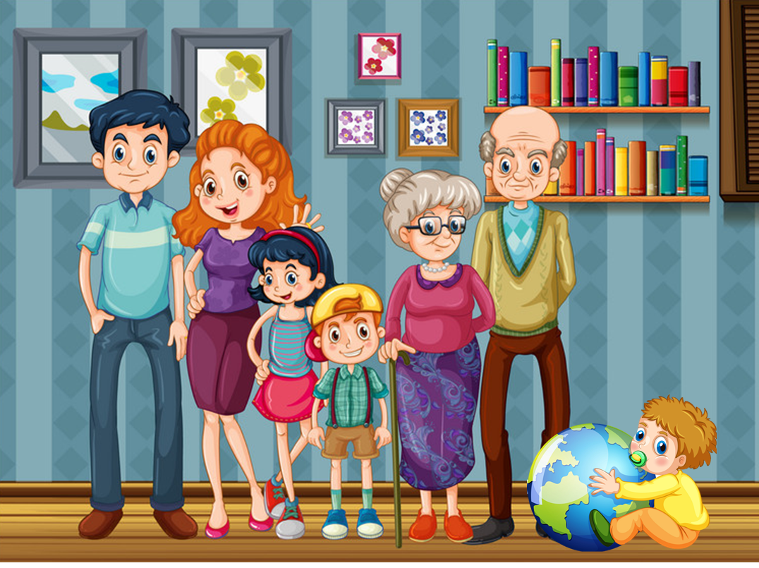
Unit
11
This is my family
Lesson 3

Slide 3
OBJECTIVES
01
02
!
!
Review the last lesson.
( word and sentence)
Review the numbers
03
04
Learn the new words
Learn the new phonics
“br” and “gr”

Slide 4

Warm
up
Review

Slide 5
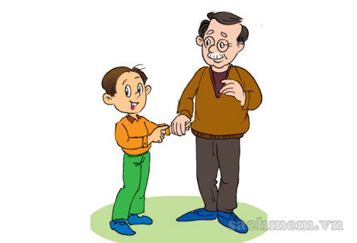
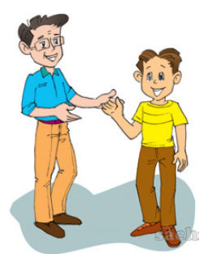
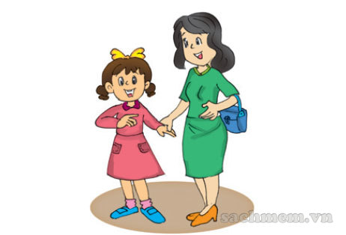
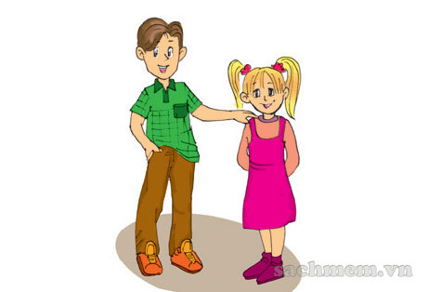
13
66
He is my grandfather.
He's sixty-six years old.
He's my son.
He's thirteen years old.
40
10
She's my mother.
She's forty years old.
She's my sister.
She's ten years old.

Slide 6
PHONICS

Slide 7

1. Listen and repeat.
br | gr
brother | grandmother
That's my brother. | My grandmother's fifty-five years old.

Slide 8

2. Listen and write.
"
"
1. My brother is fifteen.
2. My grandfather is fifty-three
years old.
______________
______________

Slide 9
Vocabulary

Slide 10
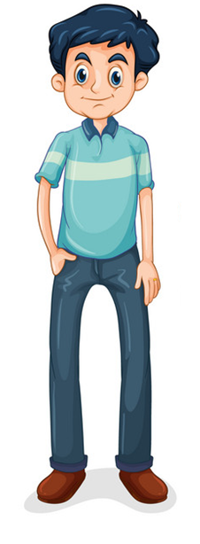
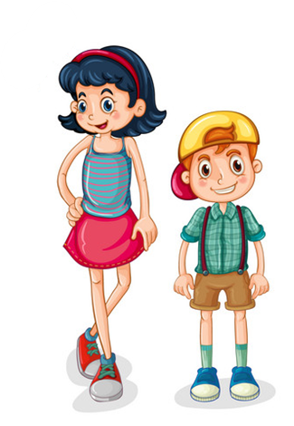
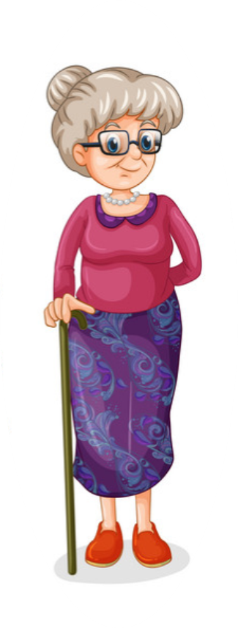
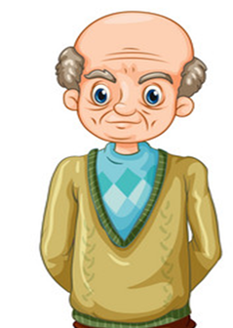

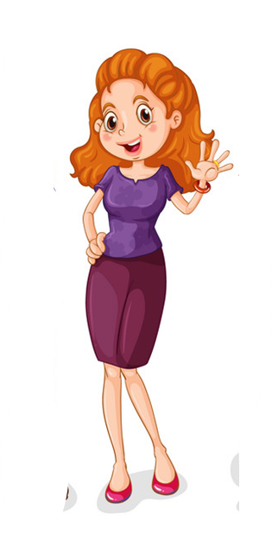
man
boy
old
woman
girl
young

Slide 11
Grammar

Slide 12


Who’s that man?
He’s my grandfather.
Who’s that woman?
She’s my grandmother.
SLIDESMANIA.COM

Slide 13
Who’s that man?
He’s my father.
Who’s that woman?
She’s my mother.

Slide 14
Who’s that girl?
She’s my sister.
Who’s that boy?
He’s my brother.

Slide 15









PLAY
Notes:
Ms Huyền Phạm - 0936.082.789 – YOUTUBE: MsPham. Facebook: Dạy và học cùng công nghệ.

Slide 16
Who’s that woman?
+18
He’s my mother.
She’s my mother.
She’s my father.
He’s my father.
Next
Notes:
Ms Huyền Phạm - 0936.082.789 – YOUTUBE: MsPham. Facebook: Dạy và học cùng công nghệ.

Slide 17
Who’s that girl?
+25
He’s my brother.
He’s my sister.
She’s my brother.
She’s my sister.
Next
Abc.xyz789
Notes:
Ms Huyền Phạm - 0936.082.789 – YOUTUBE: MsPham. Facebook: Dạy và học cùng công nghệ.

Slide 18
Who’s that man?
She’s my mother.
He’s my mother.
+17
He’s my father.
She’s my father.
Next
Abc.xyz789
Notes:
Ms Huyền Phạm - 0936.082.789 – YOUTUBE: MsPham. Facebook: Dạy và học cùng công nghệ.

Slide 19
Who’s that woman?
+13
He’s my grandfather.
She’s my grandfather.
He’s my grandmother.
She’s my grandmother.
Next
Abc.xyz789
Notes:
Ms Huyền Phạm - 0936.082.789 – YOUTUBE: MsPham. Facebook: Dạy và học cùng công nghệ.

Slide 20
Who’s that boy?
+ 20
He’s my brother.
She’s my brother.
He’s my sister.
She’s my sister.
Next
Abc.xyz789
Notes:
Ms Huyền Phạm - 0936.082.789 – YOUTUBE: MsPham. Facebook: Dạy và học cùng công nghệ.

Slide 21
Who’s that man?
+14
She’s my mother.
He’s my mother.
She’s my grandfather.
He’s my grandfather.
Next
Abc.xyz789
Notes:
Ms Huyền Phạm - 0936.082.789 – YOUTUBE: MsPham. Facebook: Dạy và học cùng công nghệ.

Slide 22
He is the son.
+14
Who is that woman?
Who is that boy?
Who is that man?
Who is that girl?
Next
Abc.xyz789
Notes:
Ms Huyền Phạm - 0936.082.789 – YOUTUBE: MsPham. Facebook: Dạy và học cùng công nghệ.

Slide 23
She is the mother.
+15
Who is that girl?
Who is that boy?
Who is that woman?
Who is that man?
Next
Abc.xyz789
Notes:
Ms Huyền Phạm - 0936.082.789 – YOUTUBE: MsPham. Facebook: Dạy và học cùng công nghệ.

Slide 24
He is the father.
+ 9
Who is that man?
Who is that girl?
Who is that woman?
Who is that boy?
Next
Abc.xyz789
Notes:
Ms Huyền Phạm - 0936.082.789 – YOUTUBE: MsPham. Facebook: Dạy và học cùng công nghệ.

Slide 25
She is the daughter.
+50
Who is that boy?
Who is that woman?
Who is that girl?
Who is that man?
Next
Abc.xyz789
Notes:
Ms Huyền Phạm - 0936.082.789 – YOUTUBE: MsPham. Facebook: Dạy và học cùng công nghệ.

Slide 26
WELL DONE!
EXIT
Notes:
Ms Huyền Phạm - 0936.082.789 – YOUTUBE: MsPham. Facebook: Dạy và học cùng công nghệ.

Slide 27
PRACTISE

Slide 28

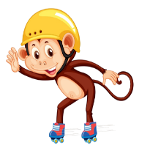
Read and match.
1. Who’s that?
2. How old are you?
3. How old is your father?
4. How old is your mother?
a. I’m ten.
b. He’s fifty.
c. She’s forty-five.
d. It’s my mother.

Slide 29
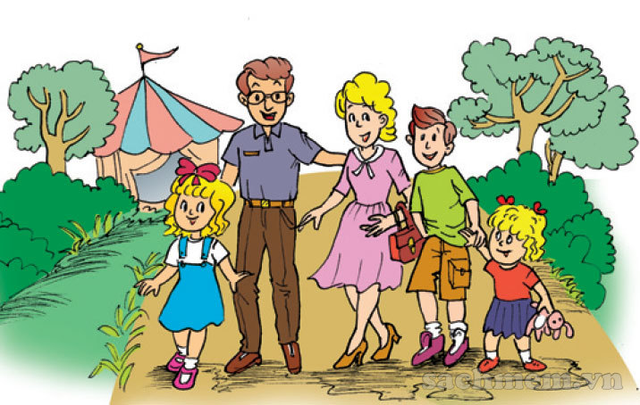
Look, read and write.
This is a photo of my (1) family. Look at the man. He is my (2) father. He is forty-four years old. The woman next to him is my (3) mother. She is thirty-nine years old. The boy is my (4) brother. He is fourteen years old. And the little girl is my (5) sister. She is five years old. Can you find me and guess how old I am?
_________
_________
_________
_________
_______

Slide 30
Project
Draw your family. Tell your classmates about it.
There are _______ people in my family.
My father is _________ years old, and my mother _______ is years old.
My sister/brother is _______ years old.
I am _______ years old.
We are a happy _______.

Slide 31
Home link
Using the new words and sentences in the real life .
Prepare:
Unit 12: Lesson 1
Do the homework in WB (SBT): page

Slide 32

Wednesday, January 19 2022
Unit 11: This is my family - Lesson 3
1. Phonics
- br : brother
- gr : grandmother
2. New words
- man : đàn ông
- woman : phụ nữ
- boy : cậu bé
- girl : cô bé
- young : trẻ
- old : già
3. Homework
th

Slide 33


Thank you!

