Slide 1
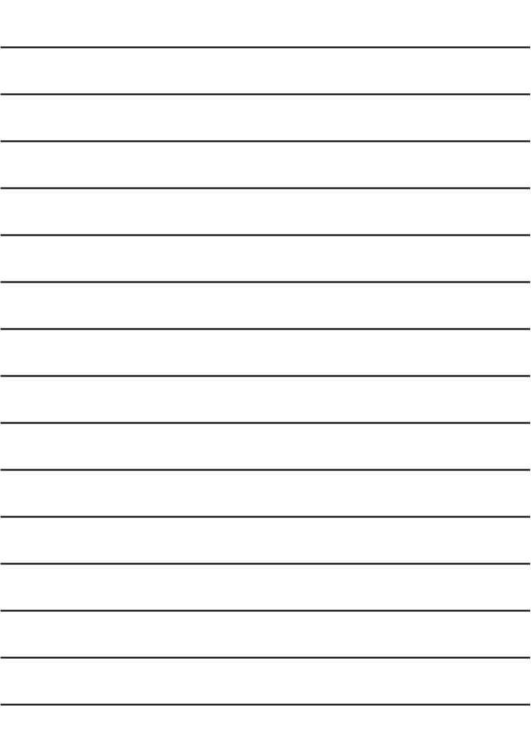

Book: English 3
Teacher : Miss Linh
Welcome to
our class!

Slide 2
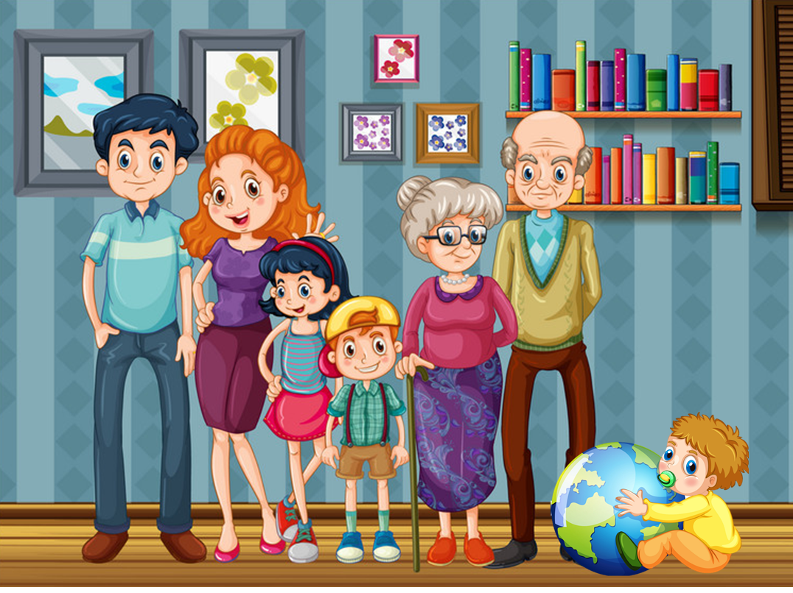

Unit 11
This is my family
Lesson 2

Slide 3
Objectives
01 .
Review last lesson
( words and sentence)
02 .
03 .
Learn the numbers
(from 11 to 100)
Learn the new sentences

Slide 4
Warm up

Slide 5
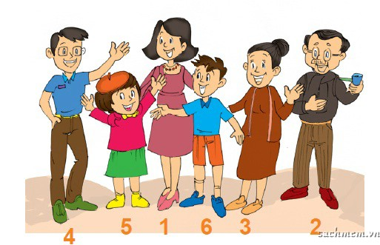
Who’s that?
He’s my grandfather.
Who’s that?
He’s my father.
Who’s that?
He’s my brother.
Who’s that?
She’s my sister.
4
5
1
6
3
2
Who’s that?
She’s my mother.
Who’s that?
She’s my grandmother.

Slide 6

Numbers

Slide 7



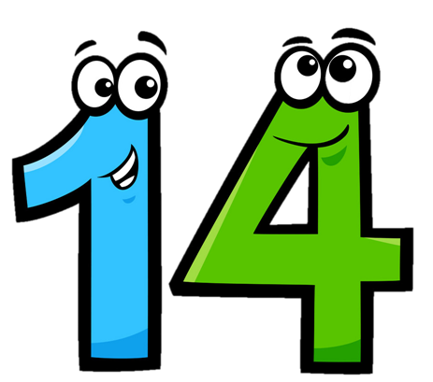




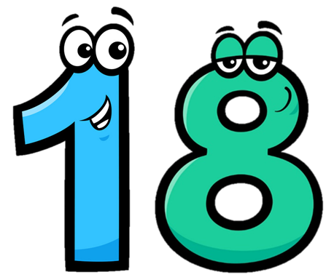

eleven
/ɪˈlevn/
twelve
/twelv/
thirteen
/ˌθɜːˈtiːn/
fourteen
/ˌfɔːˈtiːn/
fifteen
/ˌfɪfˈtiːn/
sixteen
/ˌsɪksˈtiːn/
seventeen
/ˌsevnˈtiːn/
eighteen
/ˌeɪˈtiːn/
nineteen
/ˌnaɪnˈtiːn/

Slide 8








twenty
/ˈtwenti/
thirty
/ˈθɜːti/
forty
/ˈfɔːti/
fifty
/ˈfɪfti/
seventy
/ˈsevnti/
eighty
/ˈeɪti/
ninety
/ˈnaɪnti/
sixty
/ˈsɪksti/

Slide 9



a
b
c
eleven

Slide 10
a
b
c
twelve

Slide 11
a
b
c
thirteen

Slide 12
a
b
c
fourteen

Slide 13
Choose the correct number.
a
b
c
fifteen

Slide 14
a
b
c
sixteen

Slide 15
a
b
c
seventeen

Slide 16
a
b
c
eighteen

Slide 17
a
b
c
nineteen

Slide 18
fifteen
sixteen
seventeen
eleven
thirteen
twelve
eighteen
nineteen
sixteen

Slide 19
fifteen
thirteen
eighteen
eleven
sixteen
twelve
fourteen
fifteen
sixteen

Slide 20
eleven
nineteen
eighteen
twelve
eleven
thirteen
fifteen
fourteen
twelve

Slide 21
forty
thirty
fifty
twenty

Slide 22
ninety
seventy
eighty
sixty

Slide 23
21
=
20
+
1
twenty-one
twenty
one
22
=
20
+
2
twenty-two
twenty
two

Slide 24
34
=
30
+
4
thirty-four
thirty
four
43
=
40
+
3
forty-three
forty
three

Slide 25
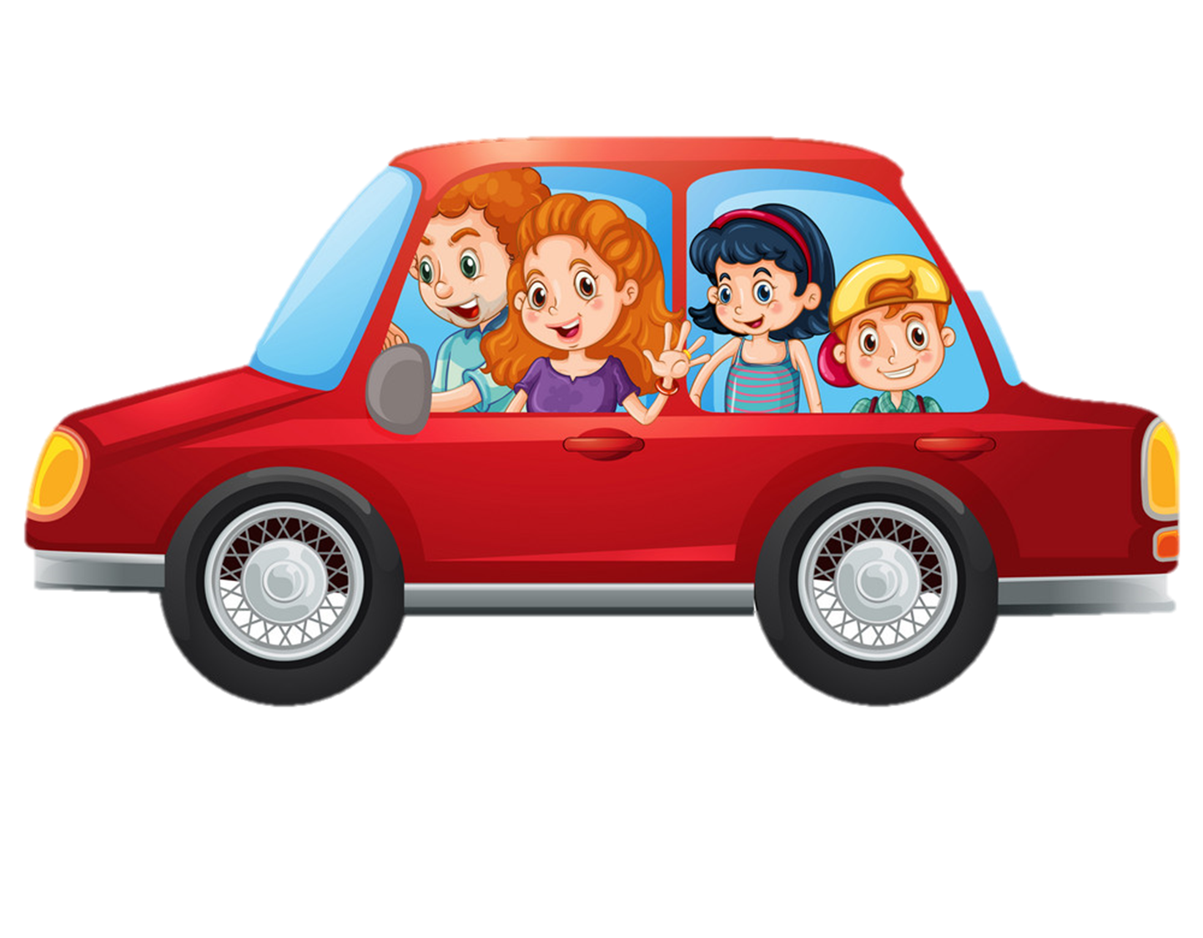
Look and say.
68
41
sixty-eight
forty-one
65
13
sixty-five
thirteen
42
11
forty-two
eleven

Slide 26

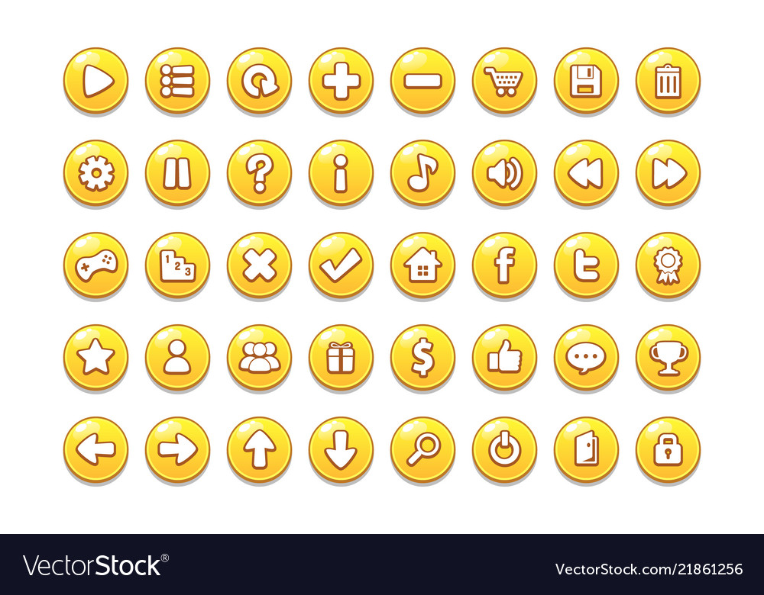


Slide 27
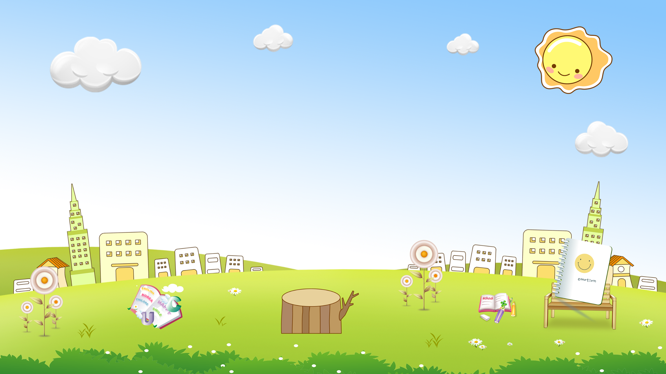










are
a. thirteen b. twelve
c. eleven
a
b
c

Slide 28
old
a. twoteen b. twelve
c. twenty
a
b
c

Slide 29
you
a. fifteen b. fourteen
c. fiveteen
a
b
c

Slide 30
old
a. threeteen b. thirteen
c. thirty
a
b
c

Slide 31
are
a. thirteen b. twelve
c. thirty
a
b
c

Slide 32
you
a. fourteen b. forteen
c. fourty
a
b
c

Slide 33
are
a. twelve b. twenteen
c. twenty
a
b
c

Slide 34
old
a. fourty b. forty
c. fourteen
a
b
c

Slide 35
you
a. fifty b. fivety
c. fifteen
a
b
c

Slide 36


are
a. nine-two b. nineteen-two
c. ninety-two
a
b
c

Slide 37

old
a. fifty b. fifty-five
c. fifteen
a
b
c

Slide 38


you
a. eighty-six b. sixteen
c. eight-six
a
b
c

Slide 39


are
a. seventeen b. seventy
c. seventy-three
a
b
c

Slide 40

old
a. four-two b. forty-two
c. fourty-two
a
b
c

Slide 41

you
a. thirty-one b. eleven
c. three-one
a
b
c

Slide 42


GOOD JOB!
STOP

Slide 43

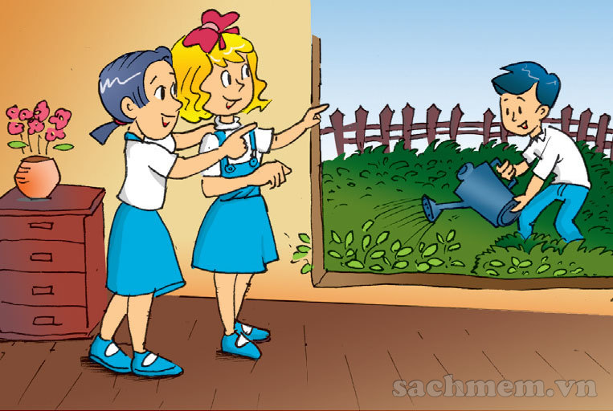
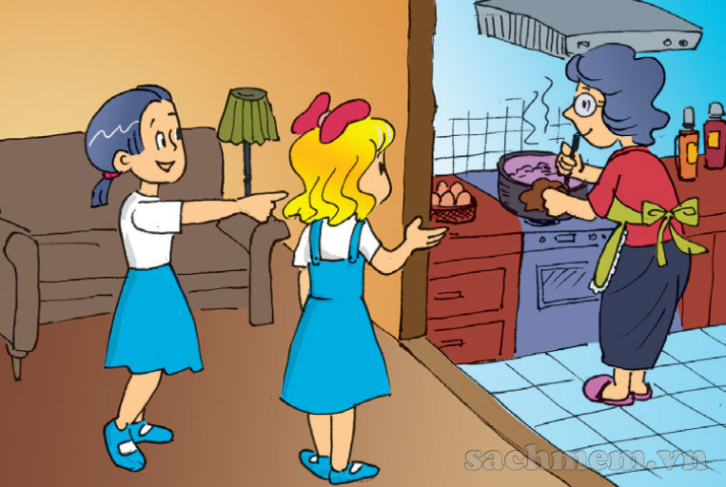
1. Look, listen and read.
a
b
That's my brother.
How old is your brother?
That's my grandmother.
How old is she?
He's seven.
She's sixty-five.

Slide 44
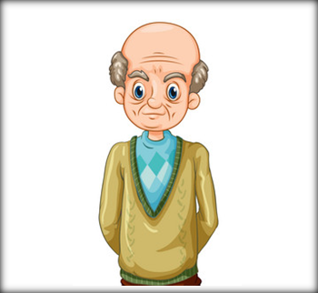
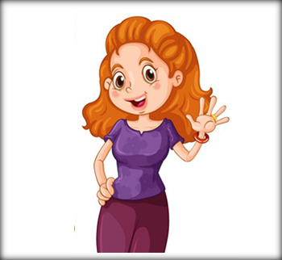
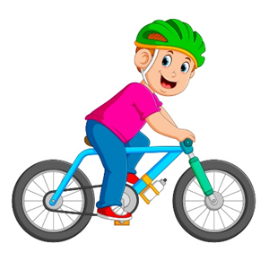

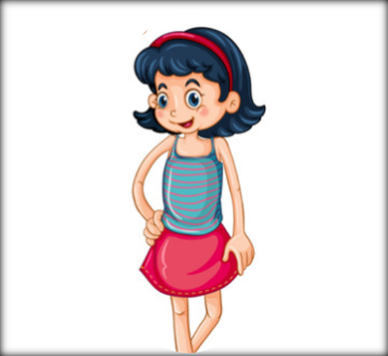
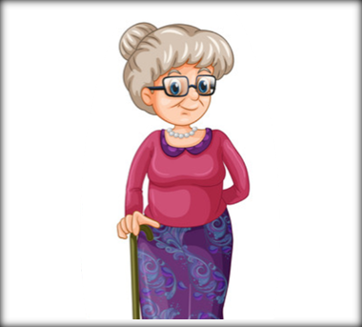
Model sentence
How old is your ____?
_____’s _______.
grandfather
mother
He, 67
She, 38
brother
father
sister
grandmother
She, 59
He, 15
He, 44
She, 11

Slide 45
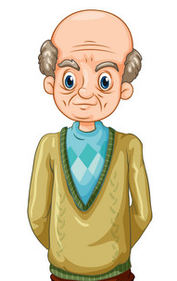
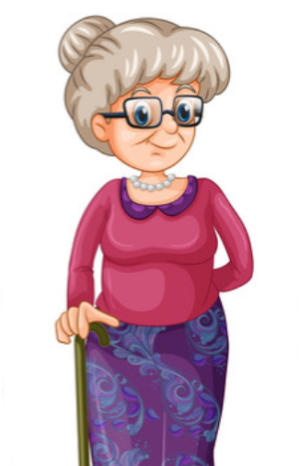
2. Point and say.
1
How old is your grandfather?
_______________________?
He’s sixty-eight.
________________________.
68
How old is your grandmother?
2
_______________________
She’s sixty-five.
__________________________.
65

Slide 46
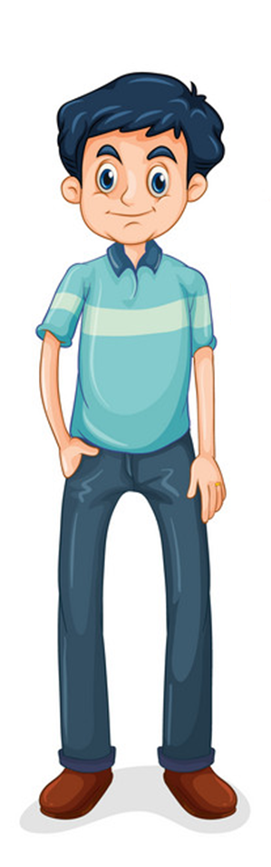
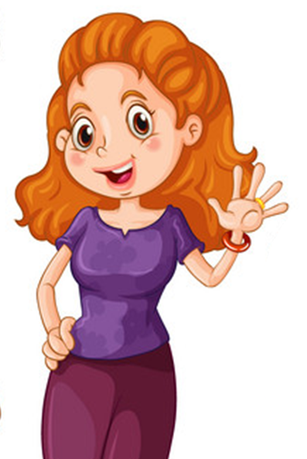
2. Point and say.
How old is your father?
3
__________
He’s forty-two.
________________________.
42
4
How old is your mother?
____________
She’s forty-one.
__________________________.
41

Slide 47
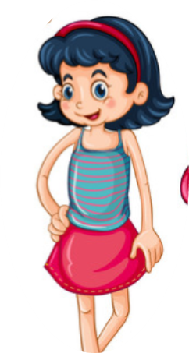
2. Point and say.
5
How old is your brother?
__________
He’s thirteen.
________________________.
13
6
How old is your sister?
____________?
She’s eleven.
__________________________.
11

Slide 48


A
B
1. Who’s that?
a. I’m ten.
2. How old are you?
b. He’s fifty.
3. How old is your father?
c. She’s forty-five.
4. How old is your mother?
d. It’s my mother.

Slide 49
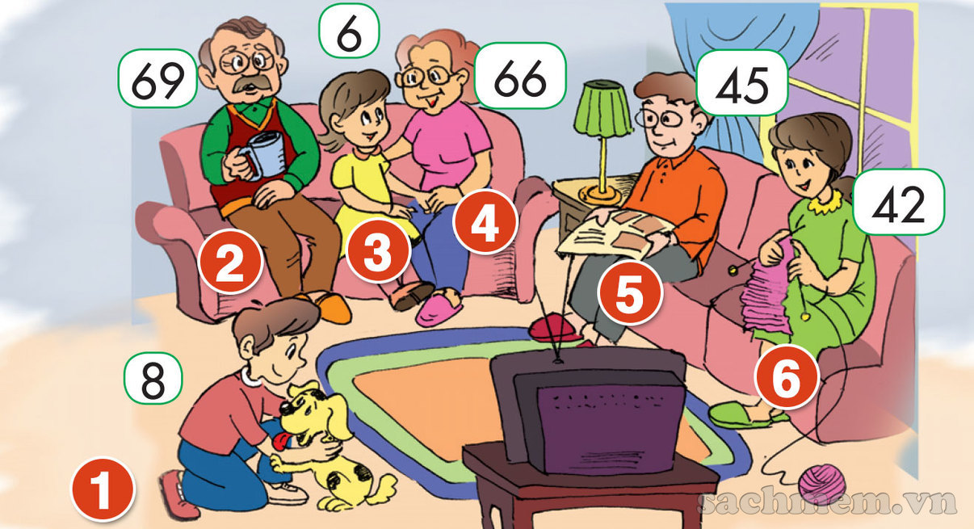
3. Let's talk.
How old is your father?
He’s forty-five.
How old is your grandmother?
She’s sixty-six.
How old is your
grandfather?
He’s sixty-nine.
How old is your
mother?
She’s forty-two.
4
2
3
5
6
1
How old is your brother?
He’s eight.
How old is your sister?
She’s six.

Slide 50
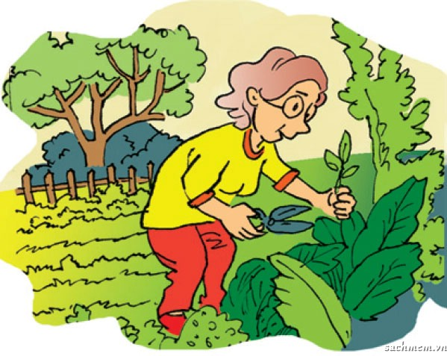
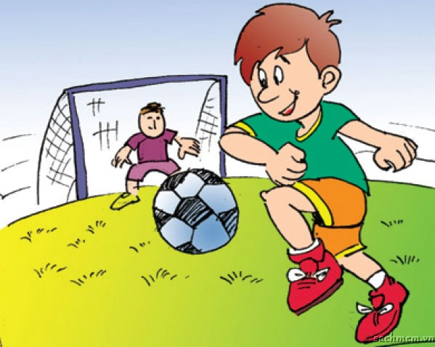
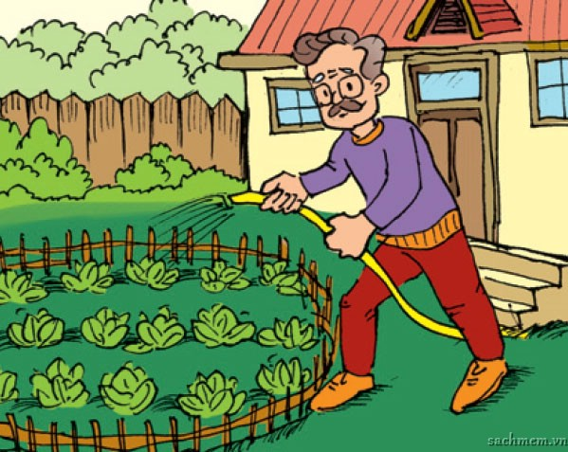
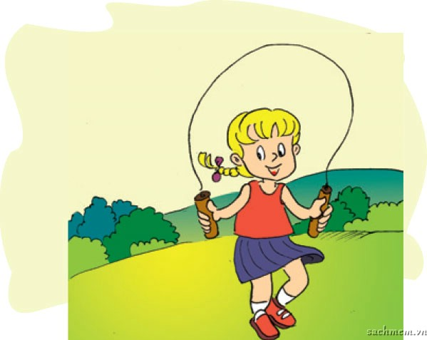
4. Listen and number
a.
b.
c.
d.
3
4
2
1

Slide 51
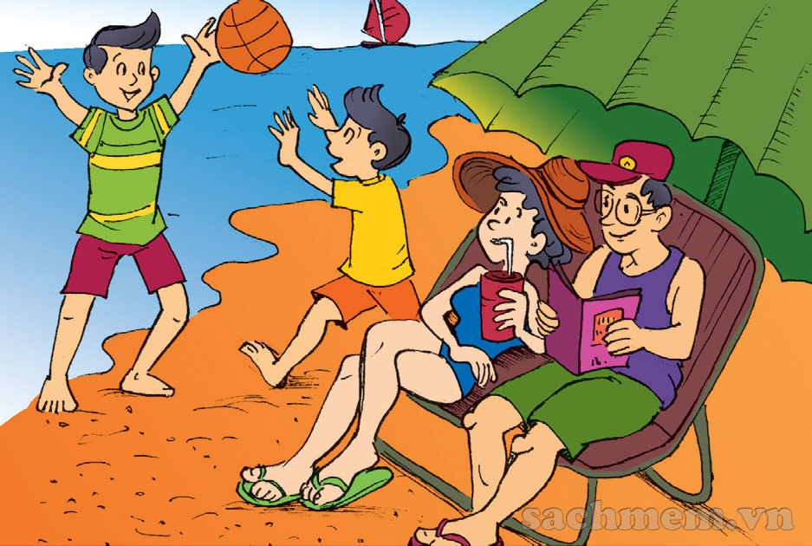
5. Read and complete.
Hi! My name is Quan. I am ten years old. That is a picture of my family. My father is forty-four years old. My mother is thirty-nine years old. My brother is fourteen years old.
 | Age
Quan | 10
His father | 44
His mother | 39
His brother | 14

Slide 52
1. How old are you?
-> I am ______________.
2. How old is your mother?
-> She is ______________.
3. How old is your father?
-> He is ______________.
4. How old is your brother/sister?
-> _______________________.
6. Write about your family.

Slide 53

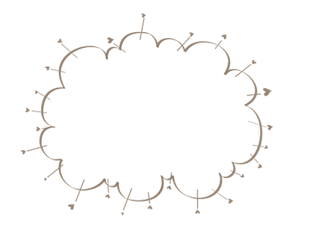
Home link
Using the new words and sentences in the real life .
Do the homework in WB (SBT): B(1,2,3) page 45
Prepare the new lesson : Unit 11: Lesson 3

Slide 54

Thursday, January 6 2022
Unit 11: This is my family - Lesson 2
1. New words
- eleven : số 11
- twelve : số 12
- thirteen : số 13
- fourteen : số 14
- fifteen : số 15
- sixteen : số 16
- seventeen : số 17
- eighteen : số 18
- ninteen : số 19
- twenty : số 20
2. Homework
th
- twenty - one : số 21
- twenty - two : số 22
- thirty : số 30
- forty : số 40
- fifty : số 50
- sixty : số 60
- seventy : số 70
- eighty : số 80
- ninety : số 90
- one hundred : số 100

Slide 55


Thank you!

