Slide 1








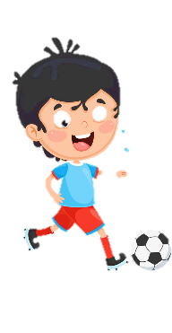
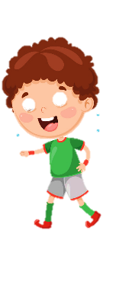











Notes:
Để nguyên trang bìa như này, chỉ thay đổi tên bài trong quá trình làm. Logo của sách Wonderful World

Slide 2






Warm up
Spin! Up and down
Notes:
Mini game: Spin! Up and down
- Tell students to make groups of 5. Each student in group holds a different flashcard/ tag name of a member in family. Spin the wheel until it stops. Call a student say the word.
- If the student listen to the word that matches their flashcard ( e.g: mum – up, sister – down, ...) they must stand up/ sit down and say out loud.

Slide 3

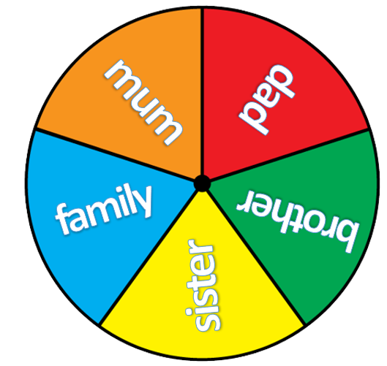


spin
Notes:
Mini game: Spin! Up and down
- Tell students to make groups of 5. Each student in group holds a different flashcard/ tag name of a member in family. Spin the wheel until it stops. Call a student say the word.
- If the student listen to the word that matches their flashcard ( e.g: mum – up, sister – down, ...) they must stand up/ sit down and say out loud.

Slide 4
spin
Notes:
Mini game: Spin! Up and down
- Tell students to make groups of 5. Each student in group holds a different flashcard/ tag name of a member in family. Spin the wheel until it stops. Call a student say the word.
- If the student listen to the word that matches their flashcard ( e.g: mum – up, sister – down, ...) they must stand up/ sit down and say out loud.

Slide 5
spin
Notes:
Mini game: Spin! Up and down
- Tell students to make groups of 5. Each student in group holds a different flashcard/ tag name of a member in family. Spin the wheel until it stops. Call a student say the word.
- If the student listen to the word that matches their flashcard ( e.g: mum – up, sister – down, ...) they must stand up/ sit down and say out loud.

Slide 6
spin
Notes:
Mini game: Spin! Up and down
- Tell students to make groups of 5. Each student in group holds a different flashcard/ tag name of a member in family. Spin the wheel until it stops. Call a student say the word.
- If the student listen to the word that matches their flashcard ( e.g: mum – up, sister – down, ...) they must stand up/ sit down and say out loud.

Slide 7
spin
Notes:
Mini game: Spin! Up and down
- Tell students to make groups of 5. Each student in group holds a different flashcard/ tag name of a member in family. Spin the wheel until it stops. Call a student say the word.
- If the student listen to the word that matches their flashcard ( e.g: mum – up, sister – down, ...) they must stand up/ sit down and say out loud.

Slide 8
spin
Notes:
Mini game: Spin! Up and down
- Tell students to make groups of 5. Each student in group holds a different flashcard/ tag name of a member in family. Spin the wheel until it stops. Call a student say the word.
- If the student listen to the word that matches their flashcard ( e.g: mum – up, sister – down, ...) they must stand up/ sit down and say out loud.

Slide 9
spin
Notes:
Mini game: Spin! Up and down
- Tell students to make groups of 5. Each student in group holds a different flashcard/ tag name of a member in family. Spin the wheel until it stops. Call a student say the word.
- If the student listen to the word that matches their flashcard ( e.g: mum – up, sister – down, ...) they must stand up/ sit down and say out loud.

Slide 10
spin
Notes:
Mini game: Spin! Up and down
- Tell students to make groups of 5. Each student in group holds a different flashcard/ tag name of a member in family. Spin the wheel until it stops. Call a student say the word.
- If the student listen to the word that matches their flashcard ( e.g: mum – up, sister – down, ...) they must stand up/ sit down and say out loud.

Slide 11



This is my family.
Notes:
Lead in
- Teacher asks 1 group to come and say in front of the class. Each student introduces him/herself:
dad
mum
brother
sister
- Then teacher introduces a family by saying: This is my mum/dad/brother/sister/ family (with hand gestures).
- Tell that students are going to learn more about how to introduce their family members.

Slide 12

Notes:
finger family song
https://www.youtube.com/results?search_query=finger+family+song

Slide 13
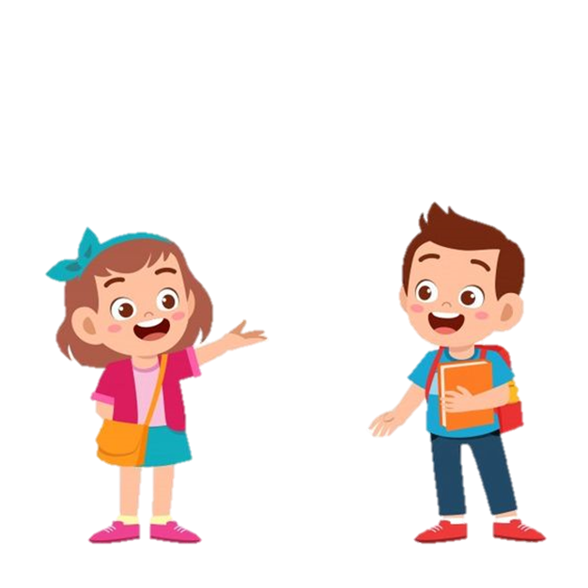
Presentation
Notes:
Task 4: Listen and repeat. (Track 1.3)
- Ask students to look and read the sentence in Activity 2 again.
- Play the recording (track 1.3). Students listen and repeat each line in chorus during the pauses.
- Point to the pictures. Ask students to notice that the structure “This is my” is repeated.
- Show pictures randomly. Ask students to say a sentence

Slide 14
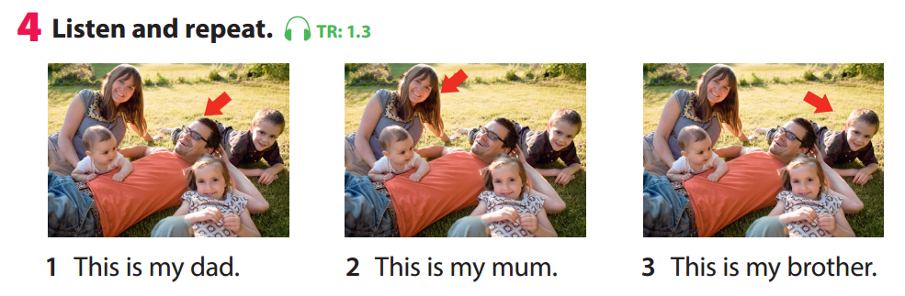
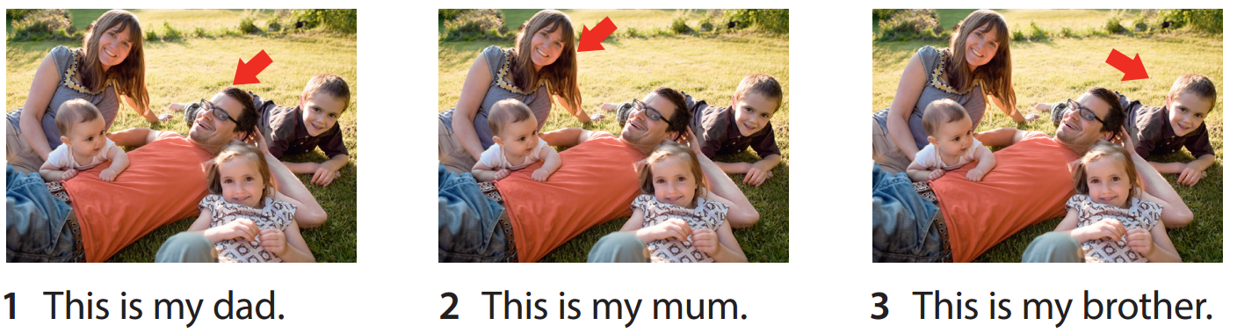

Notes:
Listen and repeat

Slide 15
Notes:
Listen and repeat

Slide 16
This is my brother.
This is my dad.
Notes:
Read

Slide 17
This is my mum.
This is my sister.
Notes:
Read

Slide 18




Listen and choose
Notes:
Mini game: Listen and choose the correct picture
- Ask students to listen and choose the correct pictures (A or B).
Key:
1. This is my dad.
2. This is my brother.
3. This is my mum.

Slide 19
1. This is my dad
A
B
Notes:
Mini game: Listen and choose the correct picture
Key: A

Slide 20
2. This is my brother
A
B
Notes:
Mini game: Listen and choose the correct picture
Key: B

Slide 21
3. This is my mum
A
B
Notes:
Mini game: Listen and choose the correct picture.
Key: A

Slide 22
Practice

Slide 23
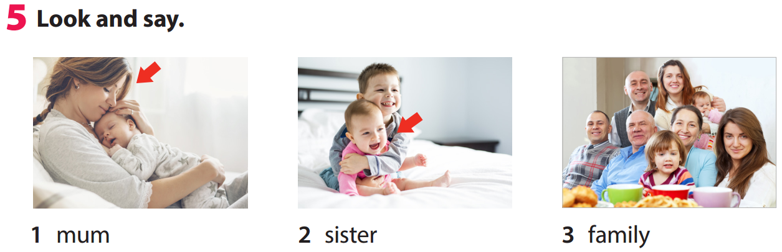
Notes:
- Tell students to look at the picture for question 1 and ask them whom the arrow points to. Elicit “mum”. Read out the example and ask students to repeat it.
- Explain the rest of the task to students. Allow them enough time to practise saying the sentences individually and then in pairs. Go round the class helping students if necessary.
- Ask volunteers to read out their answers. Correct any mistakes.

Slide 24


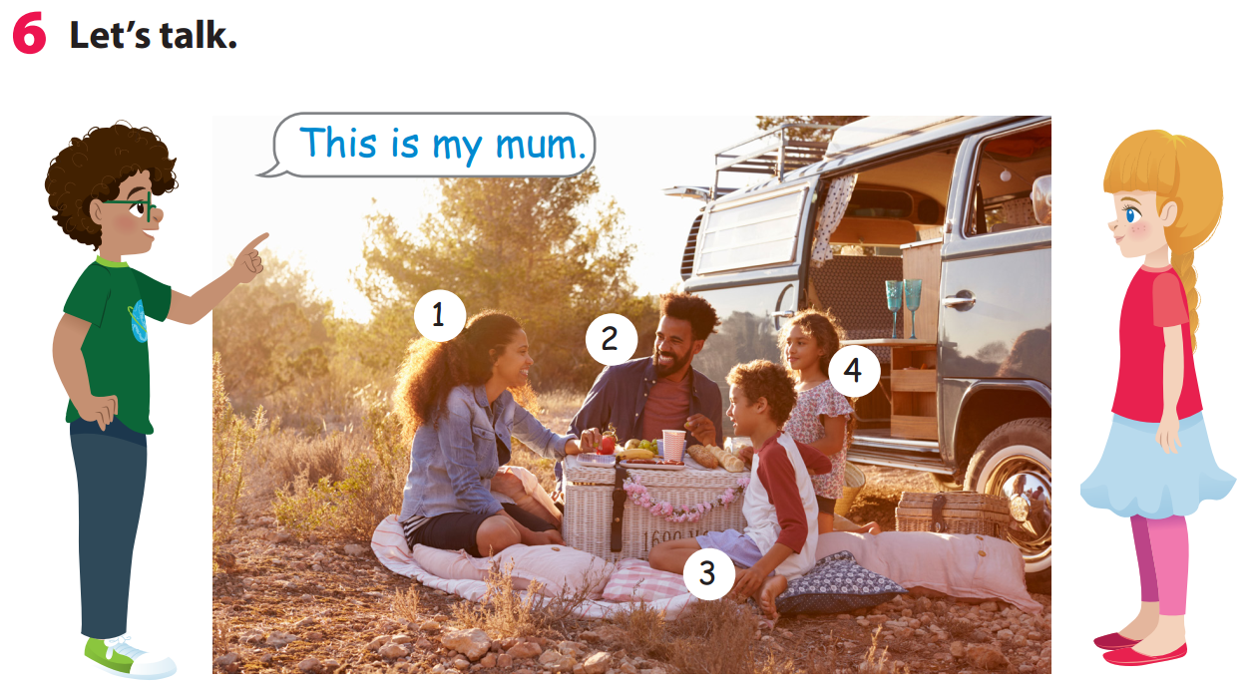
Notes:
Task 5: Look and say.
- Tell students to look at the picture for question 1 and ask them whom the arrow points to. Elicit “mum”. Read out the example and ask students to repeat it.
- Explain the rest of the task to students. Allow them enough time to practise saying the sentences individually and then in pairs. Go round the class helping students if necessary.
- Ask volunteers to read out their answers. Correct any mistakes.

Slide 25


7
1
5
2
3
6
8
4
LUCKY STAR
GO
Notes:
THIẾT KẾ HOẠT ĐỘNG TƯƠNG TÁC: câu trả lời ở cuối mỗi slide từ slide 26-33
Mini game: A lucky star
Divide class into 2 big groups. (Boys and Girls)
There are 2 lucky numbers in this game. If students choose a lucky one, they will get 5 points without answering question. If their number is not lucky one, they must read a sentence and get points if it is right, otherwise other groups will take their turn. The group which has more points will win the game.

Slide 26




You are given 3 points
Notes:
This is my sister.

Slide 27
You are given 1 point
Notes:
This is my dad.

Slide 28

You are given 5 points
Notes:
Lucky star.

Slide 29
You are given 2 points
Notes:
This is my brother.

Slide 30
You are given 5 points
Notes:
Lucky star

Slide 31
You are given 3 points
Notes:
This is my mum.

Slide 32
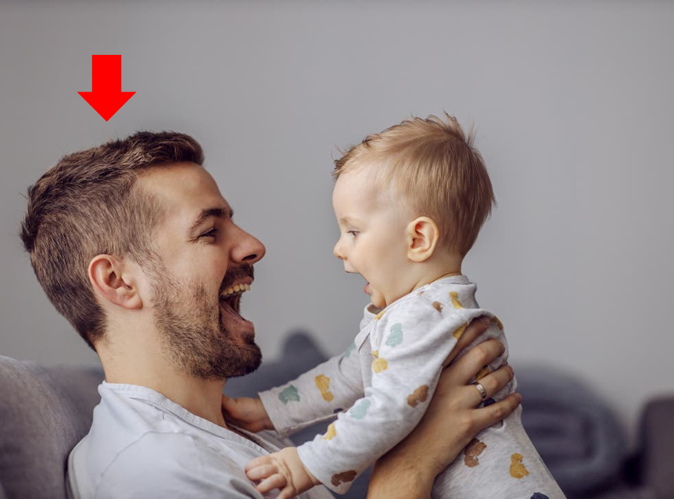
You are given 2 points
Notes:
This is my dad.

Slide 33
You are given 1 point
Notes:
This is my family.

Slide 34
Notes:
Let’s talk!
- Tell students to look at the picture. Then talk about the members of the family in the picture.
- Ask students to work in pairs to talk about the other people in the photo.
- Ask some volunteers to speak in front of the class.

Slide 35
Production

Slide 36


Speaking about
your family
Notes:
- Ask students to work in group of 6.
- Ask student to write their own question about topic family on a card.
- Each student is allowed to ask one question to their friend.
Suggested questions:
1. How many people in your family?
Student: numbers/ there are _(number)_
2. How many brothers/sisters do you have?
3. Who are they?
4. How old is your ...?

Slide 37


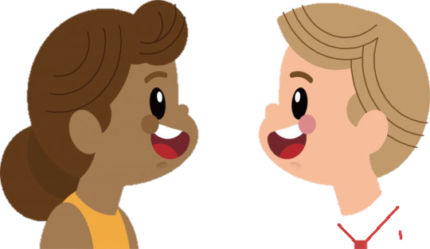
1. How many people in your family?
4/ There are 4.

Slide 38
2. Who are they?
My mum, my dad, my sister.

Slide 39
3. How many brothers/sisters do you have?
2 brothers.

Slide 40
4. How old is your sister?
She’s 10.

Slide 41




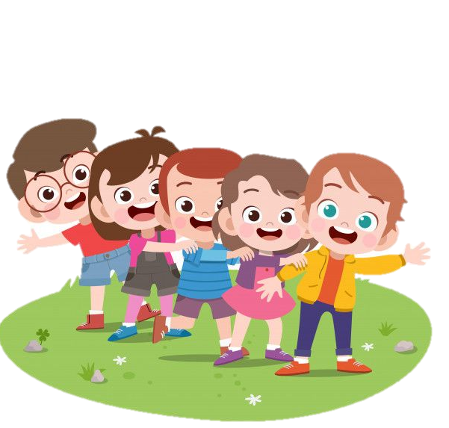
Wrap up
Time bomb game

Slide 42
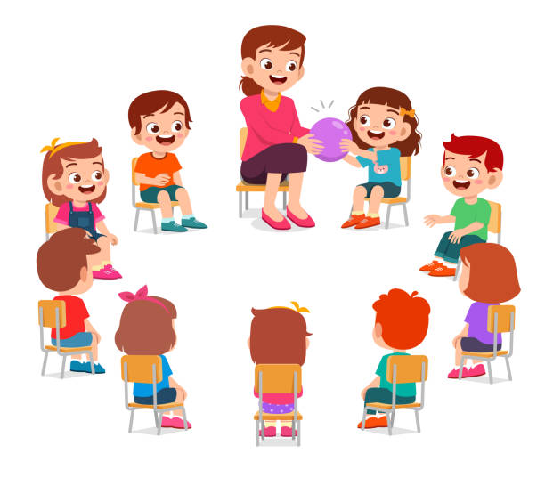
Notes:
Game: Time bomb
- Ask your class to form a circle (if possible)
- Choose one student to stand in the middle of the circle/ or in front of the class. (a leader)
- Then, throw a tennis ball/ ball to one of students.
- Each student has only 5 seconds to point any member in their family photo and say: This is my ... And throw the ball to one another friend.
- If the ball is dropped, that student must be pass it around the circle/ the class as fast as they can. The leader count down from 10.
- The last student has the ball when it “explodes” is out of the game.

Slide 43
Goodbye!

