Slide 1

Unit 2 – Lesson 1
I’m from japan

Slide 2
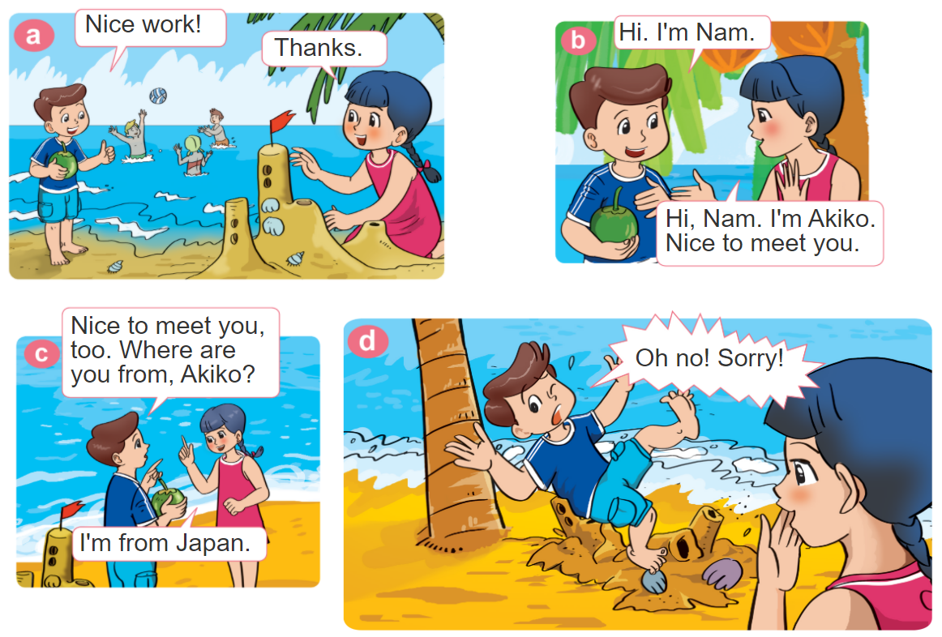

1. Look, listen and repeat.

Slide 3


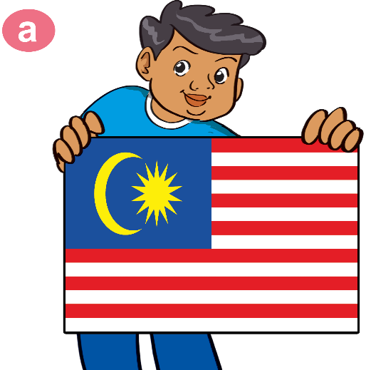



2. Point and say.
Hi. I'm Nam. Where are you from?
Hi, Nam. I'm _______. I'm from _______.
HaKim,
Malaysia
Tom,
America
Tony,
Australia
Linda,
England

Slide 4
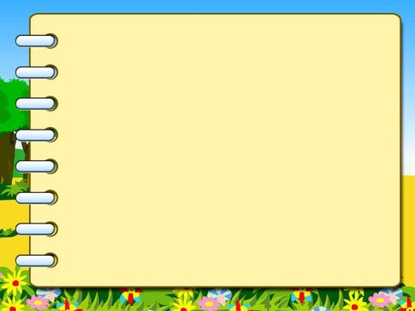
Model sentences:
Where are you from?
I’m from + country.

Slide 5

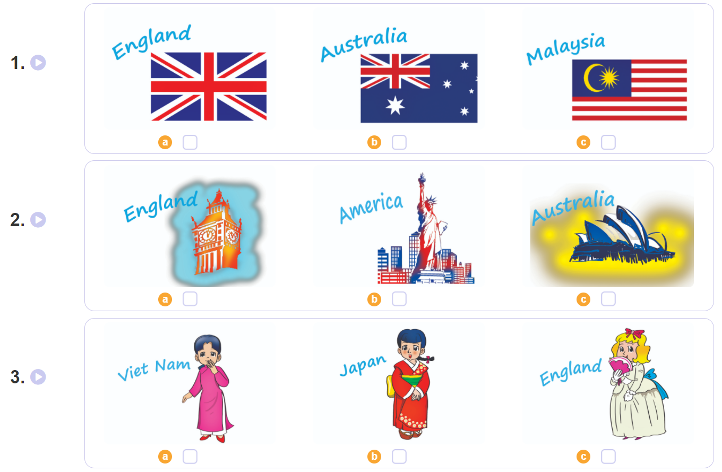

3. Listen and tick.

Slide 6
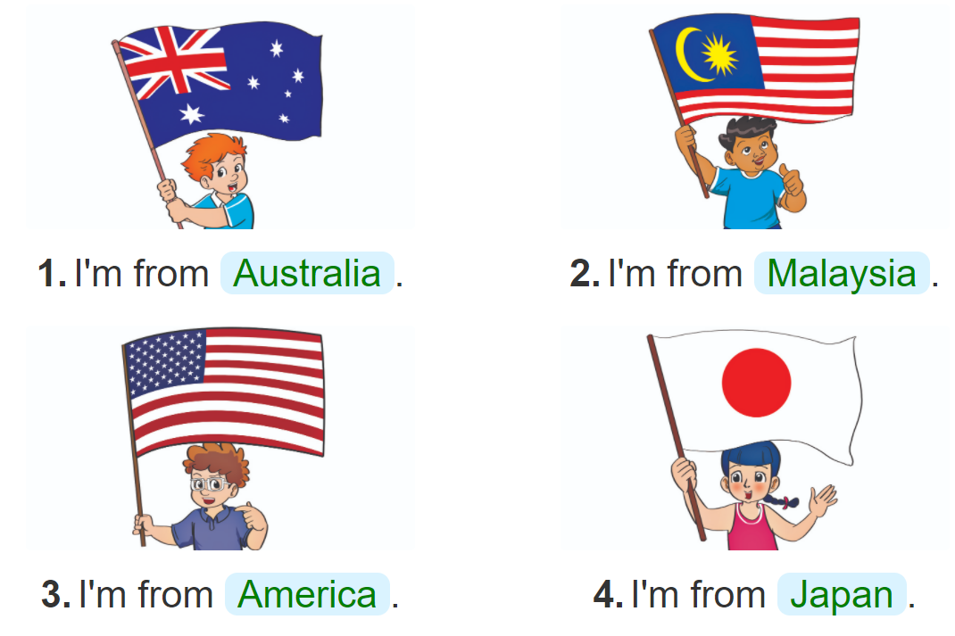
4. Look and write.
________.
________.
________.
________.

Slide 7

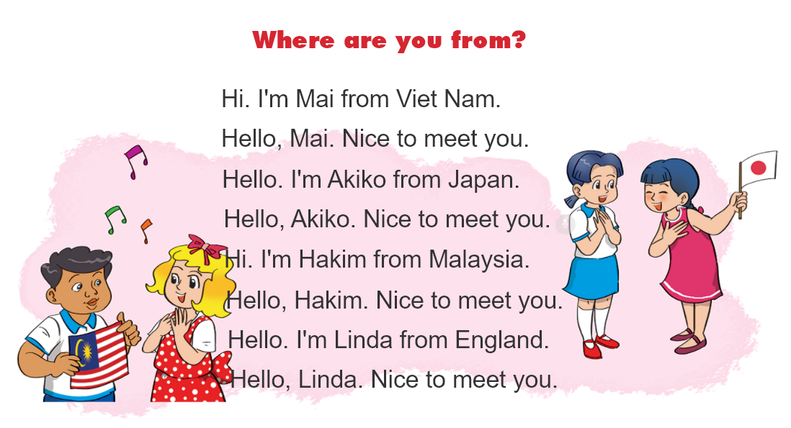

5. Let’s sing

Slide 8
Today’s lesson
Vocabulary
Malaysia
Japan
America
England
Australia
Model sentence
Where are you from?
I’m from + country.

Slide 9
Homework
- Do the exercises in Workbook.
- Prepare the next lesson.

