Slide 1

Getting Started
Lesson 1
Page 5

Slide 2
Objectives
By the end of this lesson, students will be able to follow simple instructions in class.
Vocabulary:
stand up, sit down, hands up
Structures:
Stand up, please./ Sit down, please./ Hands up, please.

Slide 3

WARM UP

Slide 4

It’s time to learn …

Slide 5

New words
stand up
sit down
hands up

Slide 6

Presentation

Slide 7
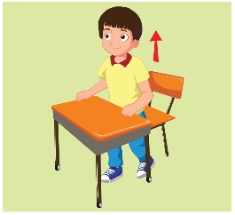
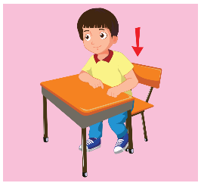


A
Listen and point. Repeat. (CD1 Track 02)
1
2
3
stand up
sit down
hands up
/stænd ʌp/
đứng lên
/sɪt daʊn/
ngồi xuống
/hændz ʌp/
giơ tay lên
Click on each English word to hear the sound.

Slide 8

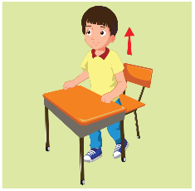


Look at the numbers and say the words.
2
1
3
2
3
1
1
2
3
1
1
2
3
3
2
1
1
3
2
3
2
3
2
1

Slide 9

Structures
Stand up, please.
Sit down, please.
Hands up, please.

Slide 10
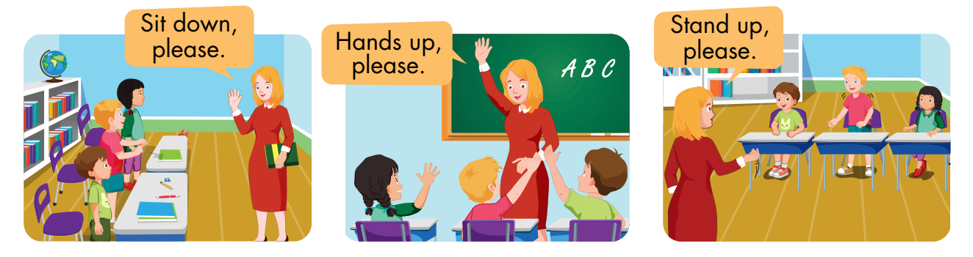
B
Listen and point. Repeat. Role-play. (CD1 Track 03)
Notes:
B. Listen and point. Repeat. Role-play. (CD1 Track 03)
Have students call out the things they can see in each picture.
Play the audio and have them point to the characters.
Play the audio again and have them repeat the new words.
Divide the class into pairs to role-play the dialogue.
Swap roles and repeat.
Invite some pairs to demonstrate the activity in front of the whole class.
Go around the class and support them if necessary.

Slide 11

Consolidation

Slide 12
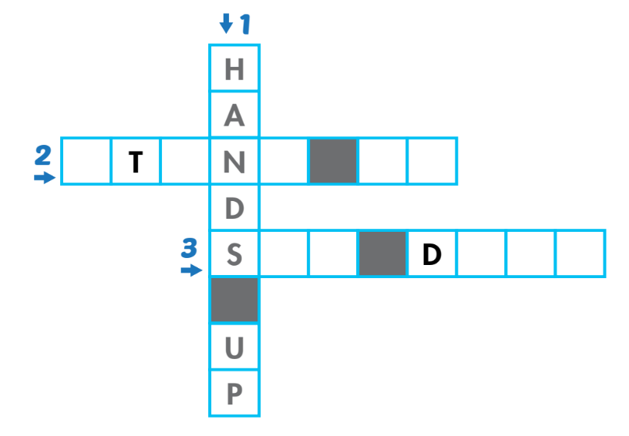
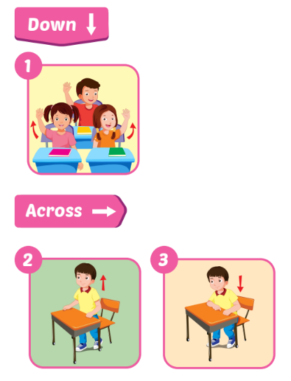
A
Look and write.
S
A
D
U
P
I
T
O
W
N

