Slide 1

Unit 3: School
Lesson 2.3
Page 43

Slide 2
Objectives
By the end of this lesson, students will be able to ask what subjects people like.
Vocabulary: math, English, art, P.E. (physical education), music
Structure: Do you like math?
- Yes, I do./No, I don't.

Slide 3

It’s time to learn …

Slide 4

Structures
Do you like math?
Yes, I do./No, I don’t.

Slide 5

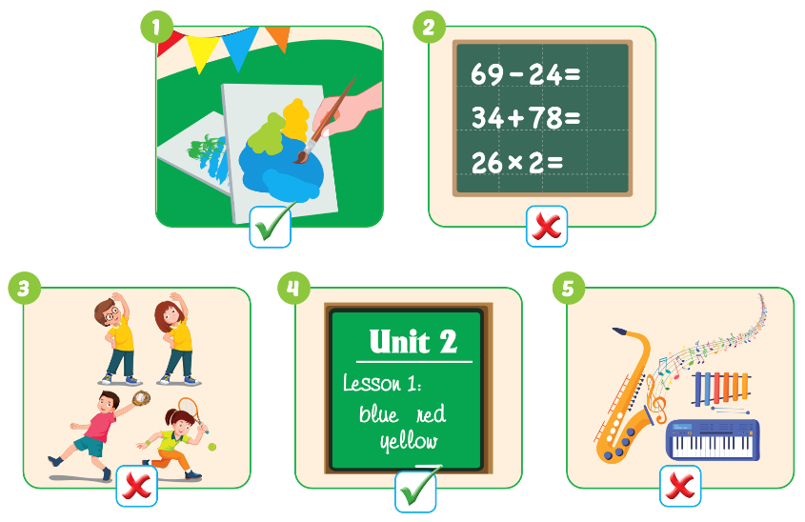

Slide 6



Do you like………….?
- …….................

Slide 7

NEXT
Help me please!

Slide 8


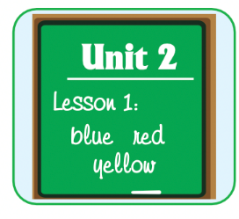


1
NEXT
Do you like English?
Do you like………….?
- …….................
ANSWER
No, I don’t.

Slide 9

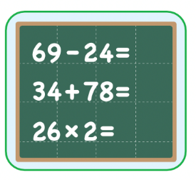


1
NEXT
2
Do you like math?
Do you like………….?
- …….................
ANSWER
Yes, I do.

Slide 10


1
NEXT
2
3
Do you like art?
Do you like………….?
- …….................
ANSWER
Yes, I do.

Slide 11

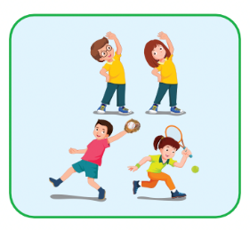
1
NEXT
2
3
Do you like P.E.?
4
Do you like………….?
- …….................
ANSWER
No, I don’t.

Slide 12

Production

Slide 13
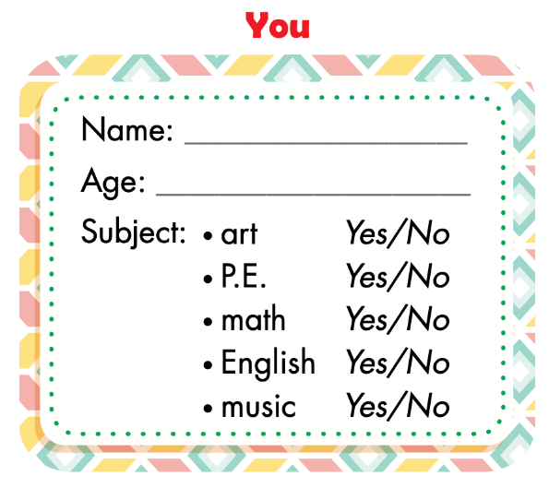
Fill in the form.
Notes:
Divide the class into groups of four.
Have Student A cover their eyes.
Have the other students put one of their own items on the
desk in a random order.
Have Student A open their eyes and try to guess.
Have other students respond.
Have students swap roles and repeat.

Slide 14
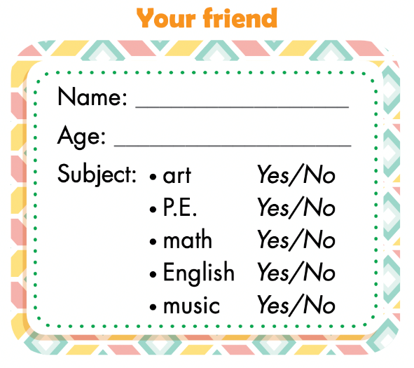



Ask, write, and circle.
Example:
Tam
8
I am 8.
Yes, I do.
I am Tam.

Slide 15
Lesson 3
Today’s lesson
Vocabularies
math, English, art,
P.E. (physical education), music
Model sentences
Do you like math?
- Yes, I do./No, I don't.

Slide 16
Lesson 3
Homework
Do the exercises on page 31 WB.
Do the exercises in Tiếng Anh 3 i-Learn Smart Start Notebook on page 23.
Prepare the next lesson (page 44 SB).

Slide 17

Enjoy your day!

