Slide 1

Unit 3: School
Lesson 1.2
Page 39

Slide 2
Objectives
By the end of this lesson, students will be able to pronounce the sounds /eɪ/, /ɪə/ and ask and answer who owns different school supplies.
Phonics: /eɪ/ and /ɪə/
Structure: Is this your (eraser)?
- Yes, it is./No, it isn't.
Are these your (notebooks)?
- Yes, they are./No, they aren't.

Slide 3

WARM UP

Slide 4
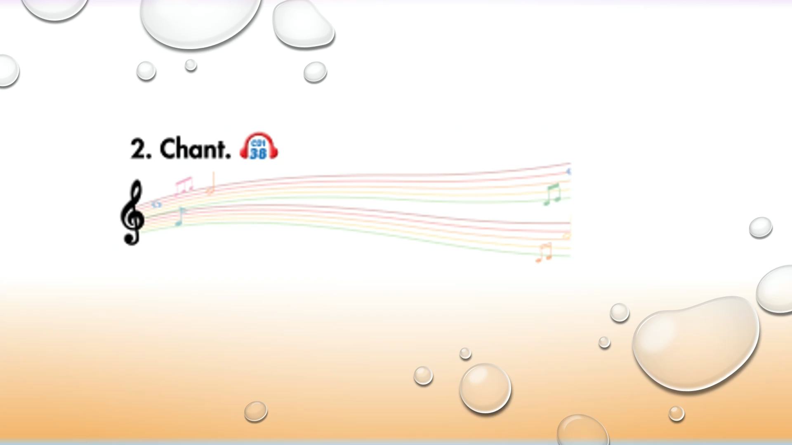

Slide 5

It’s time to learn …

Slide 6

Phonics
/eɪ/ and /ɪə/

Slide 7


Click on the icon to hear the sound
Click on each word to hear the sound
eraser
here
/eɪ/
/ɪə/

Slide 8
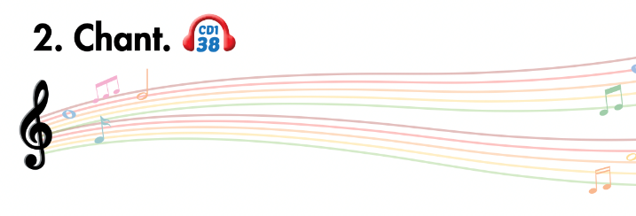
Listen and point
Listen and clap
Listen and chant

Slide 9
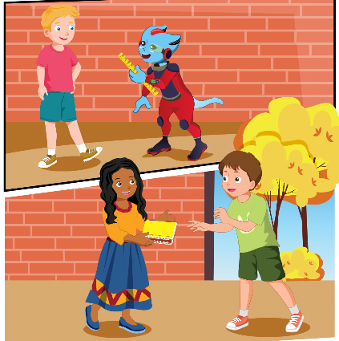

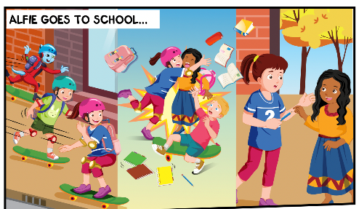
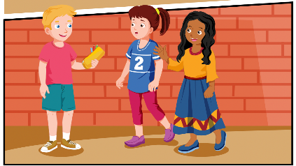
While-Listening
2.
3.
1.
4.

Slide 10

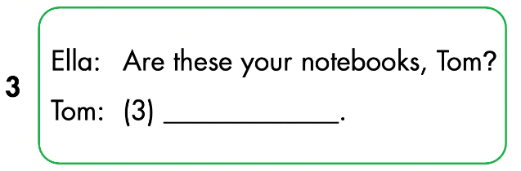
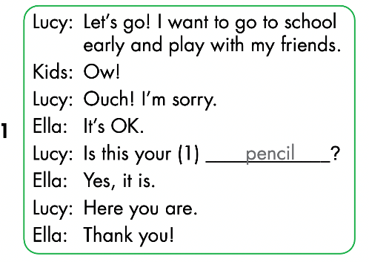
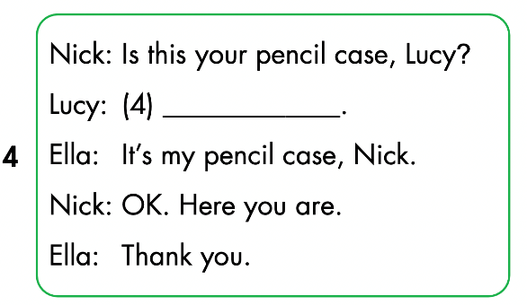
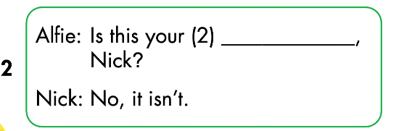

Slide 11


Yes, they are
No, it isn’t
ruler

Slide 12

CONSOLIDATION

Slide 13
Lesson 3
Today’s lesson
Phonics
/eɪ/ and /ɪə/
Sentence patterns
Is this your (eraser)?
- Yes, it is./No, it isn't.
Are these your (notebooks)?
- Yes, they are./No, they aren't.

Slide 14
Lesson 3
Homework
Review by hearts vocabulary, structures and make sentences using them.
Do the exercises on page 29 WB
Do exercises in Tiếng Anh 3 i-Learn Smart Start Notebook on page 22.
Prepare the next lesson (page 40 SB)

Slide 15

Lesson 3
Stay positive and have a nice day!

