Slide 1
Unit 7
How do you
lern English
Lesson 3

Slide 2
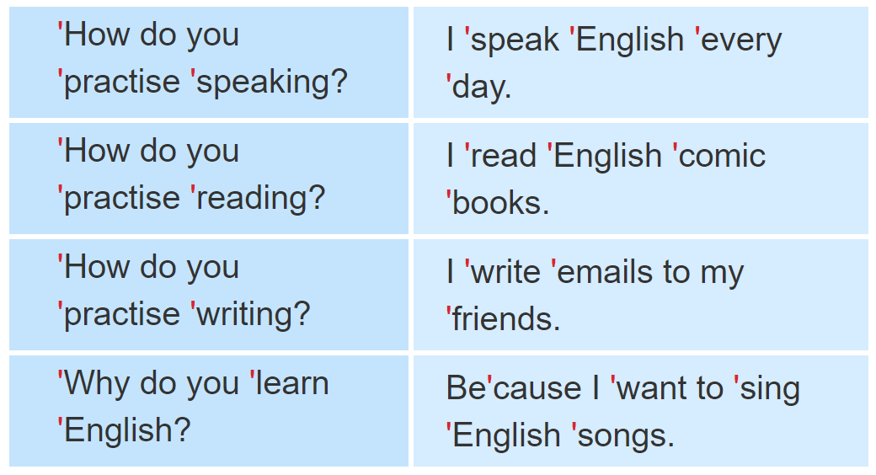
1. Listen and repeat.

Slide 3
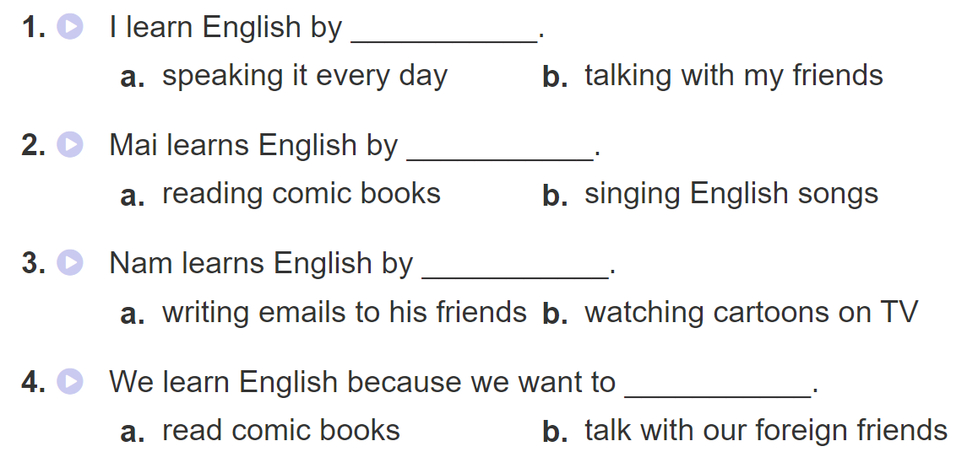
2. Listen and tick. Then write and say aloud

Slide 4
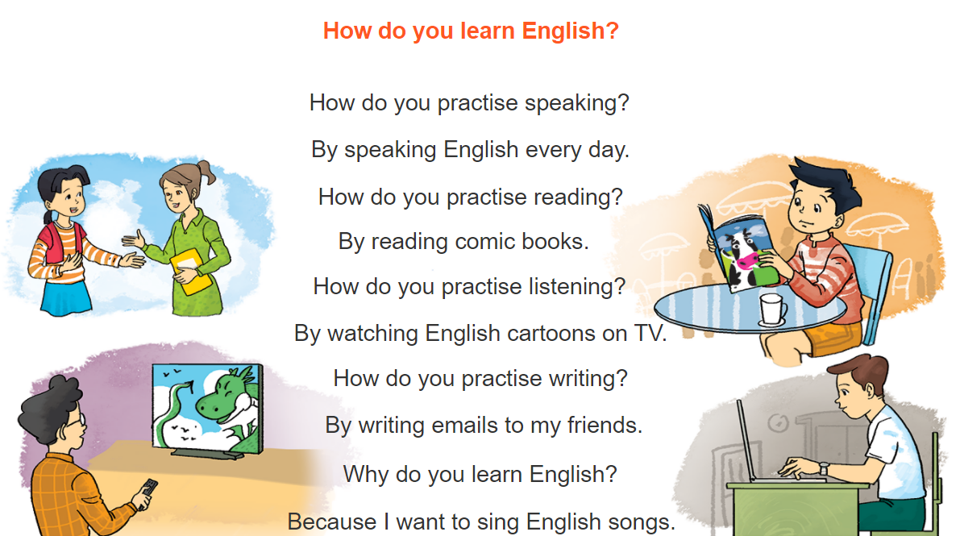
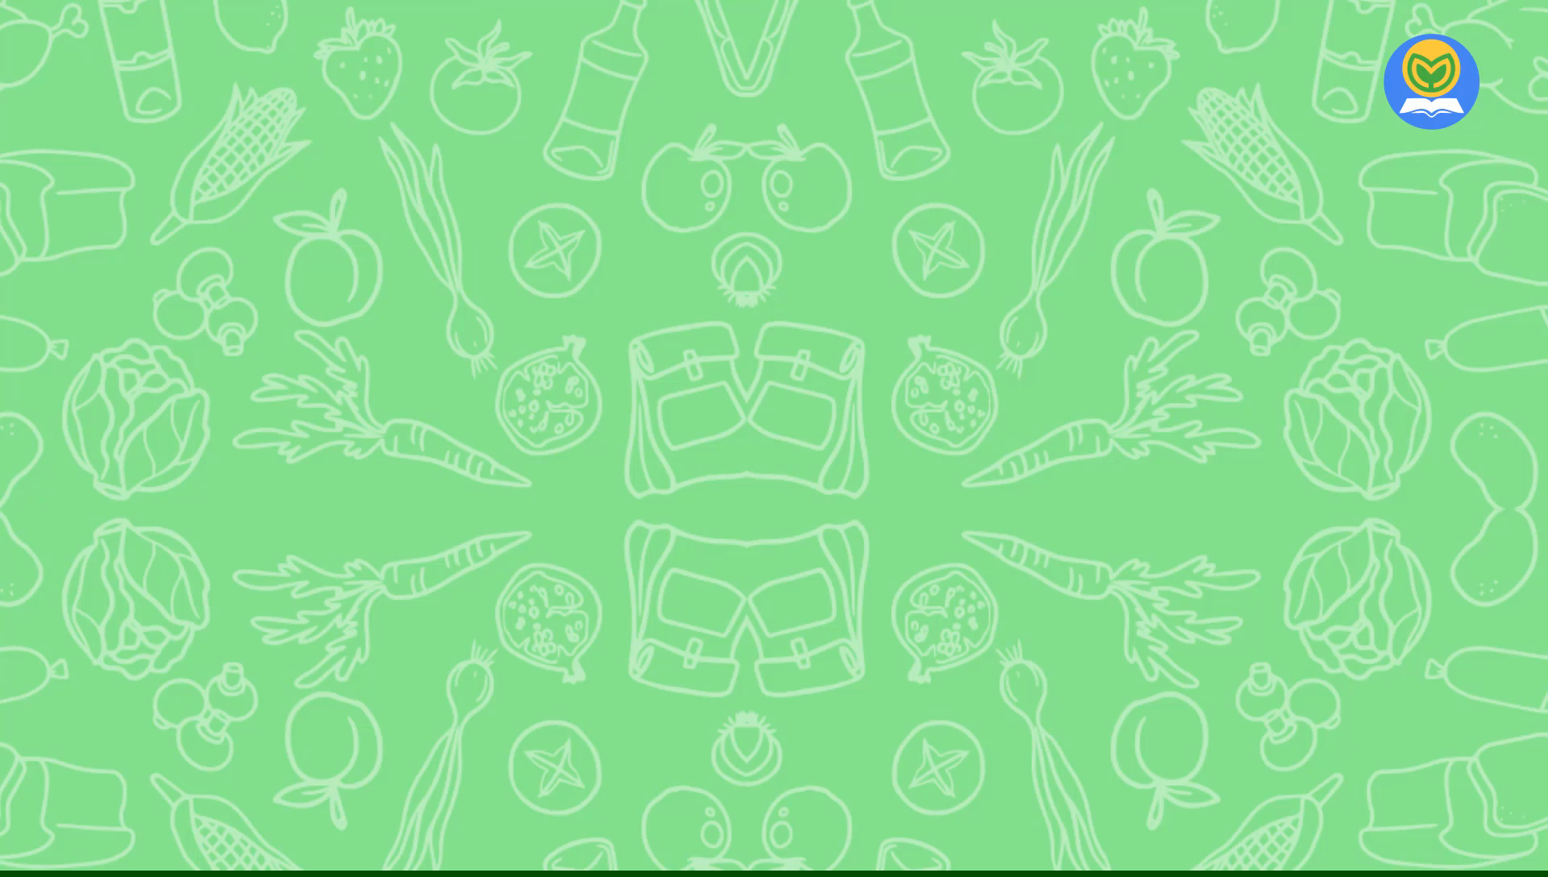
3. Let’s chant

Slide 5

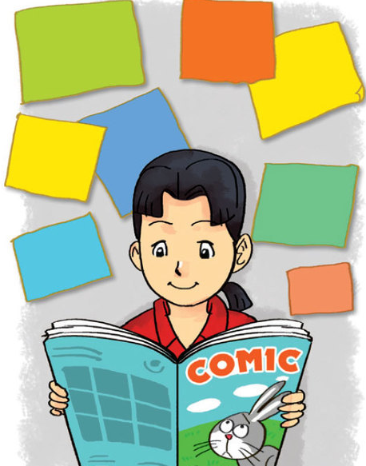
4. Read and tick True (T) or False (F)
My name is Mai. I love reading English comic books. When I see a new word, I try to guess its meaning. I write the word in my notebook and say it a few times. I often stick new words on my bedroom walls and practise reading them aloud. I learn to speak English by talking with my foreign friends in my free time. My friend Akiko is good at English. She usually practises listening by watching cartoons on TV. She learns to write by writing emails to me every day. We are happy because we can understand each other. English is necessary for communication.

Slide 6
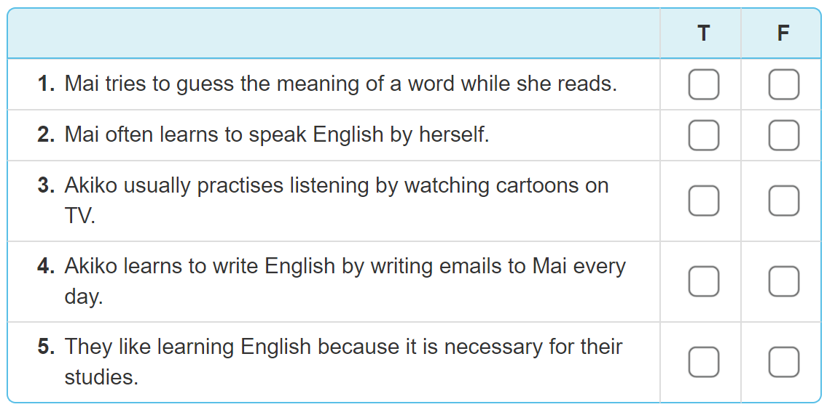
4. Read and tick True (T) or False (F)

Slide 7
4. Read and tick True (T) or False (F)
✔
✔
✔
✔
✔

Slide 8
4. Read and tick True (T) or False (F)
✔
✔
✔
✔
✔

