Slide 1

Unit 2: Family
Lesson 2.1
Page 27

Slide 2
Objectives
By the end of this lesson, students will be able to learn, practice and use …..
Vocabulary: grandfather, grandmother, uncle, aunt, cousin
Structure:
Who’s she? – She’s my aunt.
What’s her name? – Her name’s May.

Slide 3

WARM UP

Slide 4

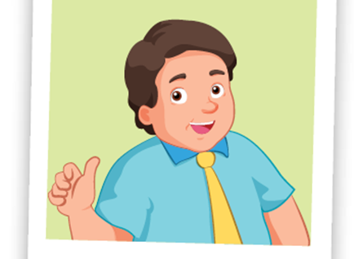
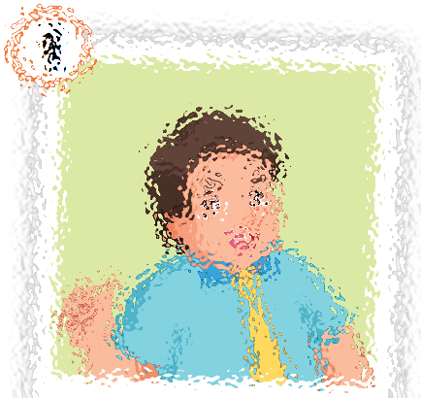
father

Slide 5
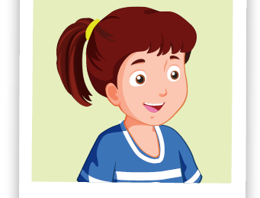
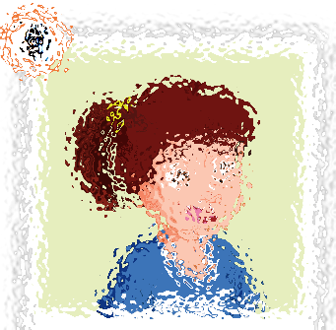
sister

Slide 6
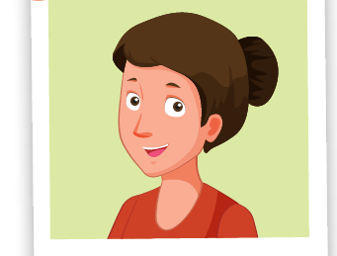
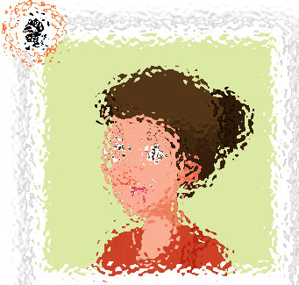
mother

Slide 7
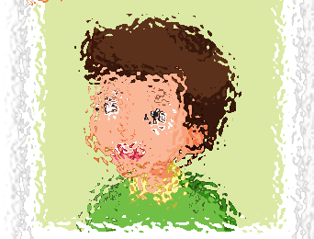
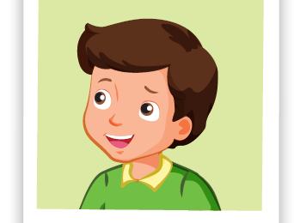
brother

Slide 8
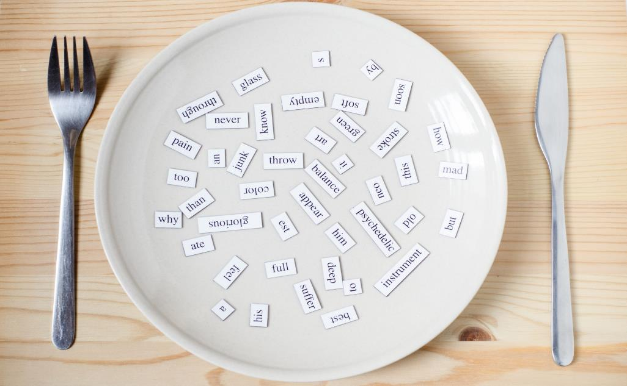
New words
grandfather
grandmother
uncle
aunt
cousin

Slide 9

Presentation

Slide 10

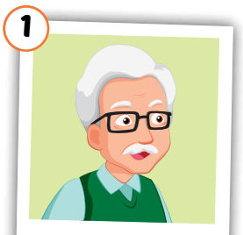
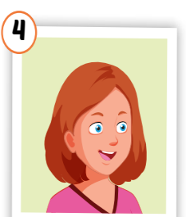
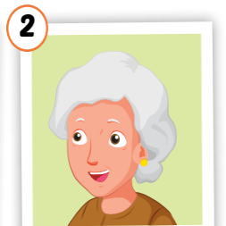
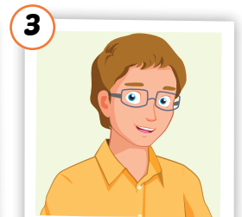
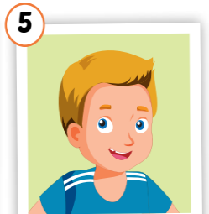
Click on each word to hear the sound.
grandfather
grandmother
uncle
aunt
cousin
/ˈɡrænfɑːðər/
ông nội,
ông ngoại
/ˈɡrænmʌðər/
bà nội,
bà ngoại
/ˈʌŋkl/
chú, bác, cậu
/ænt/
cô, dì, mợ
/ˈkʌzn/
anh/chị/em họ

Slide 11

Practice

Slide 12

Choose a number and fill in the blank.
au_t
gr_nd_athe_
1
a
2
n
f
r
c _us_n
uncl_
Click on each word to hear the sound.
3
4
o i
e
g_an_mo_her
5
r d t
Click here to show answers.
1
2
3
4
5

Slide 13

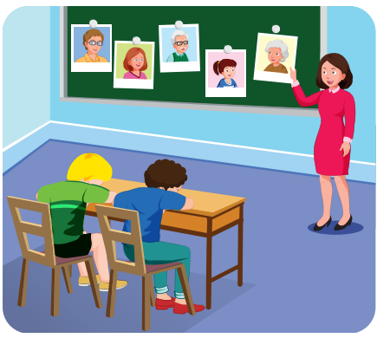
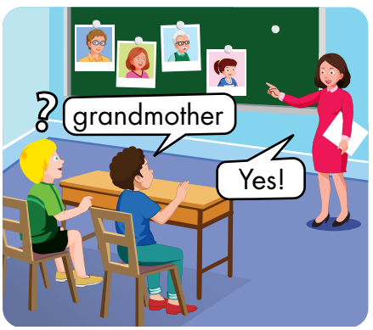

Slide 14
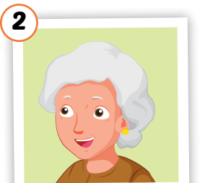





Slide 15
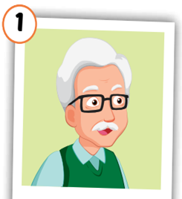
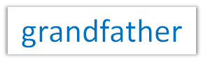
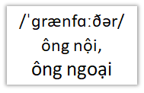

Slide 17

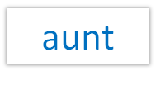


Slide 19


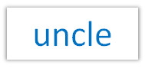
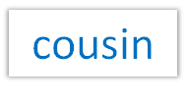



Slide 20

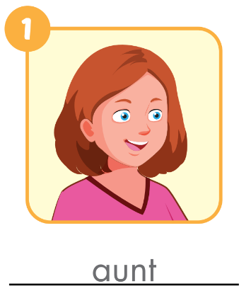
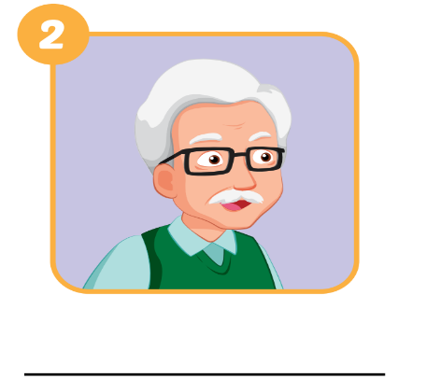
Extra Practice
WB, page 20.
grandfather

Slide 21
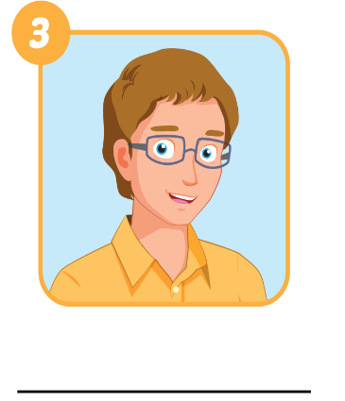
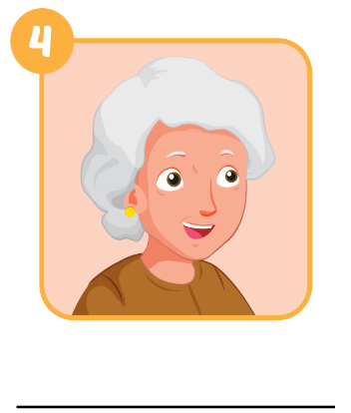
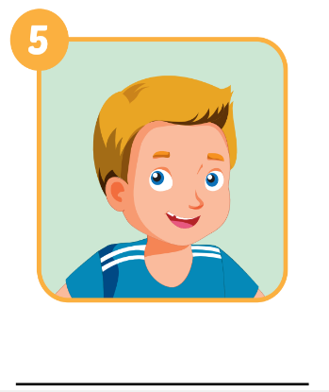
Extra Practice
WB, page 20.
uncle
grandmother
cousin

Slide 22

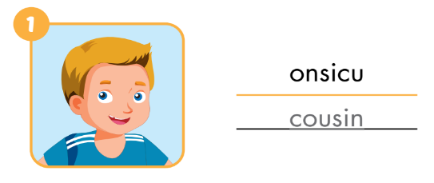
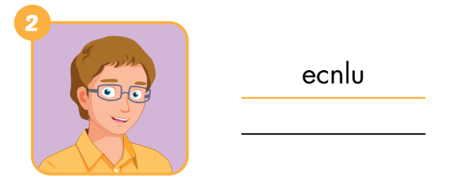
Extra Practice
WB, page 20
uncle

Slide 23
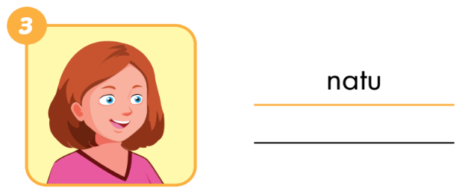
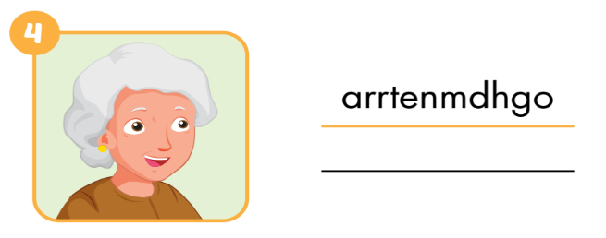
Extra Practice
WB, page 20
aunt
grandmother

Slide 24
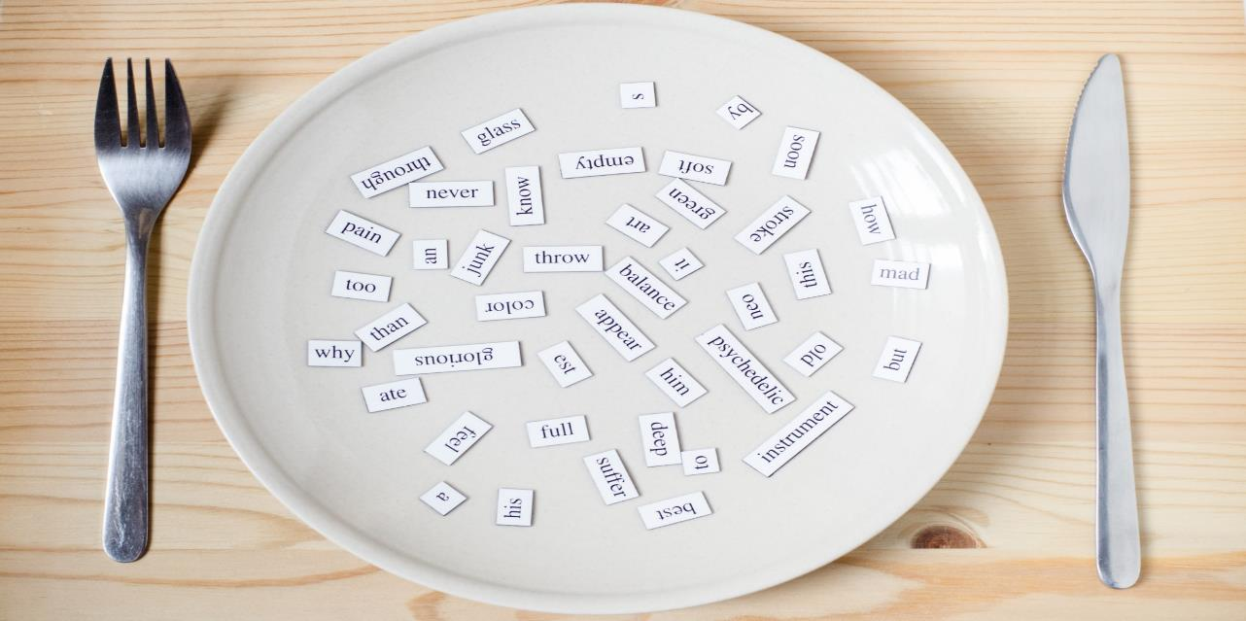
Structures
Who's he/she? - He’s/ She's my….
What's his/her name? - His/her name's ...

Slide 25
Presentation

Slide 26




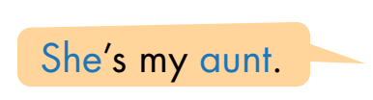



Slide 27
Practice

Slide 28

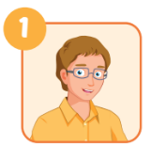
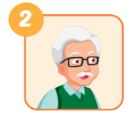
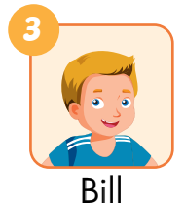
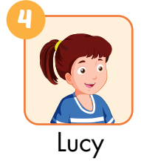
he
A: Who’s he?
B: He’s my________.
A: Who’s ___________?
B: He’s _____________.
uncle
my grandfather
A: What’s his name?
B: His name’s ______.
her name
A: What’s___________?
B: Her___________.
Bill
name’s Lucy

Slide 29

CONSOLIDATION

Slide 30
Today’s lesson
Vocabularies
grandfather
grandmother
uncle
aunt
cousin
Structures/ Sentence patterns
Who's he/she?
-> He’s/ She's my….
What's his/her name?
-> His/her name's ...

Slide 31
Lesson 3
Homework
Practice vocabularies and structure. Make sentences using them.
Do the exercises in Tiếng Anh 3 i-Learn Smart Start Workbook (page 20)

Slide 32

Have a nice day!

