Slide 1
Unit 4
When’s your birthday?
Lesson 2

Slide 2
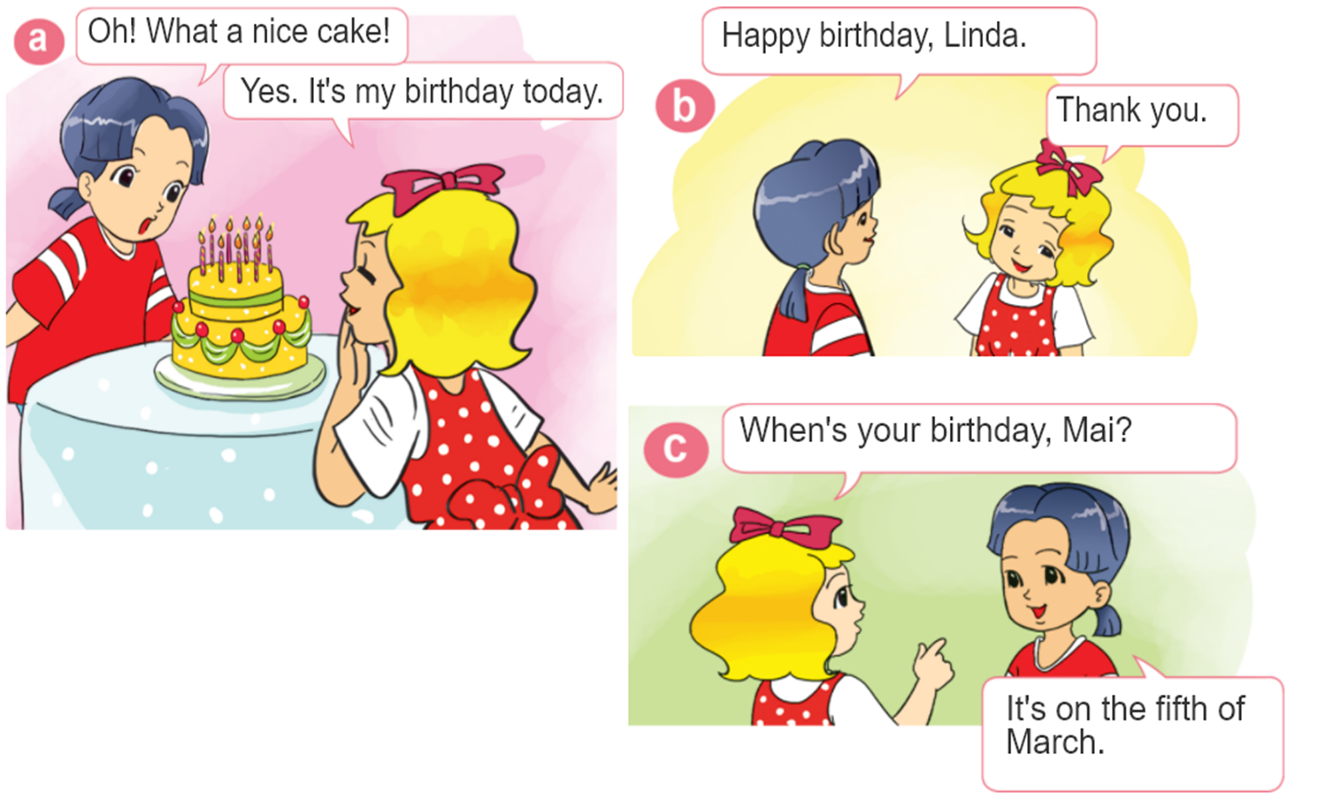
1. Look, listen and repeat.

Slide 3




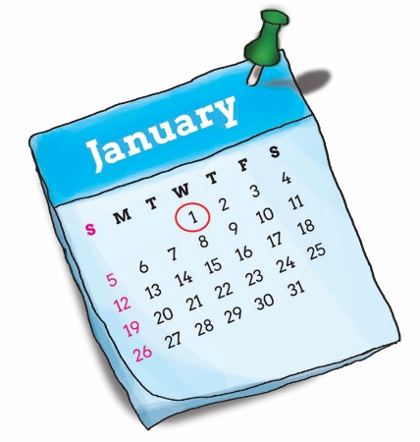
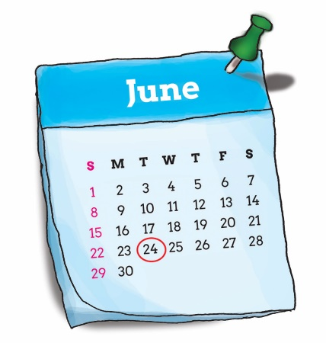
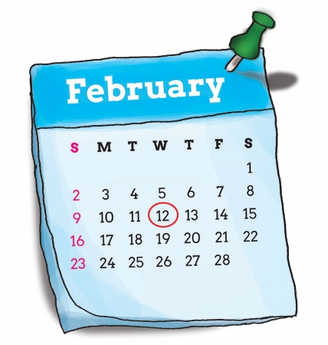
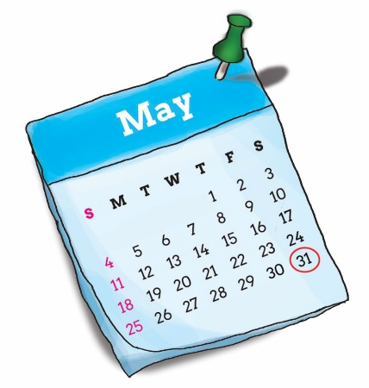
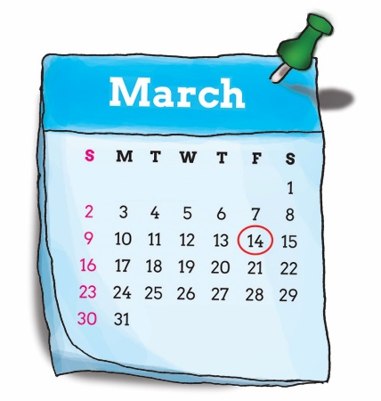
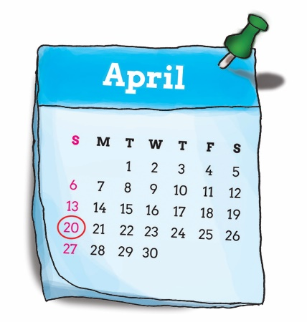
2. Point and say.
When’s your birthday?
It’s on the ____ of _____.
first
twenty-fourth
January
twelfth
thirty-first
June
February
fourteenth
twentieth
May
March
April

Slide 4
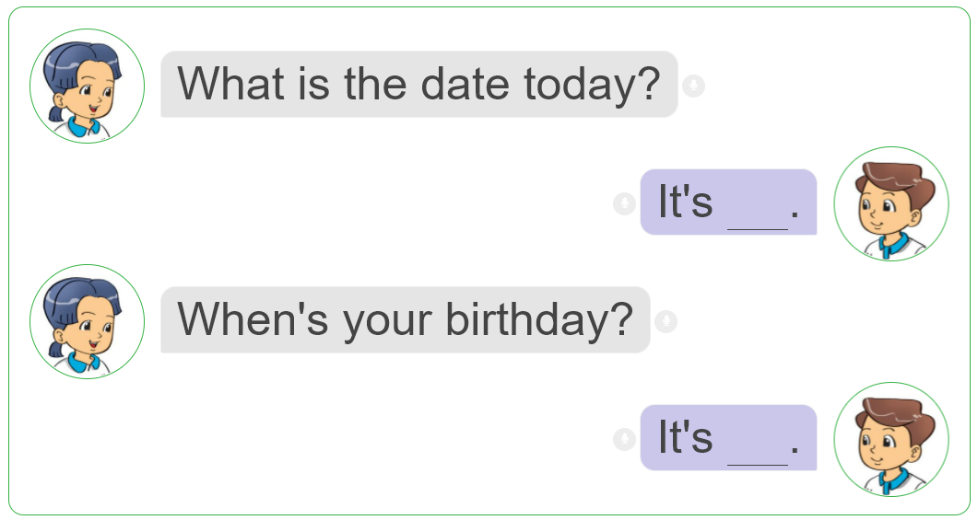
3. Let's talk.

Slide 5

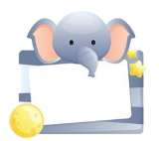

4. Listen and number.
3
1
4
2
1
2
3
4

Slide 6
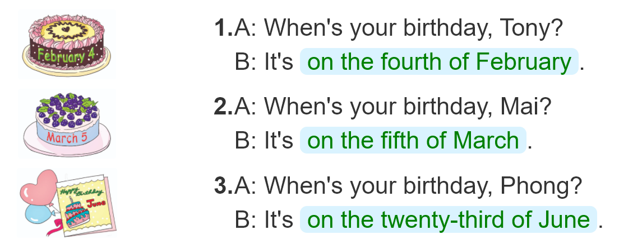
5. Look and write
____________________________________.
____________________________________.
____________________________________.

Slide 7
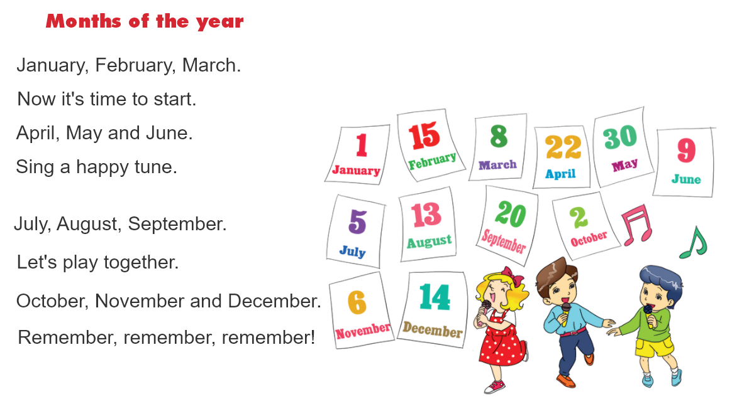

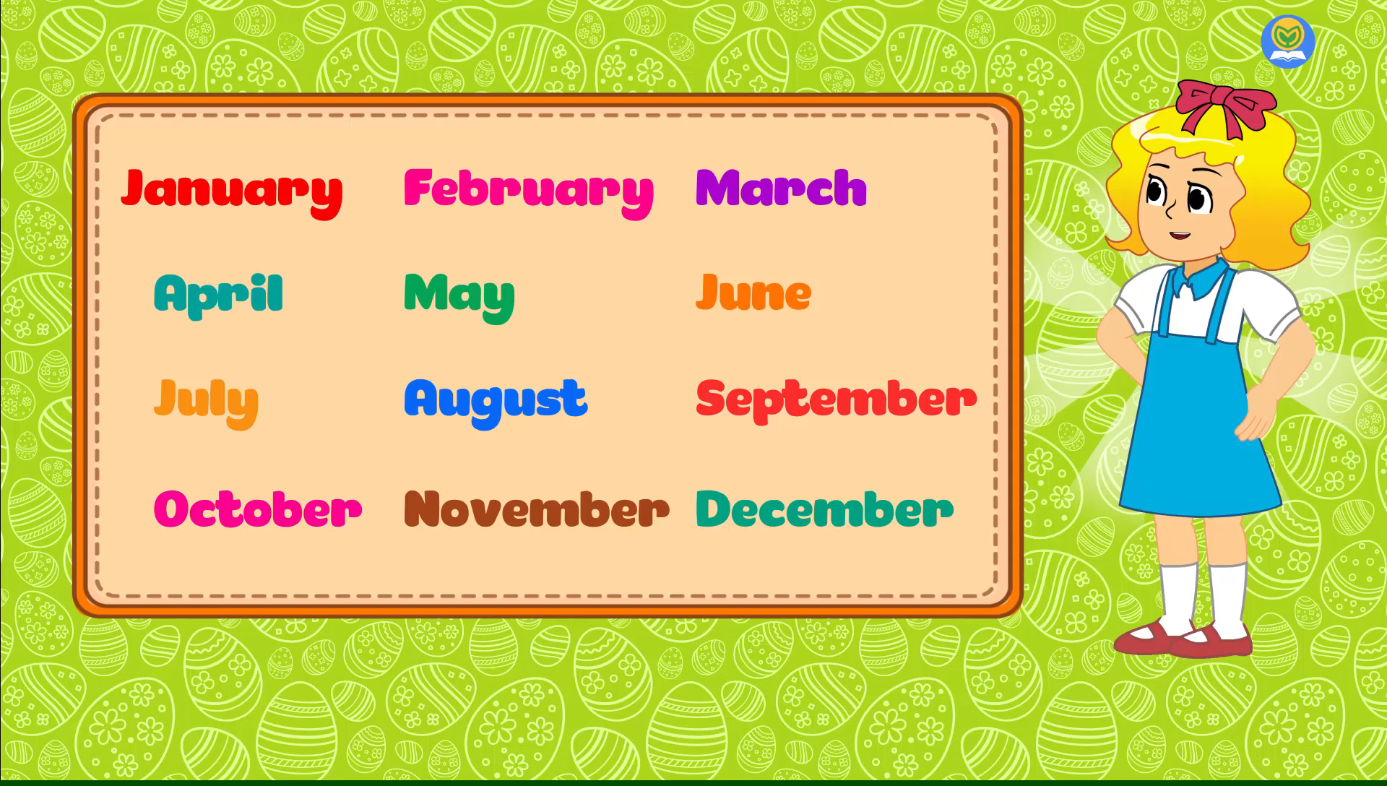
6. Let's chant

