Slide 1
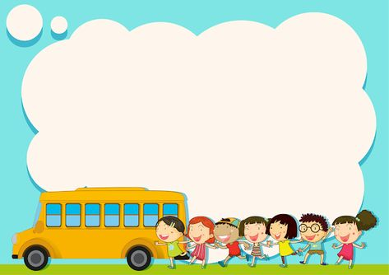
Unit 8: What subjects do you have today?
Lesson 3 (page 56+57)

Slide 2

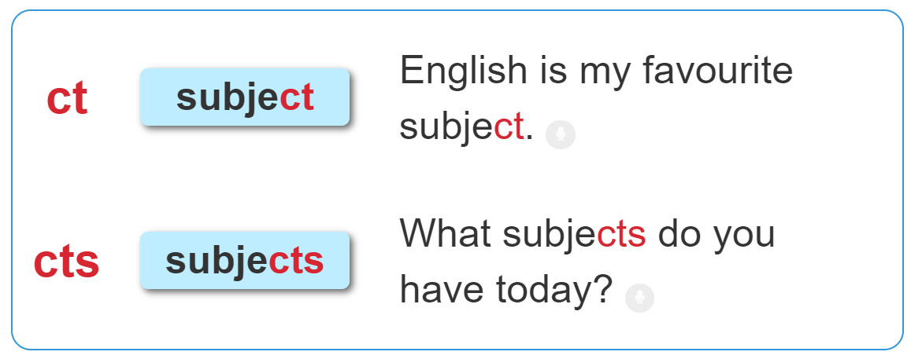

1. Listen and repeat.

Slide 3

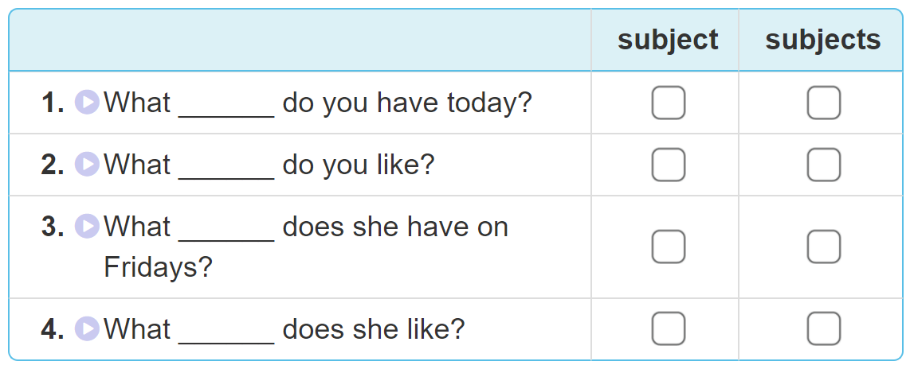

2. Listen and tick. Then write and say aloud

Slide 4
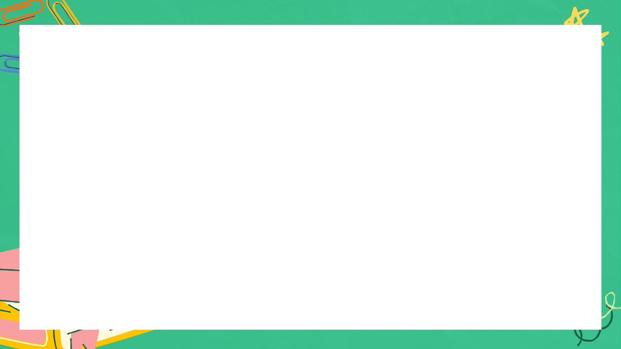

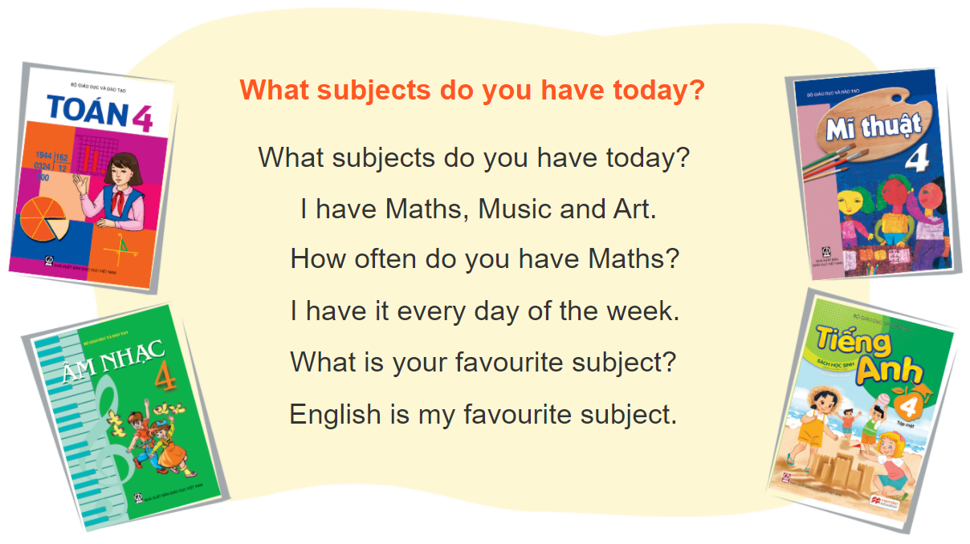

3. Let’s chant.

Slide 5
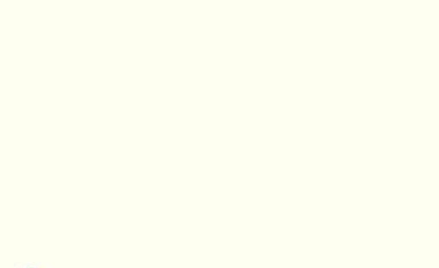
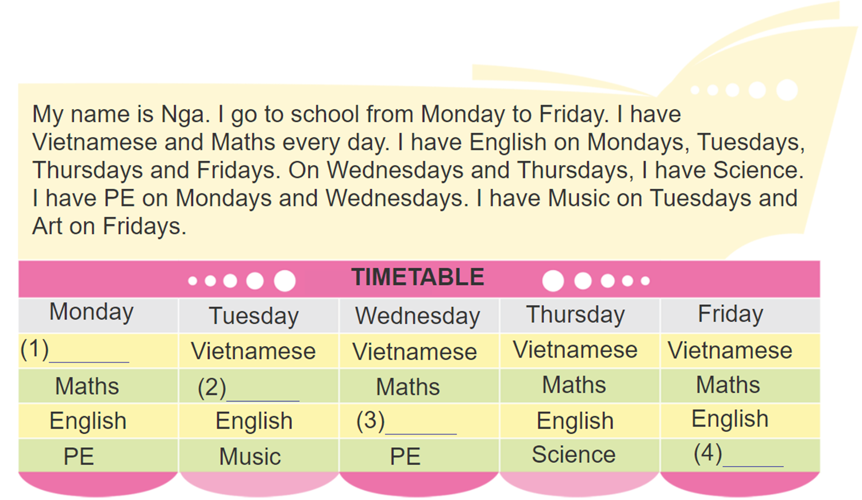
4. Read and complete
Vietnamese
Maths
Science
Art

Slide 6

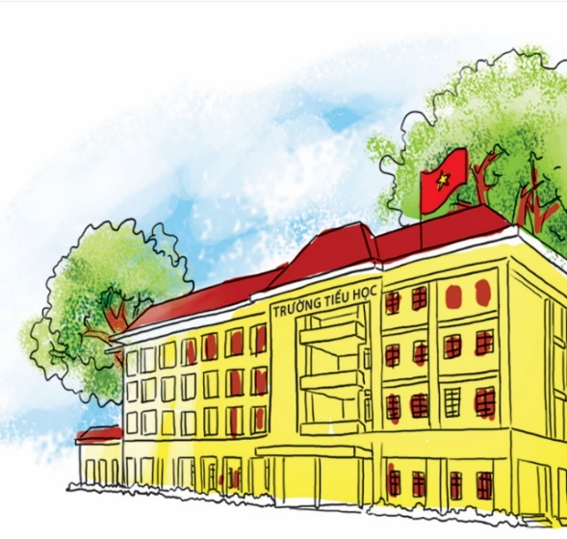
5. Write about you and your school subjects.
I am a pupil at ________________ Primary School.
I go to school from Monday to __________.
At school, I have Vietnamese, Maths, ____
__________________.
I have English on____________.
My favourite subject is____________.

Slide 7


