Slide 1


Slide 2
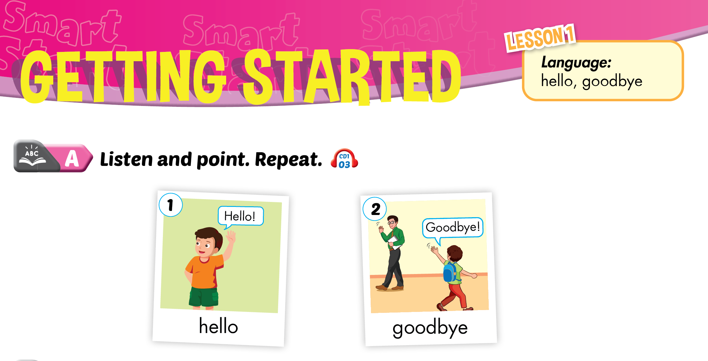

Lesson 1
Notes:
Click on the words, they will move and match up with the pictures.

Slide 3
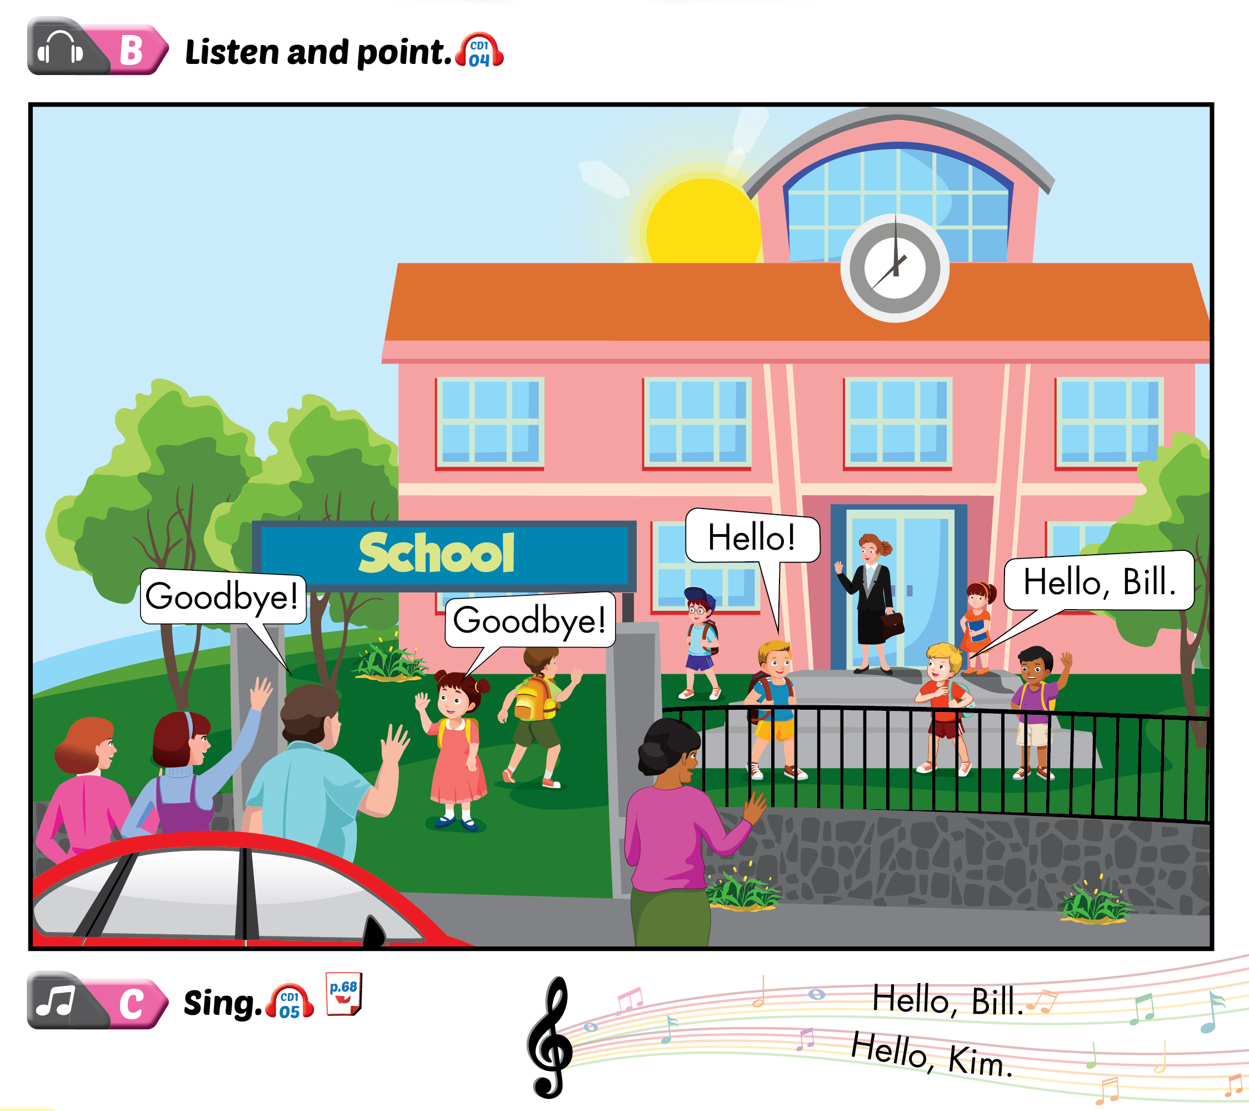
Lesson 1

Slide 4
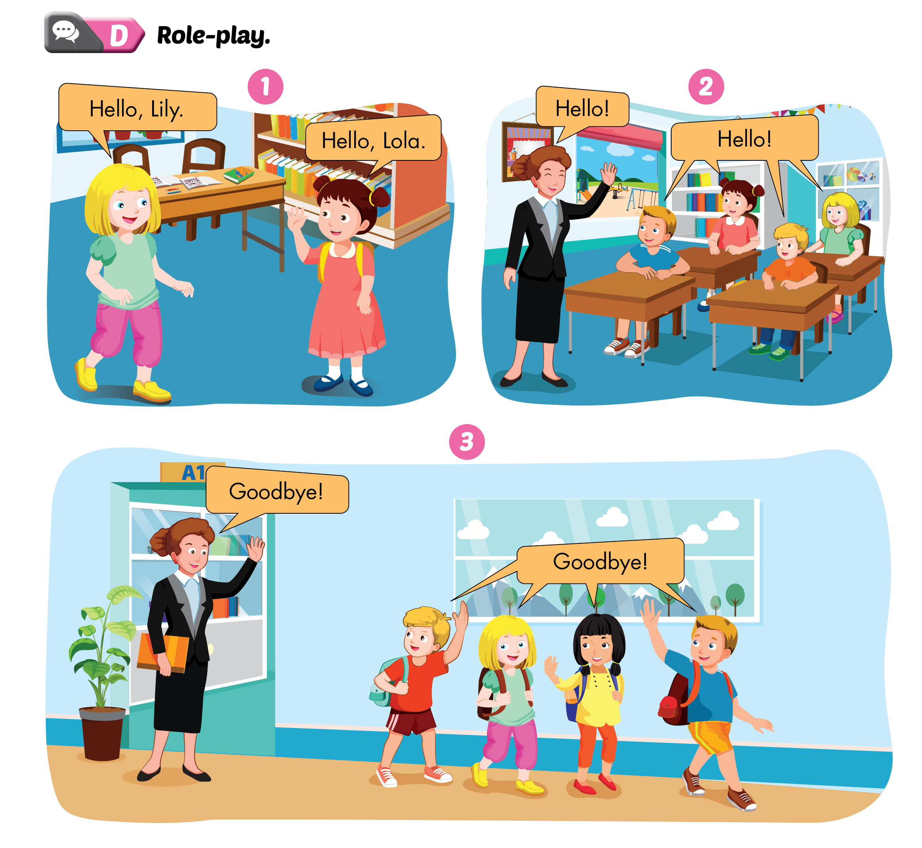
Lesson 1

Slide 5
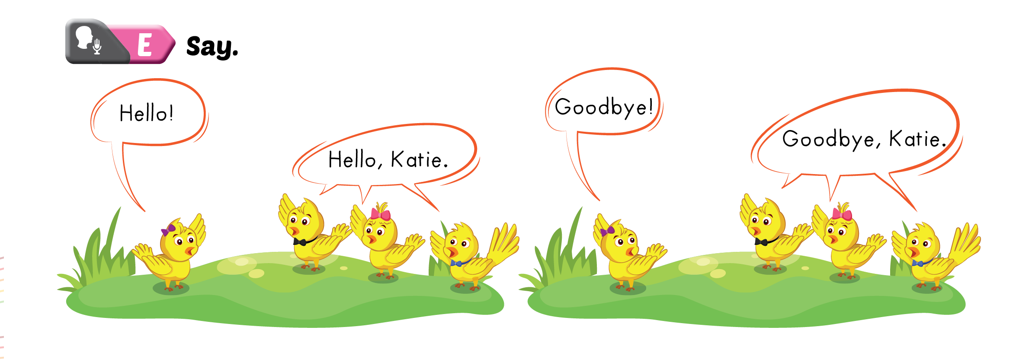
Lesson 1

Slide 6
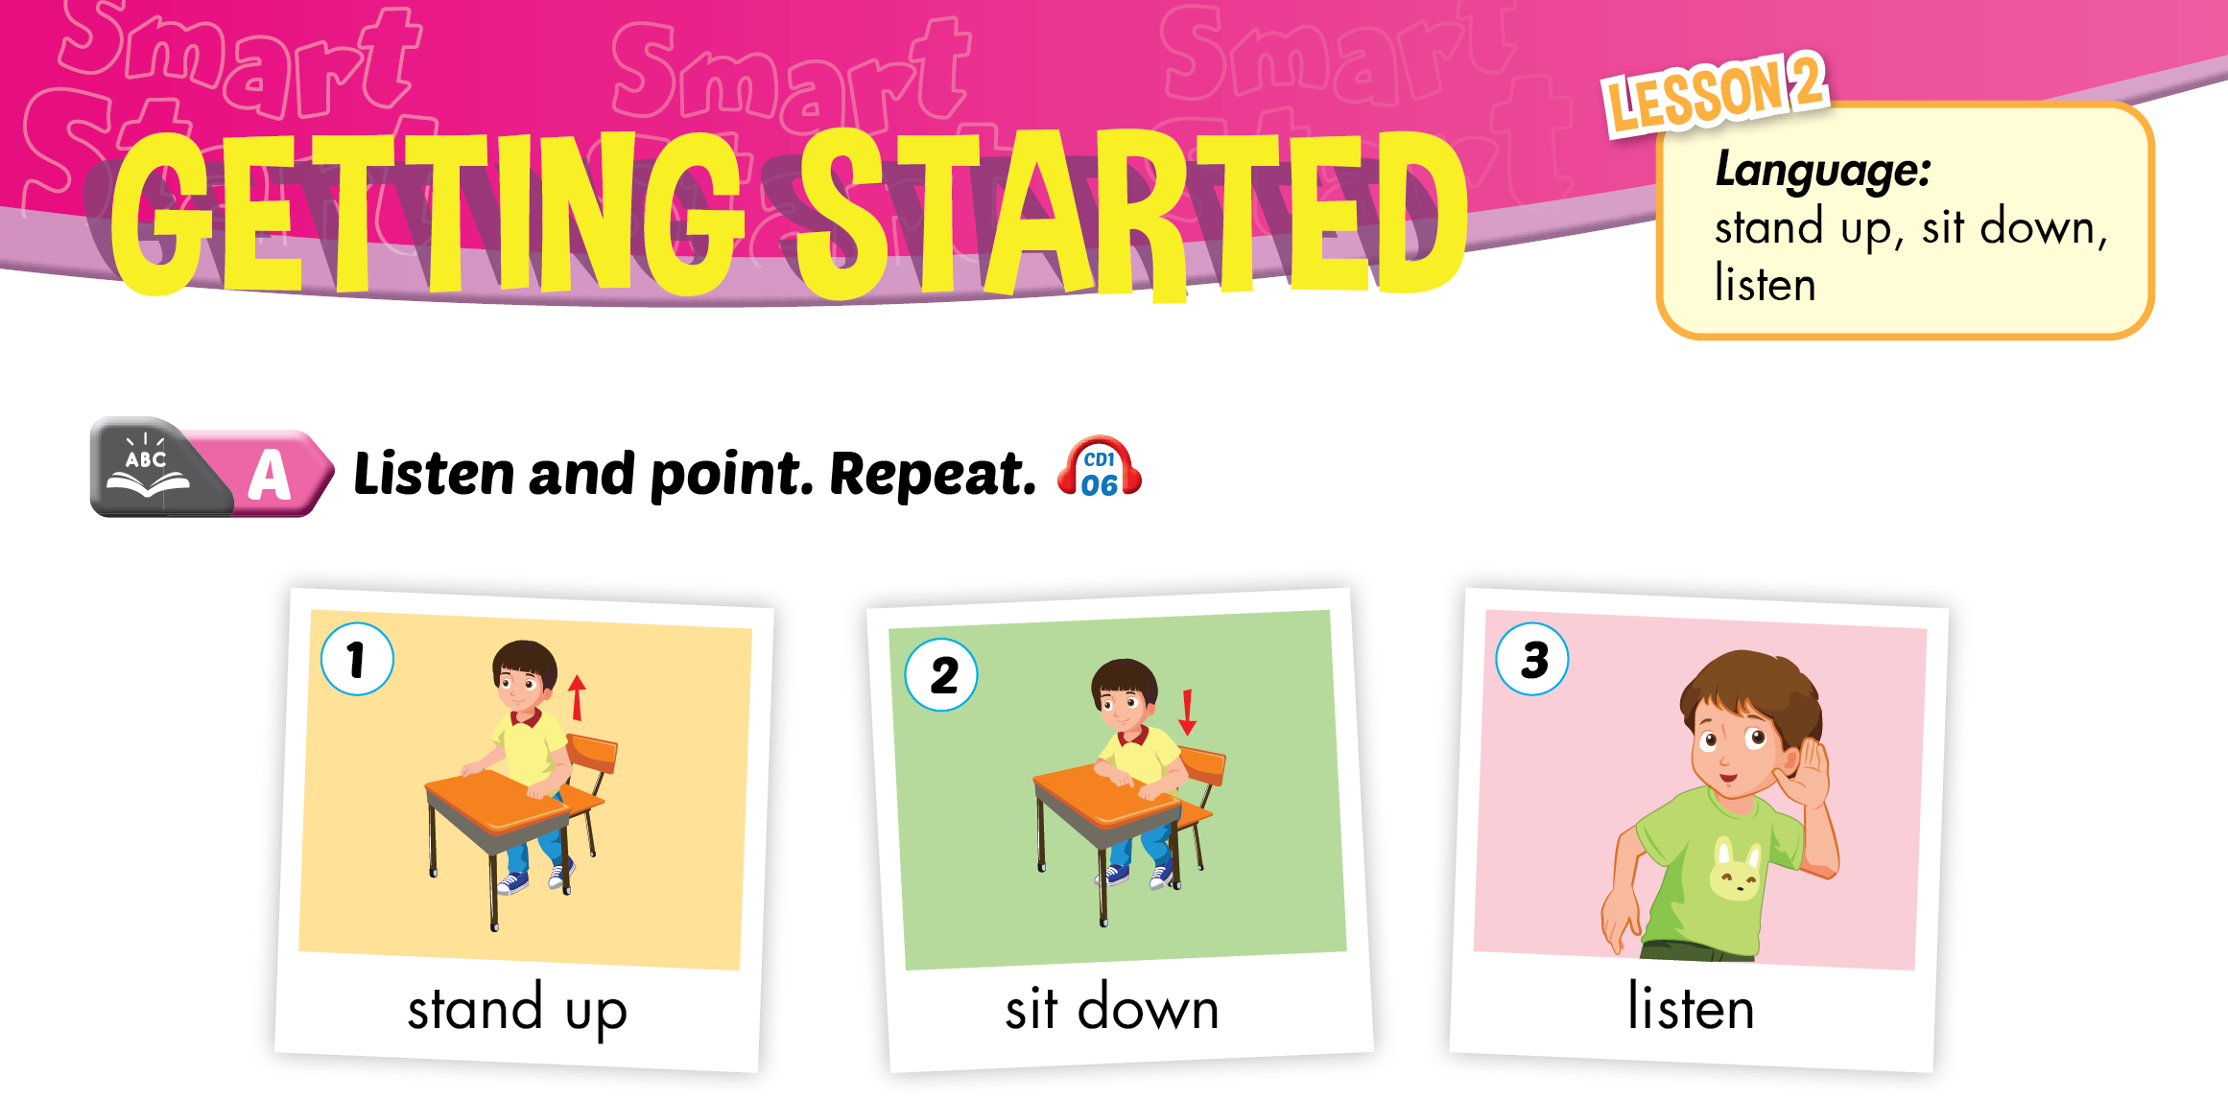

Slide 7
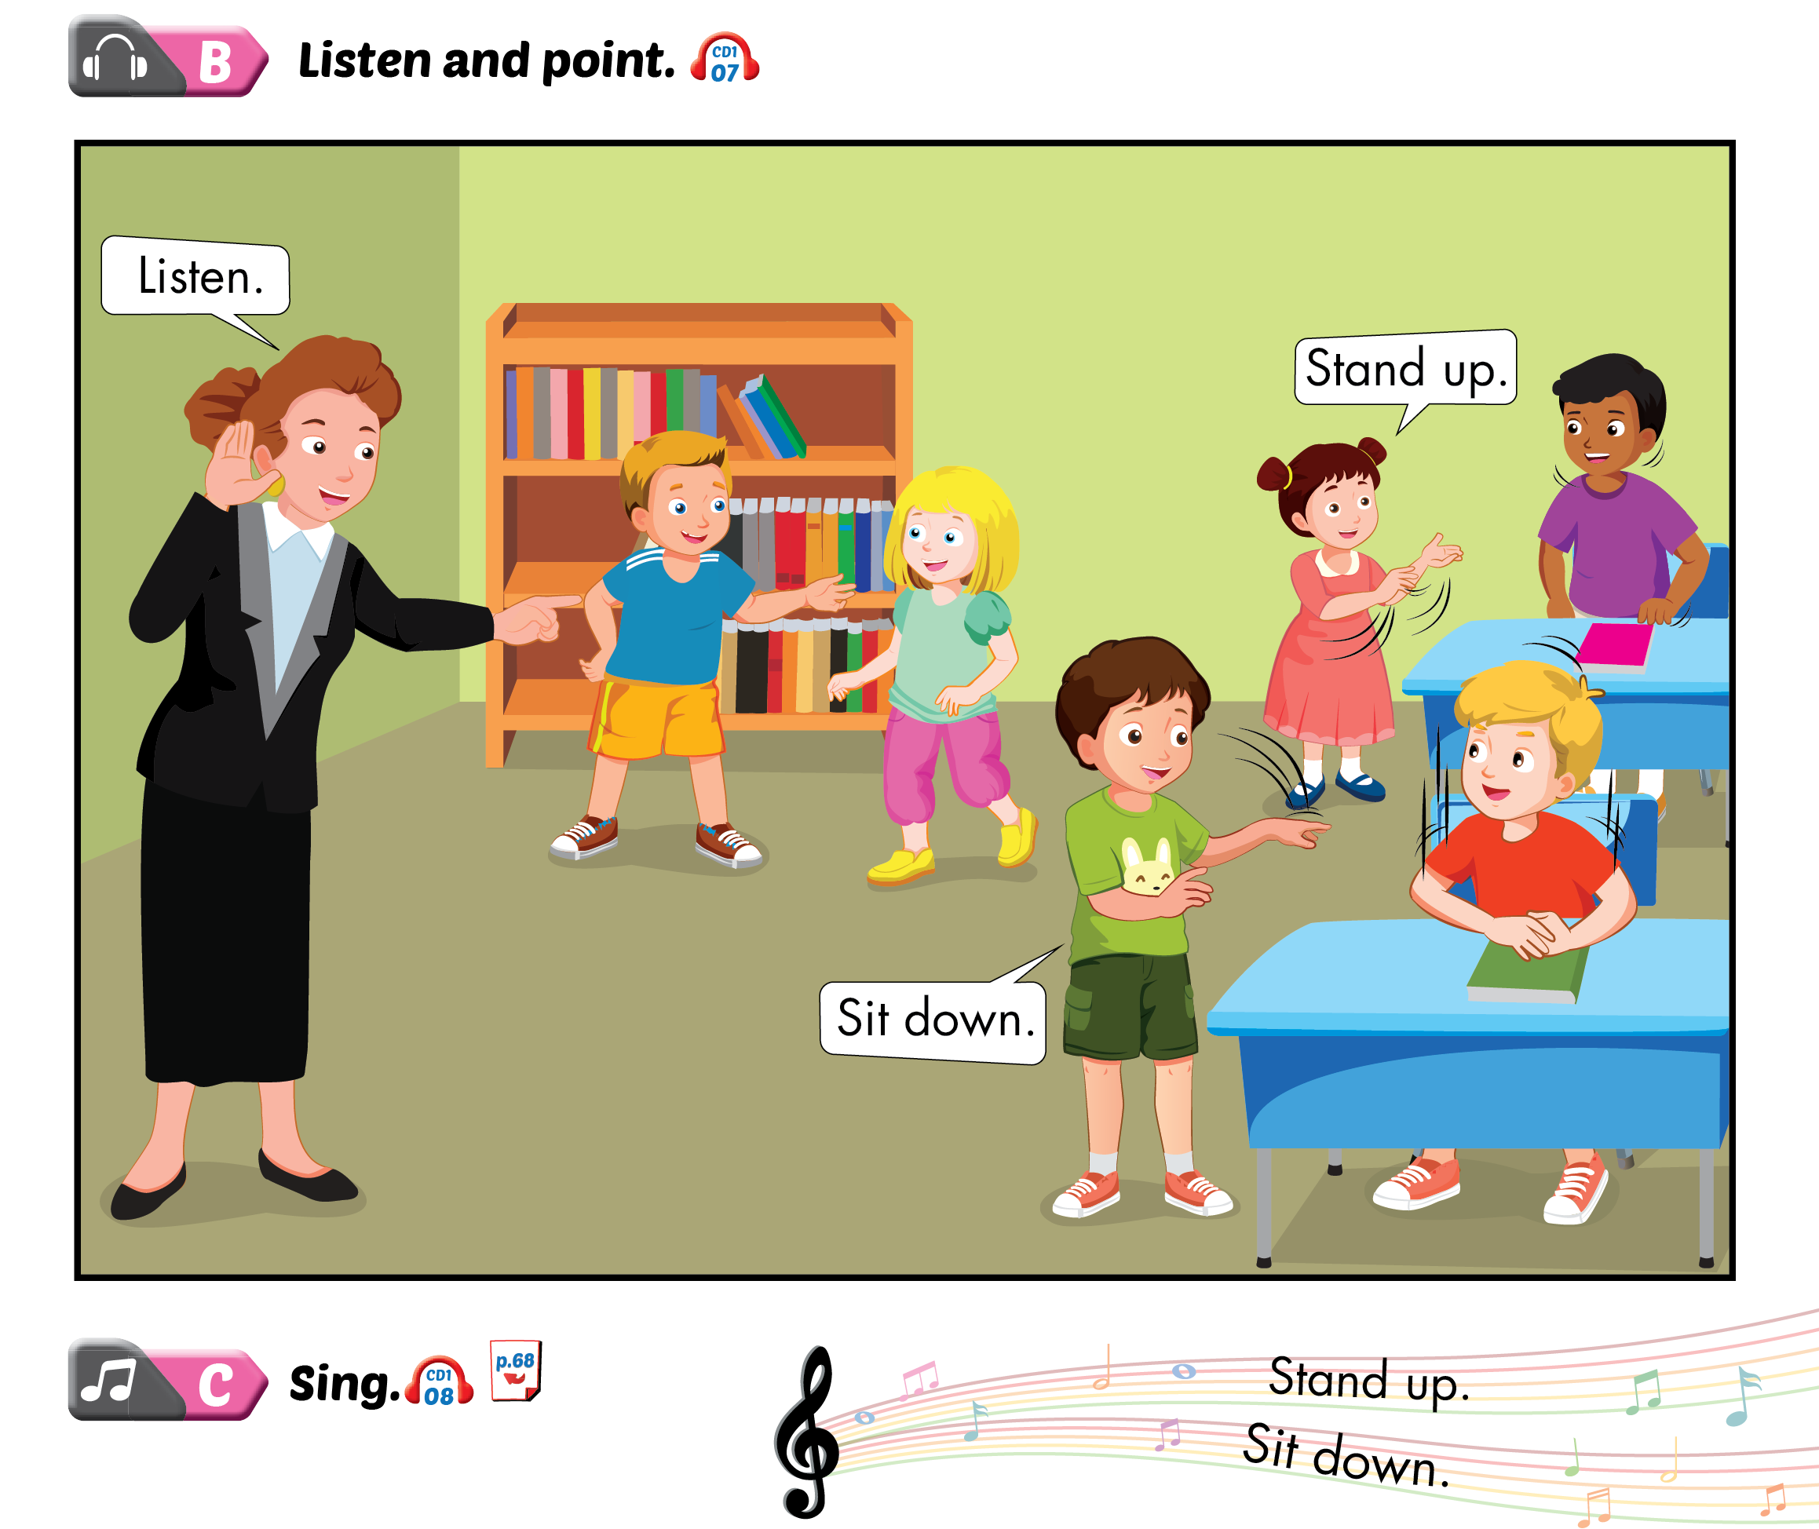
Lesson 2

Slide 8
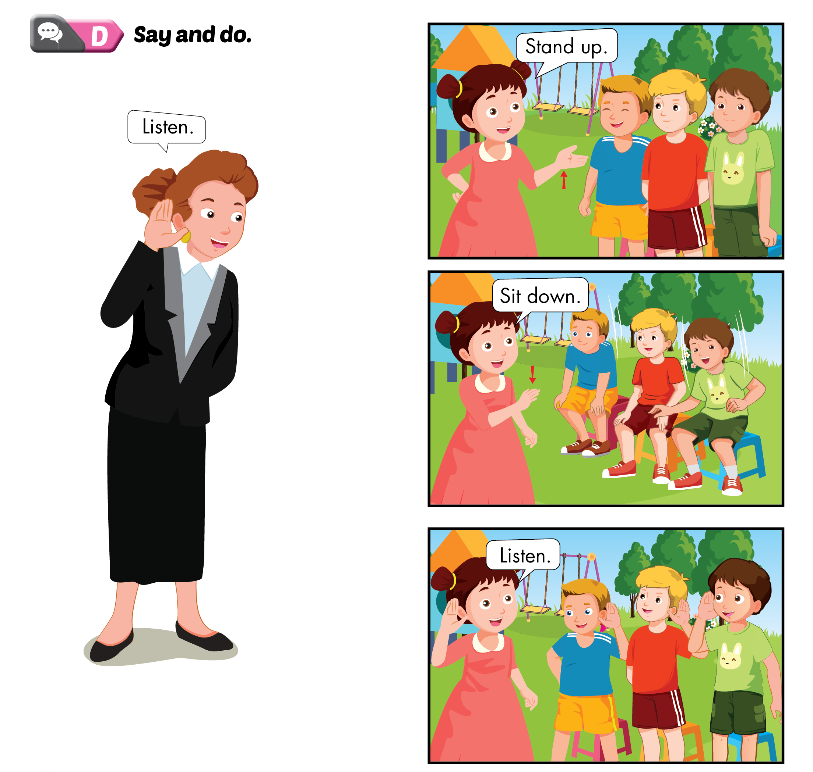
Lesson 2

Slide 9
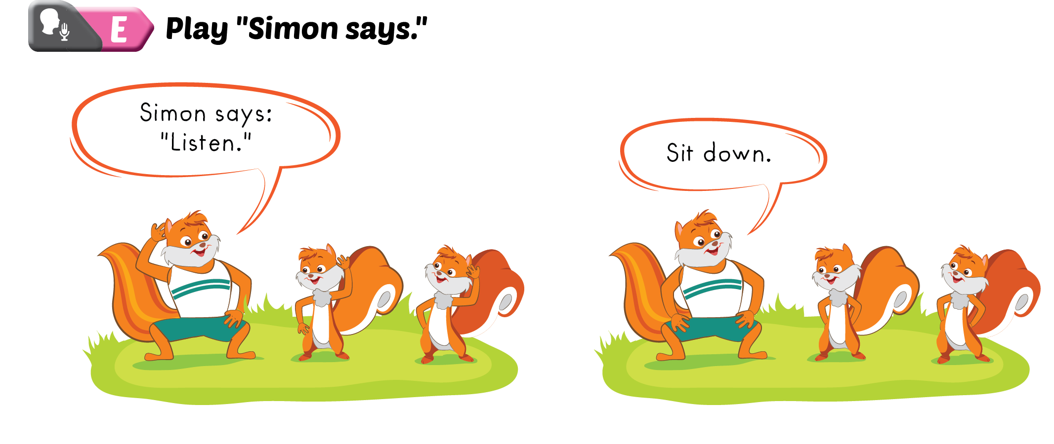
Lesson 2

