Slide 1
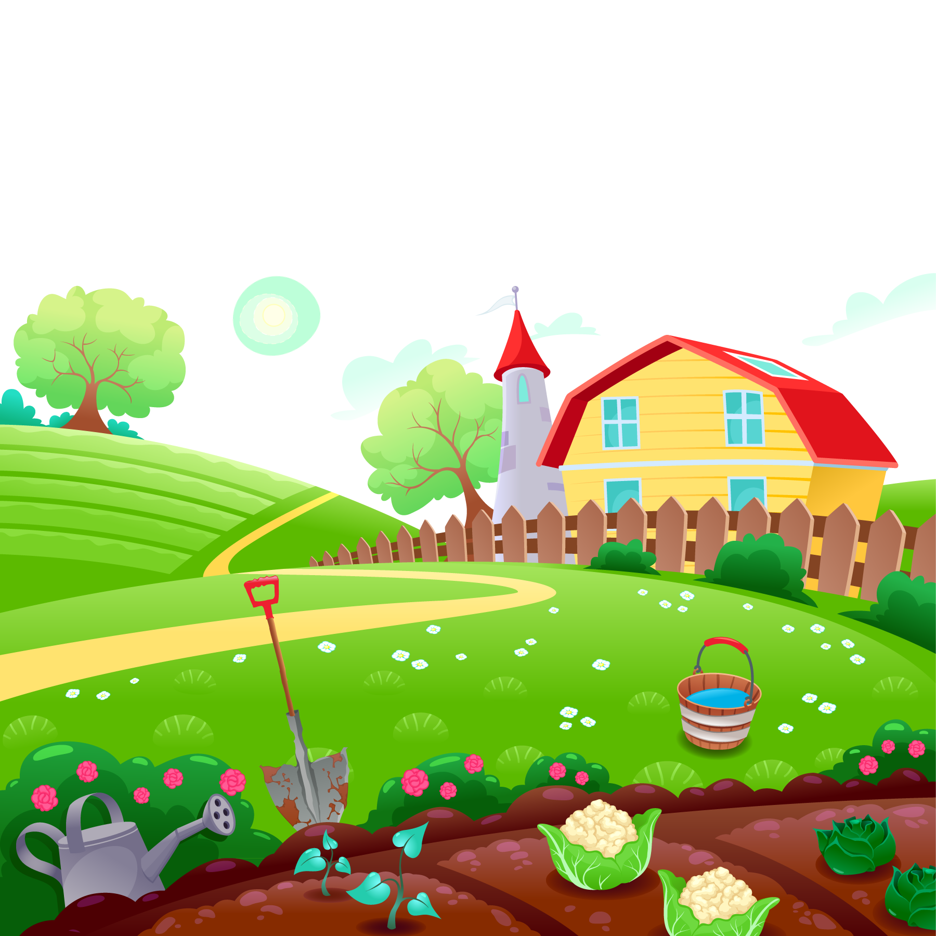

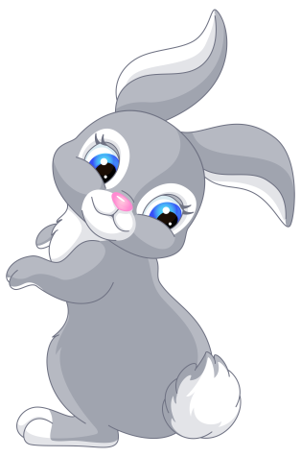
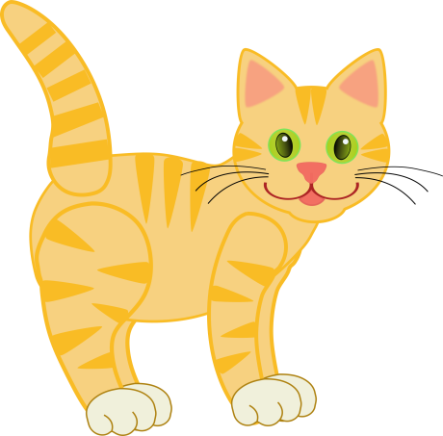
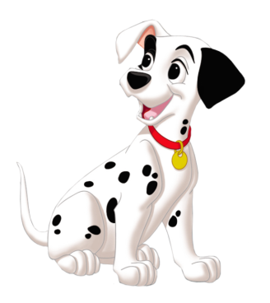

UNIT 16. DO YOU HAVE ANY PETS?
LESSON 2

Slide 2




WARM UP

Slide 3
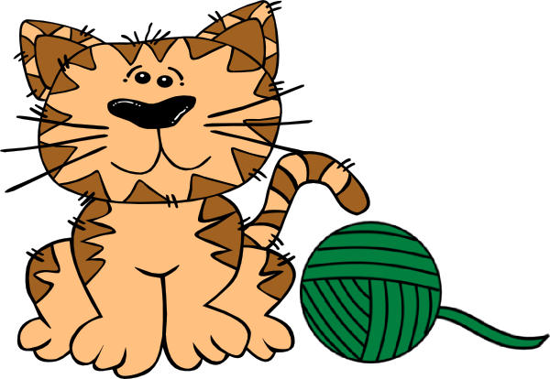
Next to

Slide 4
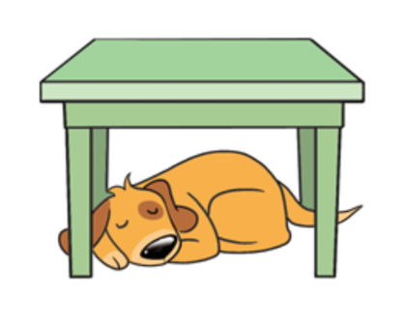
under

Slide 5
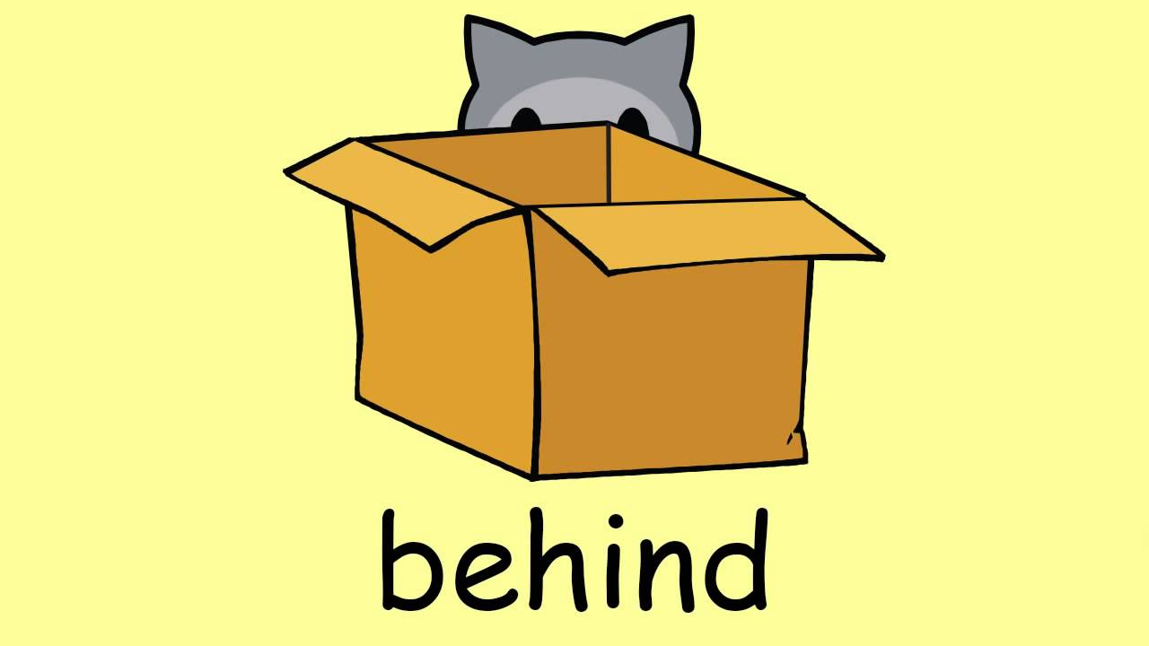

Slide 6
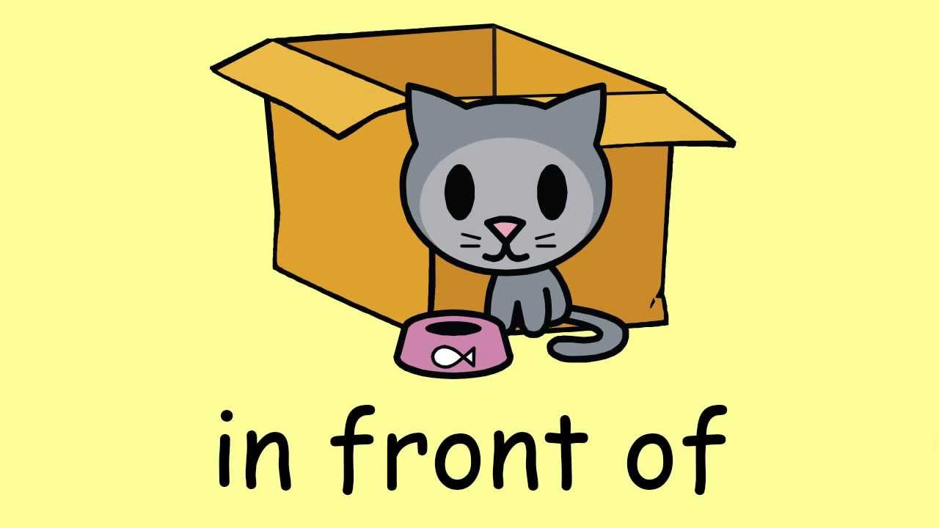

Slide 7

flower pot

Slide 8
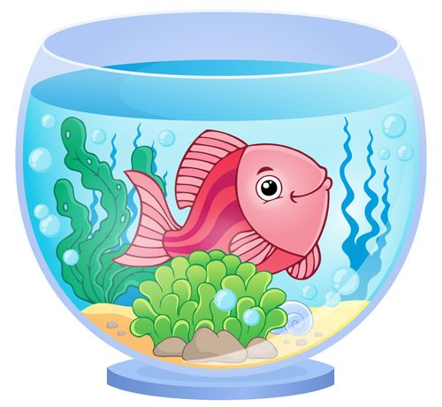
fish tank

Slide 9
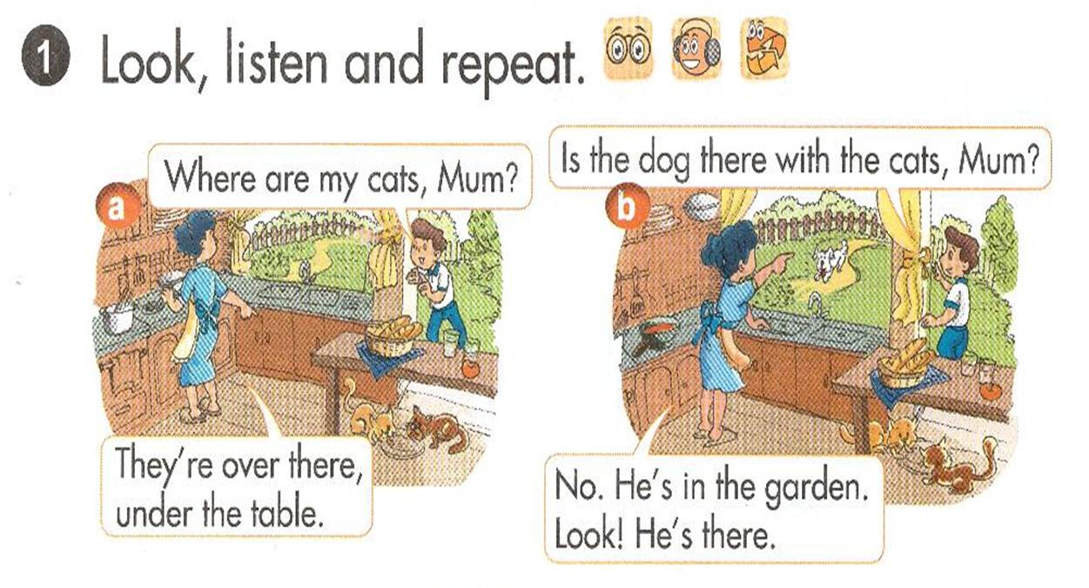


Slide 10
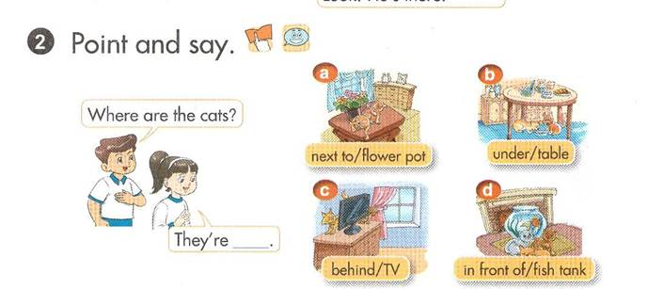


Slide 11
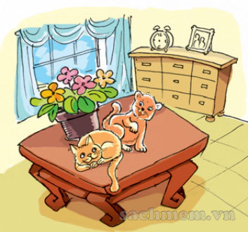

It
Where are the cats?
It
They’re
the .
next to
flower pot

Slide 12
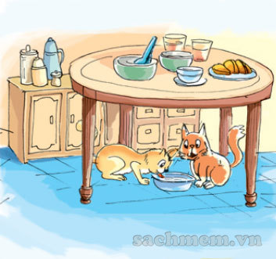
It
Where are the cats?
It
They’re
the .
under
table

Slide 13
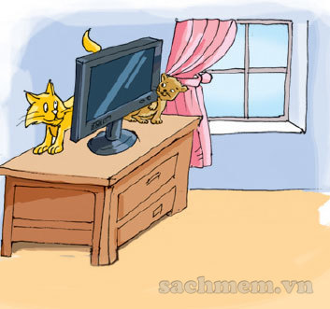
It
Where are the cats?
It
They’re
the .
behind
TV

Slide 14
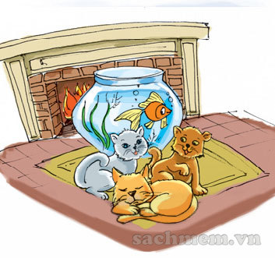
It
Where are the cats?
It
They’re
the .
in front of
fish tank

Slide 15







1. Vocabulary
- next to
- under
- behind
- in front of
- flower pot
- fish tank

Slide 16
2. Model sentence
Where are the cats?
They’re next to the flower pot.
Where are the cats?
They’re behind the TV.

Slide 17
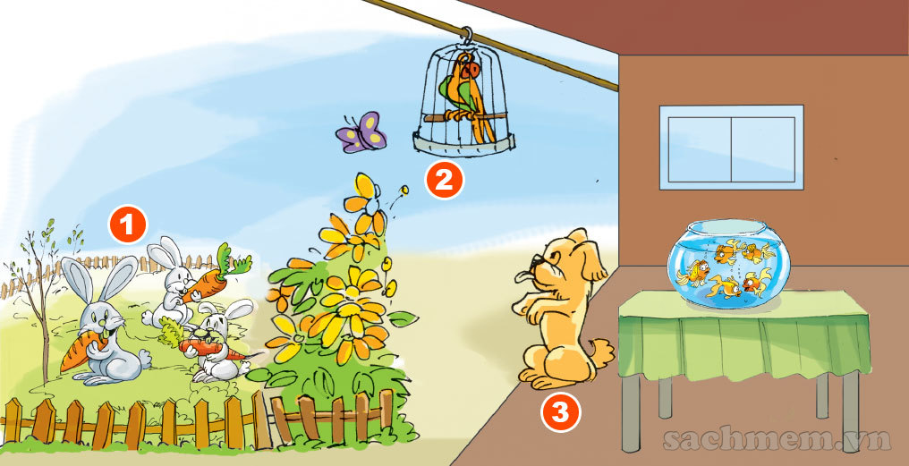
LET’S TALK

Slide 18

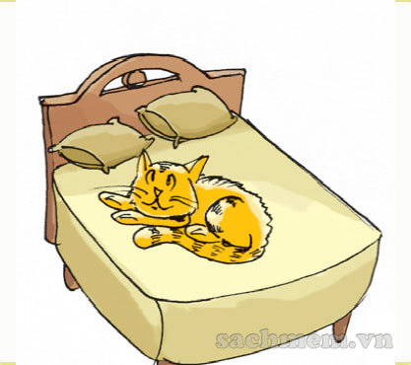
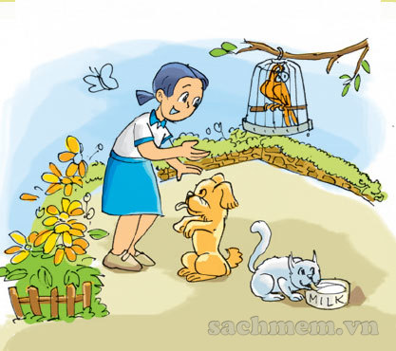
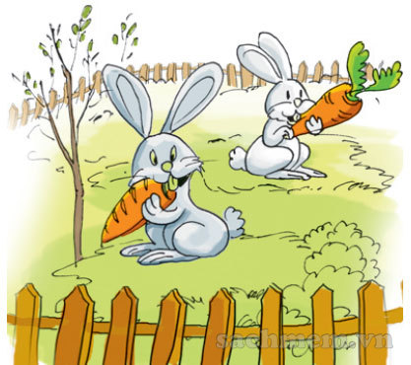
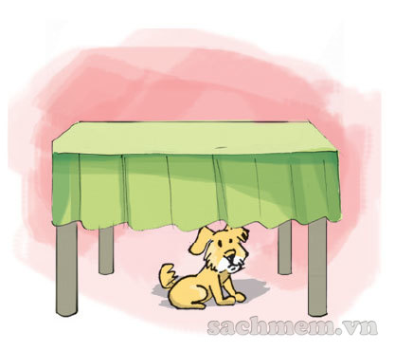
Listen & NUMBER
2
1
1
2
3
4
3
4

Slide 19
READ & WRITE
Hi! My name is Nam. I have a lot of pets. This is my cat. It is on the bed. And that is my dog. It is there, under the table. I also have two parrots and a rabbit. They are all in the garden.
1. Nam has a lot of .
2. He has a .
It is the bed.
3. He has a .
It is the table.
34. He has two and a .
They are in the .
pets
cat
on
dog
under
parrots
rabbit
garden

Slide 20




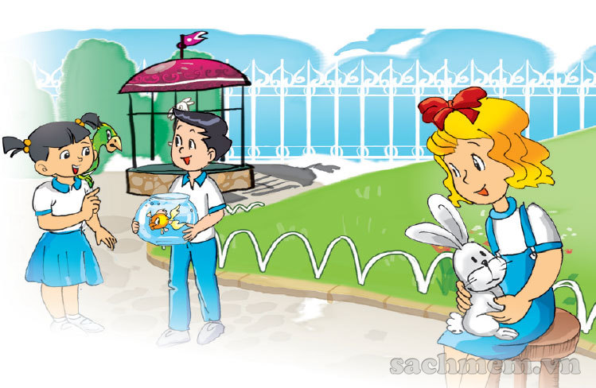
Do you have any pets?
Do you have any pets?
Yes, I do.
I have a rabbit and its name is Boo.
Do you have any pets?
Yes, I do.
I have a goldfish and its name is Blue.
Do you have any pets?
Yes, I do.
I have a parrot and its name is Sue.

Slide 21
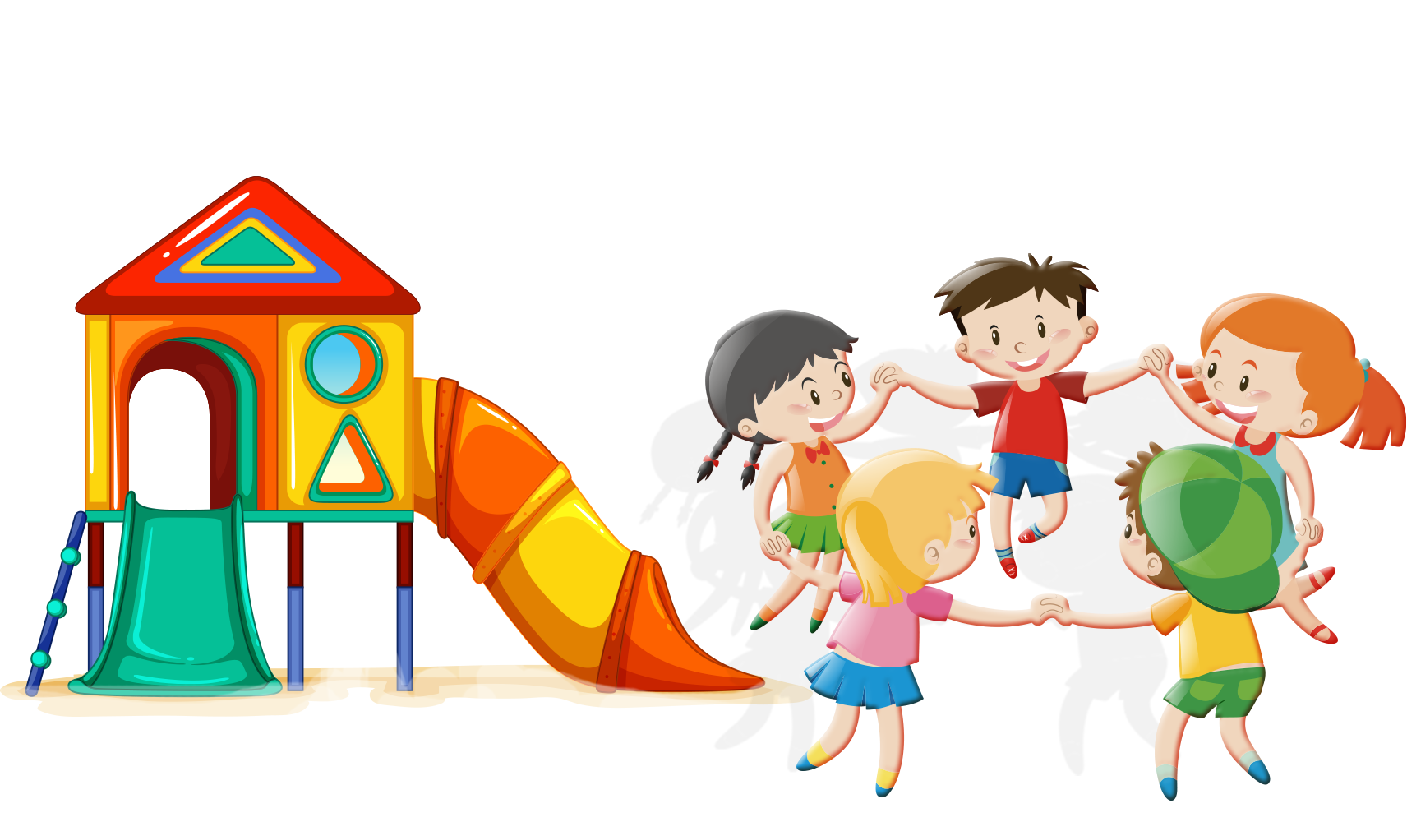
TIME TO PLAY

Slide 22




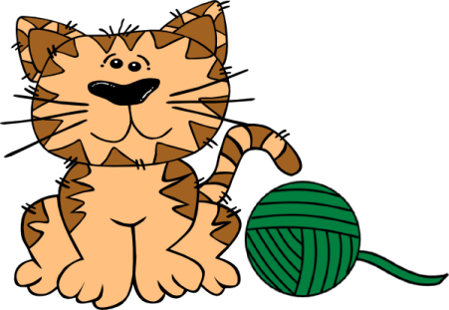



PET HOUSE
END

Slide 23




The dog is under the table
The dog is behind the table
The dog is next to the table

Slide 24
The cats are under the table
The cats are next to the flower pot.
The cats are behind the flower pot.

Slide 25
The goldfish is on the fish tank.
The goldfish is under the fish tank.
The goldfish is in the fish tank.

Slide 26
The rabbits is in the fish tank.
The rabbit is in the garden.
The rabbit is near the garden.

Slide 27
The cat is in front of the dog.
The cat is under the dog.
The cat is next to the dog.

Slide 28
The cats are under the table.
The cats are on the table.
The cats are in the table.

Slide 29
The cat is on the TV.
The cat is in the TV.
The cat is behind the TV.

Slide 30
The cats are in the fish tank.
The cats are behind the fish tank.
The cats are in front of the fish tank.

Slide 31
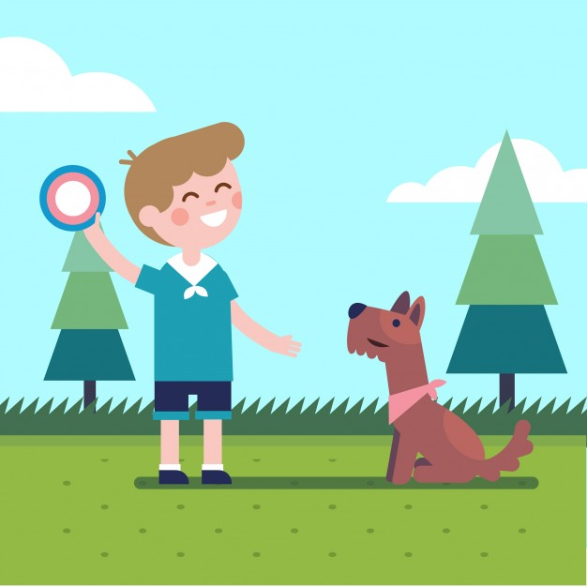


Slide 32



