Slide 1

Unit 2: Family
Lesson 2.2
Page 28

Slide 2
Let’s chant!

Slide 3
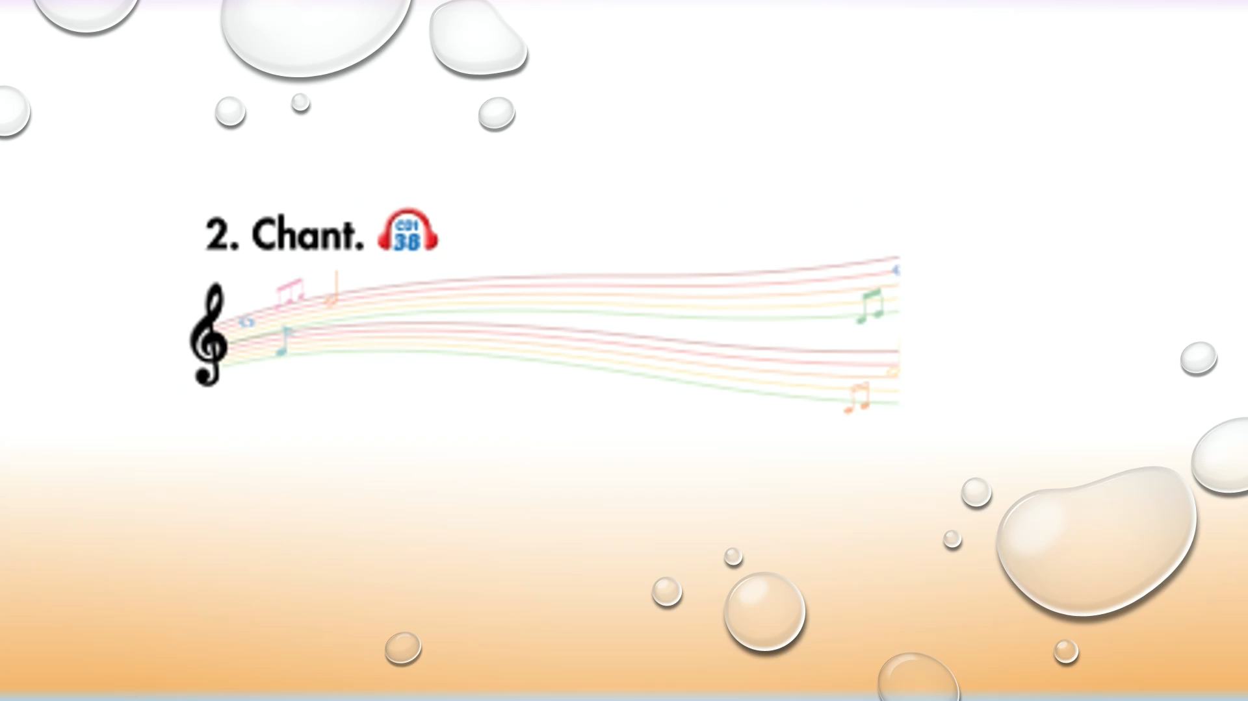

Slide 4

WARM UP

Slide 5
Let’s play!

Slide 6
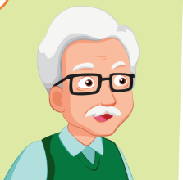
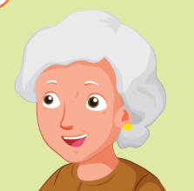
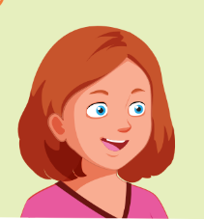
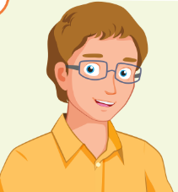
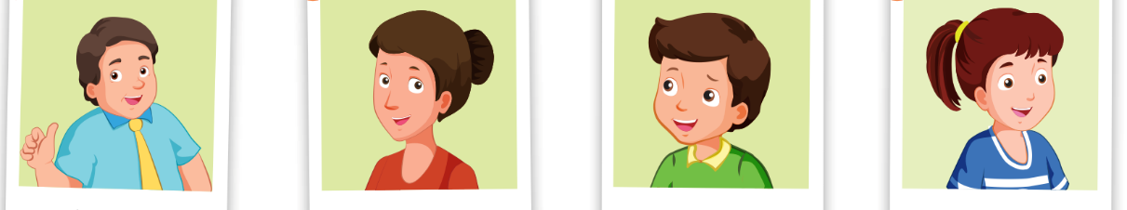

FAMILY

Slide 7
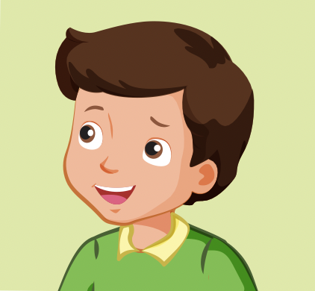


Who is he?
GREAT
brother
father
sister

Slide 8
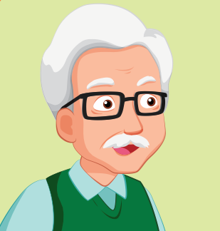
Who is he?
GREAT
father
grandfather
uncle

Slide 9
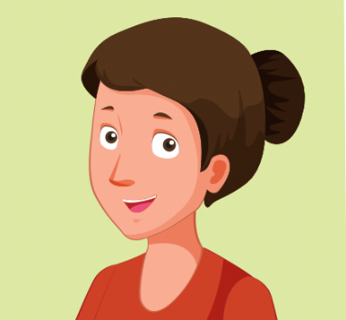

Who is she?
GREAT
father
sister
mother

Slide 10
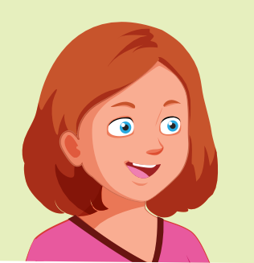
Who is she?
GREAT
aunt
sister
mother

Slide 11
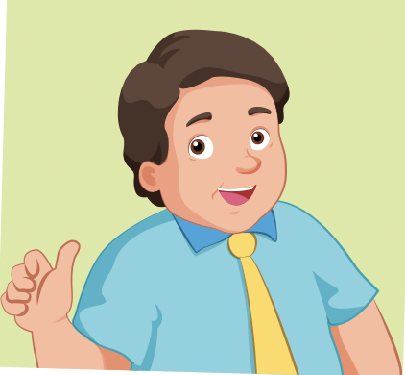
Who is he?
GREAT
brother
father
sister

Slide 12
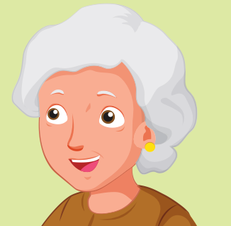
Who is she?
GREAT
aunt
grandmother
father

Slide 13
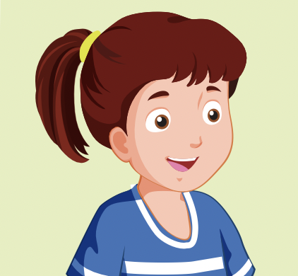
Who is she?
GREAT
father
mother
sister

Slide 14
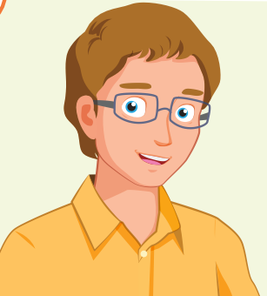
Who is he?
GREAT
uncle
brother
father

Slide 15

Presentation

Slide 16

Phonics
/ð /

Slide 17


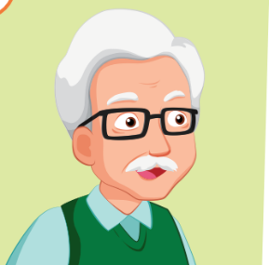
Click on the icon to hear the sound
grandmother
grandfather
/ð /
/ð /

Slide 18
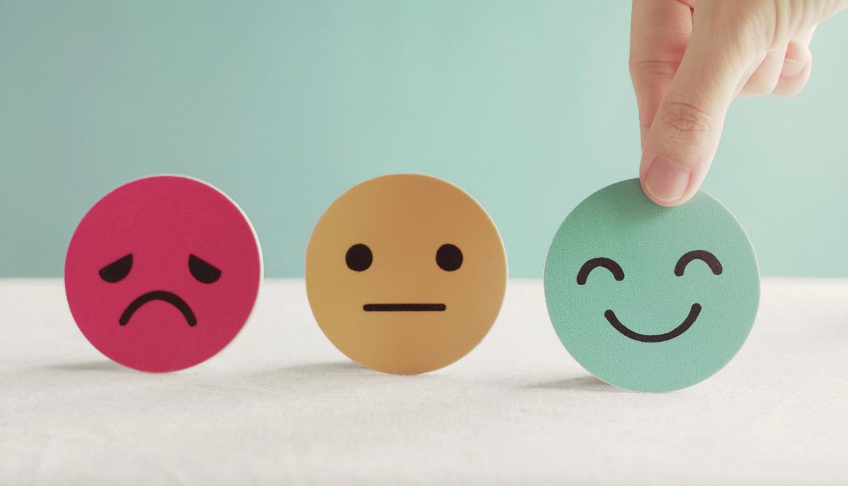
Lesson 3
Stay positive and have a nice day!

