Slide 1

Unit 2: Family
Lesson 1.2
Page 25

Slide 2

Presentation

Slide 3

Phonics
/ʌ/

Slide 4
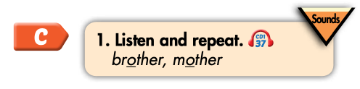

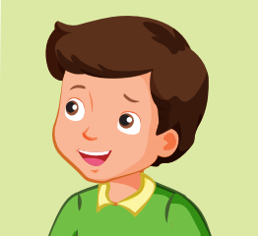

Click on the icon to hear the sound
brother
mother
/ʌ/
/ʌ/

Slide 5

Practice

Slide 6
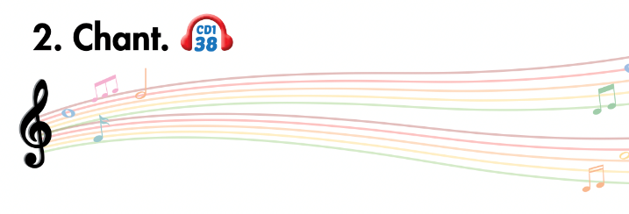
Listen and point
Listen and clap
Listen and chant

Slide 7
