Slide 1


duc giang Primary School
WELCOME ALL THE TEACHERS
TO CLASS 4E
Unit 6: Where’s your school? Lesson 1
Teacher: Nguyen Thi Hoa

Slide 2
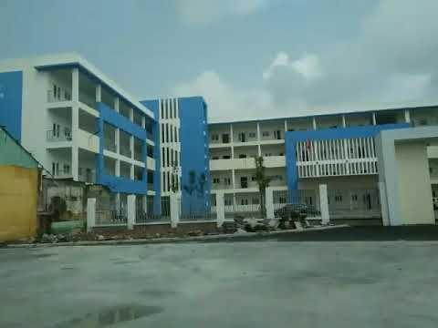
1
2
3
4
DUC GIANG PRIMARY SCHOOL

Slide 3
1. What do you do on Mondays?

Slide 4
2. What can you do?

Slide 5
3. When’s your birthday?

Slide 6
4. What is the date today?

Slide 7
Unit 6: Where’s your school?
Lesson 1

Slide 8
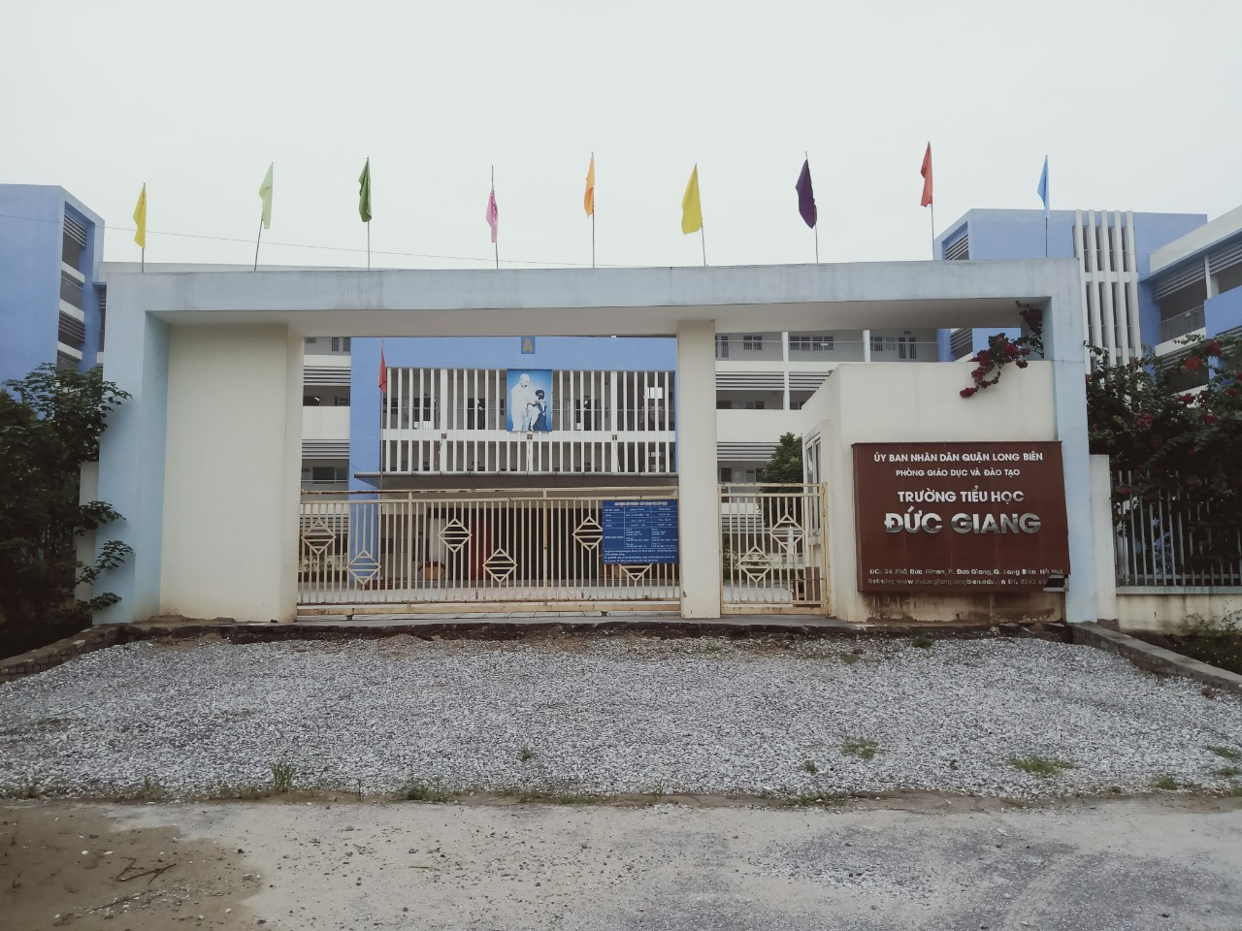

Slide 9
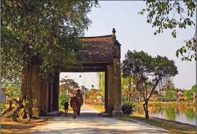

Slide 10
district
We live in Long Bien..................

Slide 11


LUCKY NUMBERS

Slide 12









Slide 13
20
Duc Giang Primary School
Duc Giang Street

Slide 14

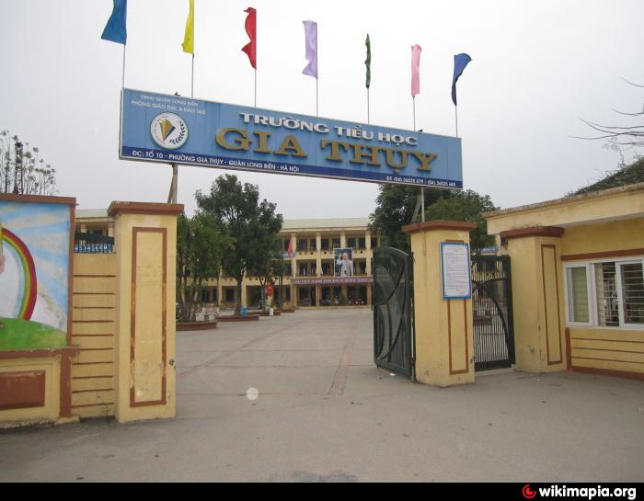
X 2
GIA THUY PRIMARY SCHOOL
Long Bien district

Slide 15
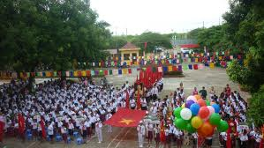
40
TIEN PHONG PRIMARY SCHOOL
Kim Quan Village

Slide 16

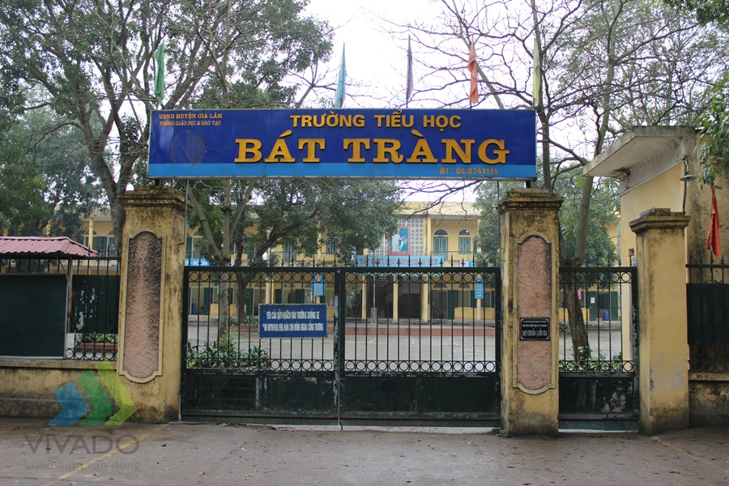
0
BAT TRANG PRIMARY SCHOOL
Bat Trang Road

Slide 17
Where’s……………………school?
A. Hoa B. Hoa is C. Hoa’s
10

Slide 18
30
Duc Giang Primary School
33 Duc Giang

Slide 19

Homelink
Learn by heart the new words.
- Practice the model sentences.

Slide 20


