Slide 1
WARM-UP

Slide 2

Lucky numbers
2
3
1
4
6
5

Slide 3
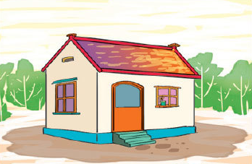
This is a ______. It is small.
A. yard
B. house
C. pond
√

Slide 4
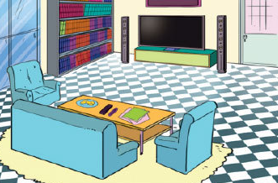
______ a living room. It is large.
A.There is
B. Is there
C.Is that
√

Slide 5
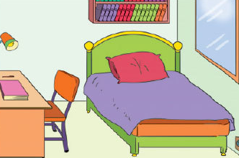
______ a bedroom in the house?
A. This is
B. There is
C. Is there
√

Slide 6

Is there a pond in the garden?
No, there isn't.

Slide 7
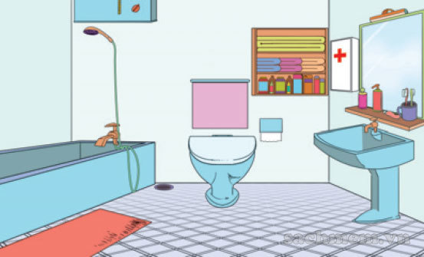
Yes, there is.
A.Is there a living room?
B.Is there a bathroom?
C.Is there a bedroom?
√

Slide 8
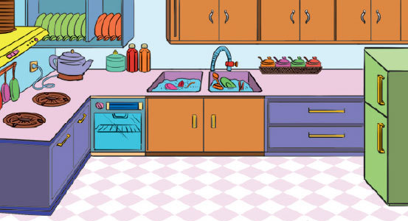
No, there isn’t.
A. Is there a kitchen?
B. Is there a bathroom?
C. Is the kitchen small?
√

Slide 9
Unit 12
This is my house
Lesson 3

Slide 10
PHONICS

Slide 11

1. Listen and repeat
ch | kitchen | This is the kitchen.
th | bathroom | Is there a bathroom?

Slide 12
2. Listen and write
1. The bathroom is large.
2. Is there a kitchen?
_____________
_____________

Slide 13
13
Unit
Where’s my book?
Lesson 1

Slide 14







Vocabulary
chair
bed
table
coat
ball
poster
picture

Slide 15
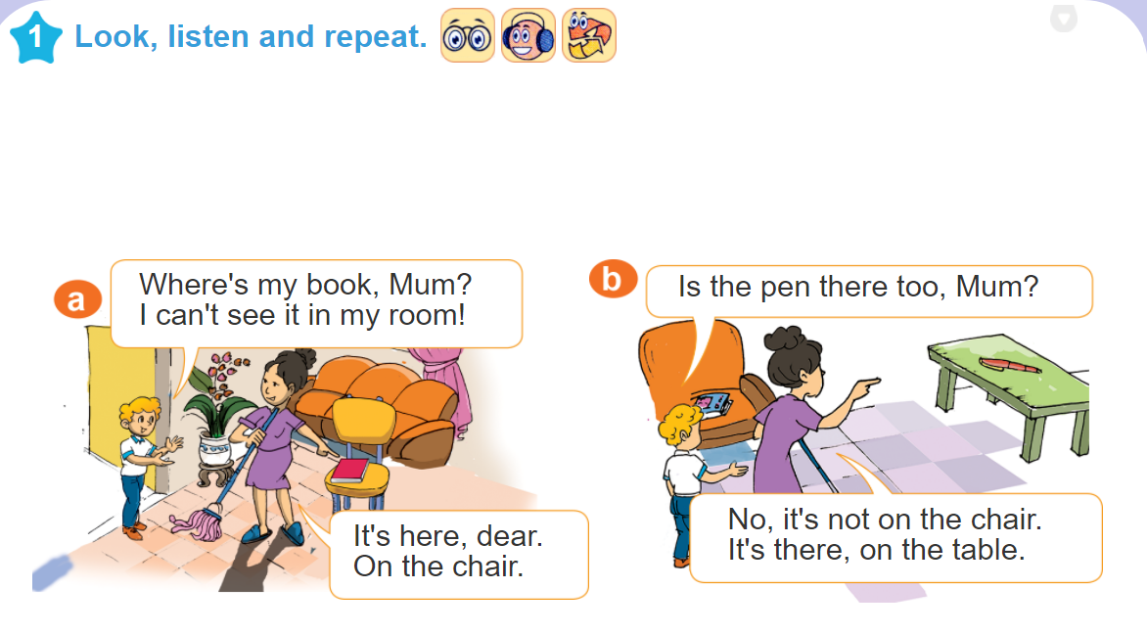

Slide 16

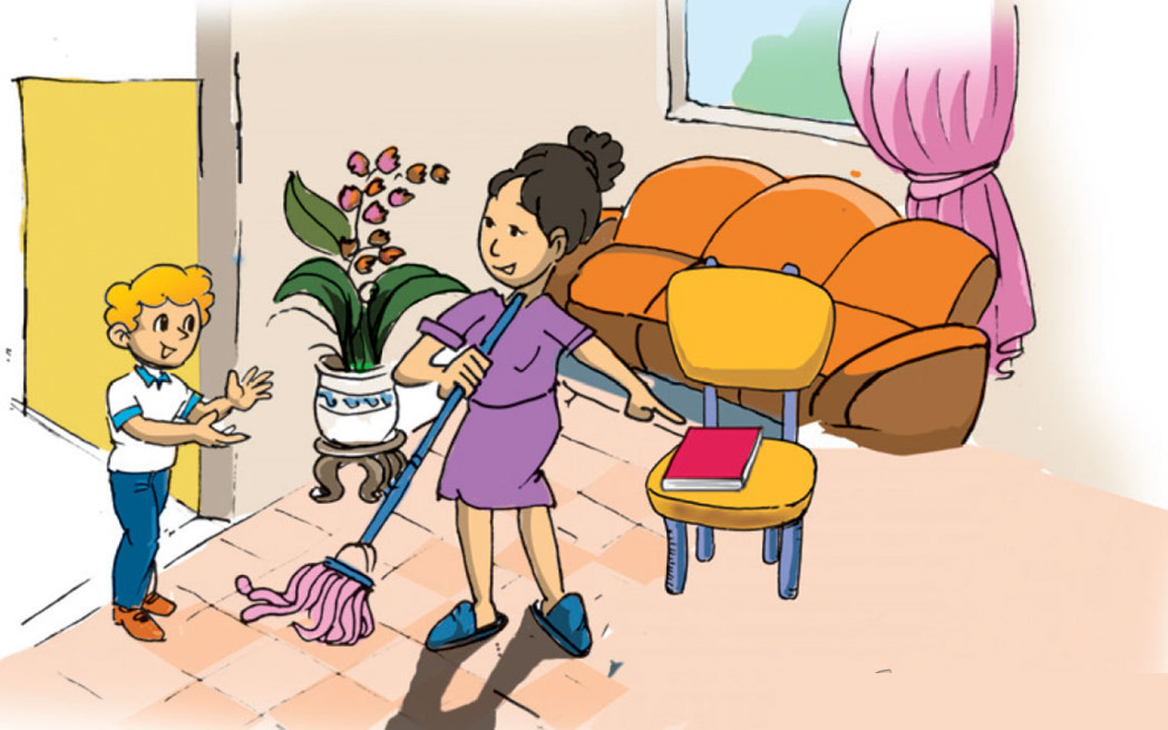
1. Look, listen and repeat
a
Where's my book, Mum?
I can't see it in my room!
It's here, dear. On the chair.

Slide 17
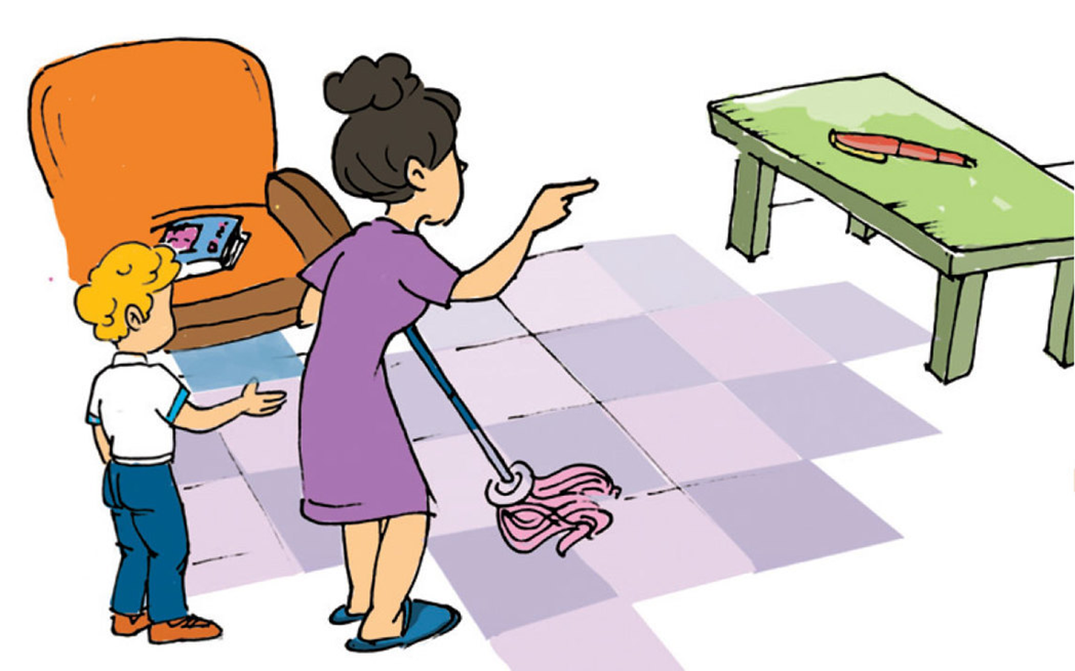

1. Look, listen and repeat
b
No, it's not on the chair.
It's there, on the table.
Is the pen there too, Mum?

Slide 18
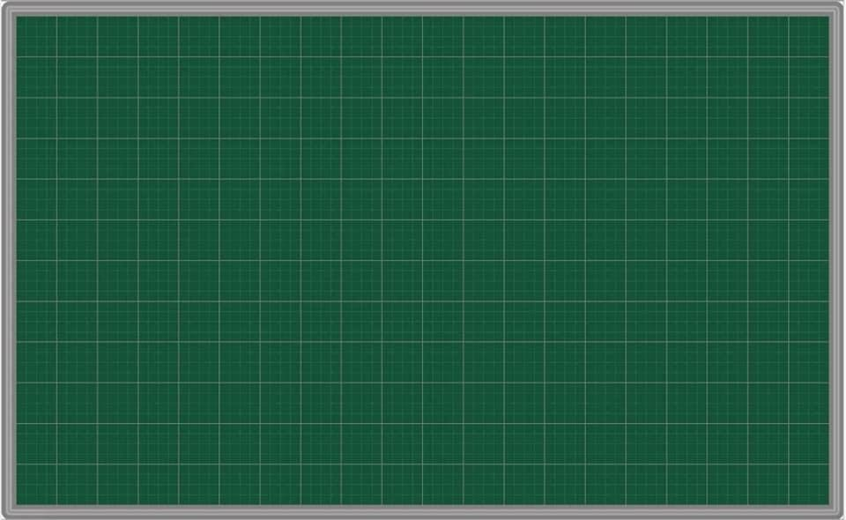
Model sentence
my book ?
A: Where’s my book?.
B: It’s here.
here.
Where’s = Where is

Slide 19


2. Point and say
Where's my chair?
Where's my ball?
It’s here.
It’s there.

Slide 20
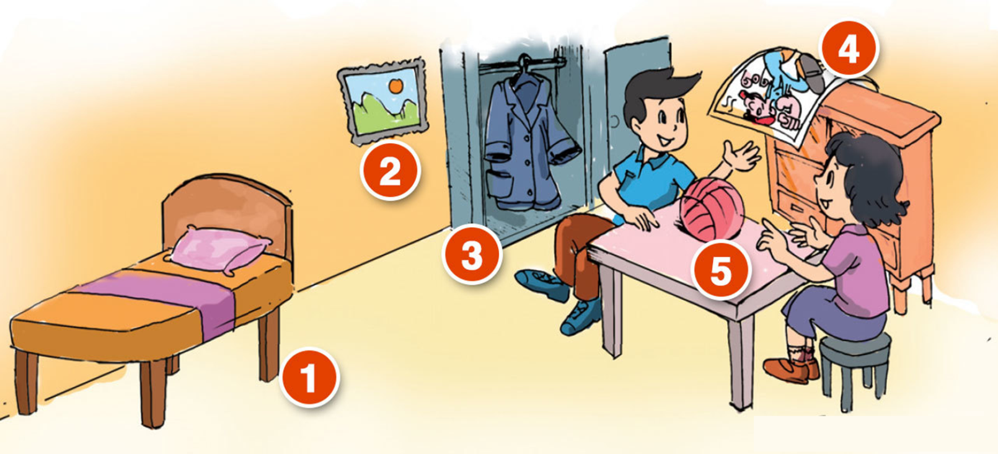
3. Let’s talk
Where's my picture?
Where's my bed?
It’s there/here.
It’s there/here.
4
Where's my ball?
2
It’s here/there.
3
5
1
Where's my coat?
Where's my poster?
It’s there/here.
It’s here/there.

Slide 21
Monday, February 7th , 2022
Unit 12: This is my house. (Lesson 3)
+ Unit 13: Where’s my book? ( Lesson 1)
1.Phonics
ch kitchen, chair…..
th bathroom, three…..
2.New words
- poster: tấm áp phích
- ball: quả bóng
- bed: cái giường
- coat: áo khoác
- chair: cái ghế
- here: ở đây
- table: cái bàn
- there: ở kia
- picture: bức tranh
- Where…? : Ở đâu, Chỗ nào

Slide 22
3 .Model sentences
* Hỏi – đáp xem đồ vật nào đó ở đâu
A: Where’s my book?
B: It’s here. On the chair.
Ex: Where’s the chair?
It’s there.
Where’s = Where is

Slide 23
4. Homework
- Học thuộc từ mới và mẫu câu. Luyện viết mỗi từ mới 3 dòng vào vở.
- Học thuộc kĩ mẫu câu. Luyện tập mẫu câu với phần 2. point and say. Lấy 2 ví dụ cho mẫu câu.
- Mở đĩa hoàn thành phần 4. Listen and tick (P19)
- Làm sách bài tập ( WB) – Unit 12

