Slide 1
WARM-UP

Slide 2

h
o
u
s
e
h
o
u
s
e

Slide 3
Unit 12
This is my house
Lesson 1

Slide 4
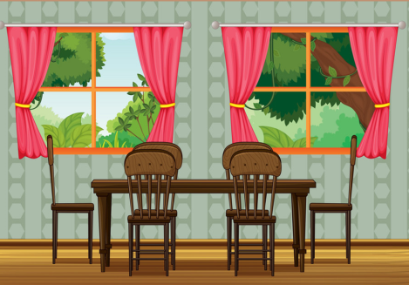
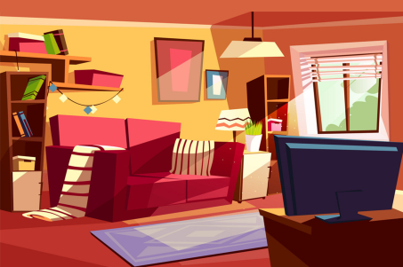

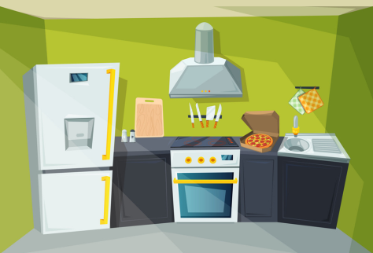
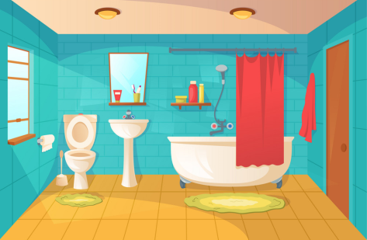
Vocabulary
Dining room
Bedroom
Living room
Kitchen
Bathroom

Slide 5
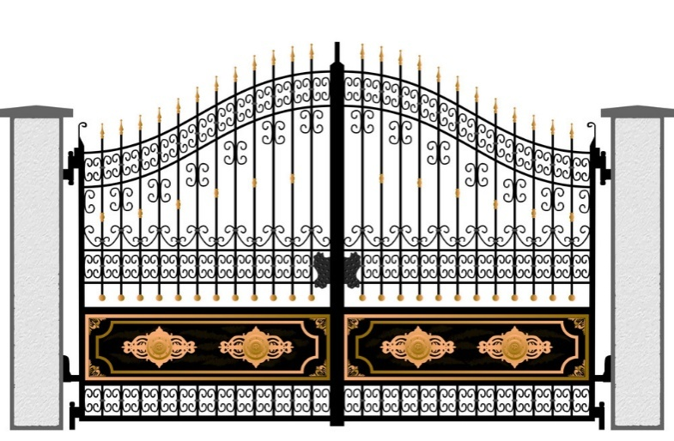
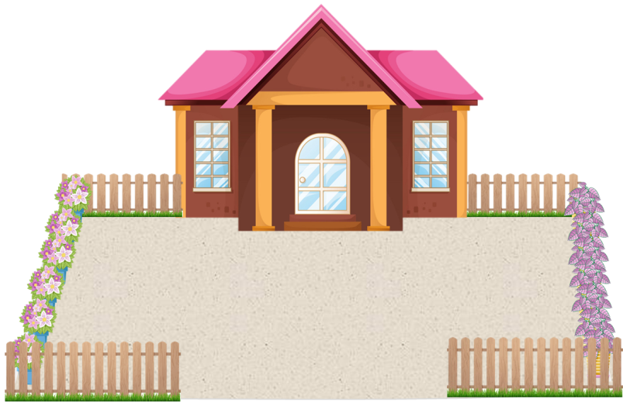



Vocabulary
Gate
Yard
Fence
Pond
garden

Slide 6
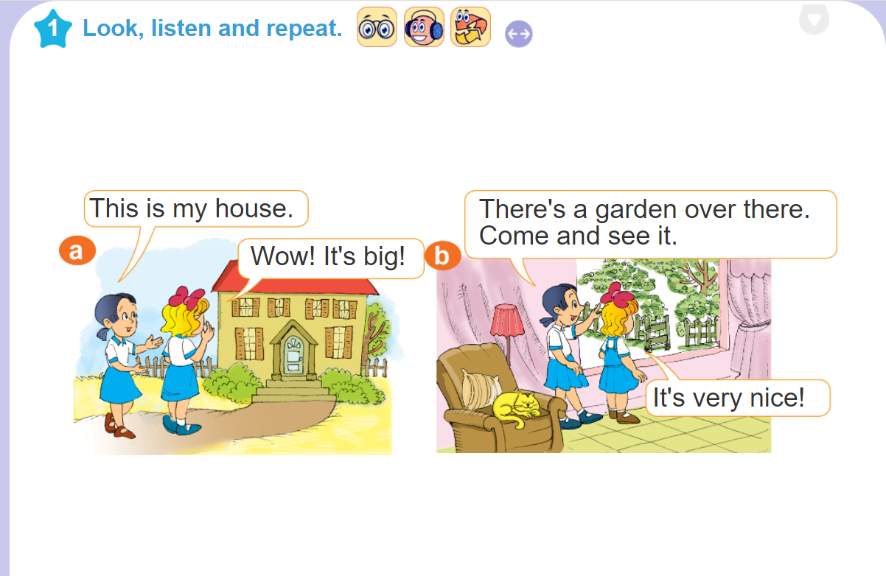

Slide 7


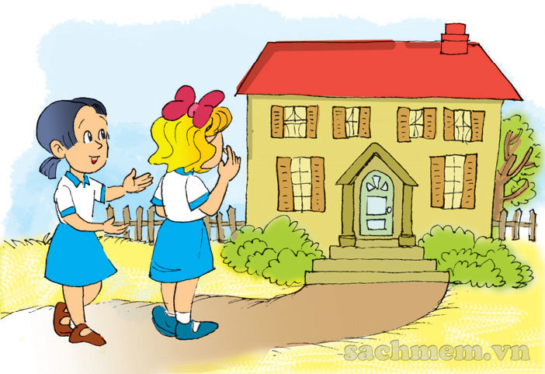
1. Look, listen and repeat.
This is my house.
Wow! It's big!

Slide 8
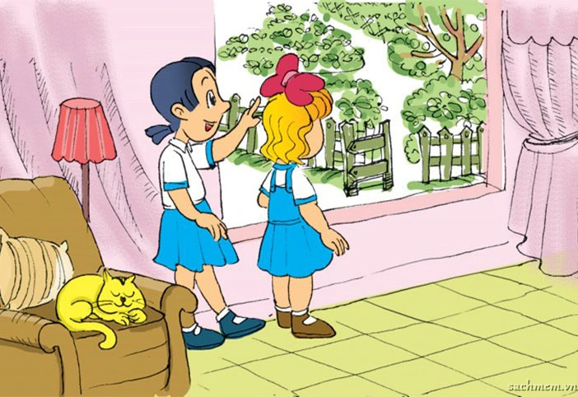
1. Look, listen and repeat.
There's a garden over there.
Come and see it.
It's very nice!

Slide 9
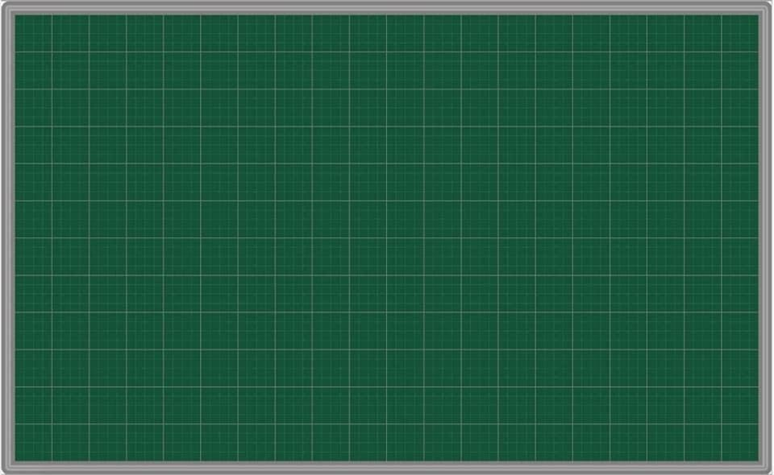
Model sentence
There’s a garden over there.
a garden over there.
It’s very nice!

Slide 10



2. Point and say.
There's a bedroom.
_____________ .
It's very nice!

Slide 11

2. Point and say.
There's a kitchen.
_____________ .
It's very nice!

Slide 12
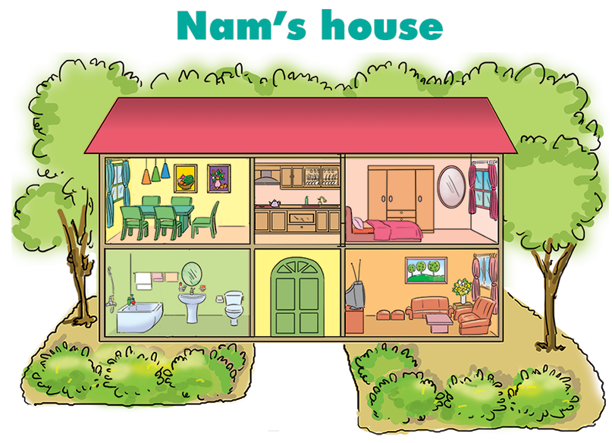


3. Let's talk.
There's a dining room.
1
2
3
Wow! It's very nice!
4
5

Slide 13
3. Let's talk.
There's a kitchen.
1
2
3
Wow! It's very nice!
4
5

Slide 14
3. Let's talk.
There's a bedroom.
1
2
3
Wow! It's very nice!
4
5

Slide 15
3. Let's talk.
There's a bathroom.
1
2
3
Wow! It's very nice!
4
5

Slide 16
3. Let's talk.
There's a living room.
1
2
3
Wow! It's very nice!
4
5

Slide 17
Unit 12
This is my house
Lesson 2

Slide 18
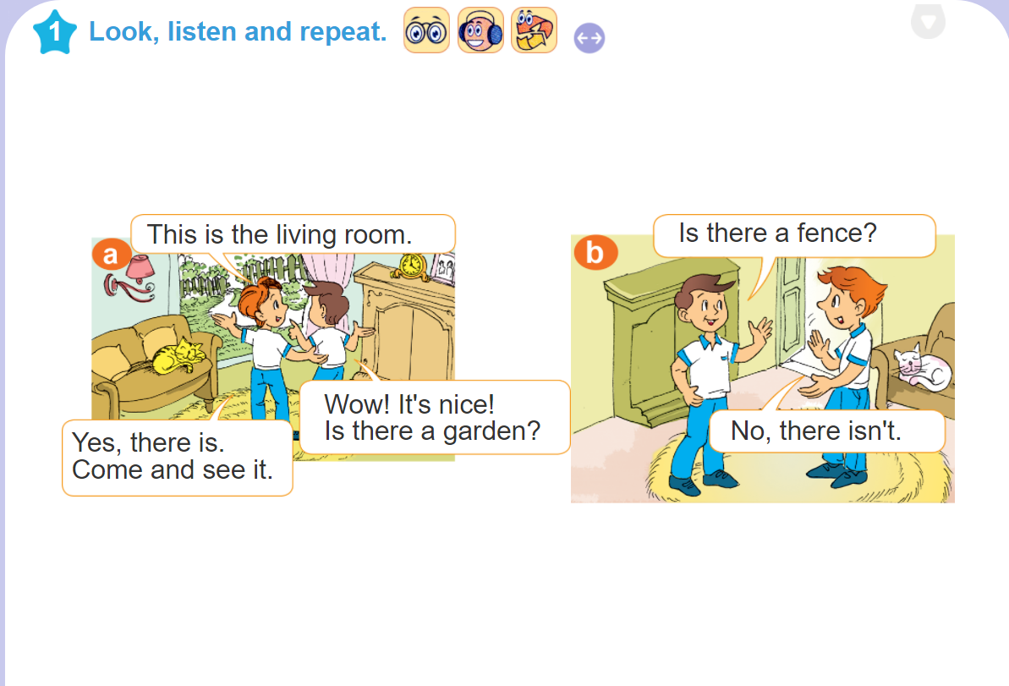

Slide 19

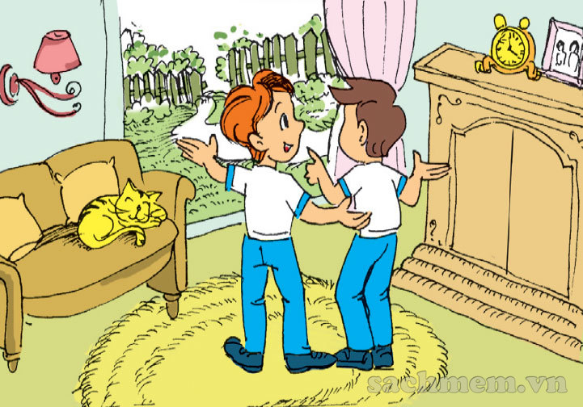
1. Look, listen and repeat.
Wow! It's nice!
Is there a garden?
This is the living room.
Yes, there is. Come and see it.

Slide 20
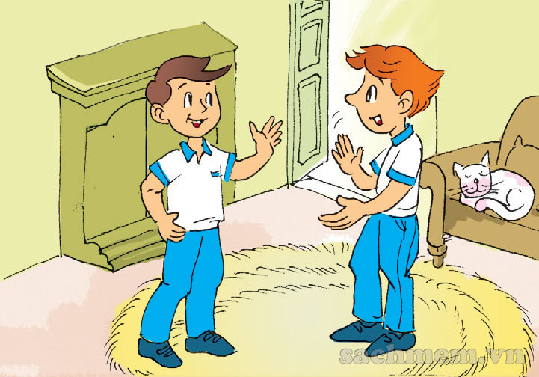
1. Look, listen and repeat.
Is there a fence?
No, there isn't.

Slide 21
Model sentences
a garden?
Is there a garden?
√ Yes, there is.
x No, there isn’t.

Slide 22
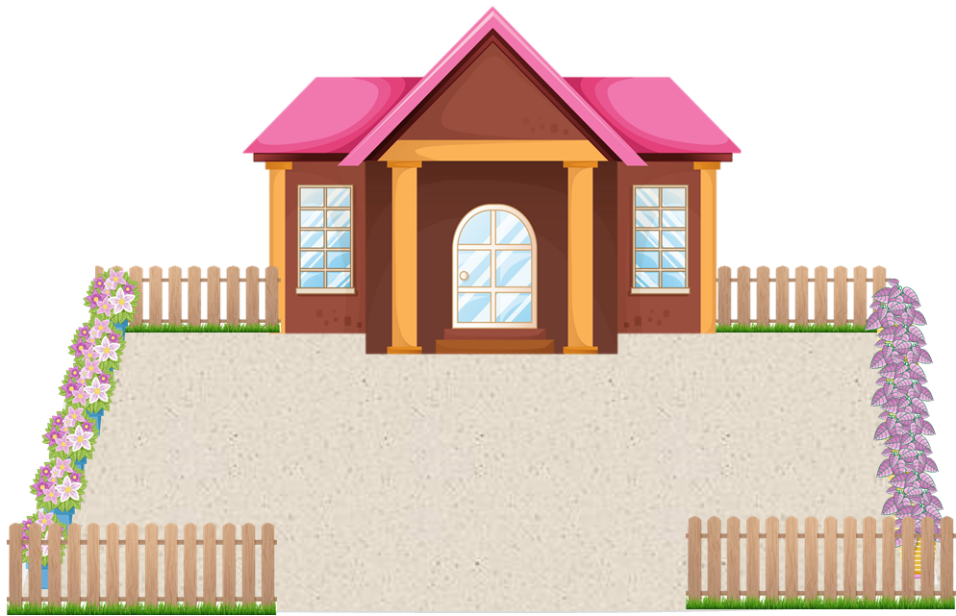
Is there a yard?
_____________ ?
Yes, there is
________ .

Slide 23
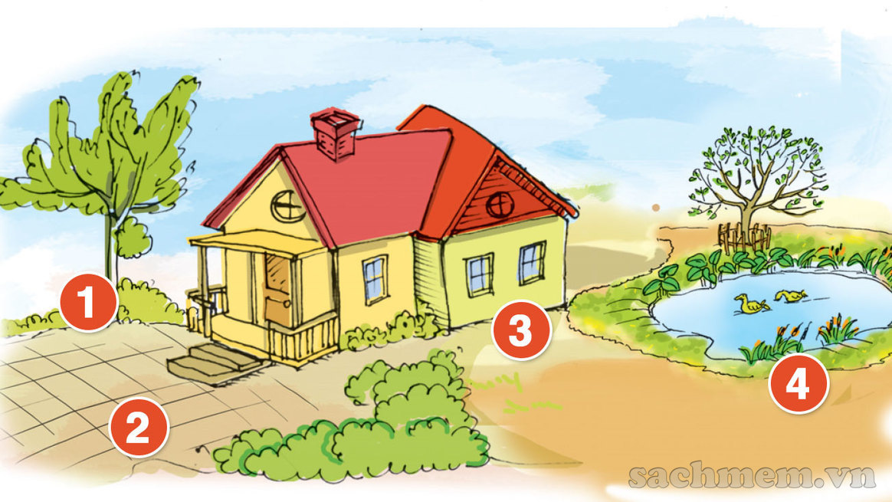
2. Let's talk.

Slide 24
2. Let's talk.
1
Is there a fence?
No, there isn’t.

Slide 25
2. Let's talk.
1
Is there a fence?
No, there isn’t.

Slide 26
2. Let's talk.
3
Is there a gate?
No, there isn’t.

Slide 27
2. Let's talk.
4
Is there a pond?
Yes, there is.

Slide 28
Monday, January 24th , 2022
Unit 12: This is my house.
Lesson 1+ 2 ( part 1,3)
1. New words
- house: nhà
- pond: ao
- living room: phòng khách
- yard: sân
- kitchen: phòng bếp
- fence: hàng rào
- bathroom: phòng tắm
- There is = There’s: Có một
- bedroom: phòng ngủ
- dining room: phòng ăn
- garden: vườn
- gate: cổng

Slide 29
2.Model sentences
* There’s a garden over there.
- It’s very nice.
* Is there a garden?
√ Yes, there is.
x No, there isn’t.

Slide 30
3. Homework
- Học thuộc từ mới và mẫu câu. Luyện viết mỗi từ mới 3 dòng vào vở.
- Luyện tập mẫu câu trong phần 2.Point and say. Dựa vào mẫu câu lấy 2 ví dụ.
- Mở đĩa hoàn thành phần 4. Listen (Trang 13, 15)

