Slide 1
Unit 11
What’s the matter with you?
Lesson 1

Slide 2
Vocabulary

Slide 3
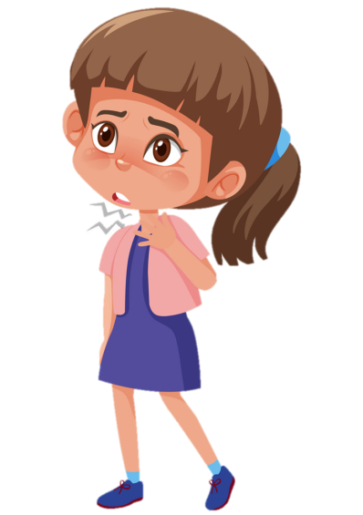
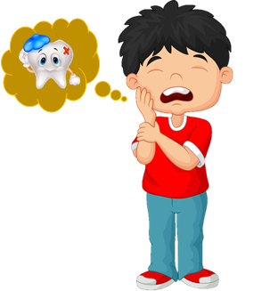


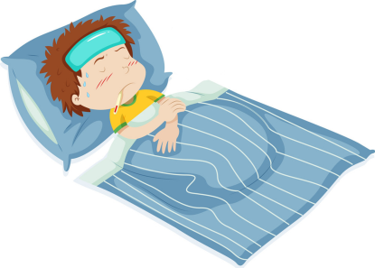

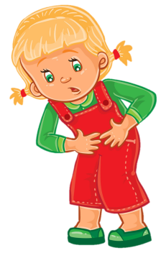

Review
1
2
3
4
5
Fever
/ˈfiːvər/
Sore throat
/sɔː θrəʊt/
Cough
/kɒf/
Toothache
/ˈtuːθeɪk/
headache
/ˈhedeɪk/
6
8
10
7
Earache
/ˈɪəreɪk/
Stomach ache
/ˈstʌmək eɪk/
Backache
/ˈbækeɪk/

Slide 4
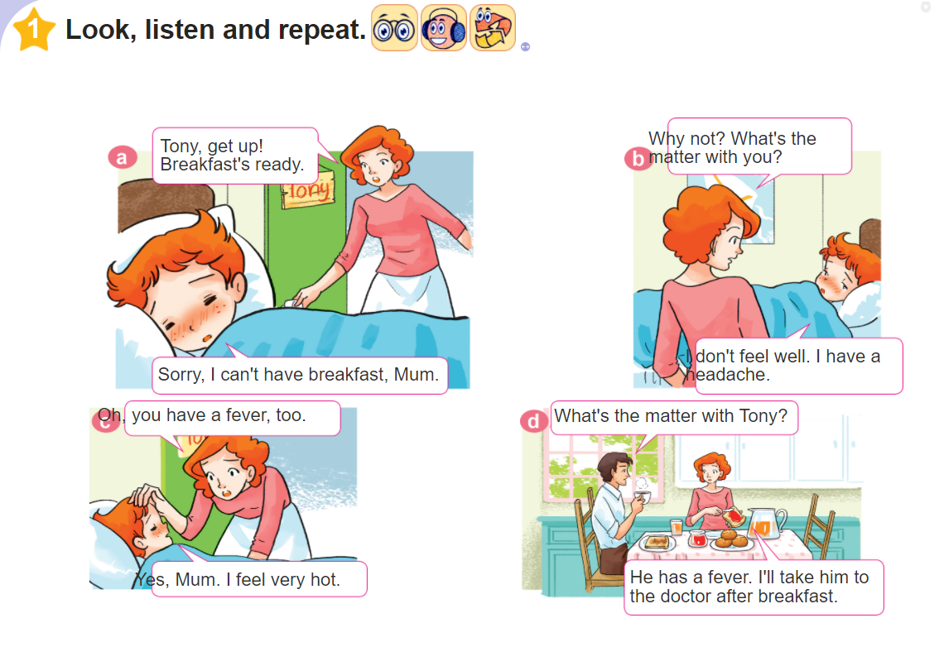

Slide 5
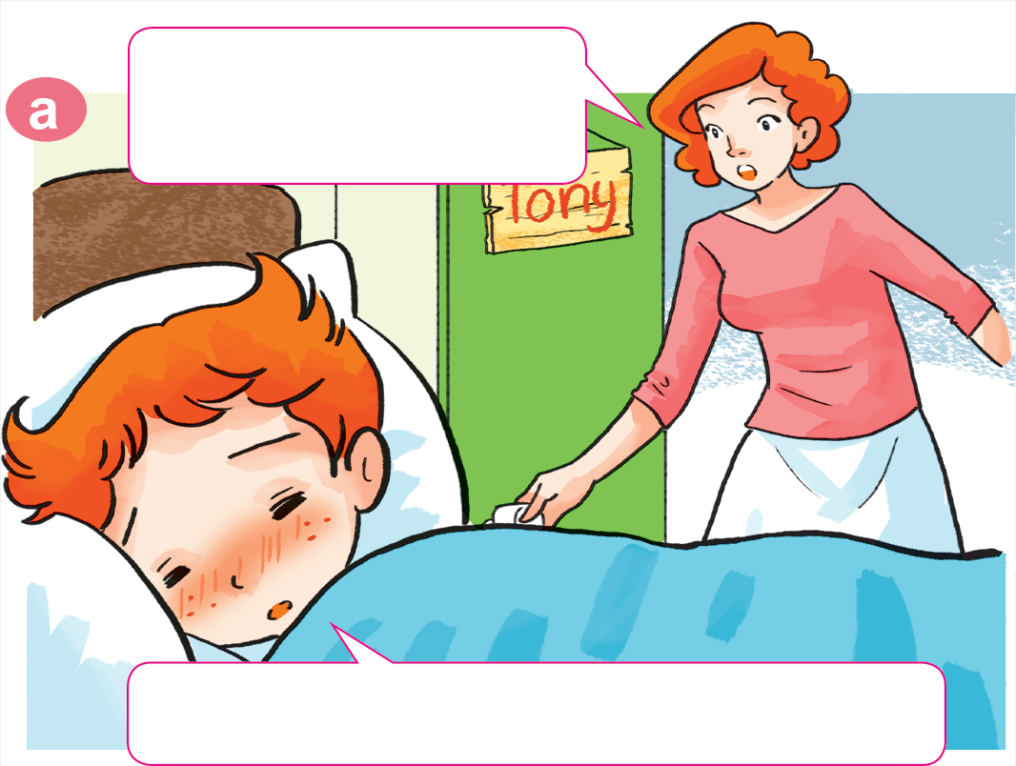

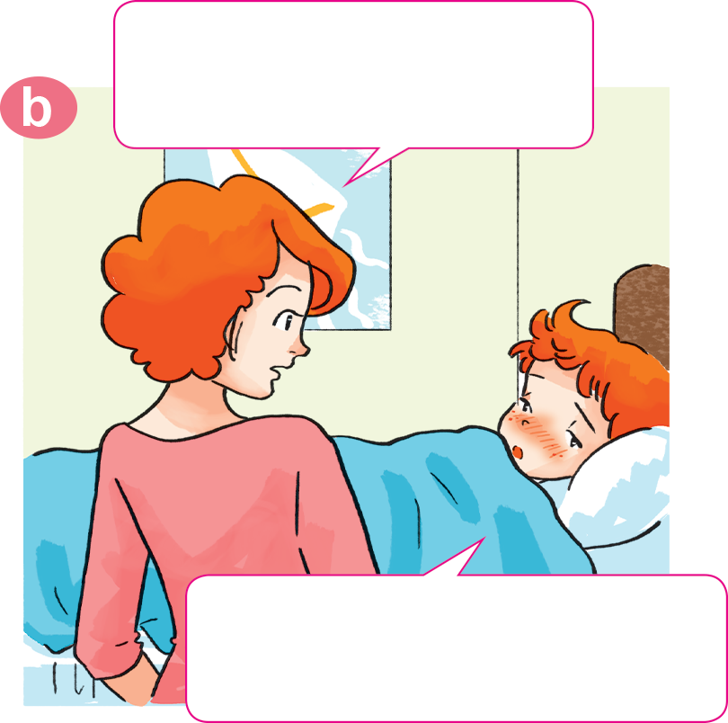
1. Look, listen and repeat.
Why not? What's the
matter with you?
Tony, get up!
Breakfast's ready.
I don't feel well.
I have a headache.
Sorry, I can't have breakfast, Mum.

Slide 6
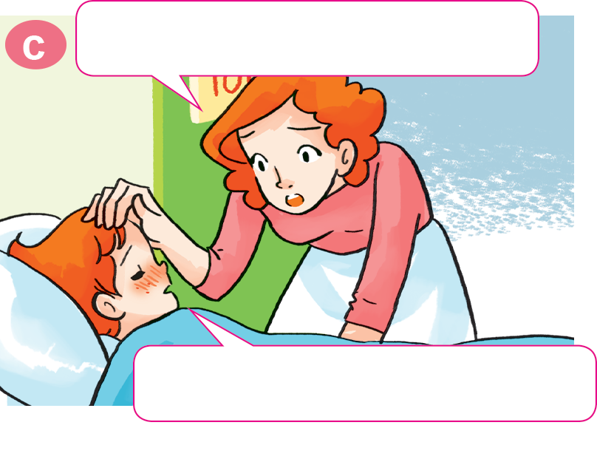
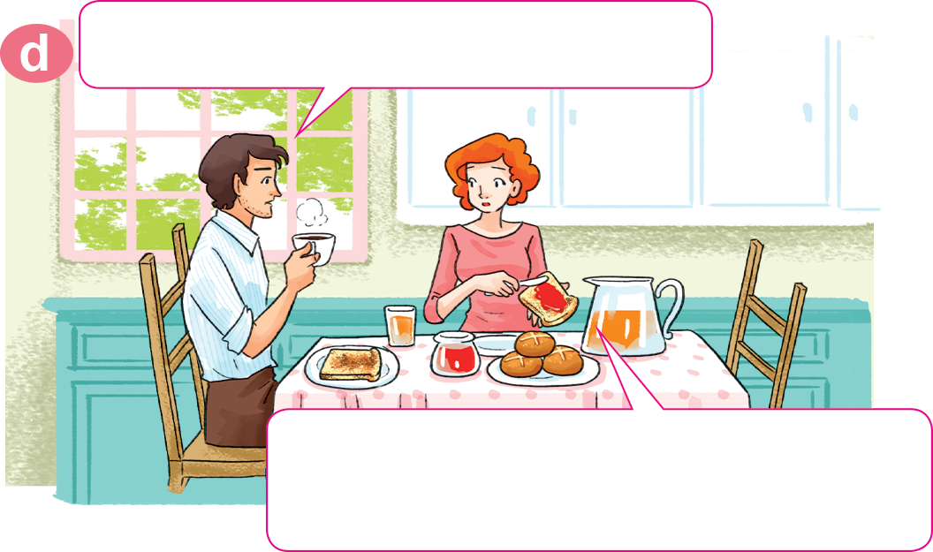
1. Look, listen and repeat.
Oh, you have a fever, too.
What's the matter with Tony?
He has a fever. I'll take him to
the doctor after breakfast.
Yes, Mum. I feel very hot.

Slide 7

Model sentence
A: What’s the matter with you?
a headache
B: I have a headache .
EX:
A: What’s the matter with you?
B: I have an earache.

Slide 8
2. Point and say.
What's the matter with you?
I have a toothache.
___________________

Slide 9

2. Point and say.
What's the matter with you?
I have a sore throat.
___________________.

Slide 10
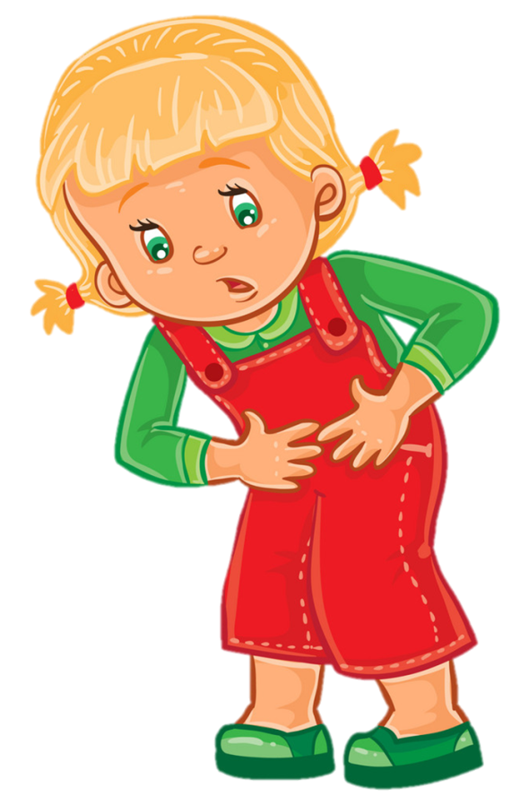

Extra sentence
What's the matter with her?
What's the matter with him?
She has
a stomach ache.
He has
a cough

Slide 11




Temperature
/ˈtemprətʃər/
Futher practice
cough
headache
What's the matter with her/him?
She/He has a/an ______________.
stomach ache
backache
Earache
/ˈɪəreɪk/

Slide 12
Friday, January 7th , 2022
Unit 11: What’s the matter with you? - Lesson 1
1. New words
- matter:vấn đề
- a toothache: đau răng
- a headache: đau đầu
- a fever: sốt
- a sore throat: đau họng
- a stomach ache: đau bụng
- a cough: ho
- an earache: đau tai
- a backache: đau lưng

Slide 13
2.Model sentences
A: What’s the matter with you?
a headache
B: I have a headache .
EX:
A: What’s the matter with you?
B: I have an earache.
A: What’s the matter with her/him?
B: She/He has a fever .

Slide 14
3. Homework
- Viết bài vào vở. Học thuộc từ mới và mẫu câu. Luyện viết mỗi từ mới 3 dòng vào vở.
- Học thuộc kĩ mẫu câu. Luyện tập mẫu câu trong phần 2.Point and say. Dựa vào mẫu câu lấy 2 ví dụ.
- Mở đĩa hoàn thành phần 4. Listen and tick. (Trang 7)

