Slide 1

Unit 3: School
Lesson 1.1
Page 38

Slide 2
Objectives
By the end of this lesson, students will be able to identify 5 school things and use them in questions.
New words: eraser, ruler, pencil, notebook, pencil case
Model sentences: Is this your eraser?
- Yes, it is./No, it isn't.
Are these your notebooks?
- Yes, they are./No, they aren't.

Slide 3

WARM UP

Slide 4

LET’S PLAY!
“Guessing words”
Notes:
Put three or four FLASHCARDS (family members) on the board and tell your child to look at them. Ask them to close their eyes and take one card away. When your child opens their eyes, ask them to guess what is missing.

Slide 5
Singular nouns
plural nouns
Eraser
Erasers
ruler
rulers
pencil
pencils
notebook
notebooks
Pencil case
Pencil cases

Slide 6

Model sentences
Is this your eraser?
Yes, it is./No, it isn’t.
Are these your notebooks?
Yes, they are./No, they aren't.

Slide 7
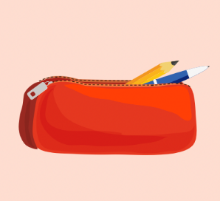


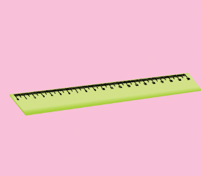



LET’S PRACTICE!
Is this your…………?
Yes, it is.
No, it isn’t.
No, it isn’t.
Yes, it is.
No, it isn’t.

Slide 8

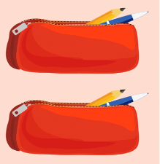
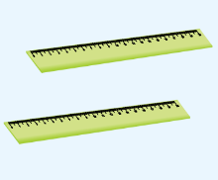
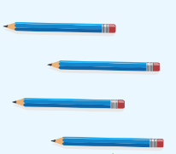

Are these your ………………?
No, they aren’t.
No, they aren’t.
Yes, they are.
Yes, they are.

Slide 9

Production

Slide 10


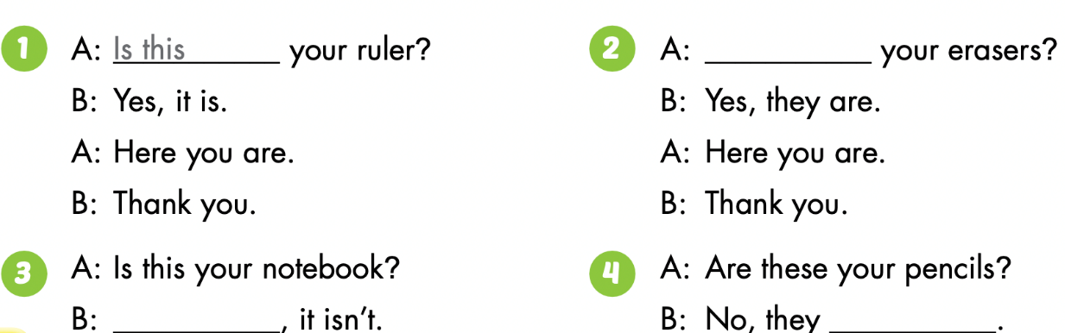

Slide 11
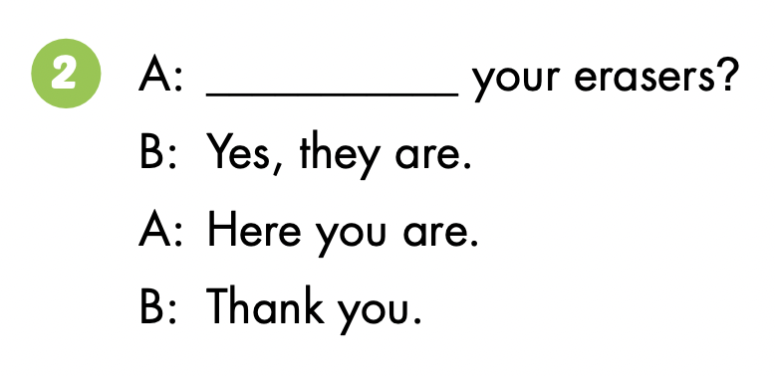
Are these

Slide 12

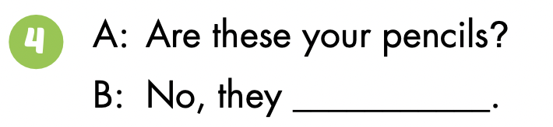
No
aren’t

Slide 13

WRAP-UP

Slide 14
Lesson 3
Today’s lesson
New words
eraser, ruler, pencil, notebook, pencil case
Model sentences
Is this your eraser?
- Yes, it is./No, it isn’t.
Are these your notebooks?
- Yes, they are./No, they aren't.

Slide 15
Lesson 3
Homework
Learn by hearts vocabularies, the model sentences and make sentences using them.
Do the exercises on page 28 WB
Prepare the next lesson (page 39)

Slide 16
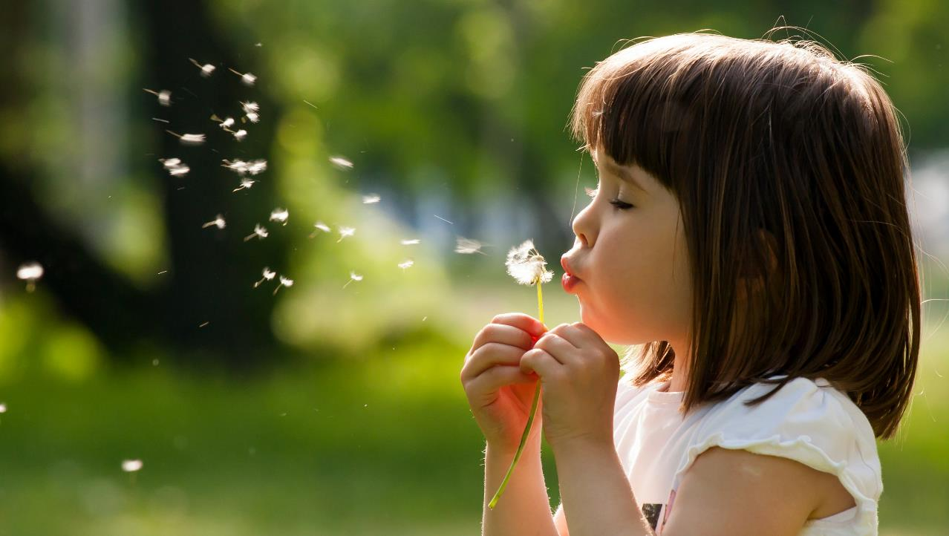
Enjoy your day!

Slide 17

Have a nice day!

