Slide 1
Unit 6
Where’s
your school?
Lesson 1

Slide 2
Vocabulary

Slide 3





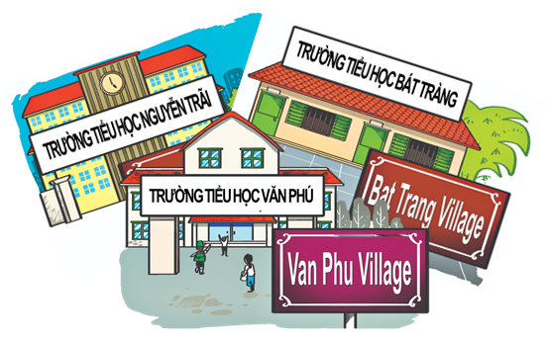

A. Vocabulary
same
street
study
village
/seɪm/
/striːt/
/ˈstʌdi/
/ˈvɪlɪdʒ/
Oxford Street
Primary School
district
/ˈɒksfəd striːt/
/ˈpraɪməri skuːl/
/ˈdɪstrɪkt/

Slide 4


Read and tick
3
1
2
6
4
study
5
7

Slide 5
Read and tick
3
1
2
6
4
district
5
7

Slide 6
Read and tick
3
1
2
6
4
Oxford Street
5
7

Slide 7
Read and tick
3
1
2
6
4
village
5
7

Slide 8
Read and tick
3
1
2
6
4
same
5
7

Slide 9
Read and tick
3
1
2
6
4
Primary School
5
7

Slide 10
Read and tick
3
1
2
6
4
street
5
7

Slide 11
Mspham – 0936082789
A. Vocabulary
same
street
study
village
/seɪm/
/striːt/
/ˈstʌdi/
/ˈvɪlɪdʒ/
Oxford Street
Primary School
district
/ˈɒksfəd striːt/
/ˈpraɪməri skuːl/
/ˈdɪstrɪkt/

Slide 12
Grammar

Slide 13
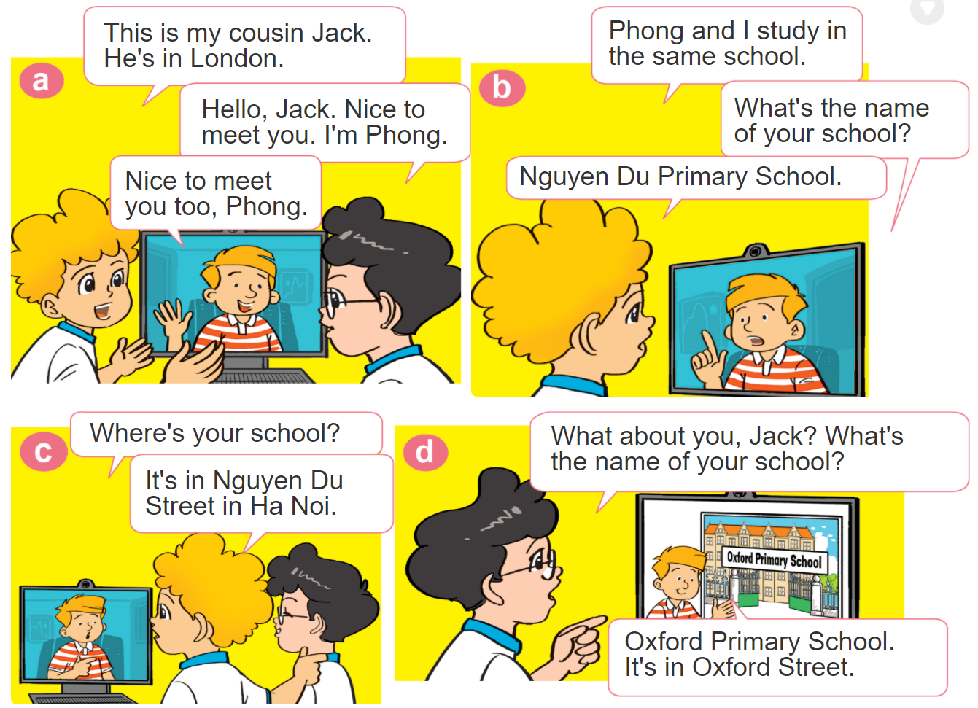

1. Look, listen and repeat.

Slide 14






2. Point and say
Where's your school?
It’s in ___________.
Oxford Street
Hoan Kiem District
Hoa Binh Street
Bat Trang Village

Slide 15

B. Structures:
Hỏi và trả lời TÊN trường của bạn là gì:
______________
Primary School.
What's the name of your school?
Tên trường +
(Trường bạn tên gì?)
(Trường Tiểu học ___.)
Hỏi và trả lời trường của bạn Ở ĐÂU:
Địa điểm
Where is your school?
It’s in ___________.
(Trường bạn ở đâu?)
(Nó ở _______)

Slide 16








Ms Huyền Phạm
0936.082.789
Notes:
Ms Huyền Phạm - 0936.082.789 – YOUTUBE: MsPham. Facebook: Dạy và học cùng công nghệ.

Slide 17


Van Phu Primary School.
What's the name of your school?
Van Phu Village.
Ms Huyền Phạm
0936.082.789
Notes:
Ms Huyền Phạm - 0936.082.789 – YOUTUBE: MsPham. Facebook: Dạy và học cùng công nghệ.

Slide 18

Oxford Primary School.
What's the name of your school?
Oxford Street.
Ms Huyền Phạm
0936.082.789
Notes:
Ms Huyền Phạm - 0936.082.789 – YOUTUBE: MsPham. Facebook: Dạy và học cùng công nghệ.

Slide 19

Nguyen Hue Street.
What's the name of your school?
Nguyen Hue Primary School.
Ms Huyền Phạm
0936.082.789
Notes:
Ms Huyền Phạm - 0936.082.789 – YOUTUBE: MsPham. Facebook: Dạy và học cùng công nghệ.

Slide 20

Nguyen Du Street.
What's the name of your school?
Nguyen Du Primary School.
Ms Huyền Phạm
0936.082.789
Notes:
Ms Huyền Phạm - 0936.082.789 – YOUTUBE: MsPham. Facebook: Dạy và học cùng công nghệ.

Slide 21
Oxford Street
Hoan Kiem District
Hoa Binh Street
Bat Trang Village
It’s on Oxford Street.
Where's your school?
It’s in Oxford Street.
Ms Huyền Phạm
0936.082.789
Notes:
Ms Huyền Phạm - 0936.082.789 – YOUTUBE: MsPham. Facebook: Dạy và học cùng công nghệ.

Slide 22
It’s in Hoa Binh village.
Where's your school?
It’s in Hoa Binh Street.
Ms Huyền Phạm
0936.082.789
Notes:
Ms Huyền Phạm - 0936.082.789 – YOUTUBE: MsPham. Facebook: Dạy và học cùng công nghệ.

Slide 23
It’s in Bat Trang Village.
Where's your school?
It’s in Bat Trang street.
Ms Huyền Phạm
0936.082.789
Notes:
Ms Huyền Phạm - 0936.082.789 – YOUTUBE: MsPham. Facebook: Dạy và học cùng công nghệ.

Slide 24
It’s in Hoan Kiem District.
Where's your school?
It’s in Hoan Kiem village.
Ms Huyền Phạm
0936.082.789
Notes:
Ms Huyền Phạm - 0936.082.789 – YOUTUBE: MsPham. Facebook: Dạy và học cùng công nghệ.

Slide 25

Good job!
Ms Huyền Phạm
0936.082.789
Notes:
Ms Huyền Phạm - 0936.082.789 – YOUTUBE: MsPham. Facebook: Dạy và học cùng công nghệ.

Slide 26

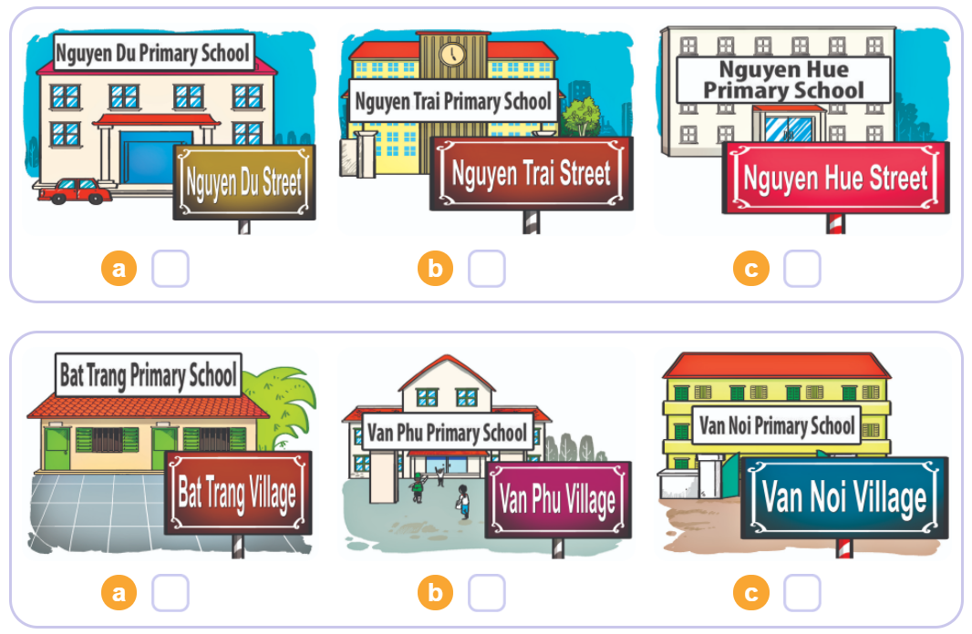

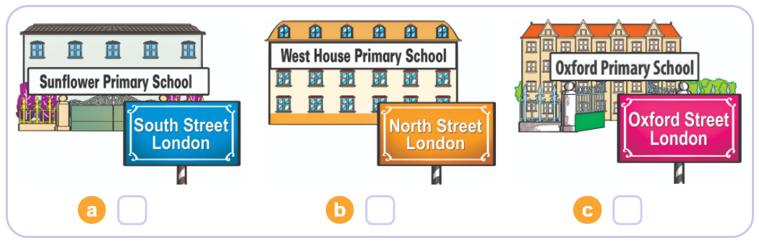
3. Listen and tick
1
2
3

Slide 27
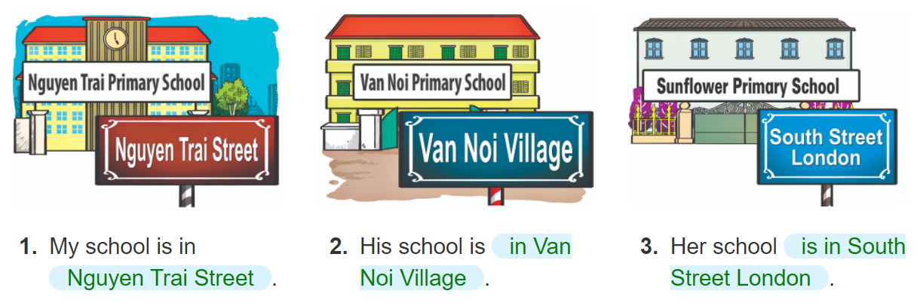
4. Look and write
______
__________
______________________
____________
________________

Slide 28
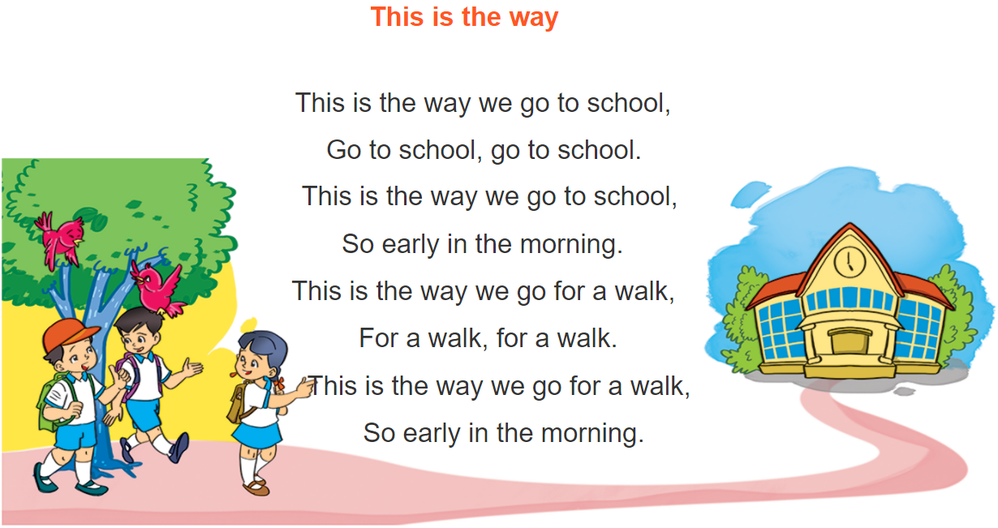



5. Let’s play

