Slide 1
Unit 5
CAN YOU SWIM?
Lesson 3

Slide 2
Warm-up

Slide 3


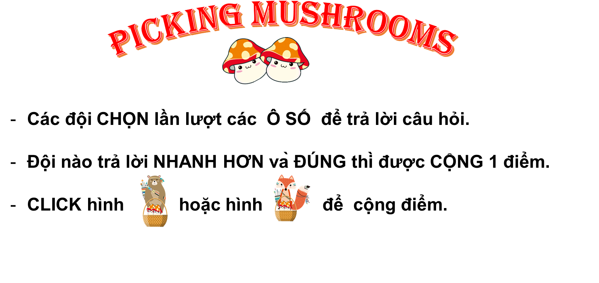







PICKING MUSHROOMS
1
2
3
Các đội CHỌN lần lượt các Ô SỐ để trả lời câu hỏi.
Đội nào trả lời NHANH HƠN và ĐÚNG thì được CỘNG 1 điểm.
CLICK hình hoặc hình để cộng điểm.
4
5
6
7
8
9
10

Slide 4

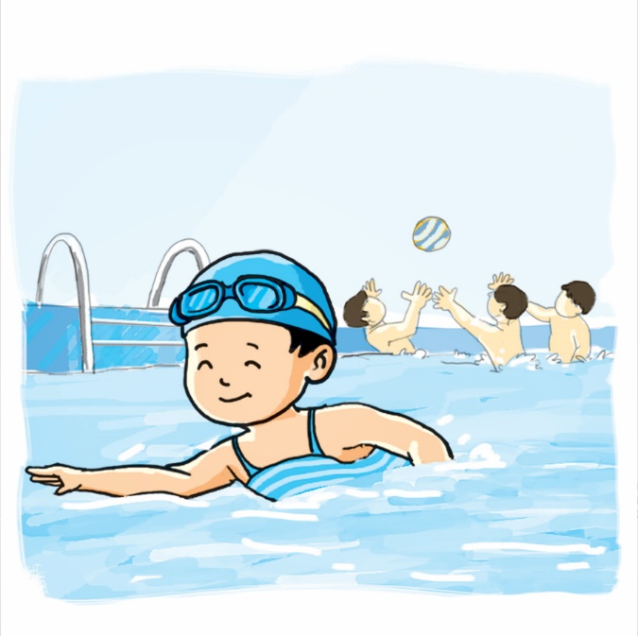






Time’s up
1
2
3
4
5
6
7
8
9
10
What can he do?
Back
A. He can swim
B. Yes, he can.
C. No, he can’t.
A.

Slide 5
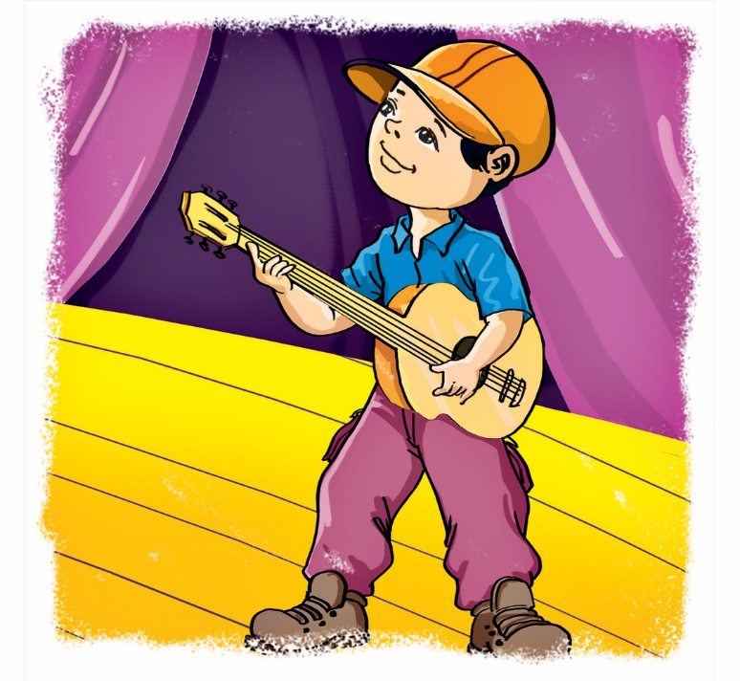
Time’s up
1
2
3
4
5
6
7
8
9
10
What can you do?
Back
A. I play the guitar.
B. I can play the guitar.
C. I can play guitar.
A.

Slide 6
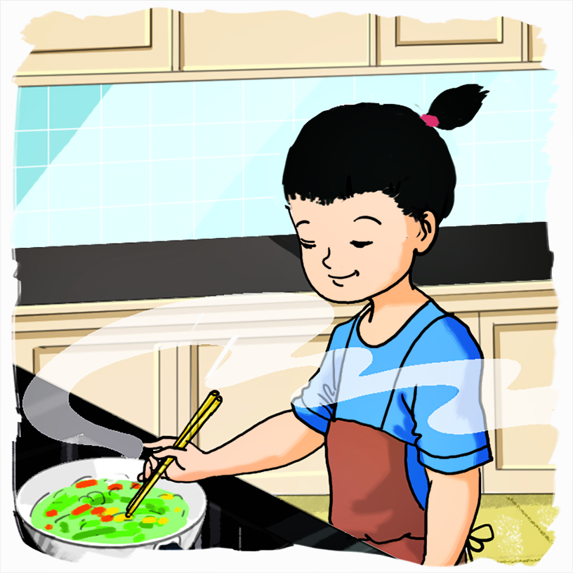
Time’s up
1
2
3
4
5
6
7
8
9
10
What can she do?
Back
A. I can cook.
B. She can cook.
C. She is cooking.
A.

Slide 7
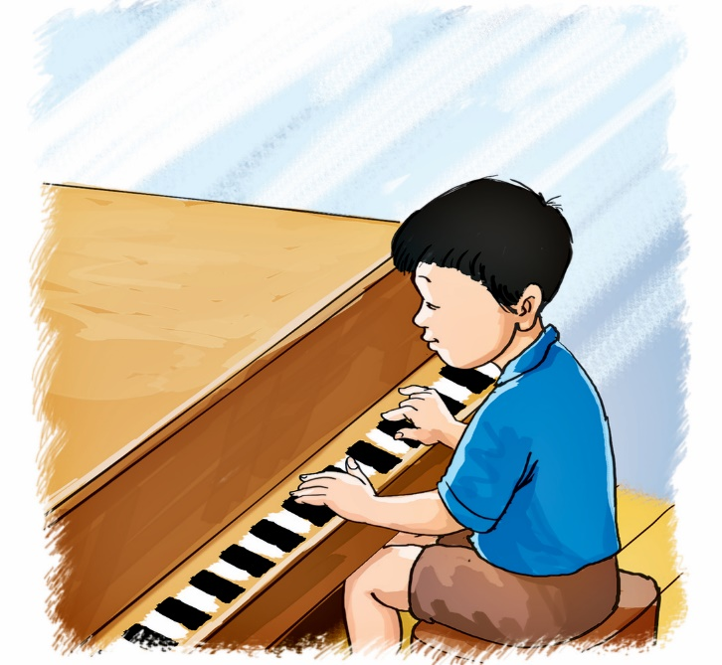
Time’s up
1
2
3
4
5
6
7
8
9
10
Can he play the piano?
Back
A. Yes, he is.
B. Yes, he can’t.
C. Yes, he can.
A.

Slide 8
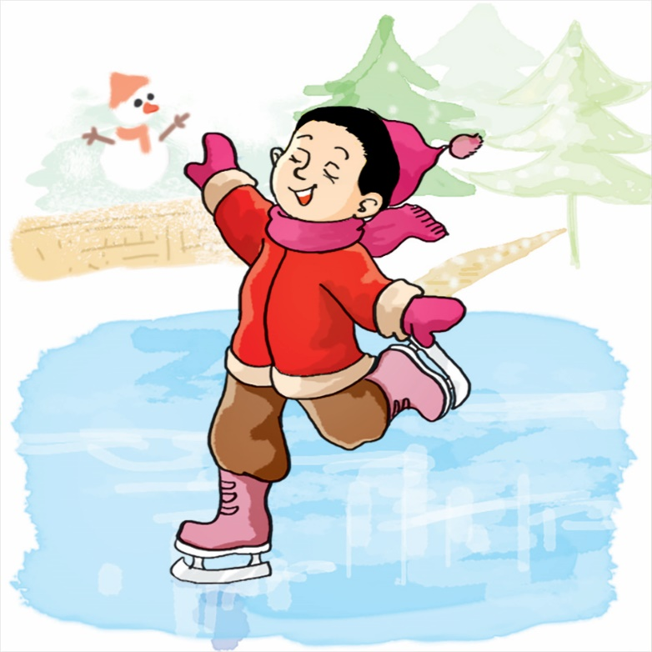
Time’s up
1
2
3
4
5
6
7
8
9
10
Can you skate?
Back
A. Yes, I can’t.
B. No, I can’t.
C. Yes, I am.
A.

Slide 9
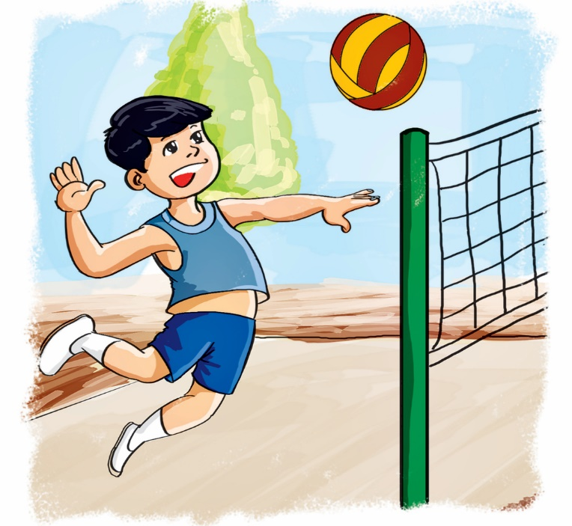
Time’s up
1
2
3
4
5
6
7
8
9
10
_______ play volleyball?
Back
A. He can
B. Can he
C. What can
A.

Slide 10
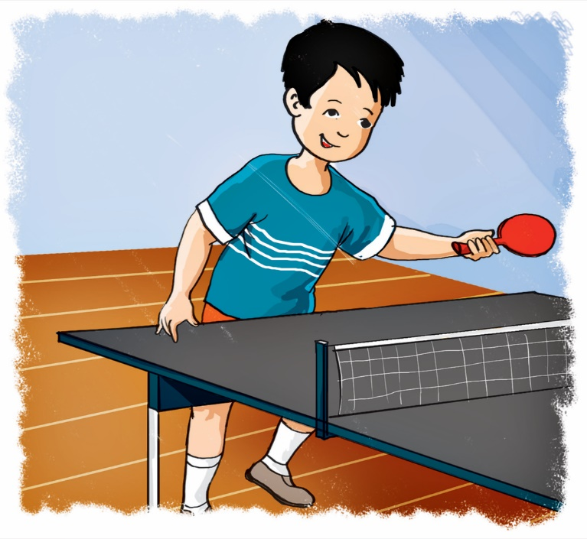
Time’s up
1
2
3
4
5
6
7
8
9
10
_______ you do?
Yes, I can.
Back
A. Do
B. Can
C. What can
A.

Slide 11
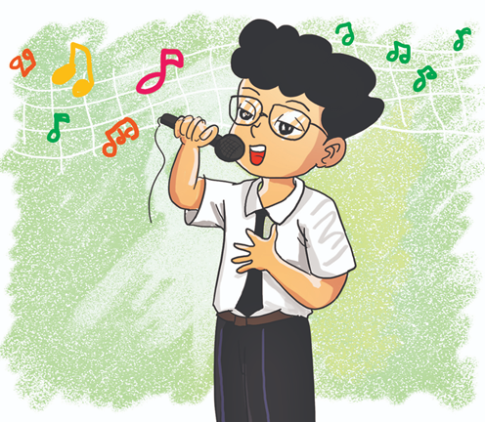
Time’s up
1
2
3
4
5
6
7
8
9
10
Can you sing?
____, I can’t.
Back
A. Yes
B. No
C. And
A.

Slide 12
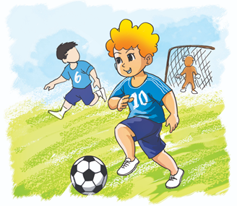
Time’s up
1
2
3
4
5
6
7
8
9
10
Can ____ play football?
Yes, they can.
Back
A. you
B. they
C. he
A.

Slide 13
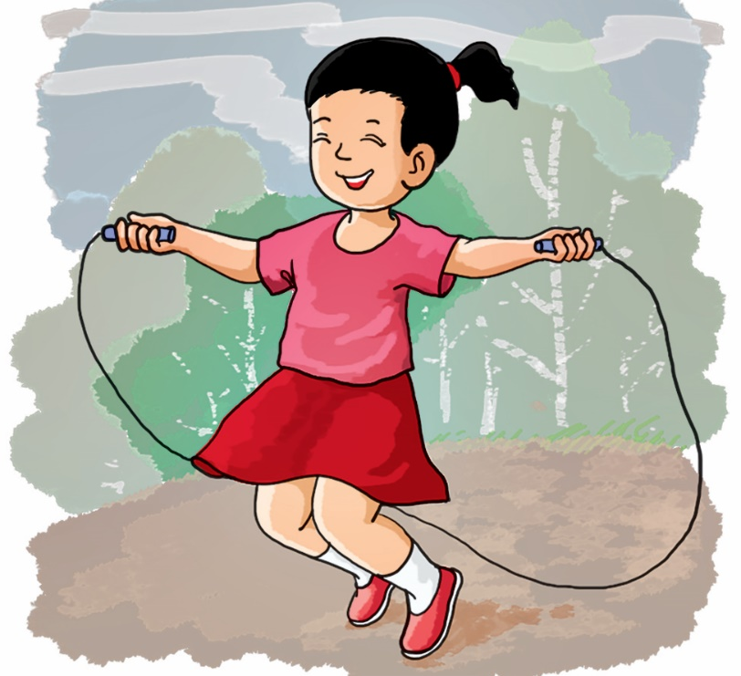
Time’s up
1
2
3
4
5
6
7
8
9
10
Can she skip?
Back
A. Yes, she is.
B. Yes, she do.
C. Yes, she can.
A.

Slide 14
Phonics

Slide 15
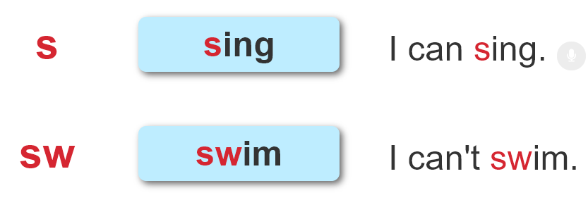

1. Listen and repeat.

Slide 16
2. Listen and number. Then say aloud.
1
2
3
4
Can you sing?
Can you swim?
4
1
Can you sit
on the chair?
Can you swing?
2
3

Slide 17
Practise

Slide 18
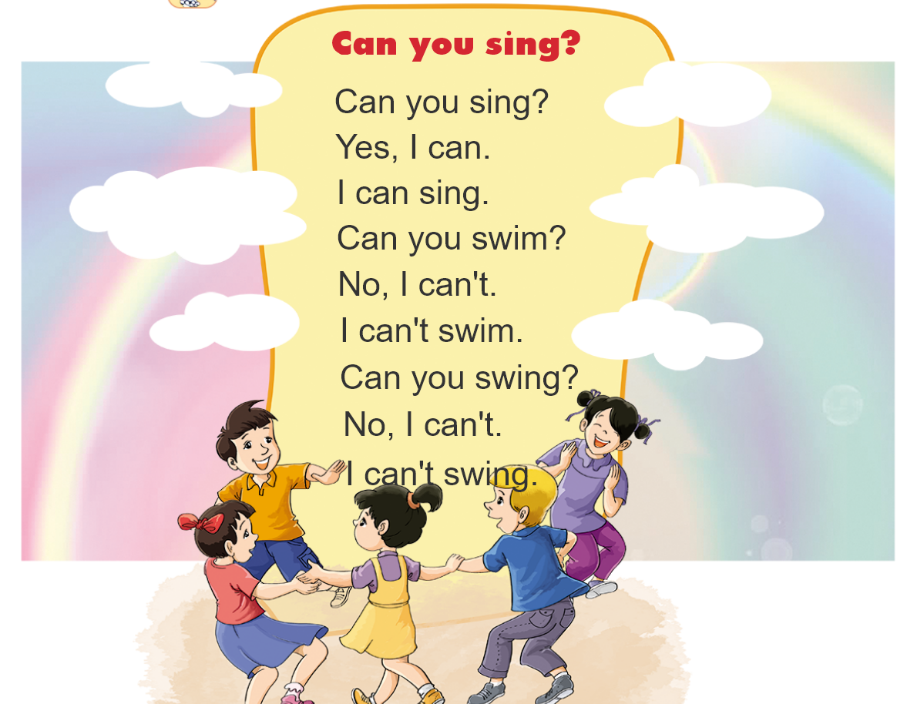


3. Let's chant

Slide 19
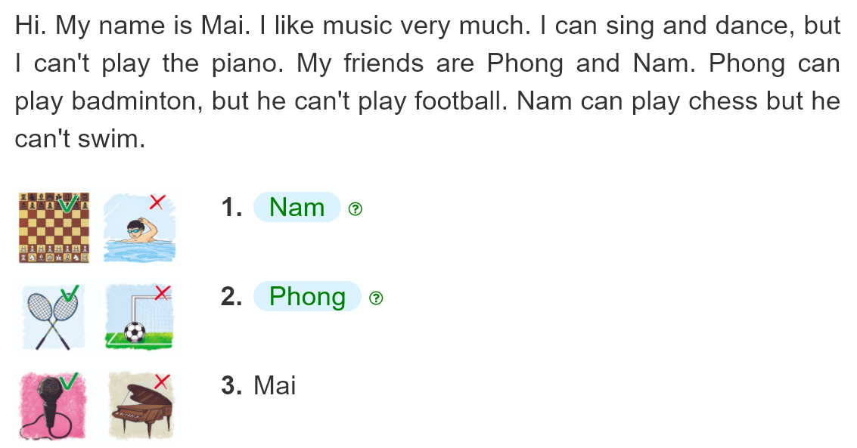
4. Read and match
__________.
__________.
__________.

Slide 20
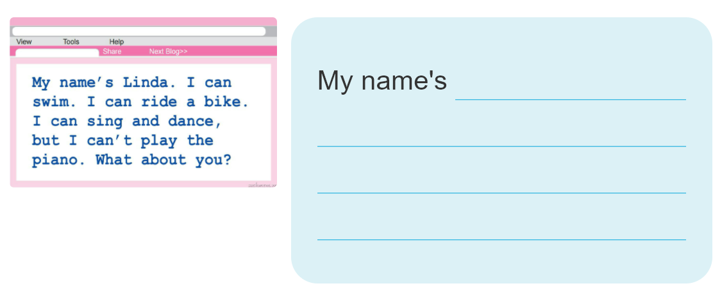
5. Write about you

Slide 21
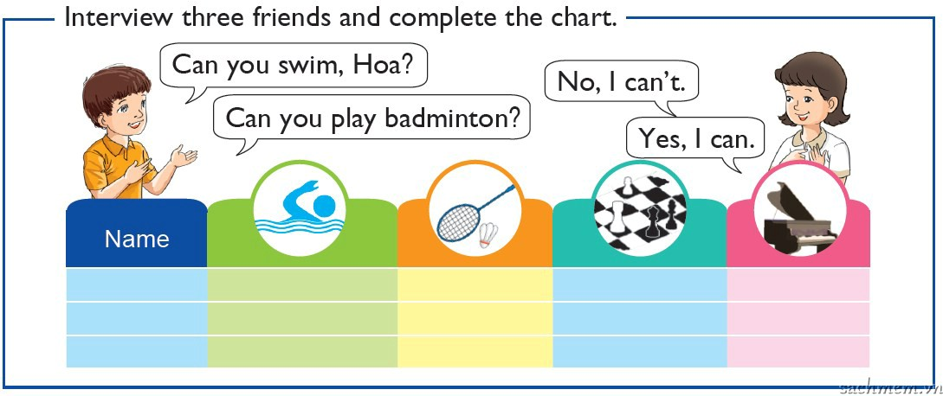
6. Project

