Slide 1
English grade 4
Unit 2 – Lesson 3
I’m from japan

Slide 2











GO FISHING
Game
PLAY
EXIT
Notes:
Ms Huyền Phạm - 0936.082.789 – YOUTUBE: MsPham. Facebook: Dạy và học cùng công nghệ.

Slide 3












0
Score:
EXIT
7
8
6
9
2
4
1
10
5
3
13
12
11
14
15
Notes:
Ms Huyền Phạm - 0936.082.789 – YOUTUBE: MsPham. Facebook: Dạy và học cùng công nghệ.

Slide 4




Akiko: Where are you from?
Nam: I'm from ______.
A
VietNam
B
VietNamese
C
English
D
STOVE
Notes:
Ms Huyền Phạm - 0936.082.789 – YOUTUBE: MsPham. Facebook: Dạy và học cùng công nghệ.

Slide 5
Hakim: What nationality are you?
Akiko: I'm ______. How about you?
Hakim: I'm Malaysian.
A
Japan
B
Japanese
C
Japanian
D
Climb
Notes:
Ms Huyền Phạm - 0936.082.789 – YOUTUBE: MsPham. Facebook: Dạy và học cùng công nghệ.

Slide 6
What nationality are you?
A
I’m Australian.
B
I Australian.
C
I’m Australia.
D
May
Notes:
Ms Huyền Phạm - 0936.082.789 – YOUTUBE: MsPham. Facebook: Dạy và học cùng công nghệ.

Slide 7
Where are you from, Hakim?
A
I Malaysia.
B
I’m from Malaysia.
C
I’m Malaysian.
D
Watch
Notes:
Ms Huyền Phạm - 0936.082.789 – YOUTUBE: MsPham. Facebook: Dạy và học cùng công nghệ.

Slide 8
Hi. I am Hakim.
Today is Sunday.
They are my friends.
Mai, Nam, Quan and Phong are _________.
A
From Vietnamese
B
Viet Nam
C
Vietnamese
D
Next to
Notes:
Ms Huyền Phạm - 0936.082.789 – YOUTUBE: MsPham. Facebook: Dạy và học cùng công nghệ.

Slide 9
What’s your name?
A
I’m Akio.
B
I’m from Janpan.
C
I’m Japanese.
D
Next to
Notes:
Ms Huyền Phạm - 0936.082.789 – YOUTUBE: MsPham. Facebook: Dạy và học cùng công nghệ.

Slide 10
I’m from England.
A
What your name?
B
Where are you
from?
C
What nationality
are you?
D
She plays chess
in his free time.
Notes:
Ms Huyền Phạm - 0936.082.789 – YOUTUBE: MsPham. Facebook: Dạy và học cùng công nghệ.

Slide 11
I’m American.
A
Where are you
from?
B
What nationality
are you from?
C
What nationality
are you?
D
They likes sport.
Notes:
Ms Huyền Phạm - 0936.082.789 – YOUTUBE: MsPham. Facebook: Dạy và học cùng công nghệ.

Slide 12
I’m from England.
A
Where are you
from?
B
Where is your
mother from?
C
Where is your dad
from?
D
She should take some warm water.
Notes:
Ms Huyền Phạm - 0936.082.789 – YOUTUBE: MsPham. Facebook: Dạy và học cùng công nghệ.

Slide 13
I’m English.
A
What nationality
is you?
B
What nationality
are you?
C
What nationality
are you from?
D
He shouldn’t watch much TV.
Notes:
Ms Huyền Phạm - 0936.082.789 – YOUTUBE: MsPham. Facebook: Dạy và học cùng công nghệ.

Slide 14
PHONICS

Slide 15
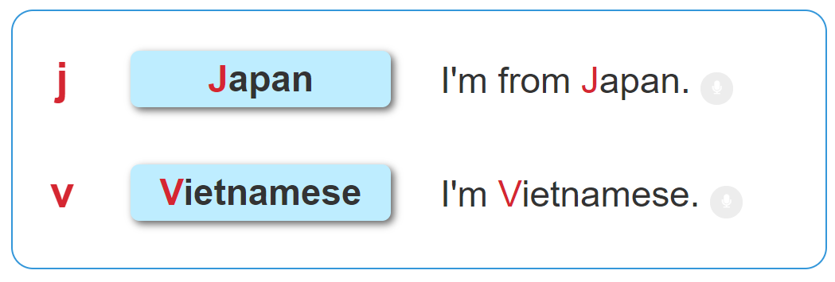

1. Listen and repeat.

Slide 16

2. Listen and tick. Then say aloud.
a. Japan
b. Japanese
a. Viet Nam
b. Vietnamese
1
2

Slide 17
PRACTISE

Slide 18

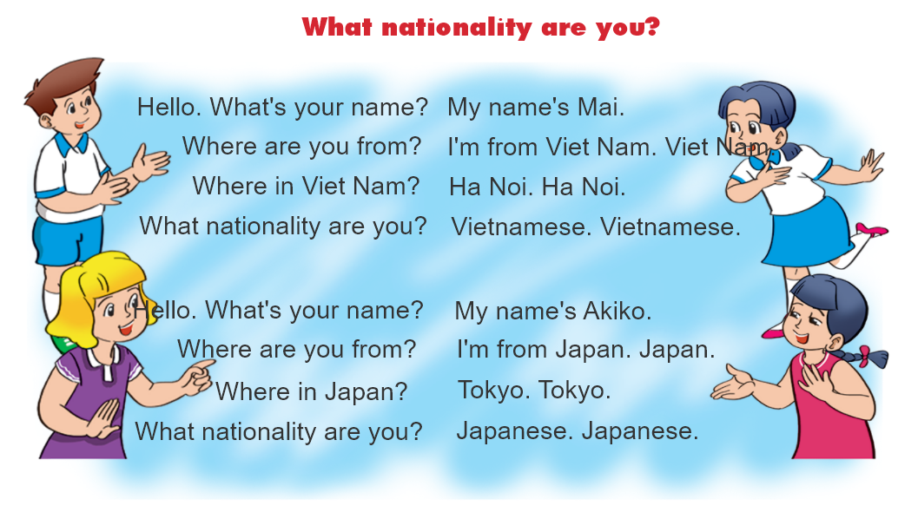

3. Let's chant.

Slide 19
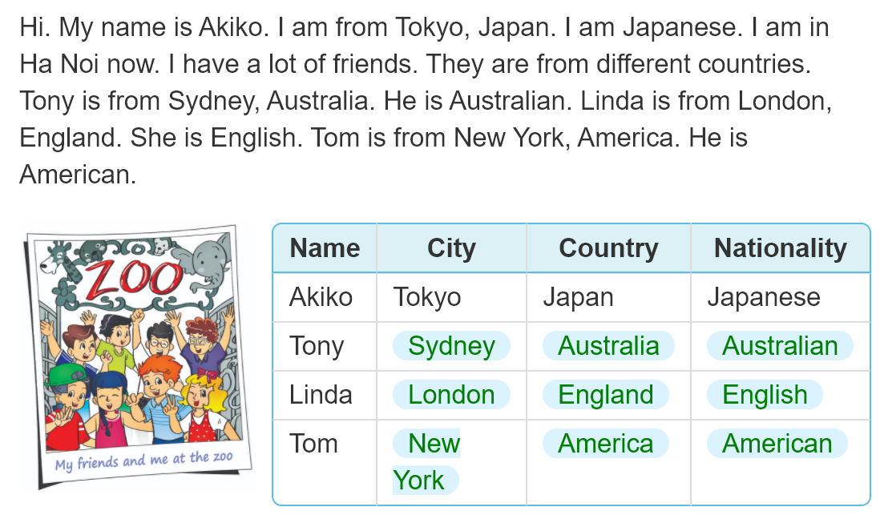
4. Read and complete.

Slide 20


THANK YOU!
Welcome to join with me!

