Slide 1
Unit 05
Are they
your friends?
Lesson 2

Slide 2
Vocabulary
They
are
/ðeɪ/
/ɑː r/
: họ
: là, thì, ở

Slide 3
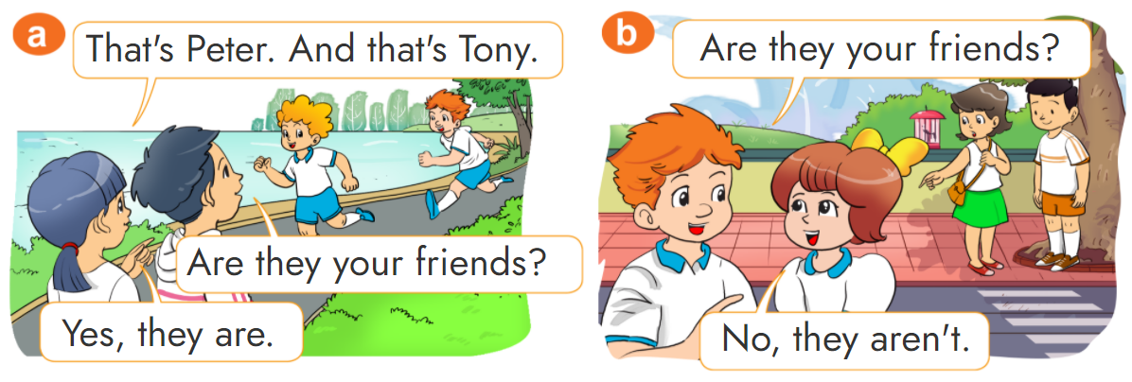


1. Look, listen and repeat

Slide 4
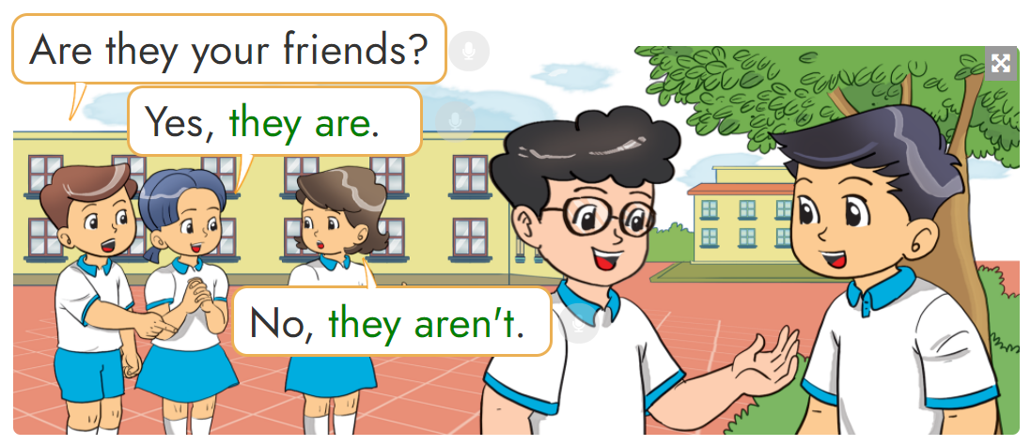
2. Point and say

Slide 5
Structures:
(?) Are they your friends?
(Họ là những người bạn của bạn phải không?)
Yes, they are.
No, they aren’t.
(ừ, đúng vậy.)
(Không, không phải.)

Slide 6
Extra tructures:
(?) Is she/he your friend?
(Chị ấy/anh ấy là bạn của bạn phải không?)
Yes, she/he is.
No, she/he isn’t.
(ừ, đúng vậy.)
(Không, không phải.)

Slide 7
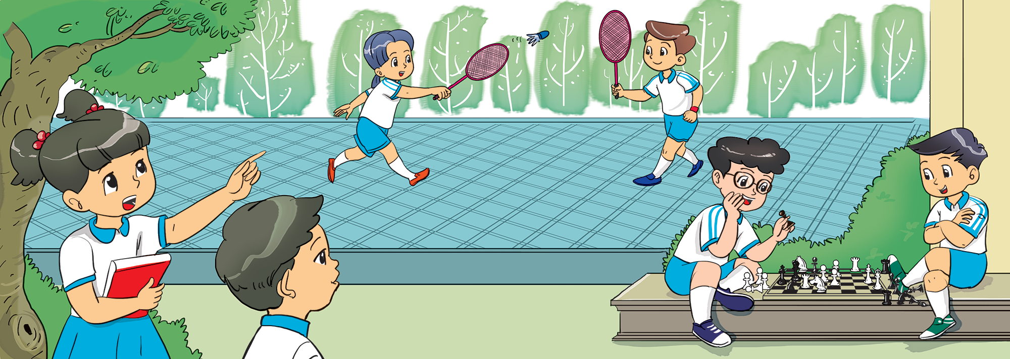
3. Let's talk.

Slide 8












Ms Huyền Phạm
0936.082.789
Ms Huyền Phạm
0936.082.789
Ms Huyền Phạm
0936.082.789
Ms Huyền Phạm - 0936.082.789 – YOUTUBE: MsPham. Facebook: Dạy và học cùng công nghệ.
Ms Huyền Phạm
0936.082.789
Notes:
Ms Huyền Phạm - 0936.082.789 – YOUTUBE: MsPham. Facebook: Dạy và học cùng công nghệ.

Slide 9

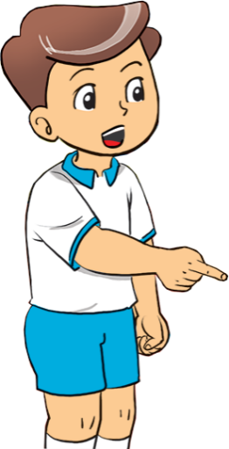

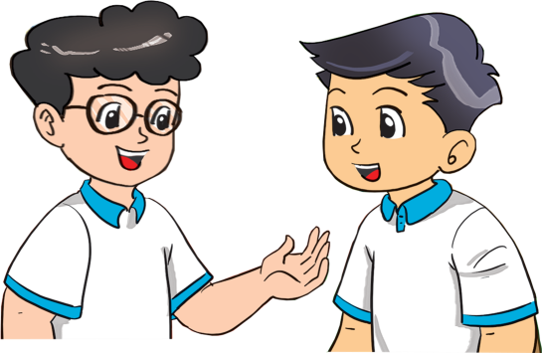





Are they your friends?
Next
No,
they aren’t.
No,
they are.
Yes,
they aren’t.
Yes,
they are.
Notes:
Ms Huyền Phạm - 0936.082.789 – YOUTUBE: MsPham. Facebook: Dạy và học cùng công nghệ.

Slide 10
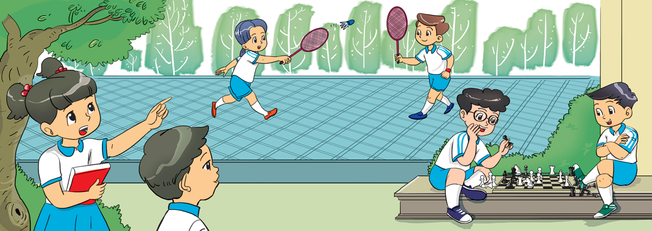
Are they your friends?
Next
Yes, it is.
No, it isn’t.
Yes,
they are.
No,
they aren’t.
Notes:
Ms Huyền Phạm - 0936.082.789 – YOUTUBE: MsPham. Facebook: Dạy và học cùng công nghệ.

Slide 11
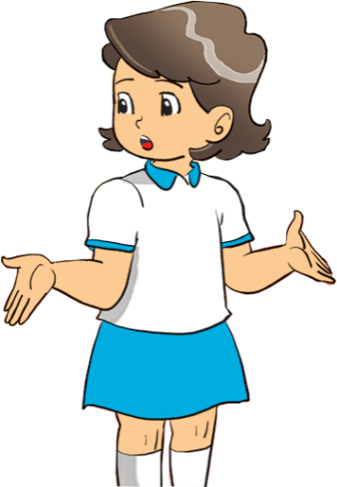
Are they your friends?
Next
Yes,
they are.
No,
they aren’t.
Yes, they is.
No,
they isn’t.
Notes:
Ms Huyền Phạm - 0936.082.789 – YOUTUBE: MsPham. Facebook: Dạy và học cùng công nghệ.

Slide 12
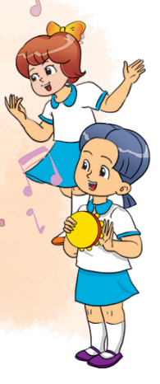
Are they your friends?
Next
No,
they aren’t.
Yes, it is.
No, it isn’t.
Yes,
they are.
Notes:
Ms Huyền Phạm - 0936.082.789 – YOUTUBE: MsPham. Facebook: Dạy và học cùng công nghệ.

Slide 13
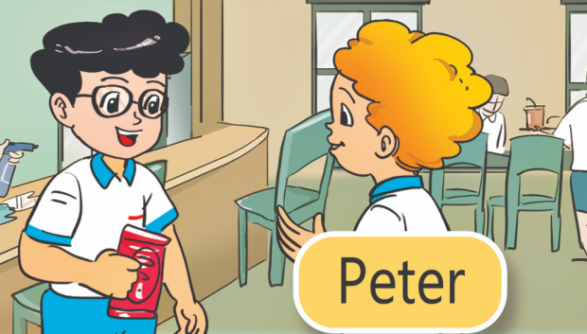
Are they your friends?
Next
Yes,
they are.
No,
they aren’t.
Yes, it is.
No, it isn’t.
Notes:
Ms Huyền Phạm - 0936.082.789 – YOUTUBE: MsPham. Facebook: Dạy và học cùng công nghệ.

Slide 14
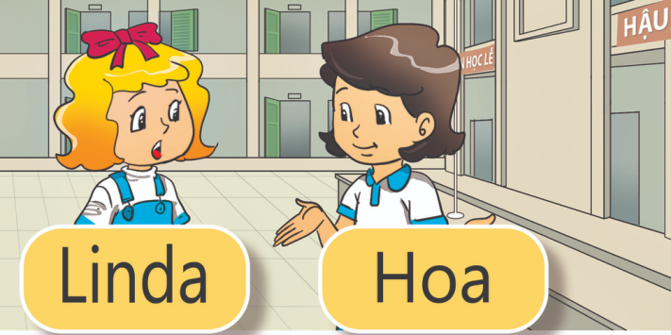
Are they your friends?
Next
Yes, it is.
No, it isn’t.
Yes,
they are.
No,
they aren’t.
Notes:
Ms Huyền Phạm - 0936.082.789 – YOUTUBE: MsPham. Facebook: Dạy và học cùng công nghệ.

Slide 15

Is she your friend?
Next
Yes, she is.
Yes, she is.
No, she isn’t.
No, he isn’t.
Notes:
Ms Huyền Phạm - 0936.082.789 – YOUTUBE: MsPham. Facebook: Dạy và học cùng công nghệ.

Slide 16
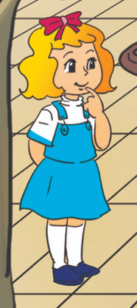
Is she your _____?
No, she isn’t.
Next
frend
frends
friend
friends
Notes:
Ms Huyền Phạm - 0936.082.789 – YOUTUBE: MsPham. Facebook: Dạy và học cùng công nghệ.

Slide 17
Next
Is he your friend?
Yes, it is.
Yes, she is.
Yes, they are.
Yes, he is.
Notes:
Ms Huyền Phạm - 0936.082.789 – YOUTUBE: MsPham. Facebook: Dạy và học cùng công nghệ.

Slide 18
____ he your friend?
Next
are
is
they
this
Notes:
Ms Huyền Phạm - 0936.082.789 – YOUTUBE: MsPham. Facebook: Dạy và học cùng công nghệ.

Slide 19








Notes:
Ms Huyền Phạm - 0936.082.789 – YOUTUBE: MsPham. Facebook: Dạy và học cùng công nghệ.

Slide 20
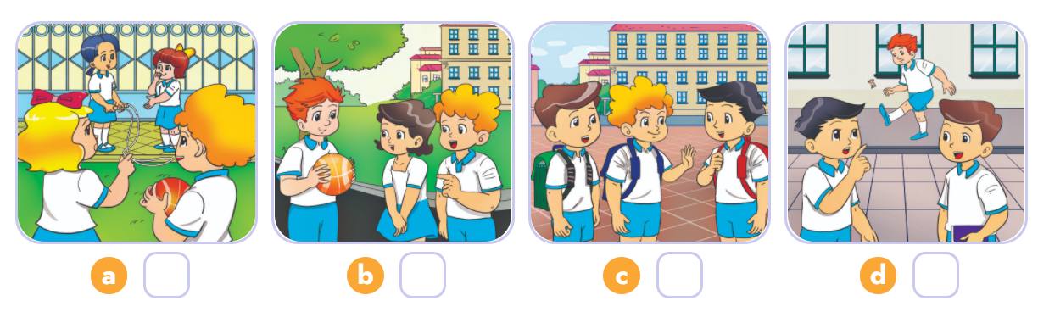
4. Listen and number
2
3
4
1
1
2
3
4

Slide 21


THANK YOU!
Welcome to join with me!

