Slide 1
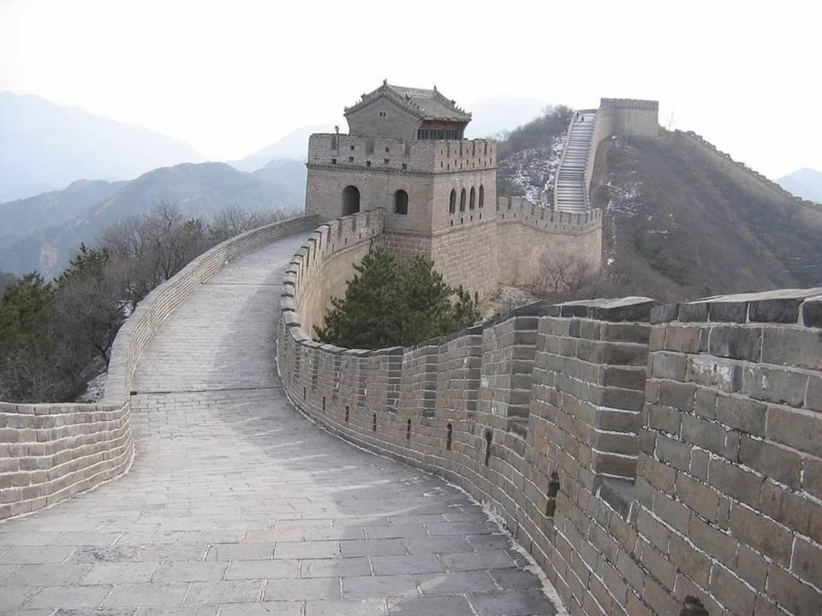
Unit 9:
My House
Lesson 2:
A. 4, 5, 6

Slide 2

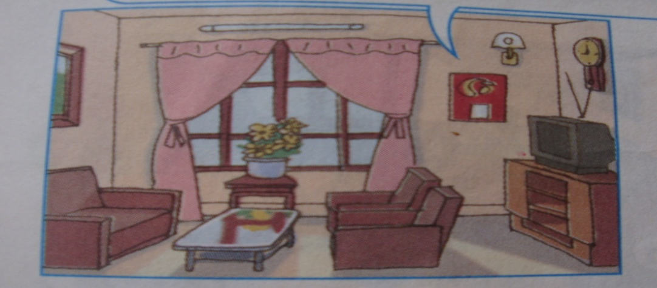
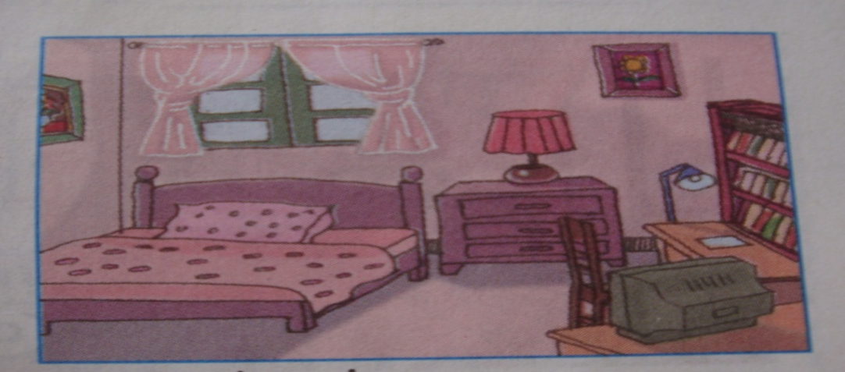
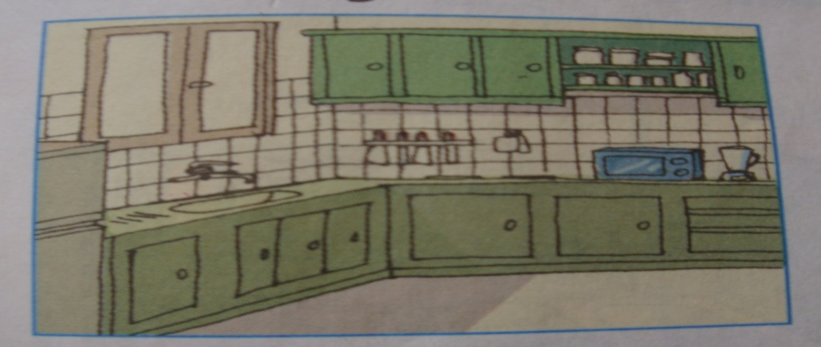
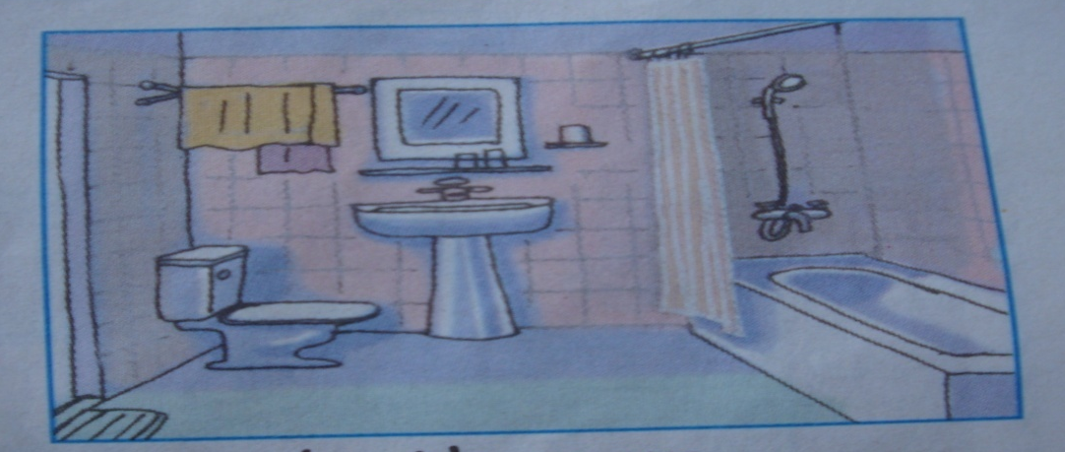
1. Listen and check: A.4 - P.84
Unit 9:
My House
Lesson 1:
A. 1, 2, 3
1.
a
b
2.
a
b

Slide 3
2. Say it right: A.5 - P.84
Unit 9:
My House
Lesson 1:
A. 1, 2, 3
1. Listen and check: A.4 - P.84
in
/i/
three
/θr/
play
/pl/
kitchen
/i/
bathroom
/θr/
please
/pl/

Slide 4

3. Let’s write: A.6 - P.85
Unit 9:
My House
Lesson 1:
A. 1, 2, 3
1. Listen and check: A.4 - P.84
2. Say it right: A.5 - P.84
1. This is my .............. .
bedroom
It is ......... .
small
2. That is ........................ .
the living room
It is ..... .
big

Slide 5

Homework:
* Learn the lesson by heart.
* Do the exercise 3, 4, 5 on P.63, 64 - Workbook.
* Prepare “Unit 9. Lesson 3. B.1,2,3”

Slide 6
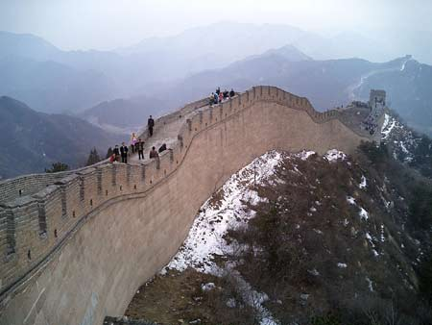
Thanks for your attendance.
Bye. See you later.

