Slide 1


Welcome to our class
Let’s Learn English Book 2

Slide 2
Checking the old lesson
Play a game :
“Matching”

Slide 3
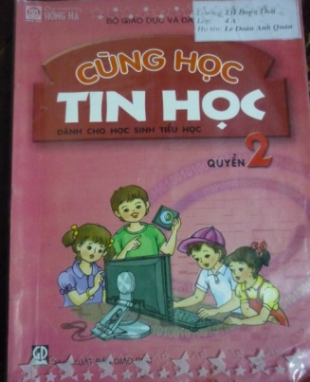
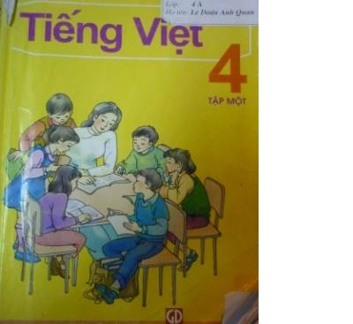

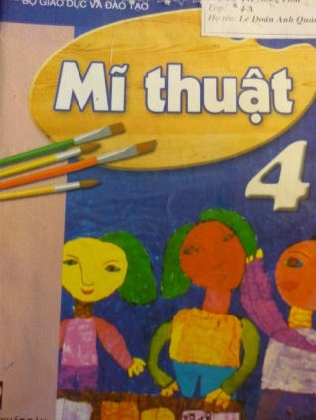
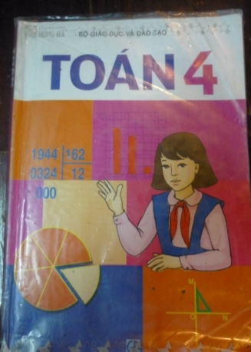
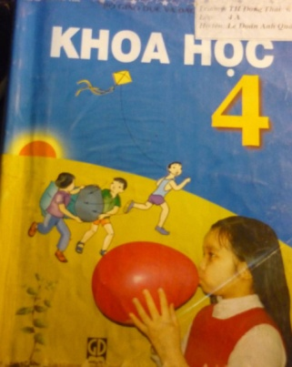
1) Music
2) Maths
3) Vietnamese
4) Science
5) Art
6) Informatics
A
D
B
E
C
F

Slide 4


Slide 5
Unit 6:
MY SCHOOL TIMETABLE
(Section B: 1,2,3)
I/Vocabulary:

Slide 6
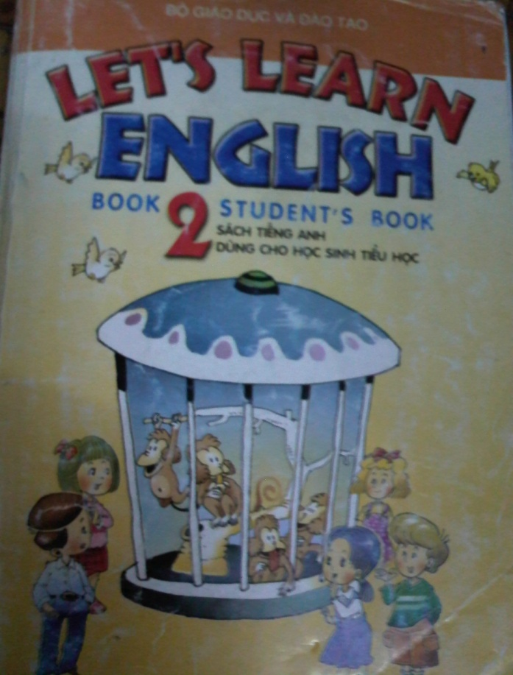
Unit 6:
MY SCHOOL TIMETABLE
(Section B: 1,2,3)
I/Vocabulary:
Read and write:
Đọc và viết.
Draw pictures:
Vẽ tranh.
Learn about animals and plants:
Học về các loài động vật và thực vật.
Sing songs:
Hát các bài hát.

Slide 7
Unit 6:
MY SCHOOL TIMETABLE
I/Vocabulary:
(Section A: 1,2,3)
Read and write:
Đọc và viết.
Draw pictures:
Vẽ tranh.
Learn about animals
and plants:
Học về các loài động vật
và thực vật.
Sing songs:
Hát các bài hát.

Slide 8

Unit 6:
MY SCHOOL TIMETABLE
(Section A: 1,2,3)
* Checking new words: Matching
A.Read and write
B.Draw pictures
C. Learn about animals
and plant
D. Sing songs
1
2
3
4
Key:
A :
4
B:
1
C:
2
D:
3

Slide 9
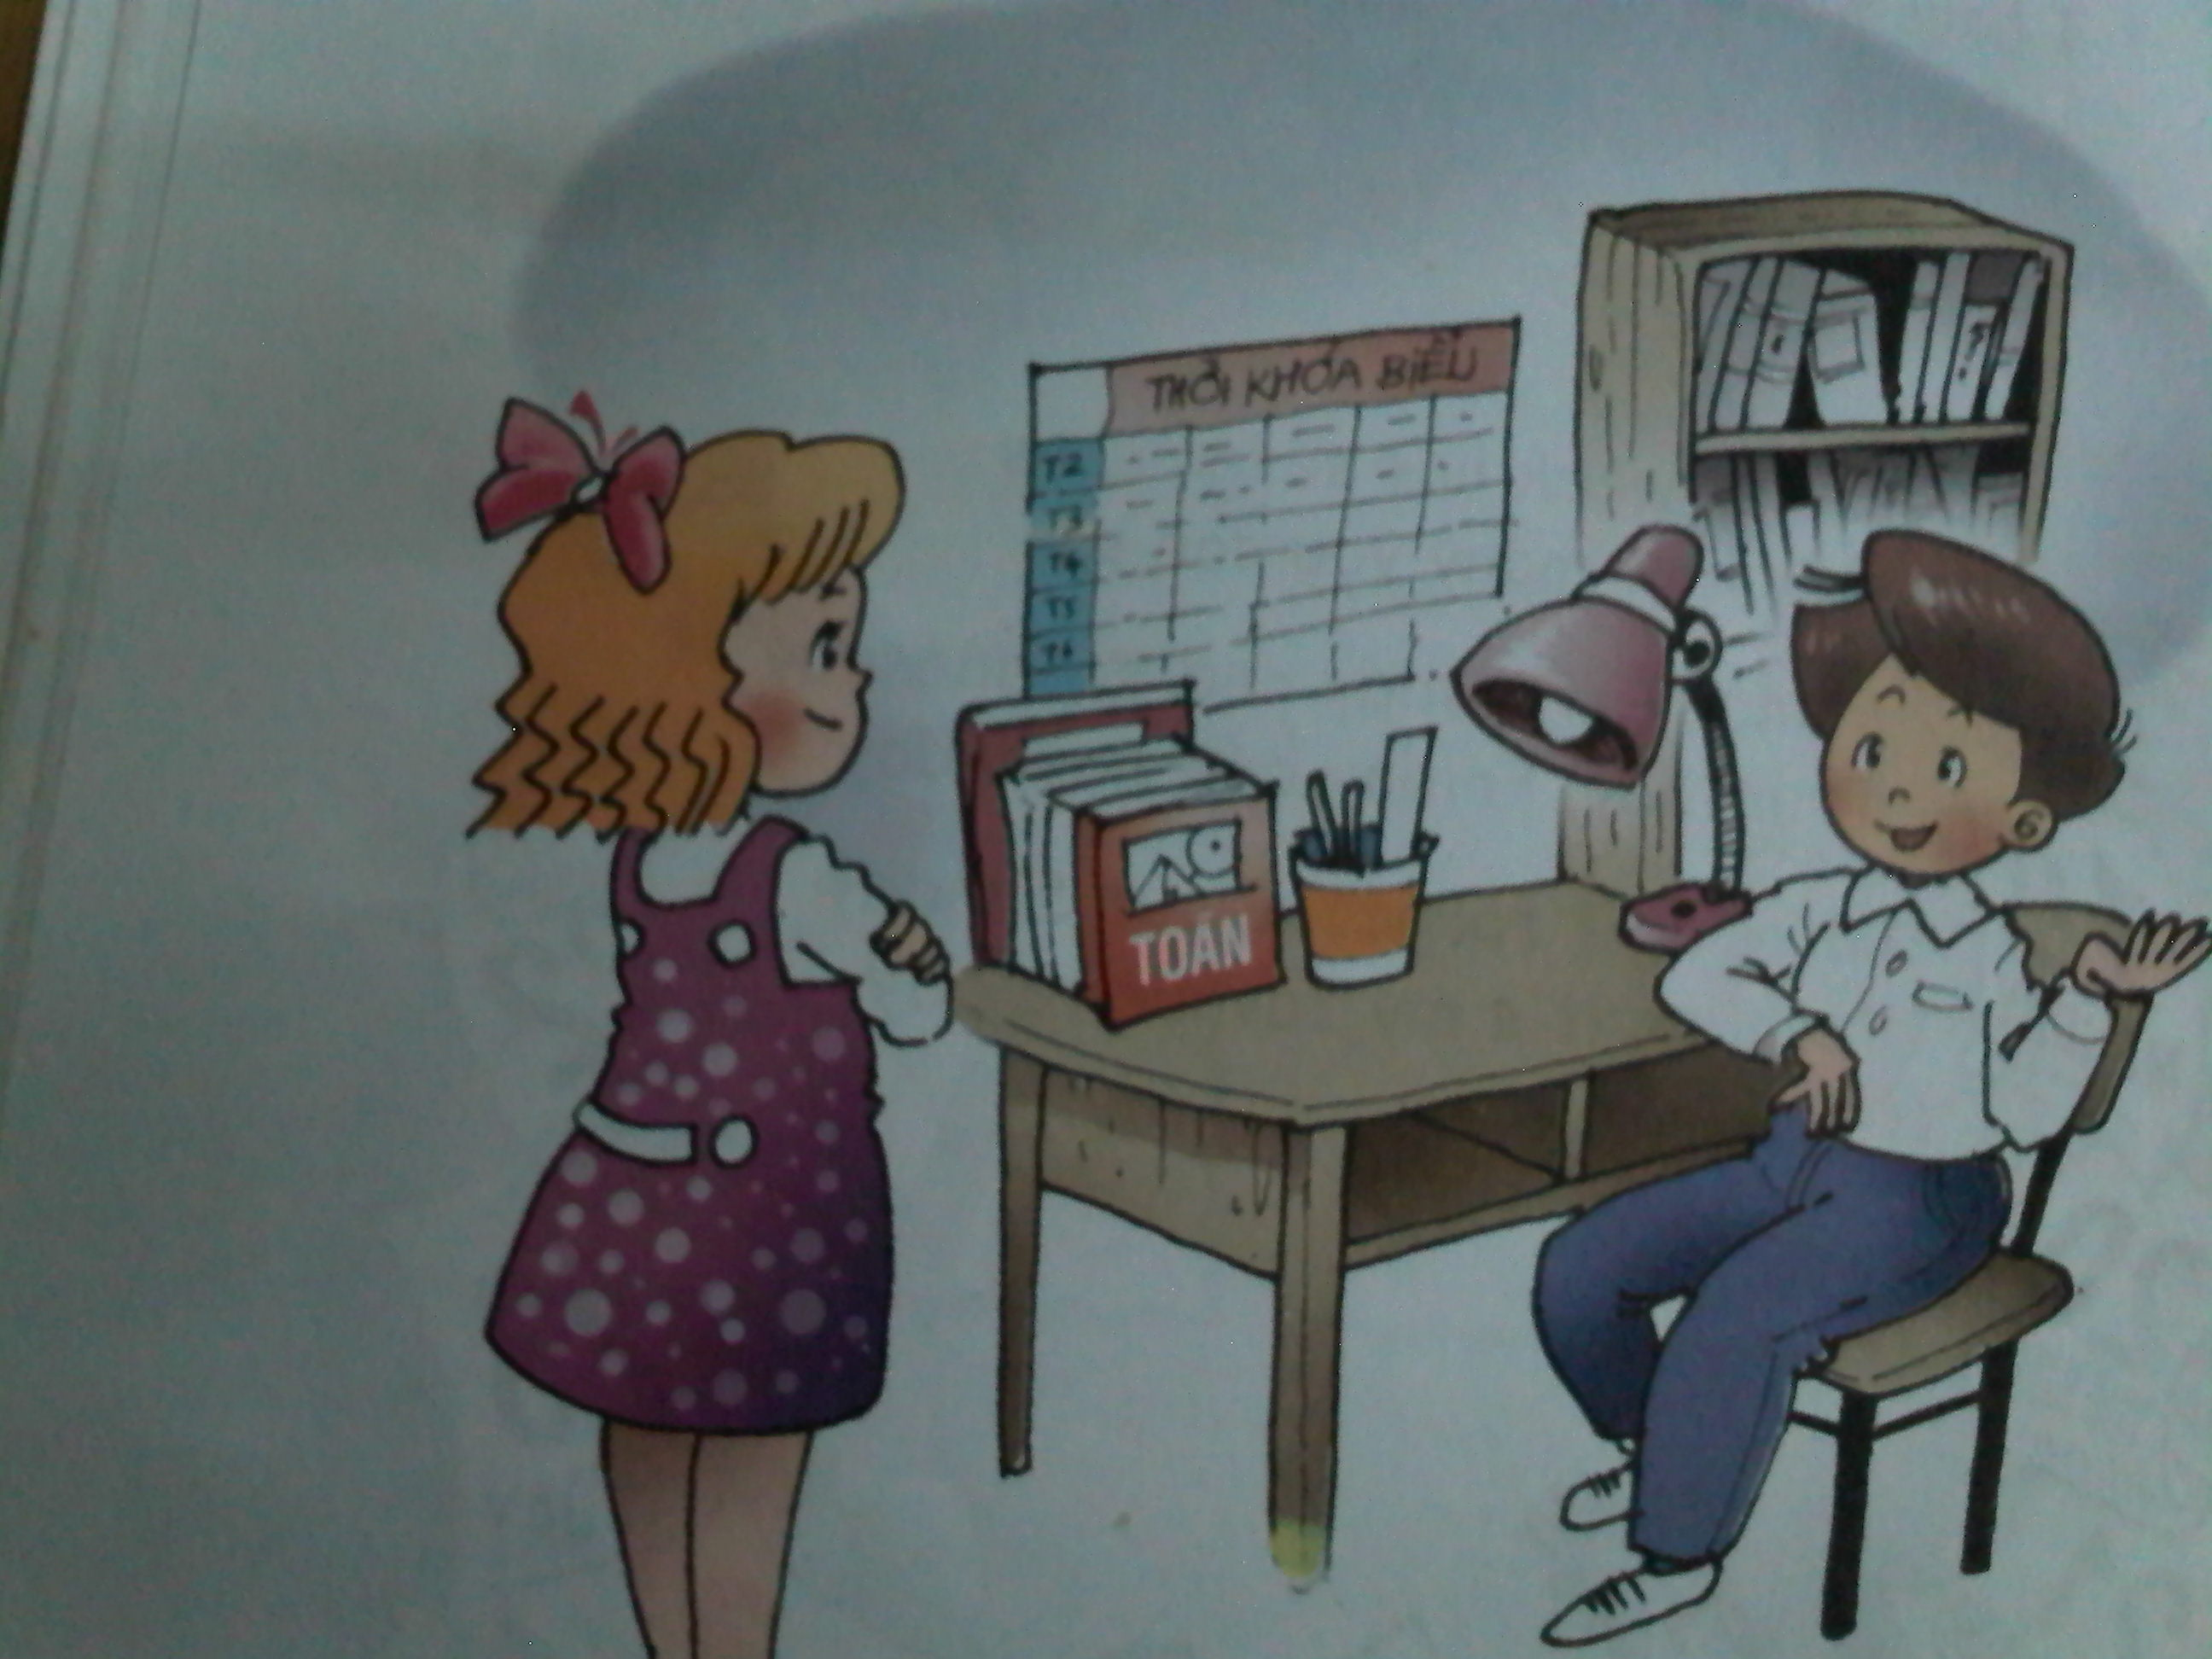

Slide 10
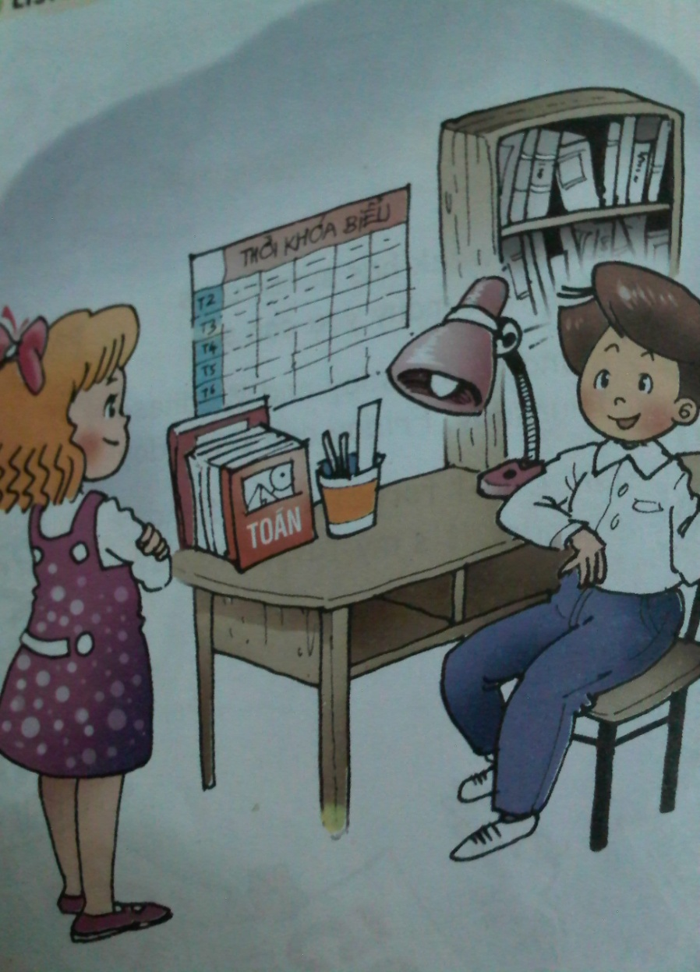
Unit 6:
MY SCHOOL TIMETABLE
(Section A: 1,2,3)
Nam: When do you have English?
Linda: I have it on Monday and Friday.
Nam: What do you do during English lessons?
Linda: I learn to read and write in English.

Slide 11
Unit 6:
MY SCHOOL TIMETABLE
(Section A: 1,2,3)
II/Structure:
Nam: What do you do during English lessons?
Linda: I learn to read and write in English.

Slide 12

Unit 6:
MY SCHOOL TIMETABLE
(Section A: 1,2,3)
III/Practce.
English lessons
A : What do you do during ……………….?
B: I learn to …………………..............
read and write in English.
Read and write:
Draw pictures:
Learn about animals
and plants:
Sing songs:

Slide 13
Unit 6:
MY SCHOOL TIMETABLE
(Section A: 1,2,3)
III/Practce.
A: When do you have……………?
B: I have it on ……………………………..
A: What do you do during ……….. lessons?
B: I learn to ……………. …………...
Read and write:
Draw pictures:
Learn about animals
and plants:
Sing songs:

Slide 14
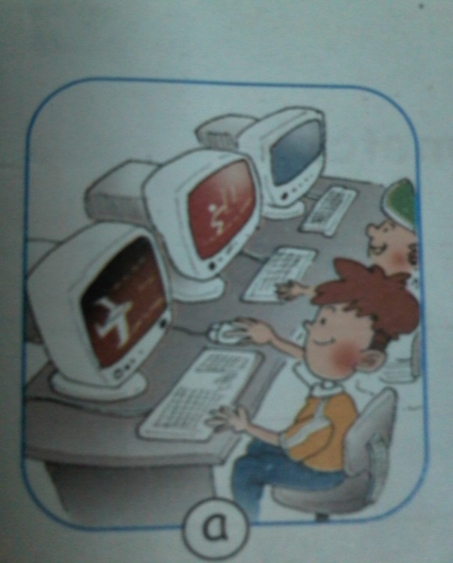
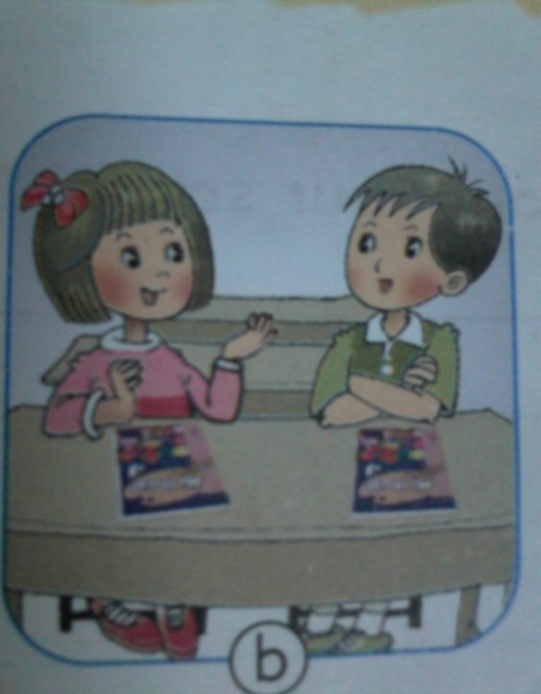
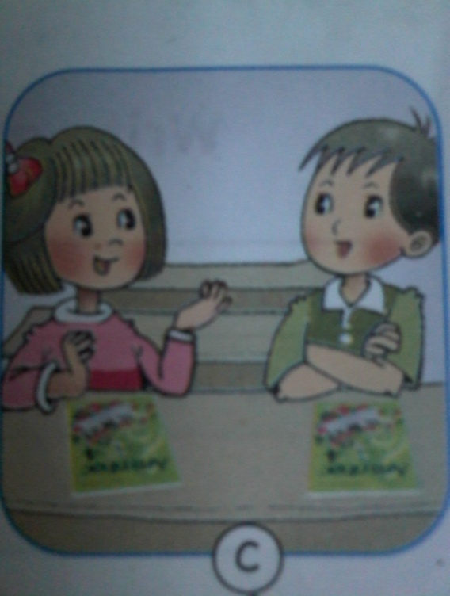
Unit 6:
MY SCHOOL TIMETABLE
(Section A: 1,2,3)
IV/Listening.
3
1
2

Slide 15

*Homework:
* Learn to newwords and grammar.
* Do exercises 6,7 in workbook

Slide 16



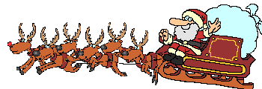
Goodbye. See you again!!!
Thanks for your attention!

