Slide 1




Slide 2
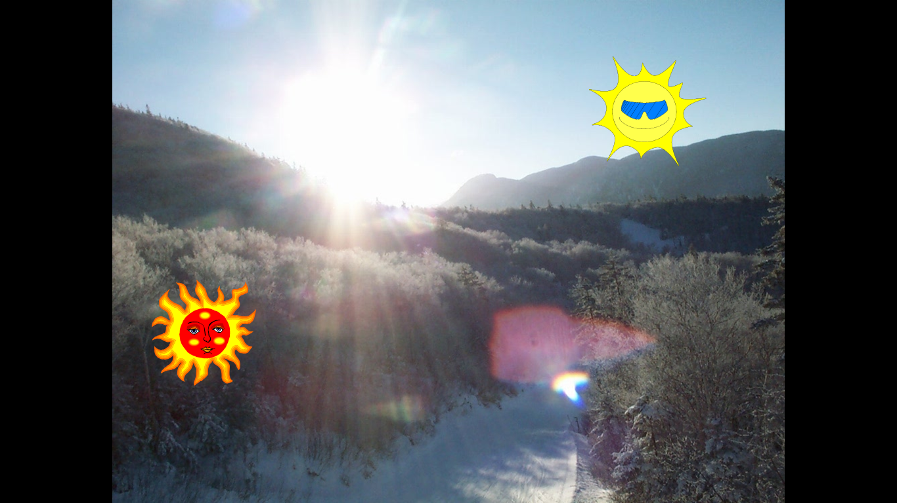
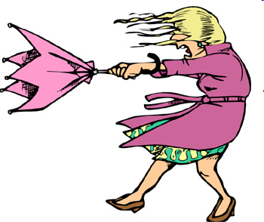

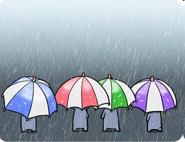
1
2
QUANG BINH
YEN BAI
LAO CAI
HUE
4
3

Slide 3
Period 111 Unit 16: THE WEATHER
Lesson 3(3,4)
3. Write
Cities | Weather
1. Hai Phong | rainy
2. Hue
3.Da Nang
4. Ho Chi Minh City
5. Your hometown
cloudy
windy
sunny

Slide 4

Activity 3: game

Slide 5




Who's a milionaire?
1. Choose the odd one.
A. weather
A. weather
B. windy
C. sunny
D. cloudy

Slide 6
Who's a milionaire?
2. Hue / in / cloudy / is / It/.
50:50
A. In Hue is cloudy.
B. It cloudy is in Hue.
C. Is it cloudy in Hue
D. It is cloudy in Hue.
D. It is cloudy in Hue.

Slide 7
Who's a milionaire?
3.the/weather/What/like/is/Hai Phong/in?
What like is the weather
in Hai Phong?
B. What the weather like in
Hai Phong?
C. What the weather is like in
Hai Phong?
D. What is the weather
like in Hai Phong?
D.What is the weather
like in Hai Phong?

Slide 8
Who's a milionaire?
4. is/in/It/ and windy/cloudy/hometown/my.
It is cloudy and windy in my
hometown.
B. Is It windy and cloudy in my
hometown.
A. It is cloudy and windy in my
hometown.
C. It cloudy and windy in my
hometown.
D. It cloudy and windy is in my
hometown.

Slide 9
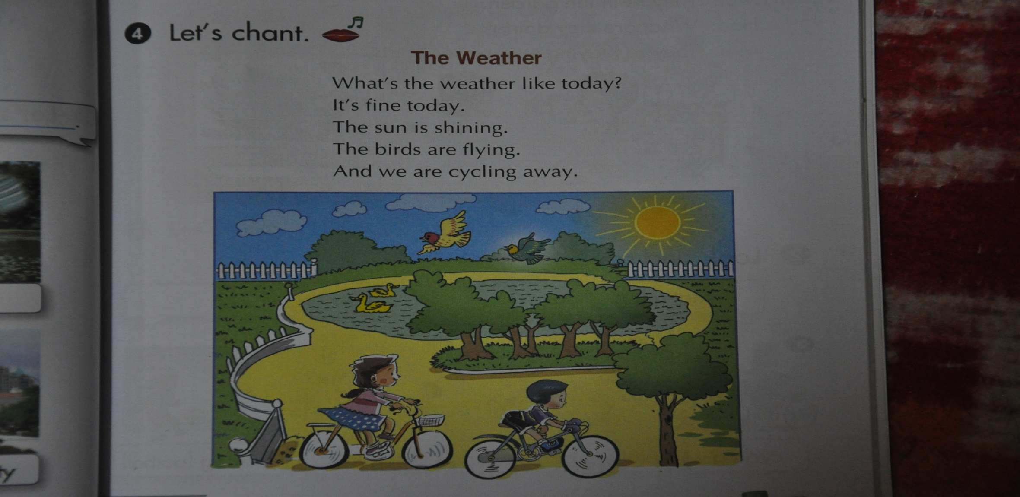
4. Let’s chant. The Weather
What’s the weather like today?
It’s fine today.
The sun is shining.
The birds are flying.
And we are cycling away.
Bird: con chim
Fly: bay

Slide 10



HOMEWORK:
Rewrie the exercise 3.
Copy exercise 4 “ Let’s chant”.

Slide 11
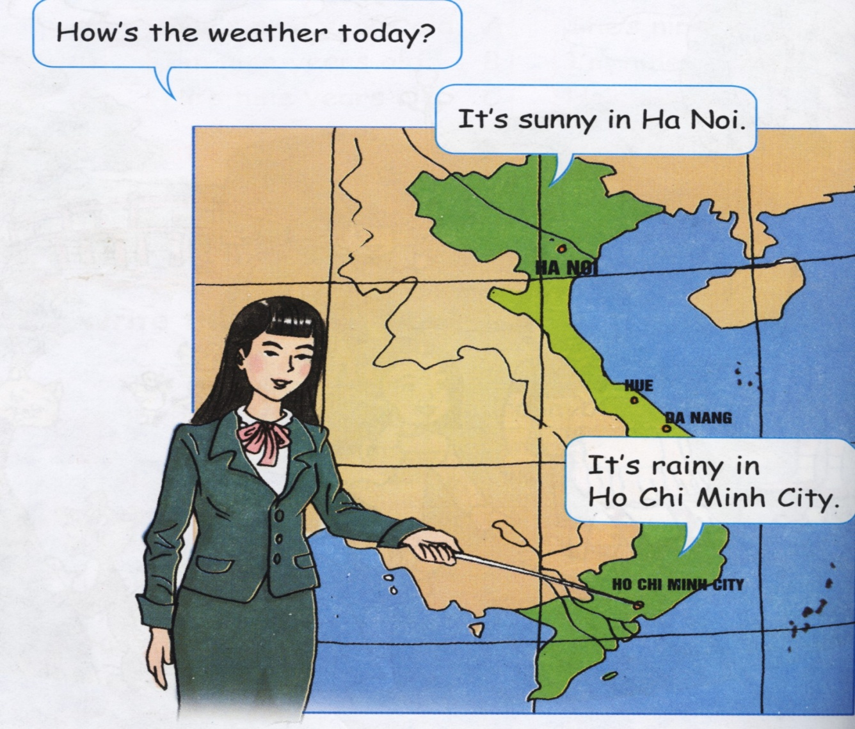

Slide 12
