Slide 1

UNIT 14 : OUR ROOM
Lesson 1 _ 1, 2

Slide 2



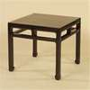

Period 91 UNIT 14 : OUR ROOM
Lesson 1 _ 1, 2
Let' play
Call out some things

Slide 3
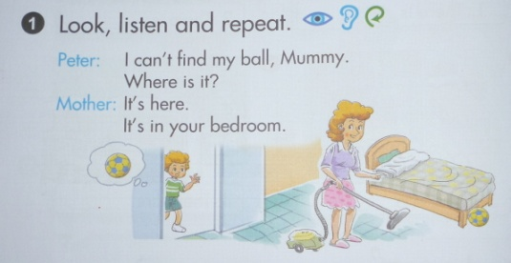
Period 91 UNIT 14 : OUR ROOM
Lesson 1 _ 1, 2
1. Look, listen and repeat
can’t :
không thể
find:
tìm
ball:
quả bóng
ball

Slide 4

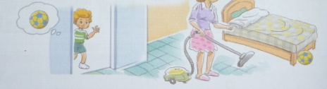
Period 91 UNIT 14 : OUR ROOM
Lesson 1 _ 1, 2
1. Look, listen and repeat
It’s here.
It’s in your bedroom.
I can’t find my ball,mummy.
Where is it?

Slide 5
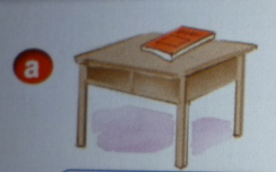
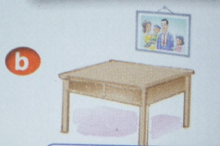
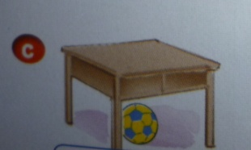
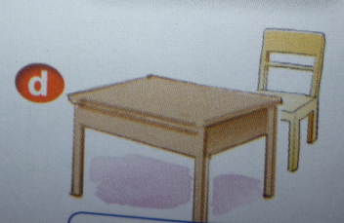
Period 91 UNIT 14 : OUR ROOM
Lesson 1 _ 1, 2
1. Look, listen and repeat
above
on
under
behind

Slide 6
Period 91 UNIT 14 : OUR ROOM
Lesson 1 _ 1, 2
1. Look, listen and repeat
Where is it?
It’s _________________.
on the desk/ table
above
under
behind

