Slide 1

DOAN KET PRIMARY SCHOOL
ENGLISH 4
UNIT 1. NICE TO SEE YOU AGAIN
LESSON 1
Teacher: Nguyen Phuong Anh

Slide 2
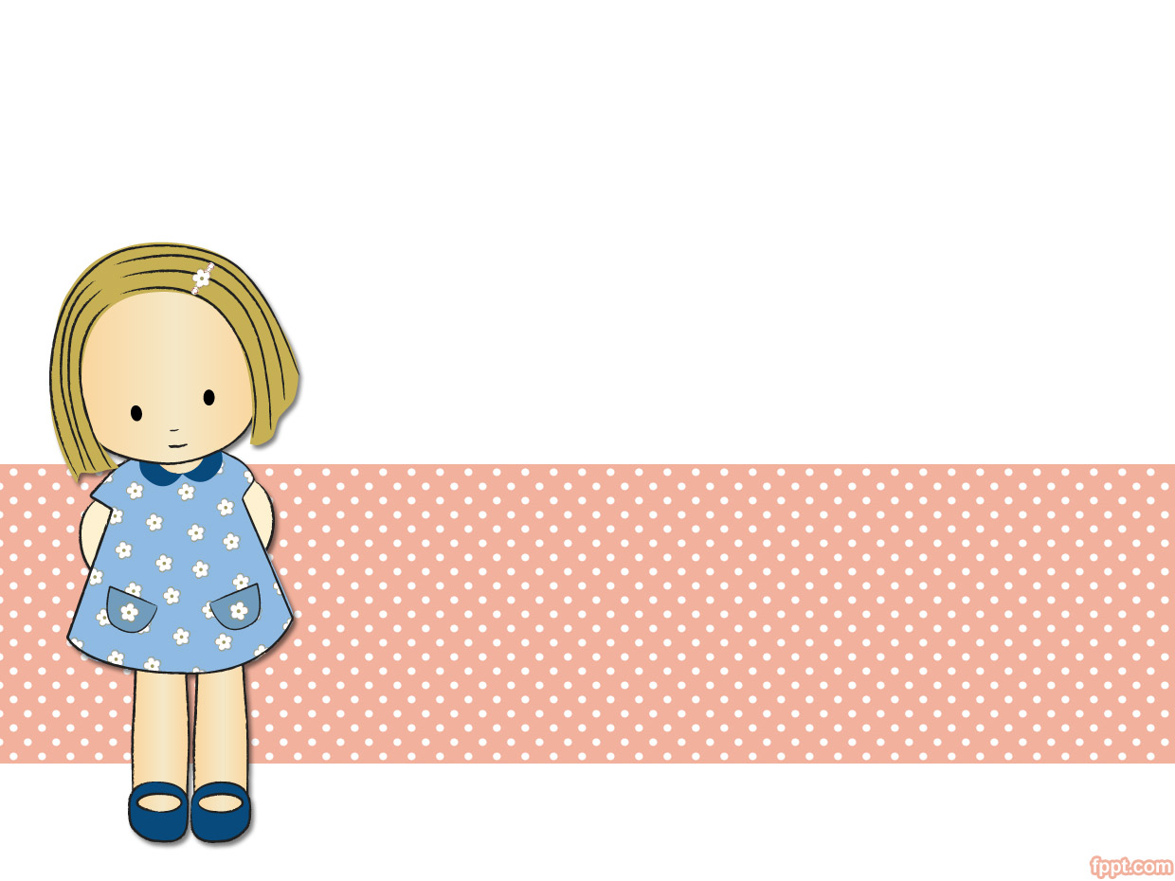
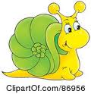
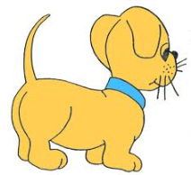

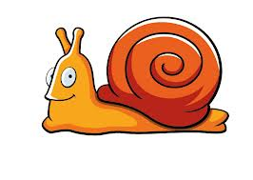
Objectives
- By the end of the lesson, students will be able to:
1. Knowledge:
- Greet and respond to greetings formally.
- Sentence Patterns: Good ____.
- Vocabulary: Mr. Loc, Ms. Hien, Mai, Nam, Phong
Good morning. / Good afternoon. / Good evening.
2. Skills.
- Listening and speaking.
3. Attitude:
- Confident in learning and practice situations
4. Forming competence:
- Self-study ability
- Use language to read and write about their school and lessons

Slide 3

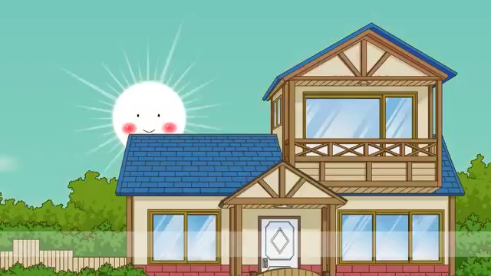
WARM UP

Slide 4

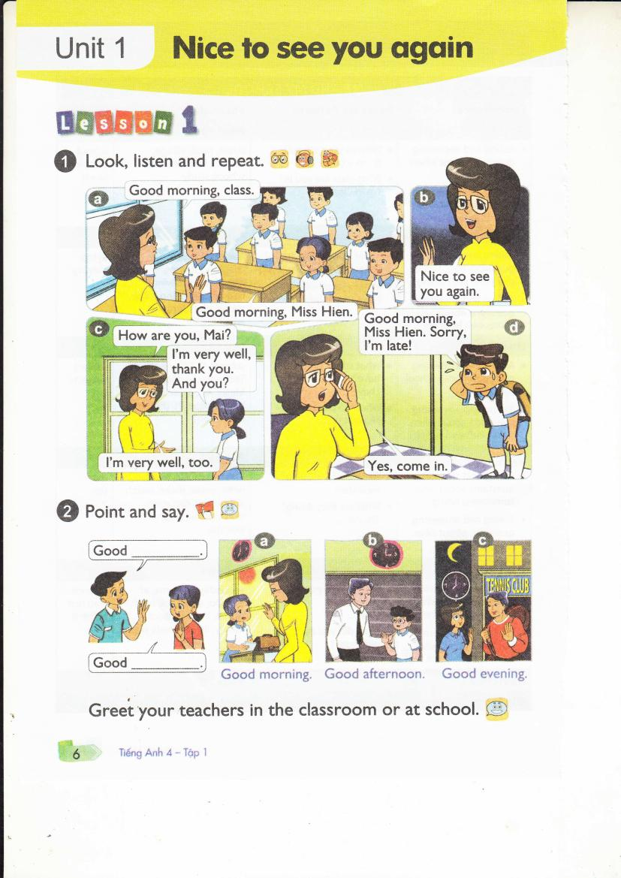
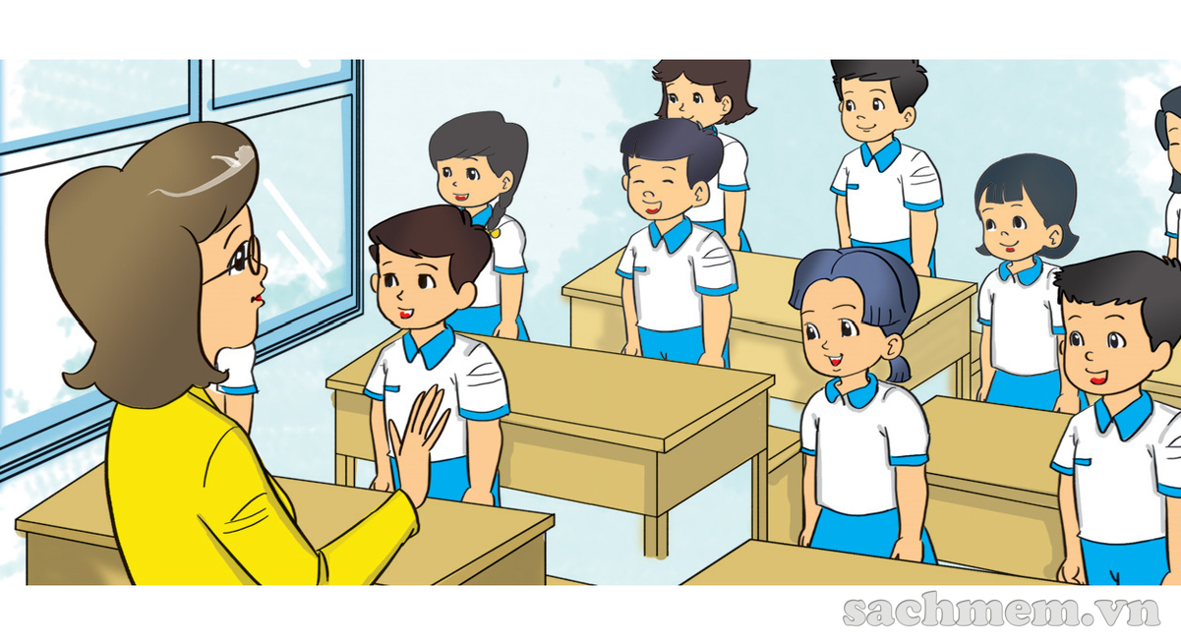

Slide 5
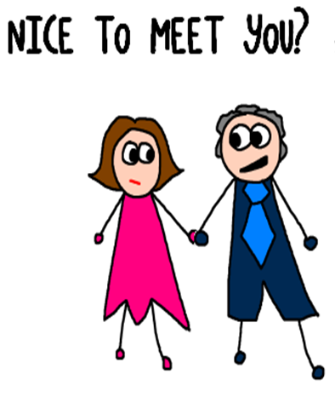

Slide 6
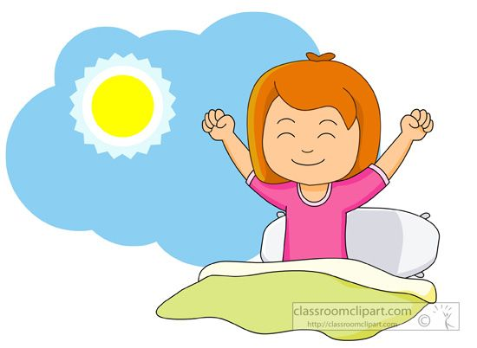
Good morning

Slide 7


Slide 8
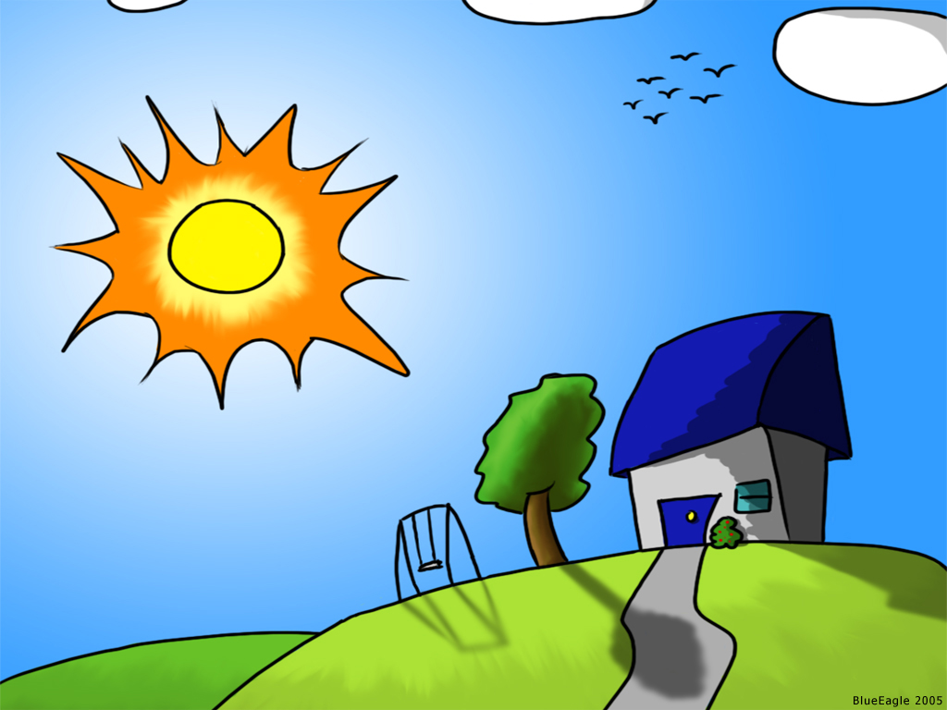
Good EVENING

Slide 9
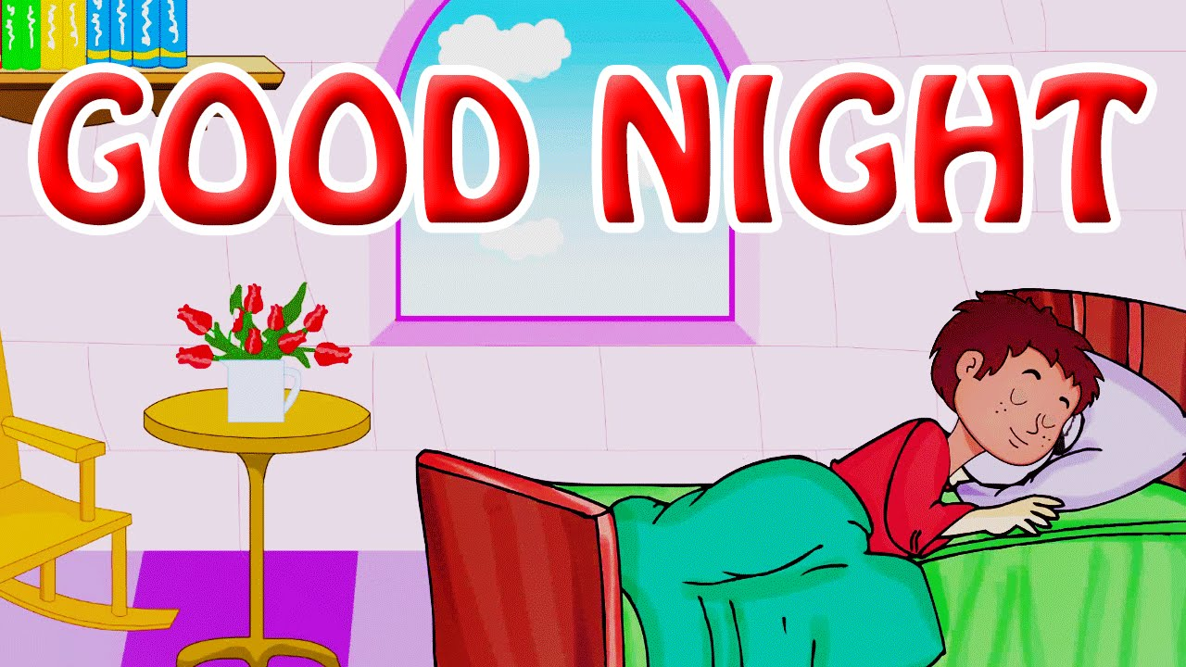

Slide 10
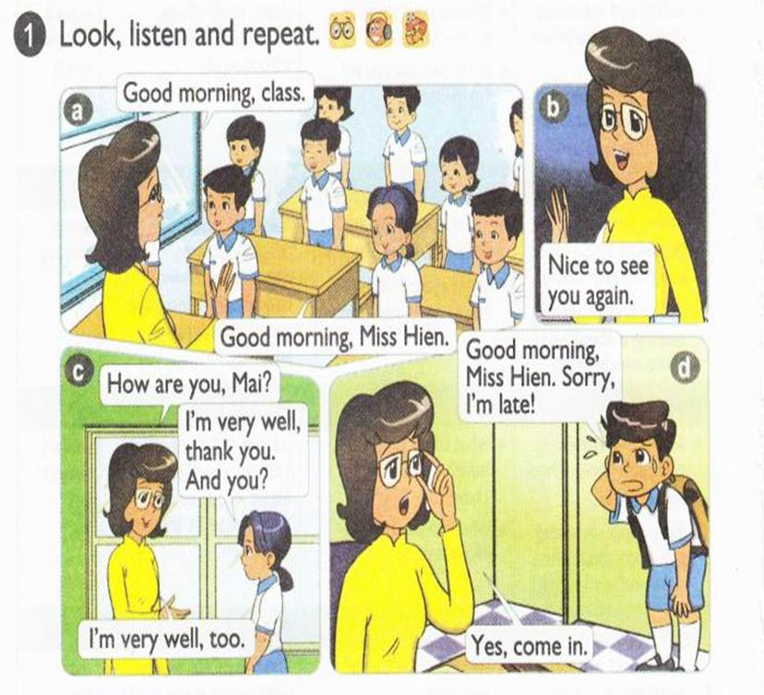


Slide 11
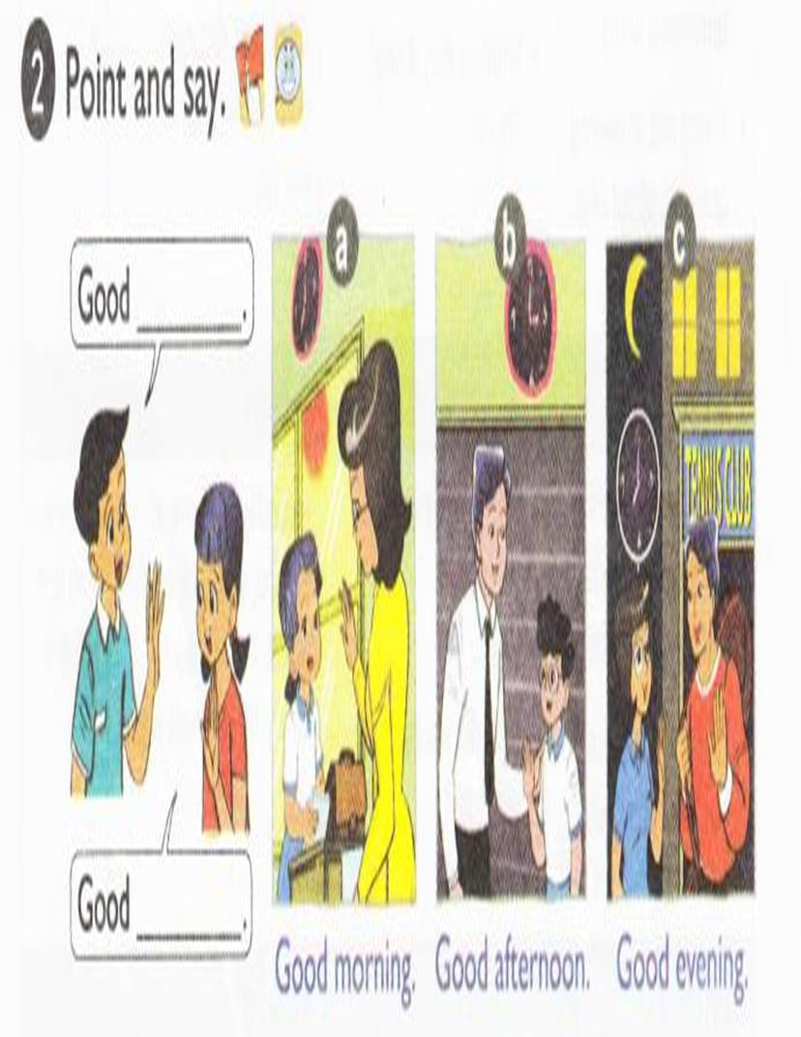

Slide 12
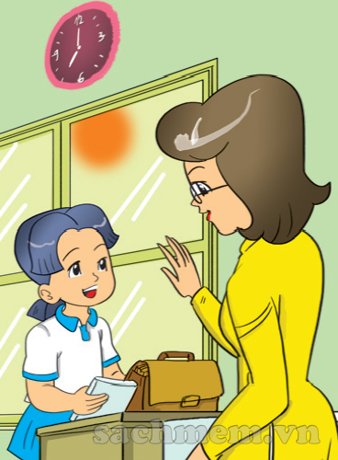
Good morning
Good morning

Slide 13
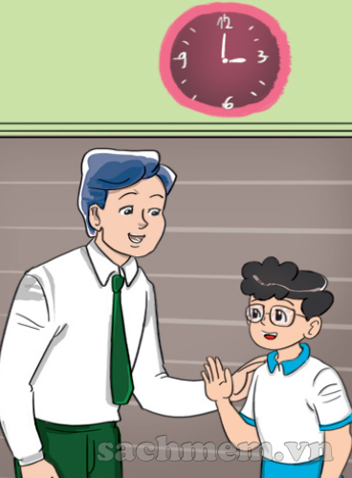
Good afternoon
Good afternoon

Slide 14
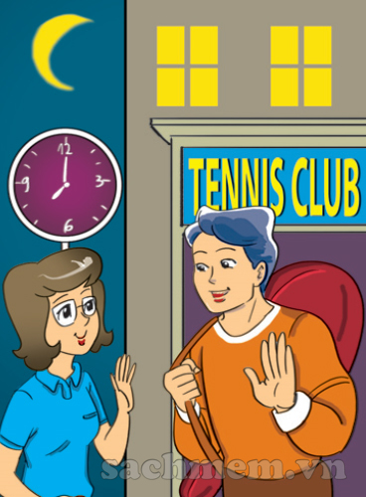
Good evening
Good evening

Slide 15
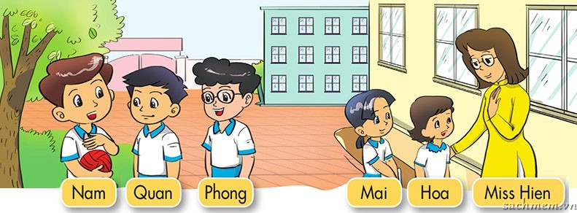


Slide 16
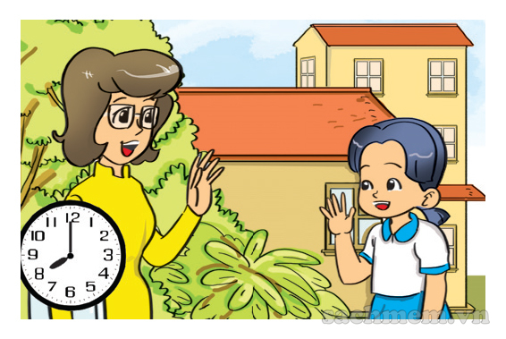
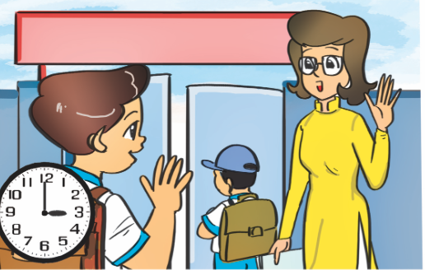
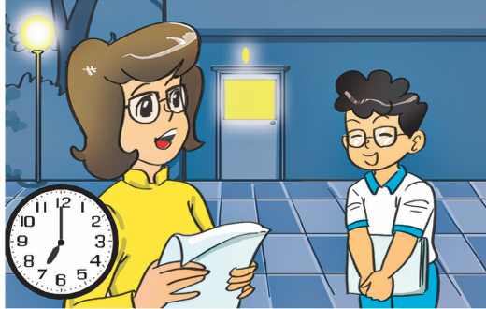
LISTEN & TICK
1
a
b
c

Slide 17
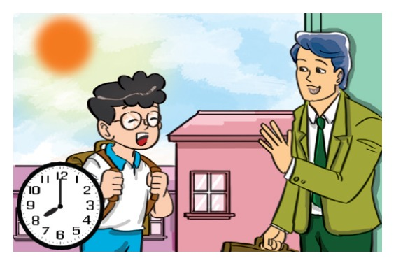
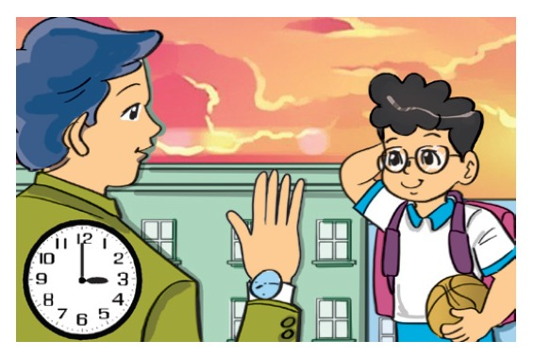
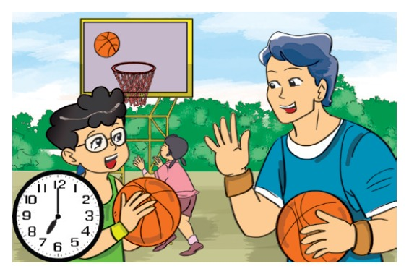
LISTEN & TICK
2
a
b
c

Slide 18
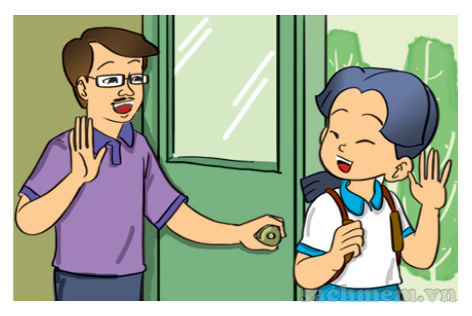
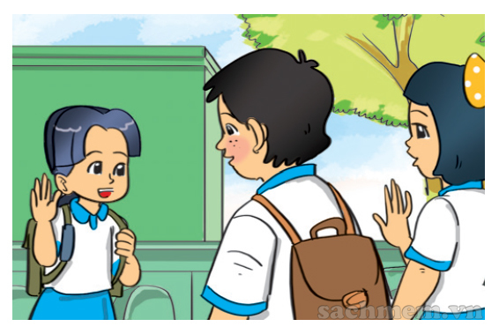
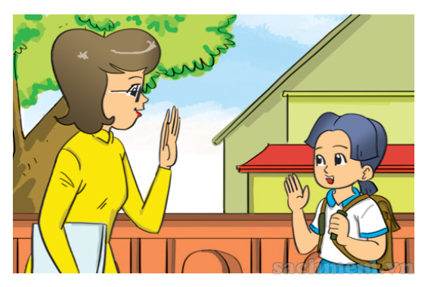
LISTEN & TICK
3
a
b
c

Slide 19
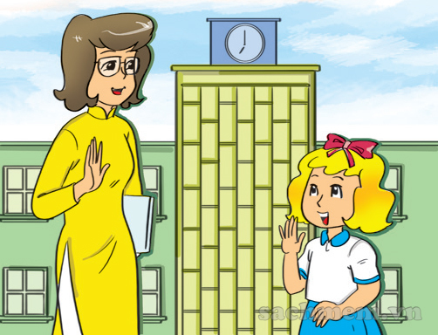
Good
morning
LOOK & WRITE

Slide 20
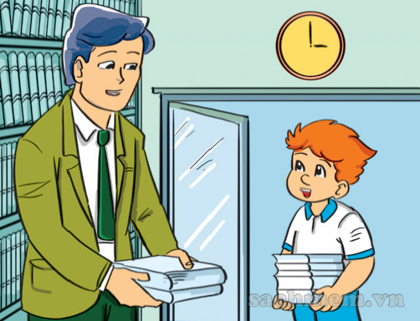
Good
afternoon
LOOK & WRITE

Slide 21
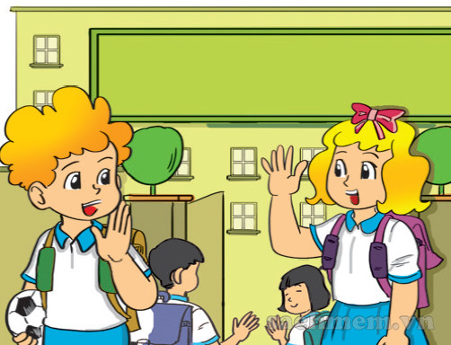
Good
bye
LOOK & WRITE

Slide 22

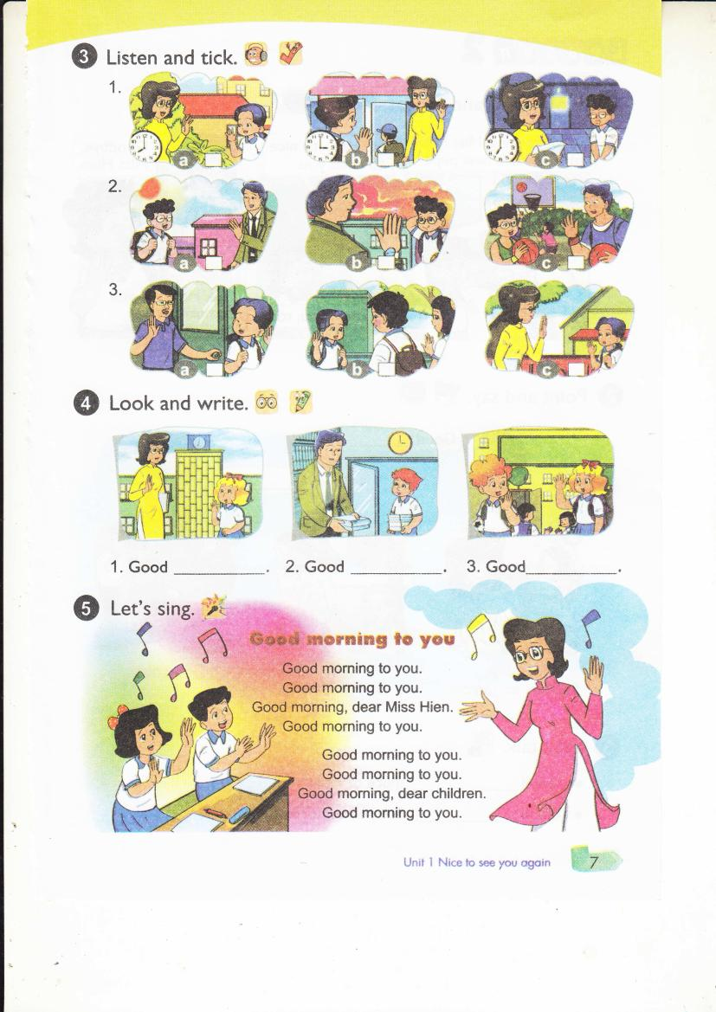

Slide 23


Slide 24
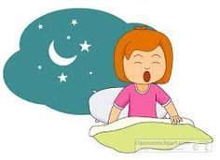
Good moning
Good afternoon
Good night
2

Slide 25

afternoon
morning
night
3

Slide 26
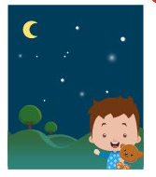
afternoon
morning
night
4

Slide 27
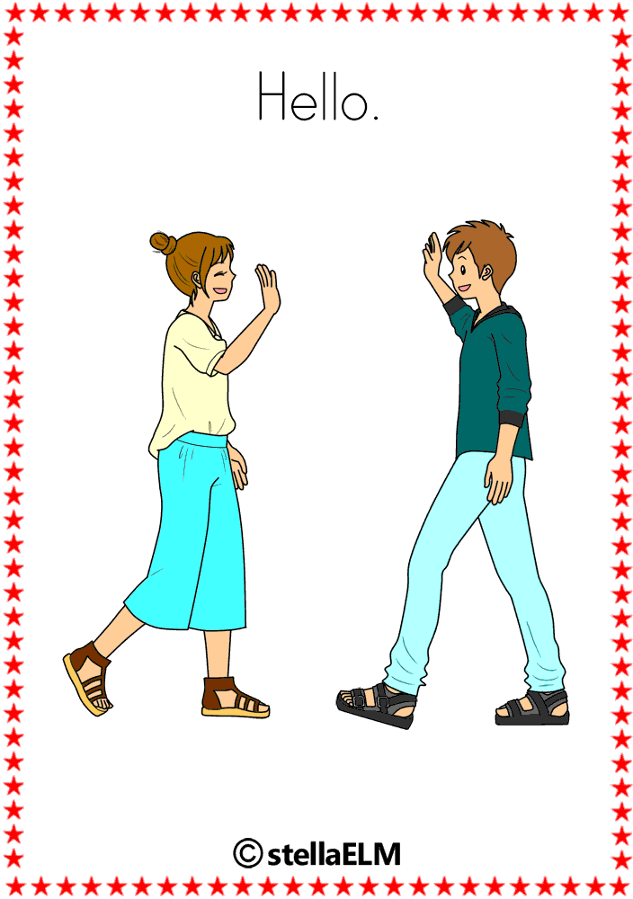
hello
Good bye
bye
5

Slide 28

BYE
GOOD BYE
NICE TO MEET YOU
6

Slide 29

BYE
GOOD BYE
HELLO/ HI
9

Slide 30
