Slide 1
GAME : CROSSWORD
C
R
A
F
T
1
C
I
2
C
O
N
I
C
A
L
A
N
T
E
R
N
S
3
L
T
S
A
Y
4
Y
L
5
M
O
U
L
D
H
I
S
T
O
R
Y
6
I
F
A
M
O
U
S
7
F
I
N
T
E
R
E
S
T
8
E
This village is ….. for its wood- carving craft
The Arts Museum is a popular place of ….. in my city.
In Hoi An you can see colorful ….. Hanging in the streets.
The … village of Bat Trang lies on the bank of the Red river.
This kind of …... hat is made in Chuong village.
Some people….. that a place of interest should be a well- known site
The ….... of Ha Noi began over a thousand years ago.
The children can ….. the clay into many shapes

Slide 2

Welcome all of teachers and students
PERIOD 9:UNIT 2: CITY LIFE
Lesson 1: Getting started
Lesson plan for English 9
Teacher: Nguyen Thu Trang
Ngo Gia Tu secondary school
2

Slide 3
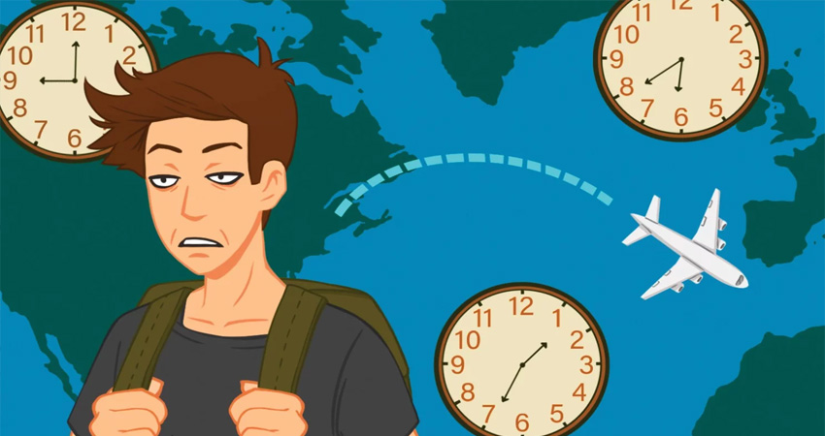

New words :
-Jet lag /ˈdʒet ˌlæɡ / ( n )
: sự mệt mỏi sau 1 chuyến bay dài
- fabulous / 'fæbjuləs/ (adj) = wonderful
: tuyệt vời
- feature / 'fi:t∫ə / (n) :
nét đặc trưng
- metropolitan /,metrə'pɔlitən/ (adj)
: thuộcthủ đô
- multicultural /ˌmʌl.tiˈkʌl.tʃər.əl/ (adj)
: thuộc nhiều lãnh vực văn hoá khác nhau
- reliable / ri'laiəbl / (adj)
: đáng tin cậy

Slide 4
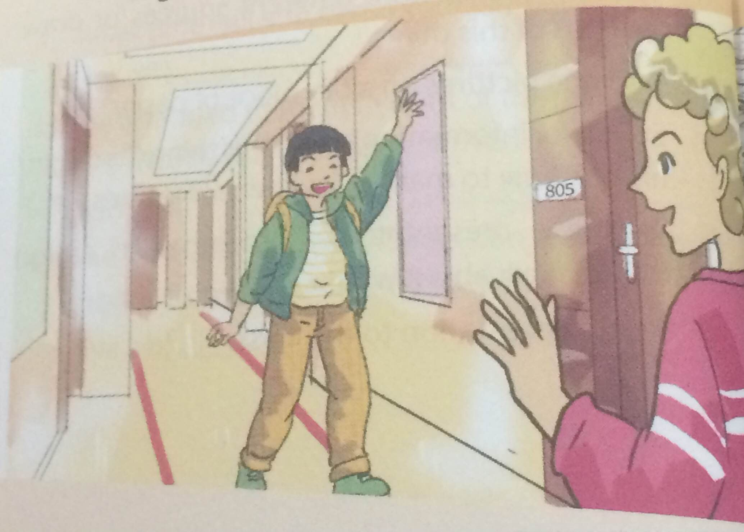
Answer the following questions.
1. What can you see in the picture?
2. Do you know these two boys?
3. Where are they now?
4. What are they talking about?

Slide 5

1. Listen and read
Duong: Hey, Paul! Over here! Paul: Hi, Duong! How's it going? Getting over the jet lag? Duong: Yes, I slept pretty well last night. Hey, thanks so much for showing me around today. Paul: No worries, it'll be good fun. Duong : So, are you from around here? Paul: Me? Yes, I was born and grew up here. Sydney's my hometown. Duong :It's fabulous. Is it an ancient city? Paul: No, it's not very old, but it's Australia's biggest city, and the history of our country began here. Duong : Wow! So what are the greatest attractions in Sydney? Paul: Well, its natural features include Sydney Harbour, the Royal National Park, and Bondi Beach. Man-made attractions such as the Royal Botanic Gardens, Sydney Opera House, and the Harbour Bridge are also well known to visitors.

Slide 6
1. Listen and read
Duong : What about transport? Paul: Public transport here is convenient and reliable: you can go by bus, by train, or light rail. Taxis are more expensive, of course.
Duong : And is Sydney good for shopping? Paul: Of course! You know, Sydney's a metropolitan and multicultural city, so we have a great variety of things and foods from different countries. I'll take you to Paddington Market later,
if you like. Duong : Wonderful. What about education? Are there many universities? Paul: Sydney has five big universities and some smaller ones. The oldest of them was set up in 1850, I believe. Duong : Oh, it sounds like a good place to get higher education. I like this town!

Slide 7
a. Complete the sentences with information from the conversation.
1. It is Duong's first _________ to Sydney. 2. In Paul's opinion, Sydney is not _________ an city. 3. Sydney Harbour is a _________ attraction of Sydney. 4. The shopping is good because of the _________ of things. 5. Duong thinks Sydney may be a good place to _________.
visit
ancient
natural
variety
study
b. Find the word in the conversation to match these definitions.
jet lag
1. tiredness from traveling across different tome zones
2. an attraction
3. that can be trusted
4. belonging to a very large city
5. including people of different races, religons, languages, and traditions
a feature
reliable
metropolitan
multicultural

Slide 8
c. Answer the questions.
Where did Paul grow up?
2. What is the biggest city in Australia?
3. How is the public transport in Sydney?
4. Why is,there a great variety of things and foods in Sydney?
5. When was the first university built in Sydney?

Slide 9

Lucky Number Game

Slide 10
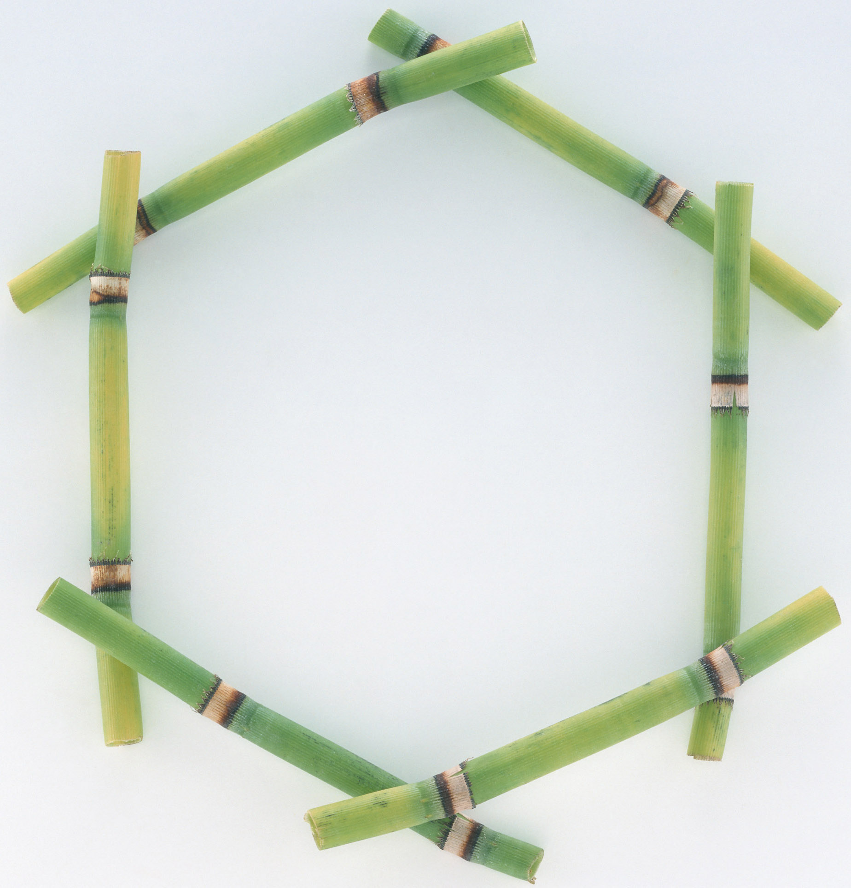

1
2
3
4
5
6

Slide 11



Lucky number.
Congratulation !

Slide 12


1. Where did Paul grow up?
- He grew up in Sydney.

Slide 13
2. What is the biggest city in Australia?
- Sydney is

Slide 14
3. How is the public transport in Sydney?
- It is convenient and reliable.

Slide 15
4. Why is there a great variety of things and foods in Sydney?
- Because it is a metropolitan and multicultural city.

Slide 16
5. When was the first university built in Sydney?
- In 1850.

Slide 17
c. Answer the questions.
Where did Paul grow up?
2. What is the biggest city in Australia?
3. How is the public transport in Sydney?
4. Why is there a great variety of things and foods in Sydney?
5. When was the first university built in Sydney?
- He grew up in Sydney.
- Sydney is.
- It is convenient and reliable.
- Because it is a metropolitan and multicultural city.
- In 1850.

Slide 18
d. Think of other ways to say these expressions from the conversation.
1. "How's it going?" 2. "Getting over the jet lag?" 3. "I slept pretty well" 4. "No worries"

Slide 19
d. Think of other ways to say these expressions from the conversation.
Suggested answer
1. "How's it going?"/ How are you going? / How are the things” 2. "Getting over the jet lag?“/ Are you recovering from the jet lag? 3. "I slept pretty well“/ I slept quite well/ I slept tight. 4. "No worries"/ That’s OK/ It’s not a problem/ It’s my pleasure.

Slide 20
2. Replace the word(s) in italics with one of the words from the box.
crowded – international – local – urban – neighbouring
1. There is not a lot of world news in this newspaper. 2. I do my shopping in the neighbourhood shops, not in the town centre. 3. At weekends the city centre is always packed with people. 4. My friend's family has just moved to a nearby town. 5. There is far too much pollution nowadays in city areas.
international
local
crowded
neighbouring
urban

Slide 21
3. Work in pairs to do the quiz.
CITY QUIZ
1. Which city is the oldest?
Ha Noi B. Hue C. Can Tho
2. Which city is in Oceania?
Baghdad B. Amsterdam C. Canberra
3. Which city is the best-known city in North America?
Chicago B. Vancouver C. New York
4. Which city is in Africa?
Luanda B. Athens C. Buenos Aires
5. Which city has the World Heritage status?
Bac Giang B. Vinh C. Hoi An
6. Which is a capital city?
A. Rio B. Moscow C. Osaka

Slide 22
Complete the summary of the dialogue between Duong and Paul
This is the ______ time Duong has been to Sydney, the biggest city in Australia. Through the trip, he has learnt that Sydney’s a metropolitan and ______ city. There are many great ______ there such as: Sydney harbour, the Royal National park, Bondi beach,… Public transport here is convenient and ______. Sydney has ______ big universities and some smaller ones. The oldest of them was set up in ______. He likes this city very much.

Slide 23
Complete the summary of the dialogue between Duong and Paul
This is the first time Duong has been to Sydney, the biggest city in Australia. Through the trip, he has learnt that Sydney’s a metropolitan and multicultural city. There are many great attractions there such as: Sydney harbor, the Royal National park, Bondi beach,… Public transport here is convenient and reliable . Sydney has five big universities and some smaller ones. The oldest of them was set up in 1850 . He likes this city very much.

Slide 24
UNIT 1: LOCAL ENVIRONMENT
Lesson 7: Looking back & project
* Vocabulary:
1. Write some traditional handicrafts in the word web below.
lanterns
pottery
paintings
marble sculptures
Handicrafts
basket weaving
conical hats
silk
lacquerware

Slide 25
2. Complete the second sentence in each pair by putting the correct form of a verb from the box into each blank.
carve - cast - weave - embroider - knit - mould
1. The artisan made this statue by pouring hot liquid bronze into a mould.
- The artisan ____________ this statue in bronze.
2. I’m decorating a cloth picture with a pattern of stitches, using coloured threads.
- I’m ____________ a picture.
3. They made baskets by crossing strips of bamboo across, over, and under each other.
They ____________ baskets out of bamboo.
4. My mum made this sweater for me from wool thread by using two bamboo needles.
My mum ____________ a wool sweater for me.
5. He made this flower by cutting into the surface of the wood.
He ____________ this flower from wood.
6. I took some clay and used my hands to make it into the desired shape.
- I ____________ the clay into the desired shape.
cast
embroidering
wove
knitted
carved
moulded

Slide 26

III. Home assignments
-Review lesson again
-Prepare A closer look 1 + LB EX1,2

