Slide 1

Welcome all of teachers and students
PERIOD 1:UNIT 1: LOCAL ENVIRONMENT
Lesson 1: Getting started
Lesson plan for English 9
Teacher: Nguyen Thu Trang
Ngo Gia Tu secondary school
0

Slide 2
WARM UP:
Jumbled words
caoll
enmentronvi
→ Local environment
1

Slide 3
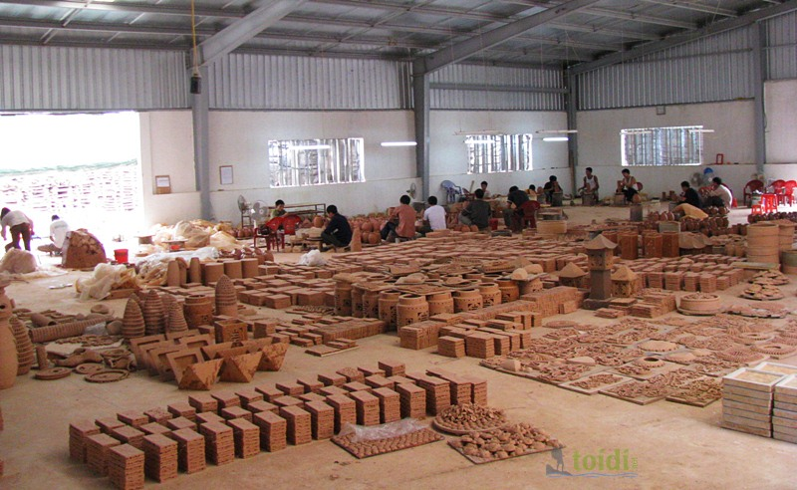
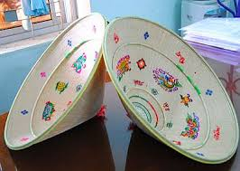
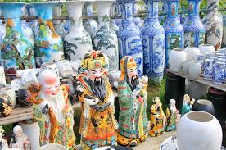
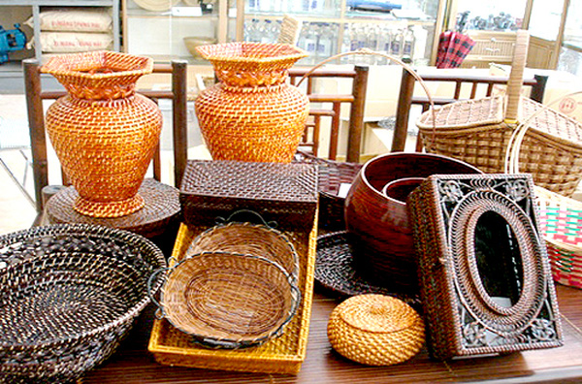
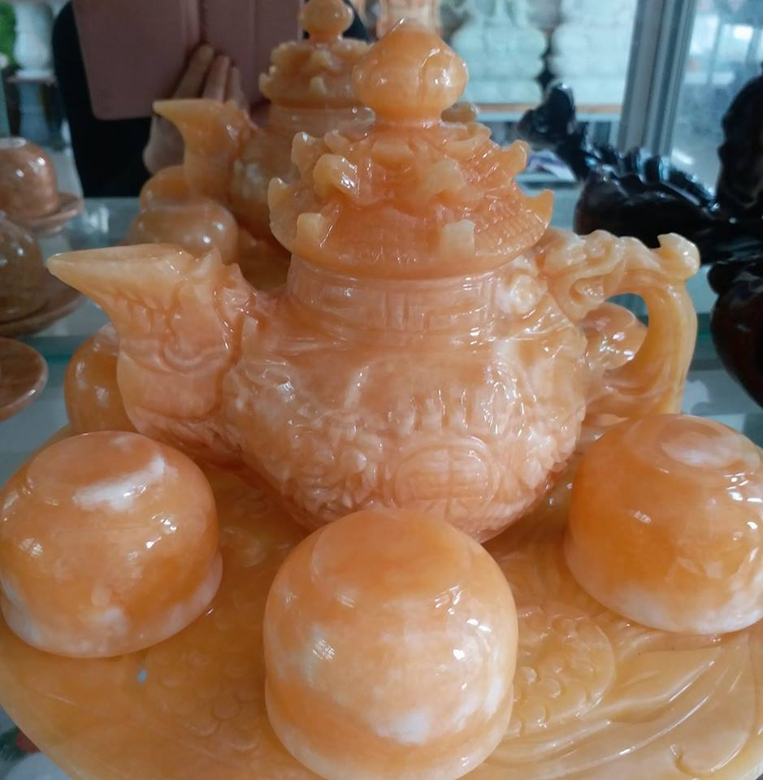
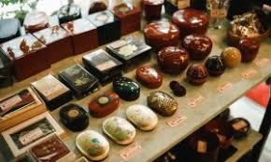
I. Vocabulary
-pottery (n)
đồ gốm
-set up (v)
thành lập
-take over (v)
tiếp quản
-artisan (n)
thợ thủ công
-conical hat (n)
nón lá
-remind (v)
tưởng nhớ
-specific region (n)
khu vực riêng
-handicraft (n)
đồ thủ công
-lacquer ware (n)
Đồ sơn mài
-marble sculpture(n)
Đá cẩm thạch điêu khắc
-workshop (n)
xưởng
2

Slide 4


II. Listen and read
1. Listen and read.
a. Can you find a word/phrase that means:
1. a thing which is skilfully made with your hands
2. start something (a business, an organisation)
3. take control of something (a business, an organisation, etc.)
4. people who do skilled work, making things with their hands
5. an interesting or enjoyable place to go or thing to do
6. a particular place
7. make someone remember or think about something
8. walk around a place to see what is there
craft
set up
take over
artisans
attraction
specific region
remind
look round
3

Slide 5

Watch out!
‘As far as I know’ is an expression. It is used to say that you think you know something but you cannot be completely sure, especially because you do not know all the facts.
4

Slide 6
1. Listen and read.
b. Answer the following questions.
1. Where are Nick, Mi, and Phong?
2. How old is the village?
3. Who started Phong’s family workshop?
4. Why is the village a place of interest in Ha Noi?
5. Where is the craft village that Mi visited?
6. Why do tourists like to buy handicrafts as souvenirs?
They’re at Phong’s grandparents’ workshop in Bat Trang.
It is about 700 years old.
His great-grandparents did.
Because people can buy things for their house and
make pottery themselves there
It’s in Hue.
Because the handicrafts remind them of a specific region.
5

Slide 7
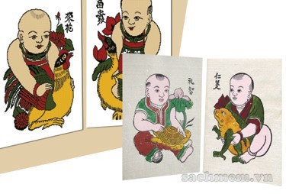
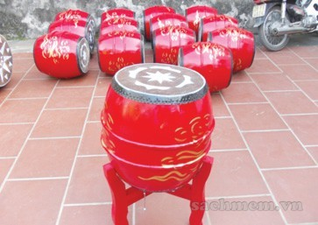
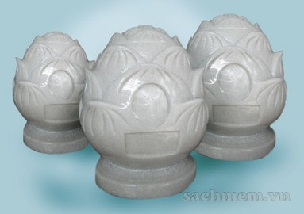
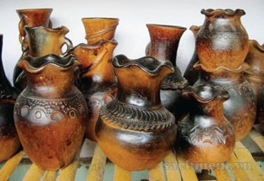
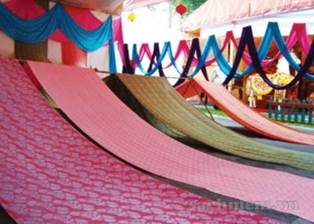
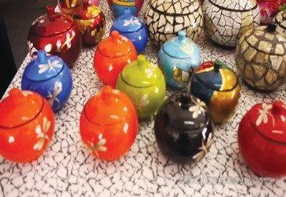
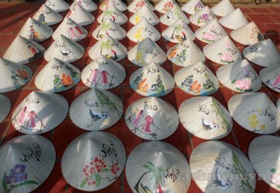
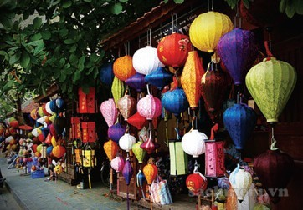
2. Write the name of each traditional handicraft in the box under the picture.
A
B
C
D
paintings
drums
marble sculptures
pottery
E
F
G
H
silk
lacquer ware
conical hats
lanterns
6

Slide 8
3. Complete the sentences with the words/ phrases from 2 to show where in Viet Nam the handicrafts are made. You do not have to use them all.
1. The birthplace of the famous bai tho ________ is Tay Ho village in Hue.
2. If you go to Hoi An on the 15th of each lunar month, you can enjoy the lights of many beautiful ________
3. Van Phuc village in Ha Noi produces different types of ________ products such as cloth, scarves, ties, and dresses.
4. On the Tet holiday, many Hanoians go to Dong Ho village to buy folk ________.
5. ________ products of Bau Truc, such as pots and vases, have the natural colours typical of Champa culture in Ninh Thuan
6. Going to Non Nuoc marble village in Da Nang, we’re impressed by a wide variety of ________ from Buddha statues to bracelets.
conical hat
lanterns
silk
paintings
Pottery
marble sculptures
7

Slide 9
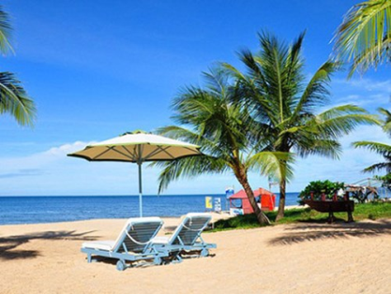
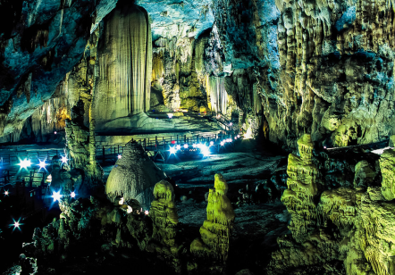
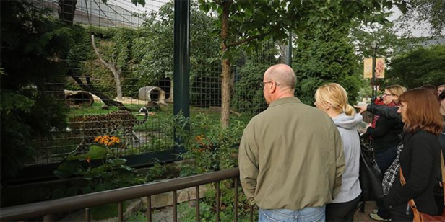
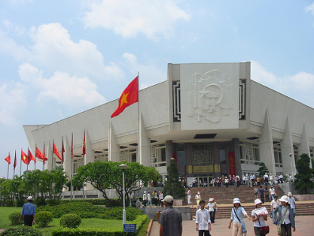
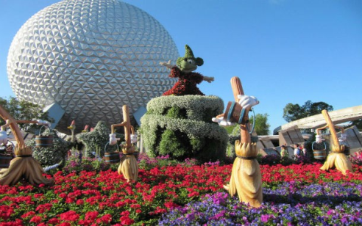
4. QUIZ: WHAT IS THE PLACE OF INTEREST?
a. Work in pairs to do the quiz.
1. People go to this area to walk, play, and relax.
2. It is a place where objects of artistic, cultural, historical, or scientific interest are kept and shown.
3. People go to this place to see animals.
4. It is an area of sand, or small stones, beside the sea or a lake.
5. It is a beautiful and famous place in the countryside.
park
museum
zoo
beach
beauty spot
b. Work in groups. Write a similar quiz about places of interest. Ask another group to answer the quiz.
8

Slide 10

HOMEWORK
Learn vocabulary by heart.
Redo exercises.
Prepare the next lesson: A closer look 1
9

