Slide 1


UNIT 1: LEISURE ACTIVITIES
Leson 5: Skills 1

Slide 2
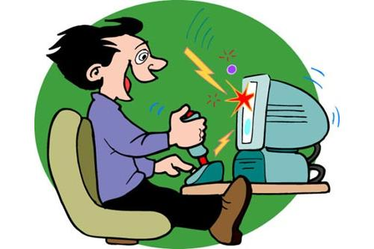
CHATTING
- Who often use the computer?
- What do you use it for ?
- What are the benefits of using computer or mobile phone leisure activities ?
- What are the harmful things it may bring us ?

Slide 3
I. New words:
- (to) exist
: tồn tại
- generation (n)
: thế hệ
- virtual (adj)
: ảo
- (to) rely on
: tin cậy
- effect (n)
: ảnh hưởng
- (to) imagine
: tưởng tượng
- (to) ban SB from + V_ing
: cấm đoán ai việc gì

Slide 4
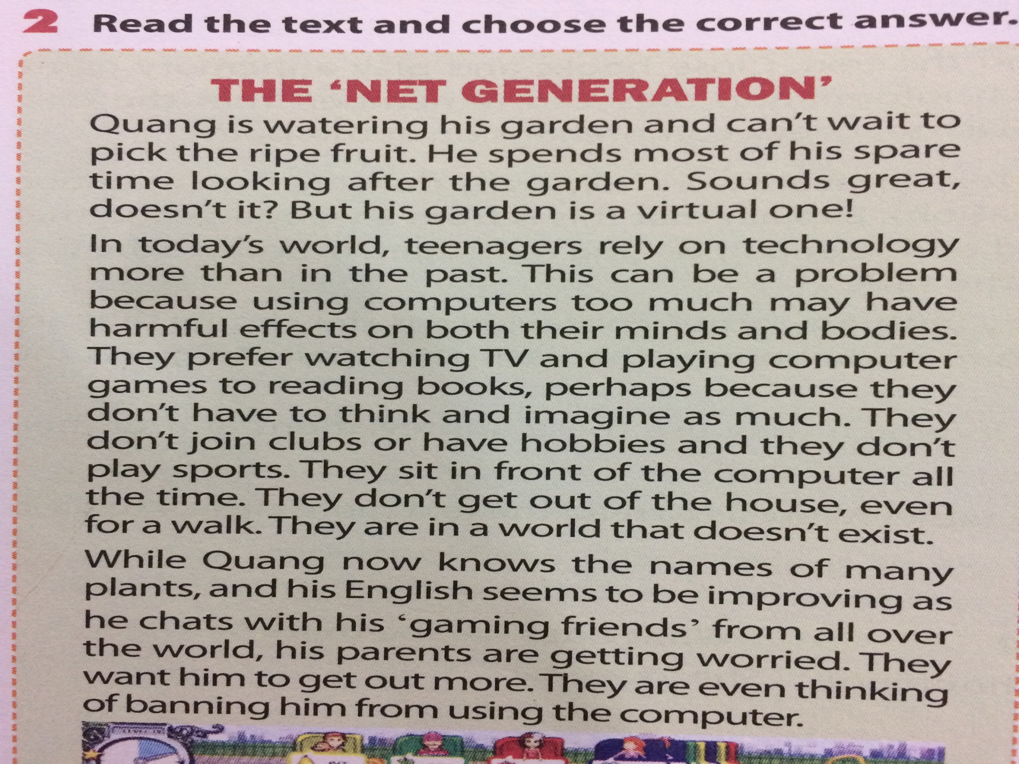
II. Reading:

Slide 5
1. Choose the correct answer:
1. The text is about ………..
A. Teenagers’ leisure time in the past
B. Teenagers’ leisure time in the present
C. Adults’ leisure time in the present
2. The text discusses ………..
A. The positive side of using technology in your free time ?
B. The negative side of using technology in your free time ?
C. Both A and B

Slide 6

2. Write the questions for the answers:
1. No, it isn’t real. It is a computer game.
2. It can harm both the mind and the body.
3. They don’t go out but just sit in front of the computer all the time.
4. Quang knows the names of many plants, and his English seems to be improving.
LUCKY NUMBER

Slide 7
1
2
LUCKY NUMBER
6
3
5
4

Slide 8
2. Write the questions for the answers:
1. Is Quang’s garden real?
2. What is the problem with using technology in your free time?
3. What/ Which leisure activities do teenagers do these day?
4. What are the benefits of using the computer?

Slide 9
1. No, it isn’t real. It is a computer game.
A
Does Quang’s garden real?
B
Is Quang’s garden real?
C
Isn’t Quang’s garden real?

Slide 10

2. It can harm both the mind and the body.
A
What is the problem with using technology in your free time?
B
Can it harm both the mind and the body?
C
What is harmful effects on both the mind and the body?

Slide 11
3. They don’t go out but just sit in front of the computer all the time.
What leisure activities do teenagers
do these days?
A
B
Which leisure activities do teenagers do these days?
C
Both A and B.

Slide 12
4. Quang knows the names of many plants, and his English seems to be improving.
A
What are the benefits of using the computers?
B
Why does Quang know the names of many plants?
C
What is the disadvantages of using the computers?

Slide 13

Lucky
number

Slide 14
Lucky
number

Slide 15
III. Speaking:
The way to give your opinion:
- I think that……..
- In my opinion,………….
The way to ask for an opinion:
- What do you think?
- How do you feel about that ?
Agreeing: I agree with you; That’s so true; Exactly.
Disagreeing: I’m afraid I don’t agree (with you); I don’t think so.

Slide 16
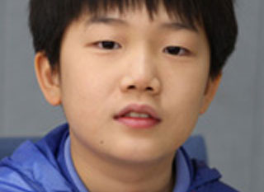
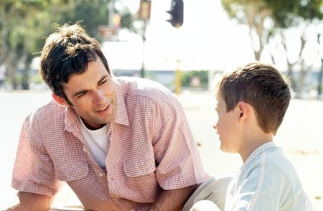
Quang and his parents are talking about how he should spend his free time. Decide which statements are from Quang & which are from his parents
quang
Quang’s father

Slide 17
Go out & play a
sport. It’s good for
you
I think com games train my mind & my memory
My E is much better
because I surf the net.
Quang’s parents
Quang
Quang
Sitting for too long
in front of the com makes your eyes tired.
I’ve made a lot of friends from the game network.
You see your real friends less & less.
Quang
Quang’s parents
Quang’s parents

Slide 18
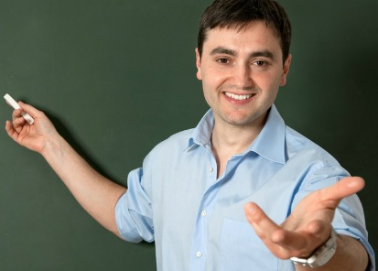
Role- Play: What’s the solution?
Quang, his parents & his teacher are discussing the impacts of his using computer

Slide 19


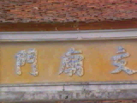
HOMEWORK
- Review the grammar structure: -
+
- Learn new words by heart
Practice the role-play
Be ready for skills 2.

