Slide 1
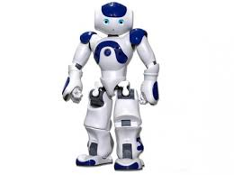
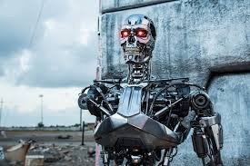
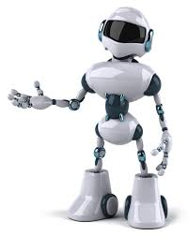
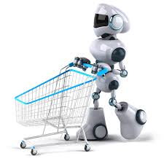
ROBOTS

Slide 2

UNIT 12: ROBOTS
Period 96:
LESSON 3: A CLOSER LOOK 2

Slide 3
Activity 1: Review Grammar:
COULD
Affirmative: I/ you/ he/ she/ it/ we/ they + could +base form
Example: She could swim at the age of 7.
Negative: I/ you/ he/ she/ it/ we/ they + could not/couldn't + base form
Example: He couldn't read until he was 6.
Interrogative: Could + I/ you/ he/ she/ it/ we/ they + base form?
Example: Could you rde a bike when you were in Year 5?
Short answers:
Yes, I/ you/ he/ she/ it/ we/ they + could.
No, I/ you/ he/ she/ it/ we/ they + couldn’t .
Usage: We use could to talk about ability in the past.

Slide 4
I. Put the words in the correct order:
1.will be able to/ In 2030,/ robots/ do many things like humans.
……………………………………………
2. be able to/ Will robots/ talk to us then?
……………………………………………
3. won't be able to/ Robots/ play football.
……………………………………………
4. be able to/ robots/ Will / recognise our faces?
……………………………………………
In 2030, robots will able to do many things like humans
Will robots be able to talk to us then?
Robots won't be able to play football.
Will robots be able to recognise our faces?

Slide 5
Emotional Expression
Digital Camera
Wifi
Gripping hands
Speech Synthesis
58cm
Speech Recognition

Slide 6

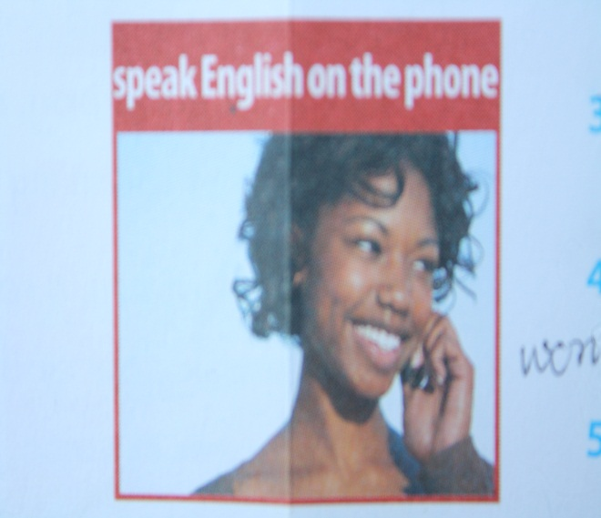
II. Will you be good at English when you are in year 8?
Look at the pictures and tick Yes or No. Then write what you think you will or won't be able to do when you are in year 8.
EX: I will/ won't be able to read an English book when I am in year 8.
Yes No
Yes No

Slide 7
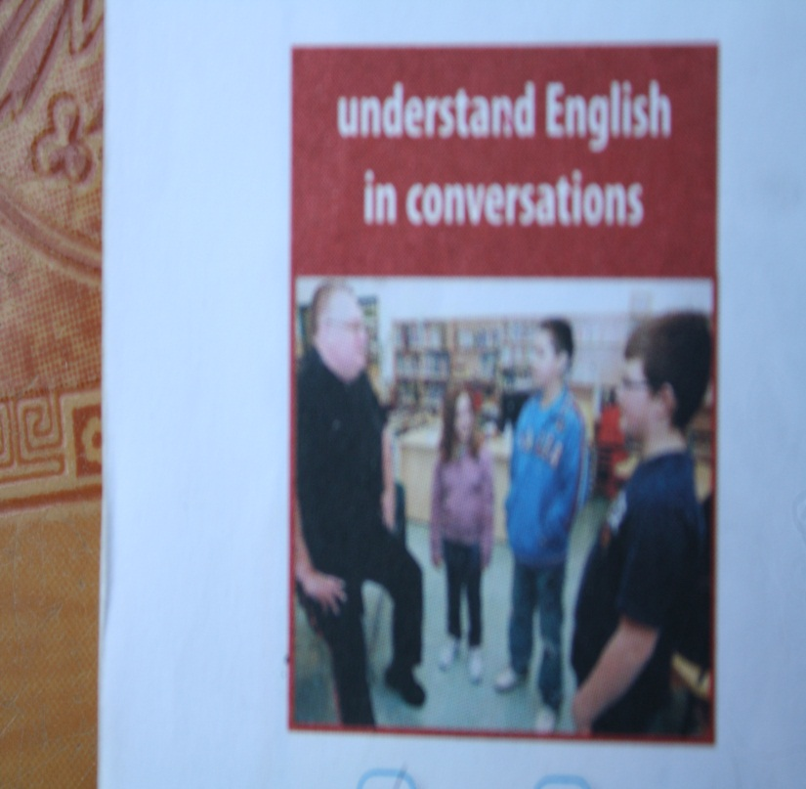
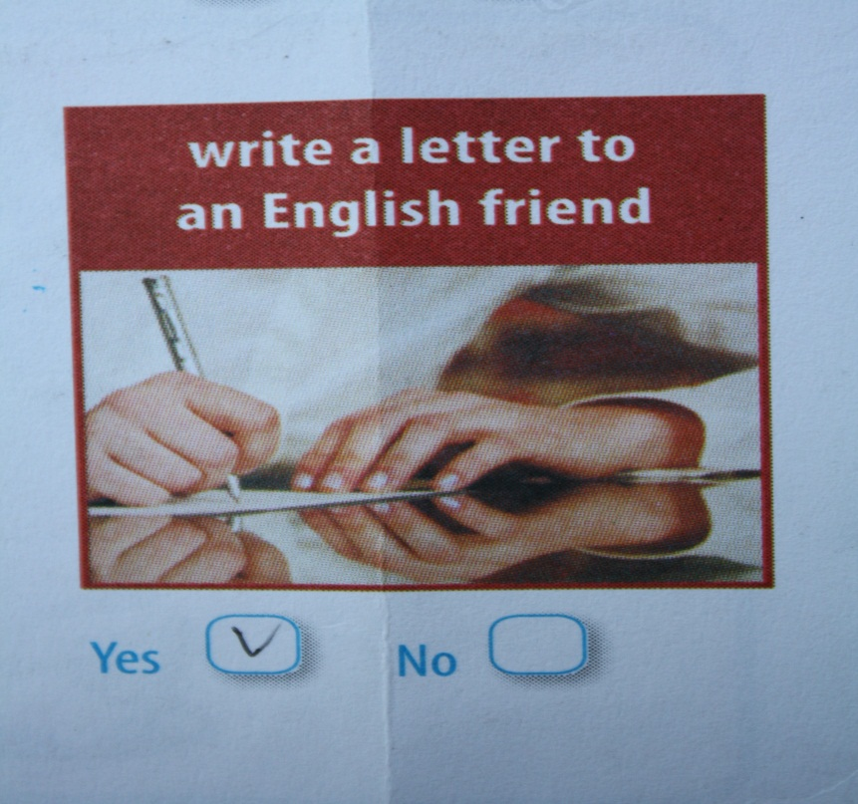
Yes No
Yes No

Slide 8
III. Work in pairs. Ask and answer the questions about the activities in 2. Tell the class about your partner.
EX:
A: Will you be able to read an English book when you are in year 8?
B: Yes, I will. / No, I won't

Slide 9
IV. Fill the gaps with can, can't, could, couldn't, will be able to or won't be able to.
1. In the past, robots ……….. teach in classes, but they can now.
2. Robots can't talk now. In 2030, they ……… talk to people.
3. Mr Van ………run very fast when he was young. Now he ……………
4. In 2030, robots will be able to talk to us, but they ………….. do more complicated things.
5. My little sister is very clever. She ….. already read some words.
couldn't
will be able to
could
can't
won’t be able to
can't

Slide 10
V. Complete the sentences. Use will be able to, can, could and the verbs from the box.
guard / make / recognise / do
1. This robot ….....…………............. our faces when the scientists improve it.
2. Home robots are more useful today-they ……….. the bed.
3. Even in the past, robots ….. …... . the laundry.
4. Now, robots ……. the house. When there's a problem, they send a message to our mobile.
will be able to recognise
can make
could do
can guard

Slide 11
VI. Work in pairs. Look at the information from the table below and tell your partner what Kitty could do in the past, can do now and will be able to do in the future.
EX: In the past, Kitty could lift heavy things. Now, it can lift heavy things…..

Slide 12
THE LESSON IS FINISHED.
THANKS FOR YOUR WATCHING.

