Slide 1

Monday, February 1st 2021
Unit 7: Television
Period 61: Lesson 7:
Looking back
Teacher: Pham Thi Dieu Linh

Slide 2

Game!!
Stop
the pictures

Slide 3

Rules
A picture runs very quickly on the screen.
Look carefully at the picture.
If you know what the picture is, please raise your hand and say “I KNOW!”, then call out the word.

Slide 4



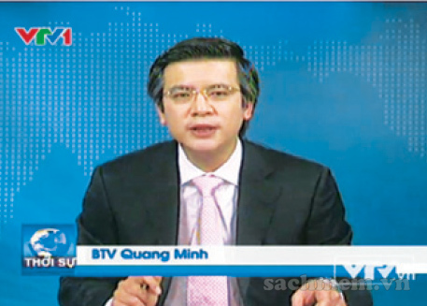

Game!!
newsreader

Slide 5

Game!!
News programme

Slide 6

Game!!
national television

Slide 7

Game!!
MC

Slide 8
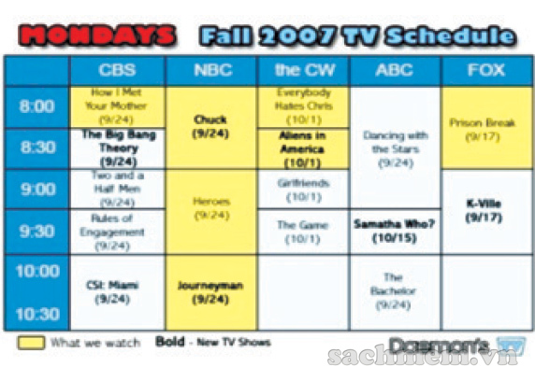
Game!!
TV schedule

Slide 9
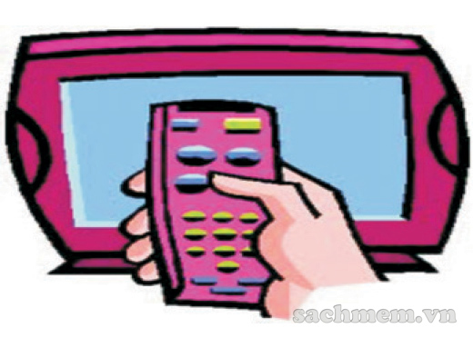
Game!!
remote control

Slide 10
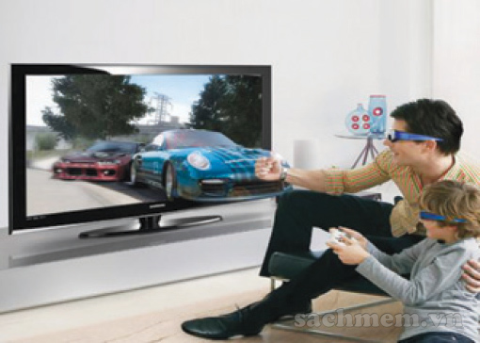
Game!!
TV viewer

Slide 11
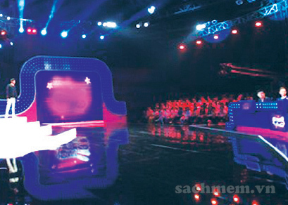
Game!!
game show

Slide 12
Vocabulary
Exercise 1: Put the words in the box in the correct columns. Add more words if you can.
Looking back
newsreader
MC
game show
documentary
animals
weathergirl
writer
cartoon
romance
home and garden
People
Programmes
Kinds of film

Slide 13
Exercise 2: Use the words in the box to fill the text below.
VTV1 is a (1) ________television channel in Viet Nam. It attracts millions of (2) ________ because it offers many different interesting programmes. The (3) ___________ tells people what is happening in Viet Nam and the rest of the world. (4) ________ bring a lot of laughter and help people (5) ________ after a hard working day. The most exciting programmes are (6) ___________. They can be both entertaining and (7) ________. Many people work hard every day to produce quality programmes for television. Some of them are programme designers, (8) ________ and reporters.
comedies
educational
game shows
7 o’clock news
writers
national
relax
viewers

Slide 14
II. Grammar:
Exercise 3: Use a question word to make a suitable question for each answer below.
1. - _________ days a week do you go to class? - I go to class five days a week.
2. - _______ did you watch on TV last night? - I watched The Red Spotted Squirrel.
3. - _____ do you like the Animals programme? - Because I love animals.
4. - _______ is your favourite television MC? - I like Minh Phong in The Gift of Music.
5. - ______was The Lonely Giraffe made? - I don't know. But I first watched it on TV last year.
Looking back
How many
What
Why
Who
When

Slide 15
II. Grammar:
Exercise 4: Use the conjunction provided to connect the sentences.
Ocean Life is on at 7.30. Laughing out Loud will follow, at 8.00.
2. I have watched The Seven Kitties many times. I like the film so much. (because)
3. BBC One is a British channel. VTV6 is Vietnamese channel. (but)
Looking back
-> Ocean Life is on at 7.30 and Laughing out Loud will follow, at 8.00.
-> I have watched The Seven Kitties many times because I like the film so much.

Slide 16
-> BBC One is a British channel but VTV6 is Vietnamese channel.
4. Along the Coast is a famous TV series. I have never watched it. (although)
5. I have a lot of homework tonight. I can't watch Eight Feet Below. (so)
Looking back
-> Although Along the Coast is a famous TV series, I have never watched it.
-> I have a lot of homework tonight, so I can't watch Eight Feet Below.

Slide 17
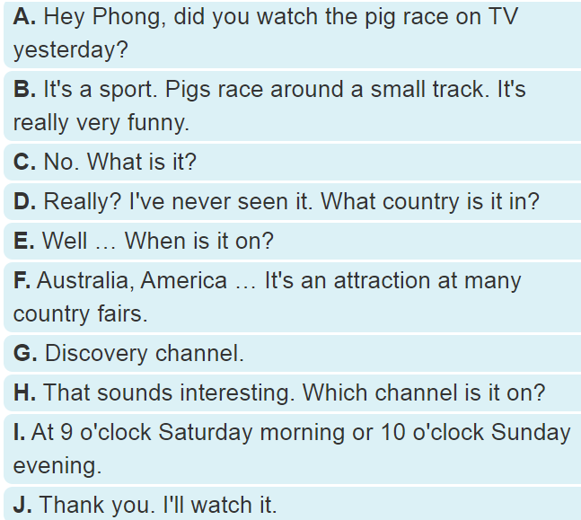
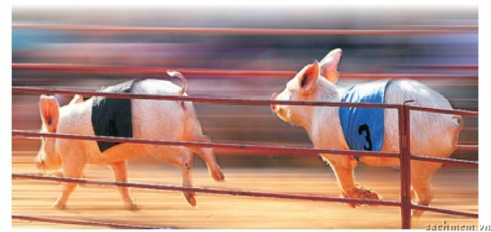
III. Communication:
Exercise 5: Rearrange the order of the sentences to have a complete conversation about a TV programme
Looking back
A
C
B
D
F
H
G
E
I
J

Slide 18
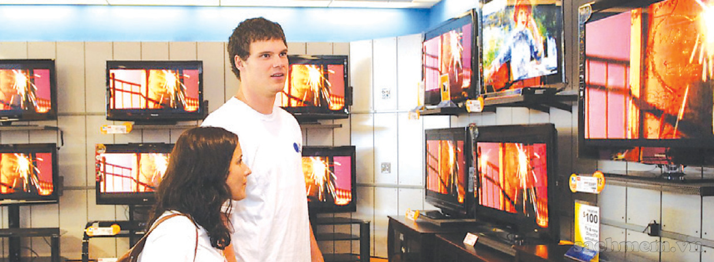
Looking back
Exercise 6: Recommend an interesting TV programme to your friends. Make a conversation based on the sample in 5.

Slide 19
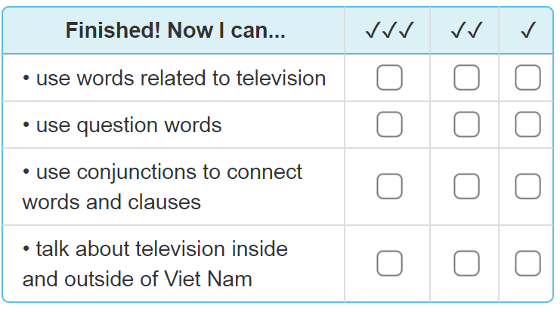
Looking back

Slide 20
- Complete all the exercise in workbook
- Learn the vocabulary words by heart.
- Prepare the next lesson :
(Unit 8: Getting Started)
Homework

Slide 21

THANKS FOR YOUR ATTENTION!
Goodbye!
See you again!

