Slide 1

English 9
UNIT 3: TEEN STRESS AND PRESURE
LESSON 5: SKILLS 1
Welcome to our class

Slide 2

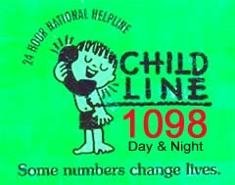
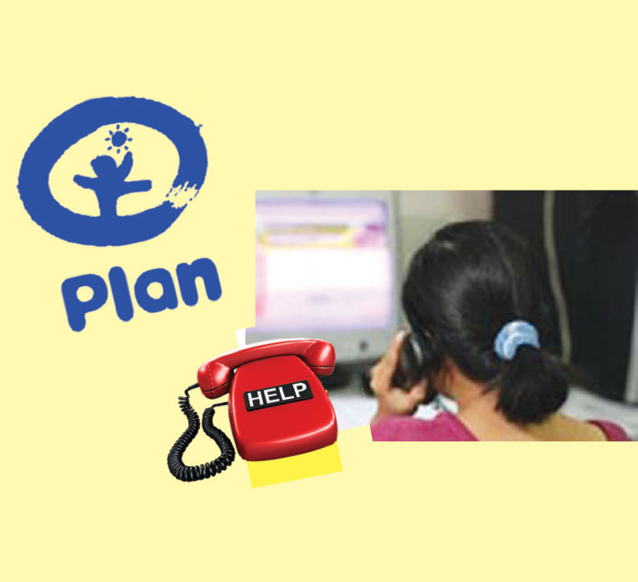

Slide 3

The Magic Number
Magic Number 18001567 is a 24-hour toll-free service for counselling and protecting children and young adults in Viet Nam. The helpline was set up in 2004 by the government with support from Plan Vietnam, an international children’s development organisation.
By 2014, the helpline had received over 1.5 million calls from children and adults nationwide. Sixty-nine per cent of the calls came from children and most child callers were in the 11-14 year old and 15-18 year old groups. The calls were mostly questions about family relationships, friendships, and physical and mental health. Moreover, nearly 3,000 cases of missing or abandoned children, or children who were suffering from violence, trafficking, or sexual abuse received emergency support. The helpline promotes child participation in its operations by involving children as peer communicators and decision makers.
A member of Child Helpline International, Magic Number aims to create favourable conditions for children to develop physically and mentally. If you need support or advice, or know of someone who does, just dial 18001567!
(The facts, figures, and photos in this text are provided by Plan Vietnam)

Slide 4
2. Answer the questions.
What is Magic Number 18001567?
2. Which age groups have called the helpline most?
3. What were the calls mostly about?
4. Why have 3,000 calls received emergency support?
5. How does Magic Number promote child participation in its operations?
6. What is the aim of the helpline?
It's a free service for counselling and protecting children and young adults in Viet Nam.
They were callers in the 11-14 year old and 15-18 year old groups.
The calls were mostly questions about family relationships, friendships, and physical and mental health.
Because they were cases of missing or abandoned children, or children who were suffering from violence, trafficking, or sexual abuse.
The helpline promotes child participation in its operations by involving children as peer communicators and decision makers.
It aims to create favourable conditions for children to develop physically and mentally.

Slide 5
3. Read the text again and decide if the following
statements are true (T) or false (F).
Statements | True | False
1. You can call Magic Number anytime during the day or night.
2. The service and the telephone calls are free.
3. Only children can call the helpline.
4. The typical caller to Magic Number is a nine-year-old child.
5. All decisions about the operation of the helpline are made by adults.
6. The service is available in all cities and provinces in Viet Nam.
√
√
√
√
√
√

Slide 6
SPEAKING
Study skill: Asking for advice
What do you think I should do (about...)?
What should I do?
What would you do in this situation?
Could you give me some advice (about...)?
If you were me, what would you do?
I wonder whether to... or...
Do you know who to speak to about this?

Slide 7
4. Listen to two students calling a child helpline and complete the notes. Then use the notes to role-play the callers.
Caller 1
Caller __________________ Feeling now __________________ Problem ___________________
Question ___________________
Caller 2
Caller __________________ Feeling now __________________ Problem __________________
Question __________________

Slide 8
5. Look at 2 A CLOSER LOOK 1.
Imagine you are one of these students. You want to call the Magic Number helpline to ask for help. What do you say? Your partner listens and takes notes.
Remember to:
• briefly introduce yourself (you can choose
whether to say your name and address or not)
• describe your problem/dilemma
• ask for help

Slide 9
HOMEWORK
- Prepare Skills 2
- Write a short paragraphabout your problems:
+ briefly introduce yourself
+ describe your problem/dilemma
+ ask for help

