Slide 1







Look and match the words/ phrases with suitable pictures
teaching respect
money management
meal planning
time management
household task
communication
1
2
3
5
4
6

Slide 2
Welcome all of teachers and students
UNIT 3: TEEN STRESS AND PRESSURE
Lesson 4: Communication
Lesson plan for English 9
Teacher: Bui Thi Chin
Tien Lu secondary school

Slide 3






1. Extra vocabulary:
-Cognitive (adj): tư duy
-Emotion (n): cảm xúc
-Concentrate (v): tập trung
-Self-discipline (adj): tự kỉ luật
-Risk taking (n): chấp nhận rủi ro
-Resolve conflict (v): giải quyết xung đột

Slide 4





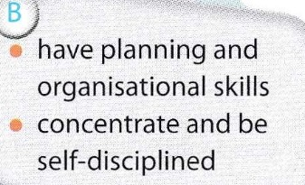
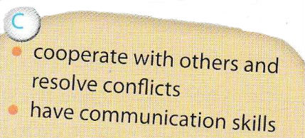
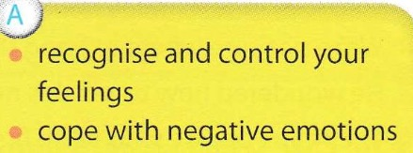
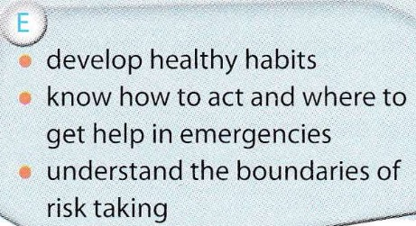
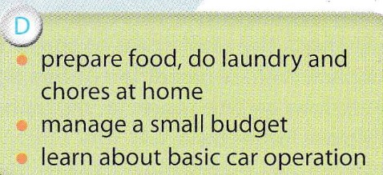
1.Match the skill to their category

Slide 5
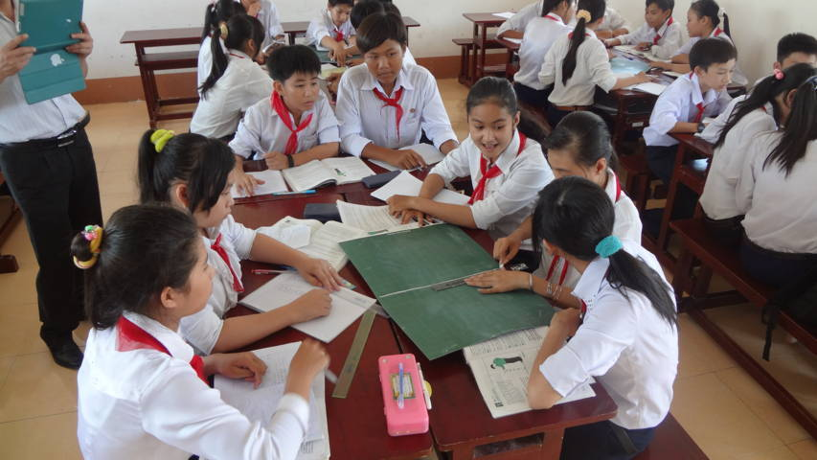
2. Discuss
-Do we teenagers in Viet Nam need all or some of these skills? Why/Why not?
⇒ I think teenagers in Viet Nam also need all of the above skills because these skills help them to be more independent and to control their feelings better.

Slide 6
3. In groups, work out a similar list of skills that Vietnamese teens
Self-care skills:
Housekeeping skills:
Emotion control skills
Social skills:
c. develop healthy habits, know what to do in emergencies and understand the boundaries of risk taking.
a. cooperate with others and resolve conflicts, communication skills.
Vietnamese
teens’ skills
b. able to cook, do laundry, clean the house and other chores and manage a small budget.
d. recognize and control your feelings and cope with negative emotions.

Slide 7

4. Look at the list of life skills for teens that your class has
developed.
1.What skills do you already
have?
2.Which skills do you need
to develop?
⇒ I already have social skills and housekeeping skills. I can cooperate pretty well with other people; therefore, I usually do well in teamwork. I can also do almost all the housework and manage a small budget. My parents give me an allowance per week and I will plan on how to spend this amount of money most effectively.
=>I need to develop self-care skills and emotion control skills. I think that these two skills are very important for me to become an independent individual.

Slide 8


HOMEWORK
Learn by heart the new words.
Speak with your friends about life skills
Prepare for the next: Skills 1

