Slide 1

English 9
UNIT 2: CITY LIFE
PERIOD 13: SKILLS 1
Welcome to our class

Slide 2
Vocabulary
determine
quyết định
conﬂict (n)
sự xung đột
index (n)
chỉ số
factor (n)
yếu tố
rank (v)
phân loại, liệt vào hạng

Slide 3
reading
1. Work in pairs. What features are important to you in a city? Put the following in order 1-8 (1 is the most important).
Transport
Education
Climate
Culture
Safety
Cost of living
Entertainment
Convenience

Slide 4
2. Read the passage quickly and find the information to fill the blanks.
1. The name of the organisation doing the survey:
The Economist Intelligence Unit (EIU)
2. The year of the survey:
2014
3. The names of the best city and the worst cities:
- The best city: Melbourne
- The worst cities: Dhaka, Tripoli, and Douala

Slide 5
3. Read the passage again and answer questions.
1. What factors are used by EIU to range the world cities?
Climate, transport, education, safety, and recreational facilities in cities are used by EIU to range the world cities .
2. Where were some famous cities on the list?
They are among the top 20.
3. Why were Dhaka, Tripoli and Douala ranked among the worst cities?
Because the living conditions there were the most difficult or dangerous.
4. Which was the most “liveable” city in Asia?
Osaka was.
5. What are some factors that should be added to the index?
They are a city's green space, urban sprawl, natural features, cultural attractions, convenience, and pollution.

Slide 6
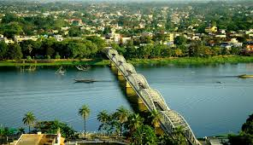
speaking
4a. Work in groups of five or six. Conduct a survey to rank your own town/city or a town city you know. Give from 10 points (the best to 1 point (the worst) to each factor.

Slide 7
Ask each student in your group the question:
"How many points do you give to factor 1 - safety? "
Factors
Points given
Total points
St A
StB
St C
St D
St E
1. safety
2. transport
3. education
4. climate
5. culture
6. facilities
7. entertainment
8. natural features
9. urban sprawl
10. pollution control

Slide 8
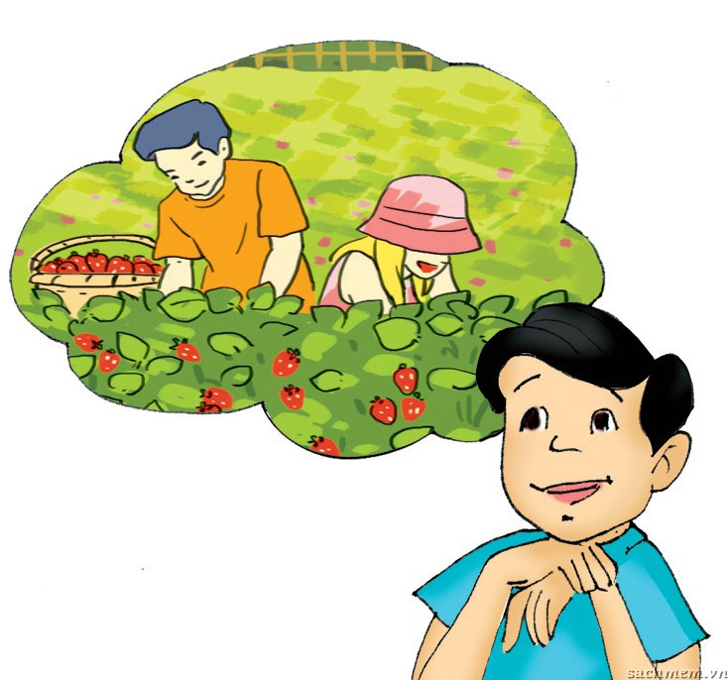
b, Work out the final result of your group. Then present it to the class. Is your group's result the same or different from that of other groups?

Slide 9
Homework
Learn by heart the new words.
Speak with your friends
Prepare for the next..

Slide 10


