Slide 1
Welcome to our class 9A7
Ms. Le Doan
Long Bien secondary school

Slide 2
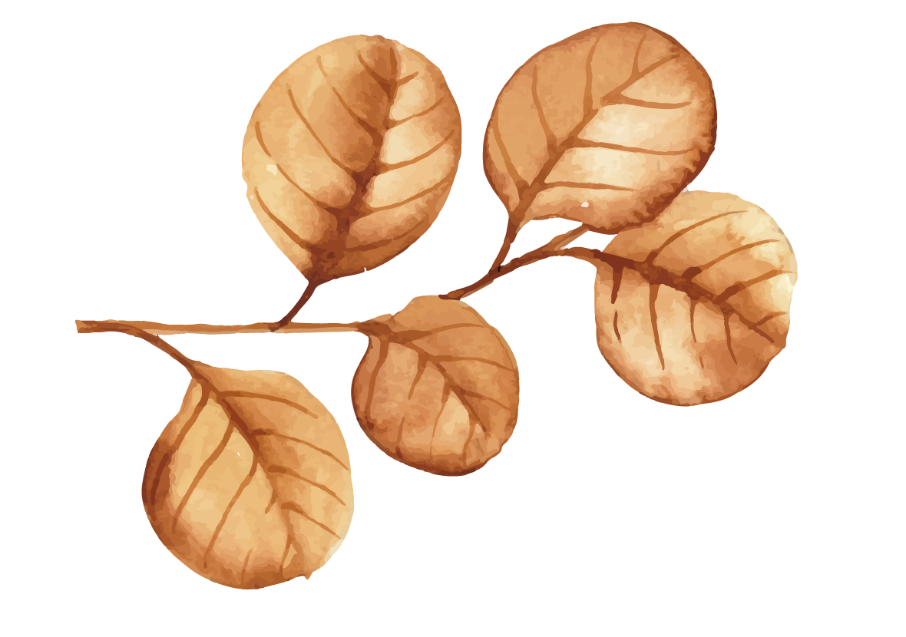
Warm - up!
Watch a video and answer some questions:
What are they talking about?
What did his grandma do for fun when she was a teenager?
Did his grandma miss the past?

Slide 3
Unit 4: Life in the past
Lesson 1: Getting started

Slide 4


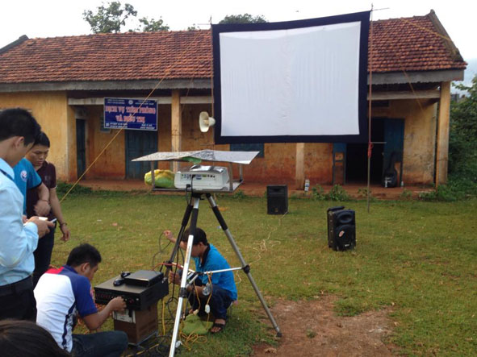
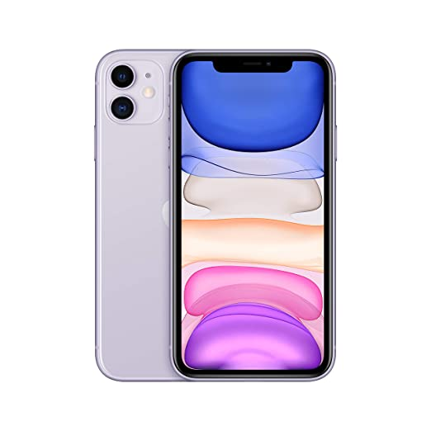
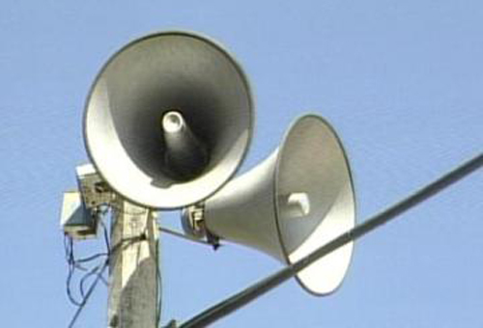

New words
mobile (a) /ˈməʊbaɪl/
01.
mobile movie team (n)
:Đội chiếu phim lưu động
loudspeaker (n) /ˌlaʊdˈspiːkə(r)/
02.
03.
wealthy (n) /ˈwelθi/:
rich
04.
suppose (n) /səˈpəʊz/ :
: to think or believe sth is true or possible.

Slide 5
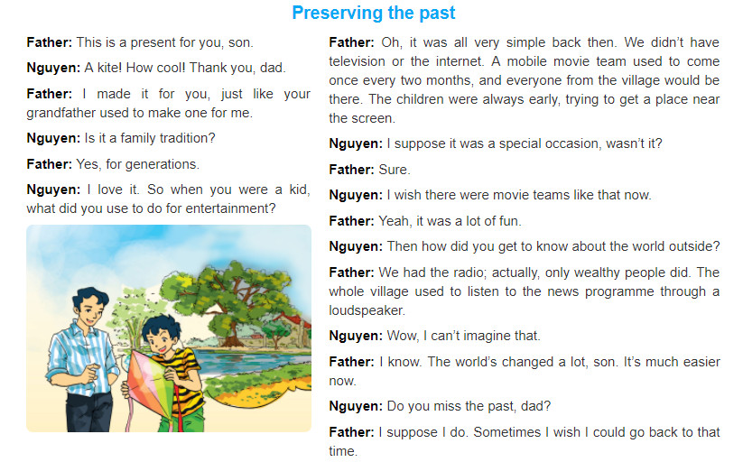
Listen and read

Slide 6
Answer the questions.
Play a game “Rescue the ocean’’.
Each student looks at the questions and gives the answer for each question in Zoom chat box.
If your answer is correct, you can rescue sealife in the ocean.
If you have all correct, you will get 2 points bonus in our lesson today.

Slide 7

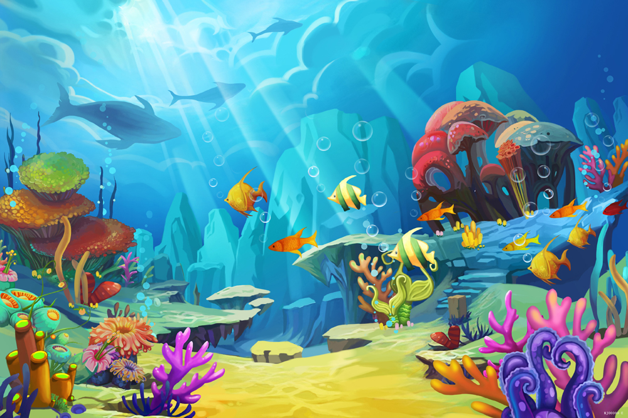



RESCUE THE OCEAN

Slide 8




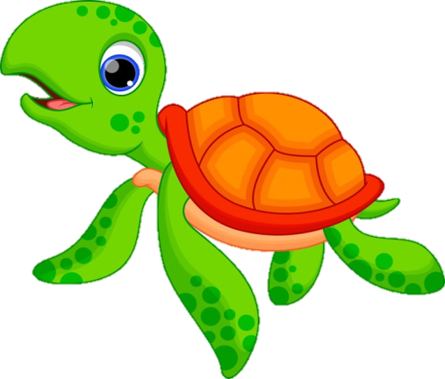
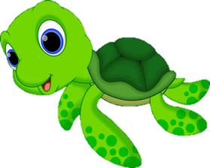

START!
What is a tradition in Nguyen's family?
A. Mothers make kites for sons.
B. Mothers make toys for daughters.
C. Grandfathers make kites for children.
D. Fathers make kites for sons.
TIME’S UP

Slide 9
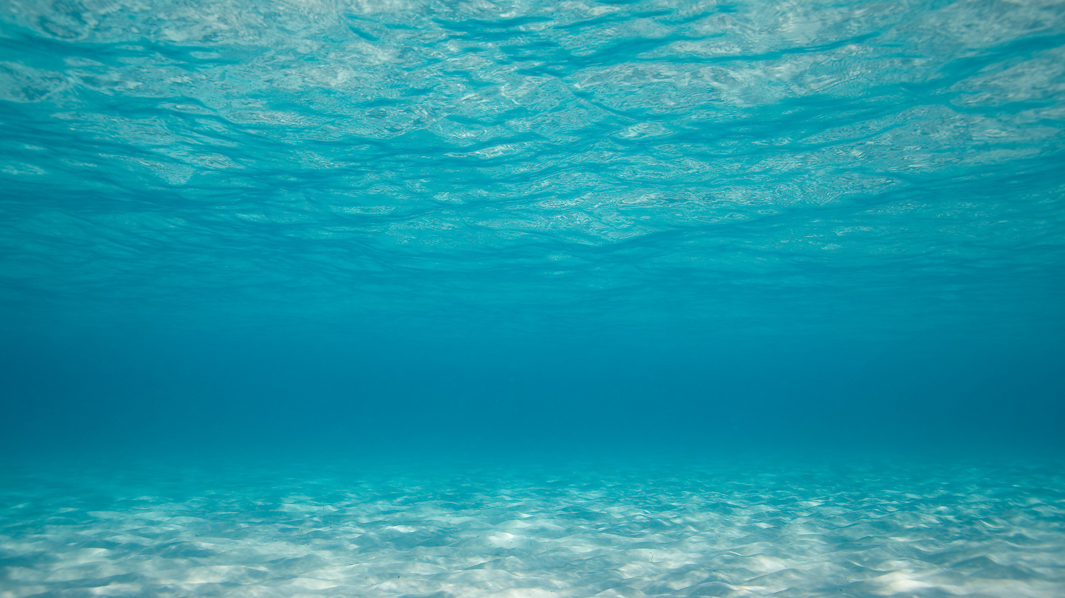
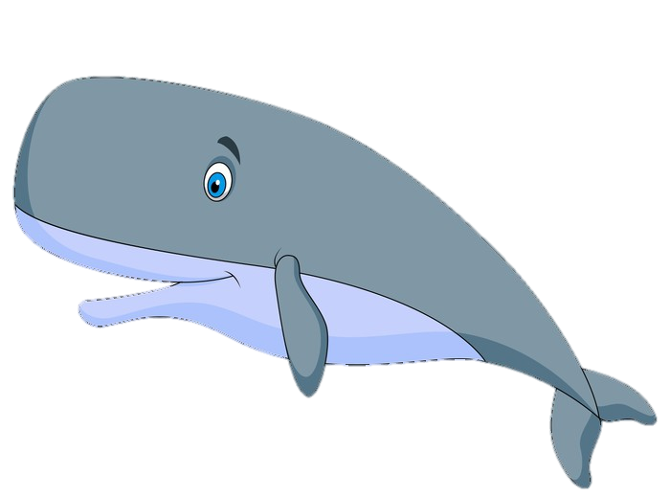

START!
2. How often did the movie team come to the village?
A. Twice a month.
B. Once every two months.
C. Every month.
D. Three times two months.
TIME’S UP!

Slide 10

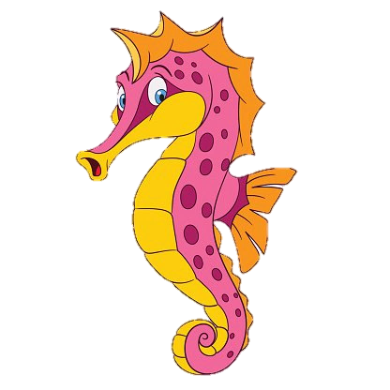
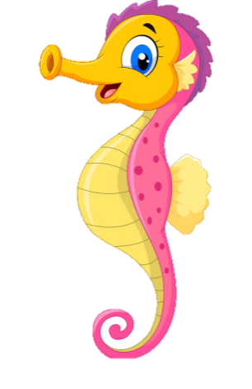

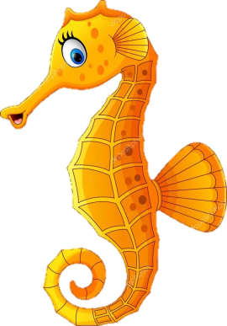
START!
3. What did the children use to do when
the movie team came to the village?
C. They were early, trying to get a place near the screen.
A. They used to come late.
B. They used to get a place near the screen.
TIME’S UP!

Slide 11
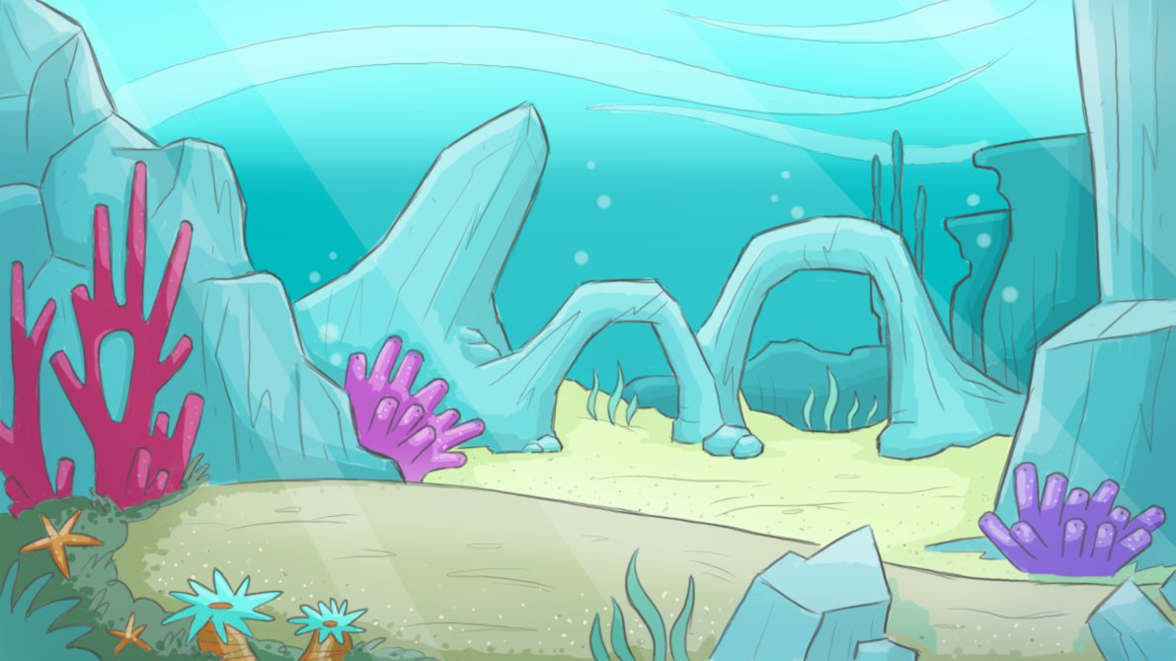
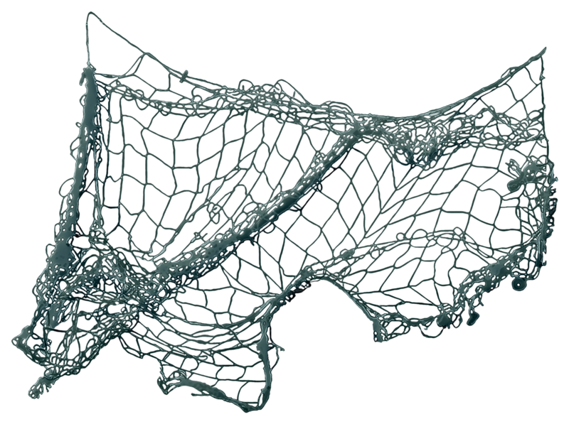
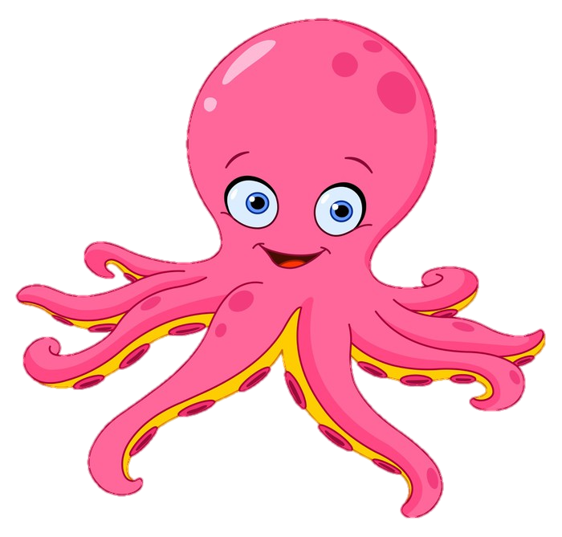
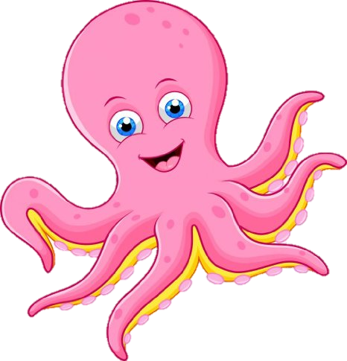
START!
4. Who in the village had a radio?
A. Only rich people.
B. Every villager.
C. The old people.
D. The poor people.
TIME’S UP!

Slide 12
CHECK THE ANSWERS!!
What is a tradition in Nguyen's family?
How often did the movie team come to the village?
What did the children use to do when the movie team came to the village?
Who in the village had a radio?
Does Nguyen's father miss the past? What did he say?
- Fathers make kites for sons.
- Once every two months.
- They used to come early, trying to get a place near the screen.
Only wealthy households.
- Yes, he does. He said: “Sometimes I wish I could go back to that time.”

Slide 13
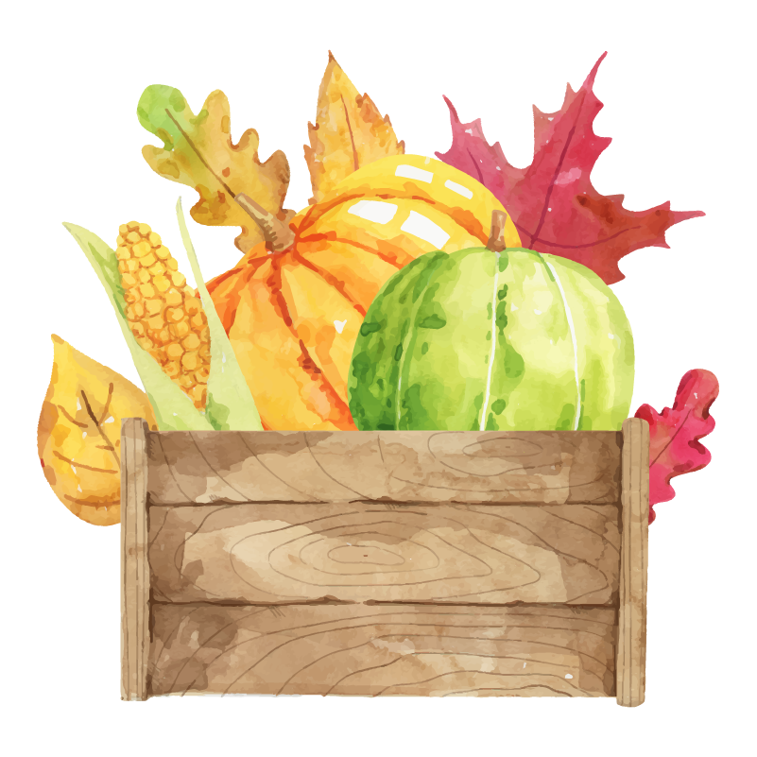
Conversation skill
Sachmem.vn
(?) Find some useful expressions in the conversation and understand their meaning.
2. Sure.
1. How cool!
No doubt about it.
Thank so much.
Of course.
I appreciate this.
agreement
That’s great.
3. Wow, I can’t imagine that.
appreciation
I can’t believe it.
Surprise
4. I wish I could go back to that time.

Slide 14

Use the words or phrases in the box to complete the sentences.
Click the link on the blooket.com.
Work individually and choose the correct answer to complete the sentences.
If you have all correct, you will get 2 points bonus in our lesson today.

Slide 15

Talk in groups to discuss about:
some of the events and practices in the past
some changes from the past to the present

Slide 16

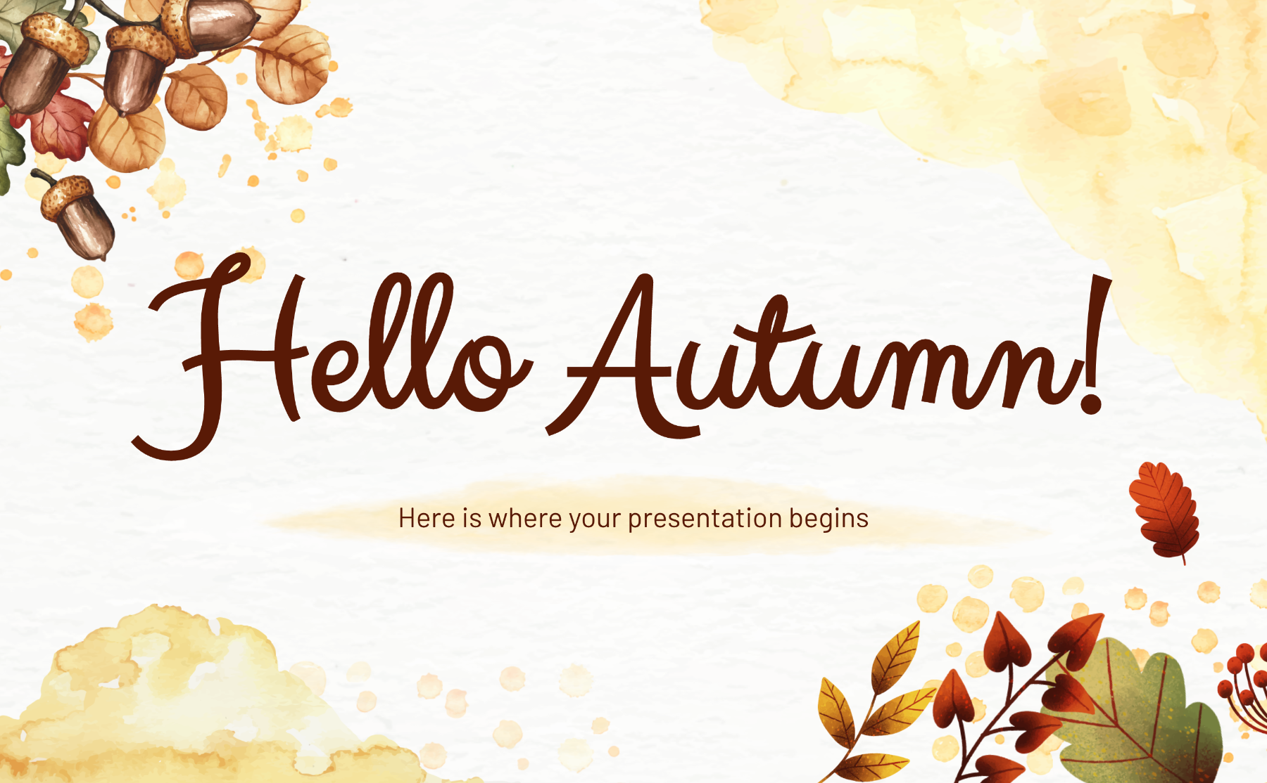
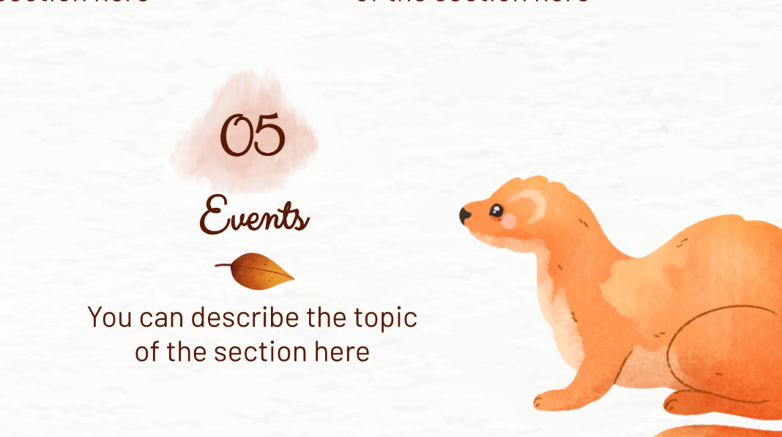
Homework
Learn some new words by heart.
Make some short conversations using the expression in the lesson.
Prepare the next lesson: A closer look 1 (page 42).

Slide 17



Thanks for attending the lesson today!

